Slide 1

Brewediq coffee
Coffee shop sales analysis
By. Ujwal Sharma

Slide 2
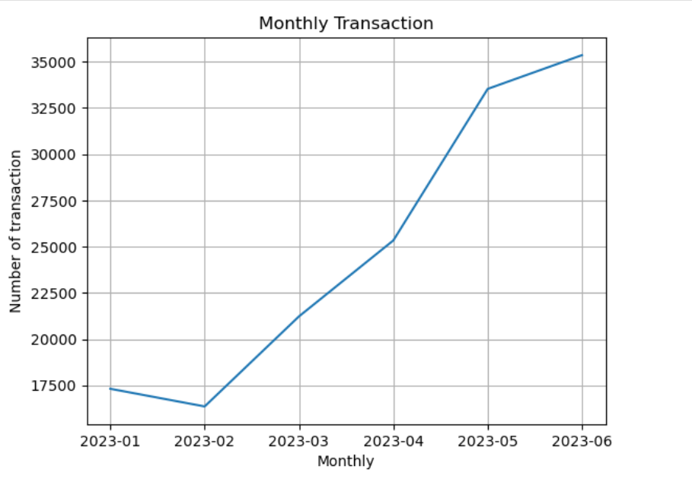
Monthly Sales Trends Over Time
# January–February Dip
1. Transactions fell slightly from 17,200 in January to 16,300 in February.
2. Possible reasons: seasonal slowdown, fewer customer visits after holiday season, or external factors
# March–April Recovery and Growth
1. Transactions jumped to ~25,200 by April, showing ~54% growth compared to February.
2. Likely indicates effective promotions, new product launches, or improving customer demand.
# Strong Growth in May
1. May recorded ~33,800 transactions, a sharp increase of ~34% from April.
2. This could reflect peak coffee demand season, successful marketing campaigns.
# June Top
1. June reached the highest point with ~35,400 transactions.
2. Growth momentum continues but at a slower pace compared to May. This suggests the business might be stabilizing after a rapid expansion.

Slide 3
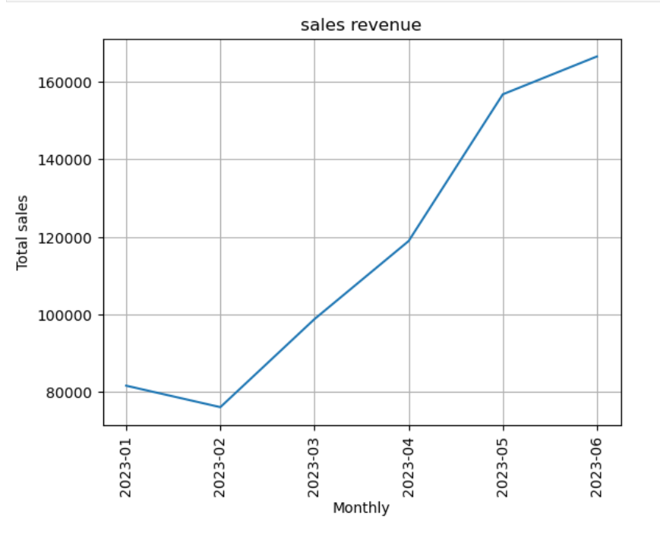
Analysis of Sales Revenue (Jan 2023 – Jun 2023)
# January (2023-01):
Sales started at around 82,000.
A Fair beginning, but not very high compared to later months
# February (2023-02):
A slight dip to about 76,000.
This suggests a weaker month, possibly due to seasonal effects, reduced demand, or external factors
# March (2023-03):
Strong recovery, with sales rising close to 100,000.
Indicates improving demand or successful promotions.
# April (2023-04):
Continued growth, reaching around 120,000.
A positive trend, showing momentum building.
# May (2023-05):
A sharp increase to nearly 157,000.
This is most significant monthly growth showing strong customer engage.
# June (2023-06):
Growth continues, peaking at about 167,000.
The highest sales in the period, showing strong performance and an upward trajectory.

Slide 4
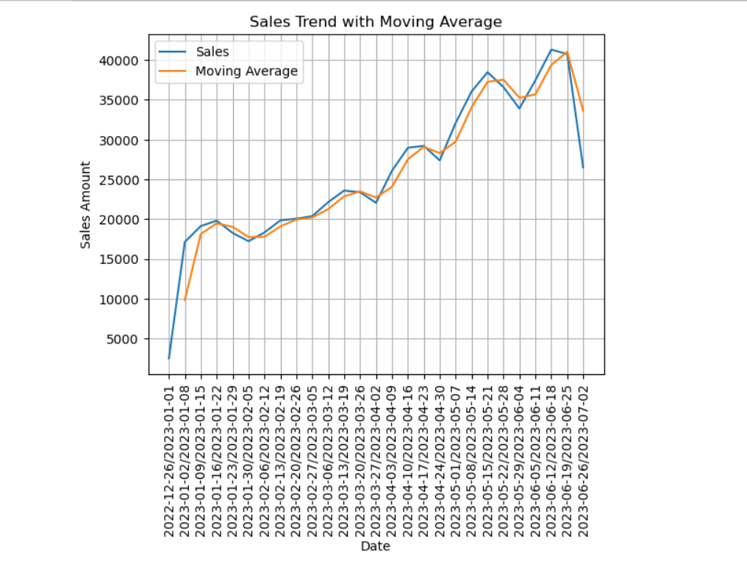
Sales Trend Analysis (Jan 2023 – Jun 2023)
Early Phase (Jan – Feb 2023):
Sales started around 3,000 in late Dec 2022.
Rapid increase in early January, peaking close to 20,000.
Some dips in late January and February, but the moving average smooths out, showing stability.
Mid Phase (Mar – Apr 2023):
Sales climbed gradually, reaching around 24,000–29,000.
The upward slope in the moving average suggests sustained growth with only minor dips
Growth Phase (May – Jun 2023):
Strong growth momentum, with sales reaching peaks of 38,000–41,000 in May and June.
The moving average stayed closely aligned with actual sales, reinforcing consistency
End of June 2023:
A sudden drop after June 25, down to about 26,000.
This may indicate seasonality, reduced customer visits, or external factors

Slide 5
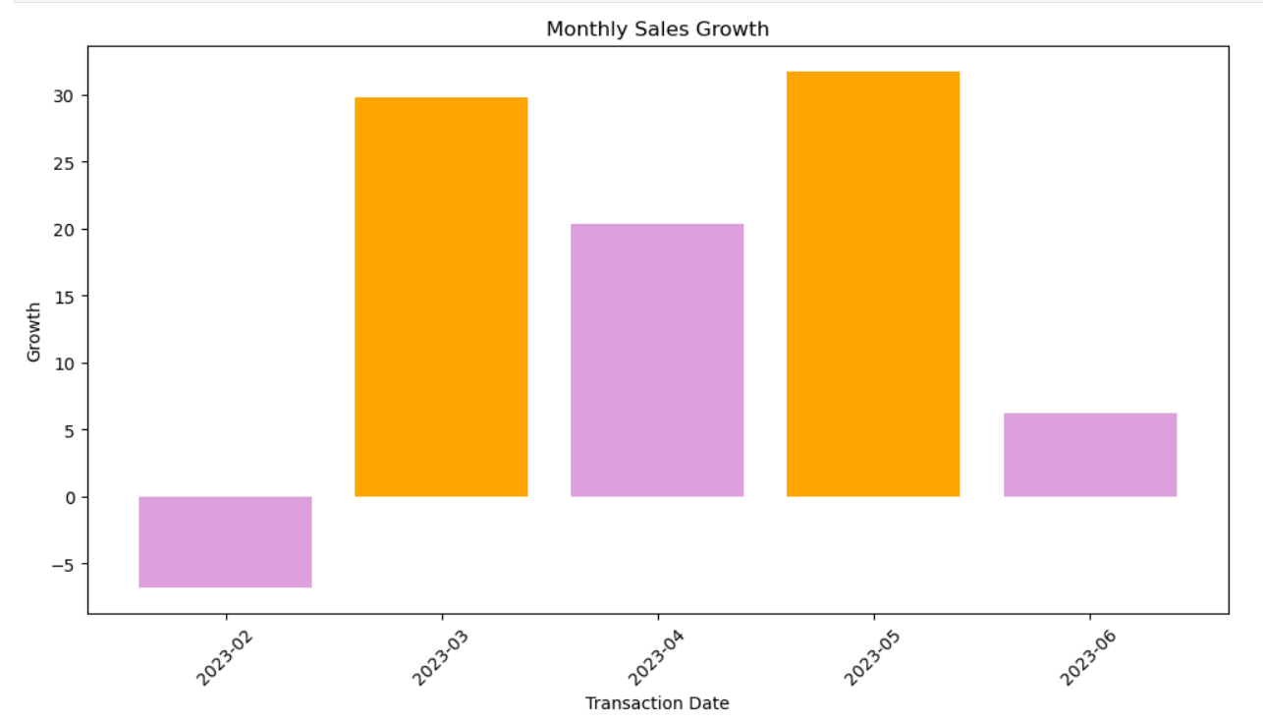
Monthly sales Growth Rate
February 2023 – Negative Growth
Sales growth is below zero, indicating a decline in performance.
This could be due to seasonal factors, market downturns, or internal business challenges
March & May 2023 – Peak Growth
These months show the highest positive growth, marked with orange bars.
Suggests strong performance—possibly due to successful campaigns, product launches, or favorable market conditions.
April & June 2023 – Moderate Growth
Growth is positive but not as strong, represented by purple bars.
Indicates stability, but not the same level of acceleration as March and May.
Could reflect consolidation phases or slower market response.

Slide 6
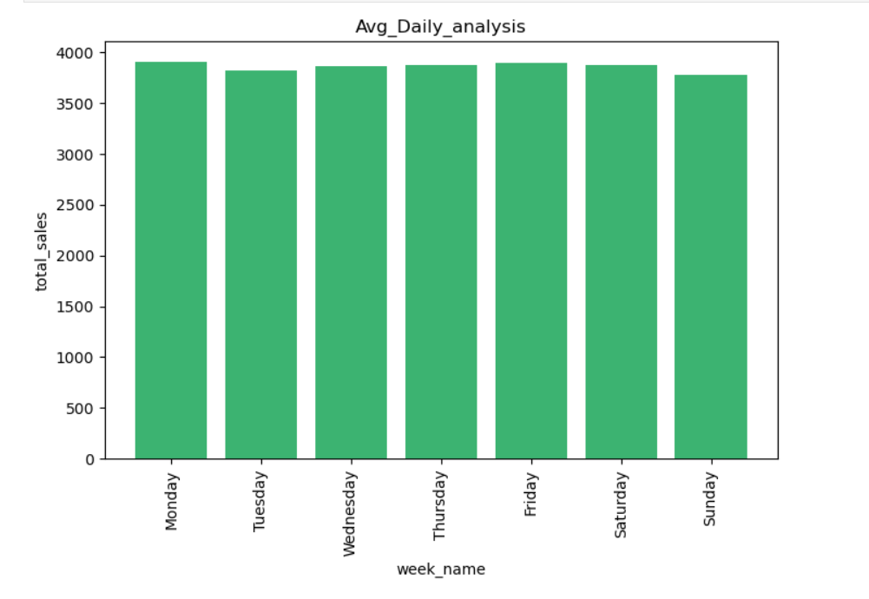
Daily Sales Analysis (Average by Weekday)
# Best Performing Days:
1. Monday, Thursday, and Friday show slightly higher sales (close to 3,900+).
2. These may be strong working days when people prefer coffee purchases, possibly morning/evening office crowds
Moderate Days:
1. Wednesday and Saturday remain stable, slightly below the top-performing days but still consistent.
Lowest Performing Day:
1. Sunday shows the lowest sales, around 3,750–3,800.
2. This could be due to fewer office-goers or reduced weekday routine coffee consumption.

Slide 7
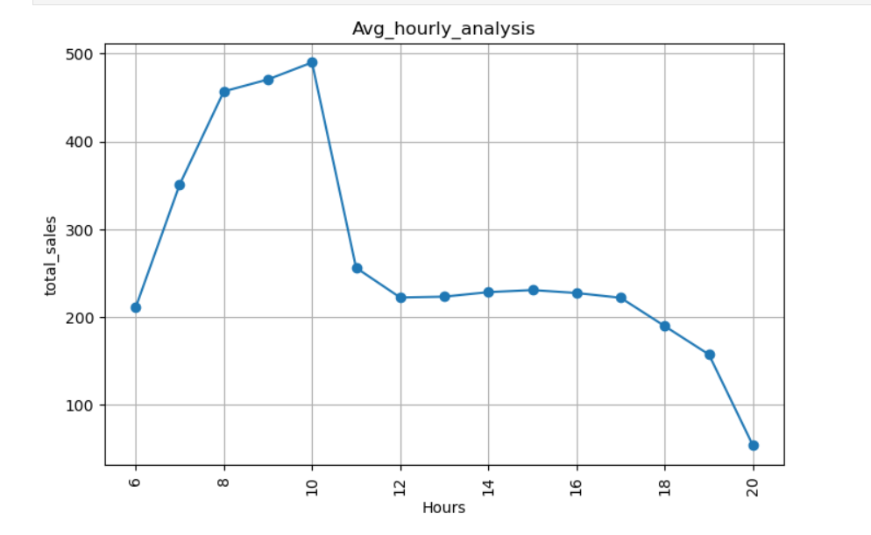
Average hourly analysis
# Early Morning Rise (6 AM – 9 AM):
1. There's a dramatic rise in total sales during these hours.
2. Sales peak around 10 AM, hitting approximately 500 units.
3. This suggests a strong morning demand—possibly driven by commuters, breakfast buyers, or early shoppers.
# Midday Decline and Plateau (10 AM – 6 PM):
1. After 10 AM, sales drop sharply and then stabilize between 12 PM and 6 PM.
2. Sales over between 200 and 250 units, indicating a steady but lower volume.
# Evening Drop-Off (6 PM – 8 PM):
1. Sales begin to decline again after 6 PM, reaching the lowest point at 8 PM.
2. This may be due to store closures, reduced foot traffic, or fewer consumer needs during late hours.

Slide 8
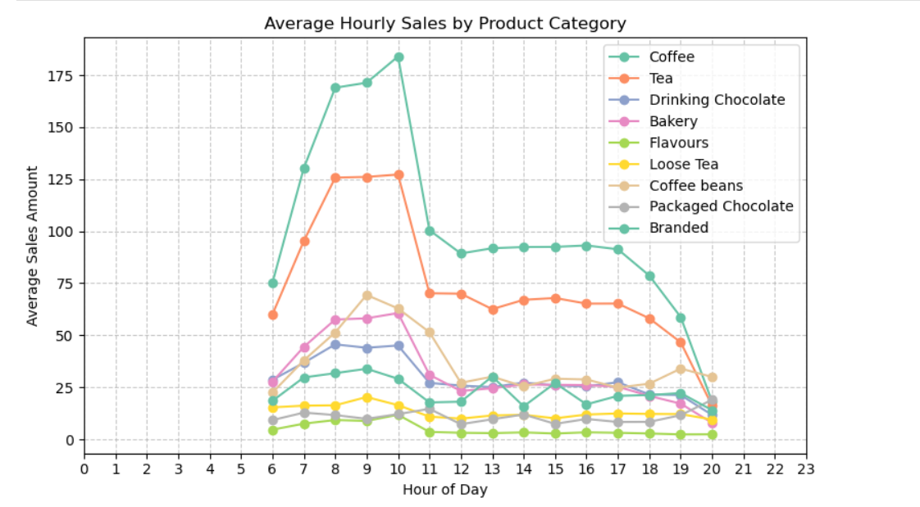
Hourly sales by product category
# Morning Peak (7–10 AM)
Coffee, tea, bakery, and drinking chocolate dominate.
This is the highest sales window, driven by breakfast and morning routines.
# Mid-day (11 AM – 2 PM)
Sales drop significantly, but coffee and tea maintain moderate demand.
Bakery and chocolate lose importance after the morning rush.
# Afternoon & Evening (2 PM – 8 PM)
Coffee and tea continue steady but lower sales.
Packaged chocolate and branded products have small evening bumps, reflecting leisure or impulse buys.

Slide 9
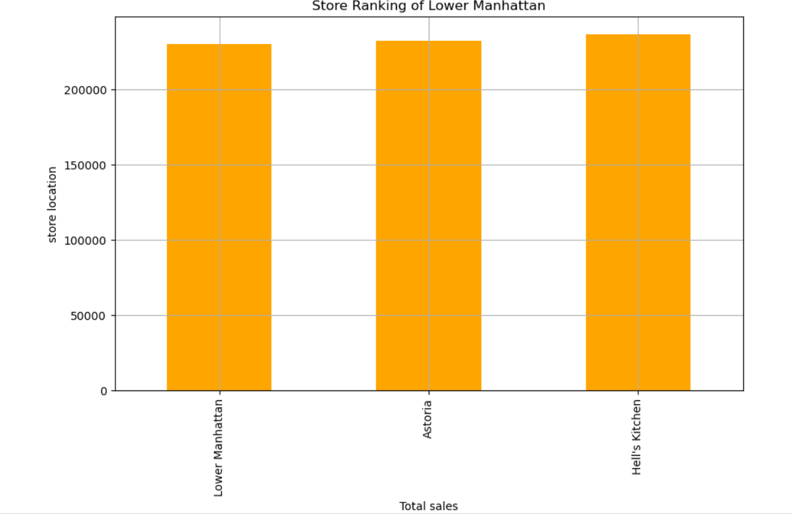
Store Rankings
Lower Manhattan vs. Hell's Kitchen:
Both stores show equal total sales, indicating they are performing at a similar level.
This parity suggests consistent customer demand or similar operational efficiency across these two locations.
Astoria:
Slightly lower total sales compared to the other two.
While not drastically behind, this difference could point to:
Less foot traffic
Different customer demographics
Potential for growth with targeted strategies

Slide 10
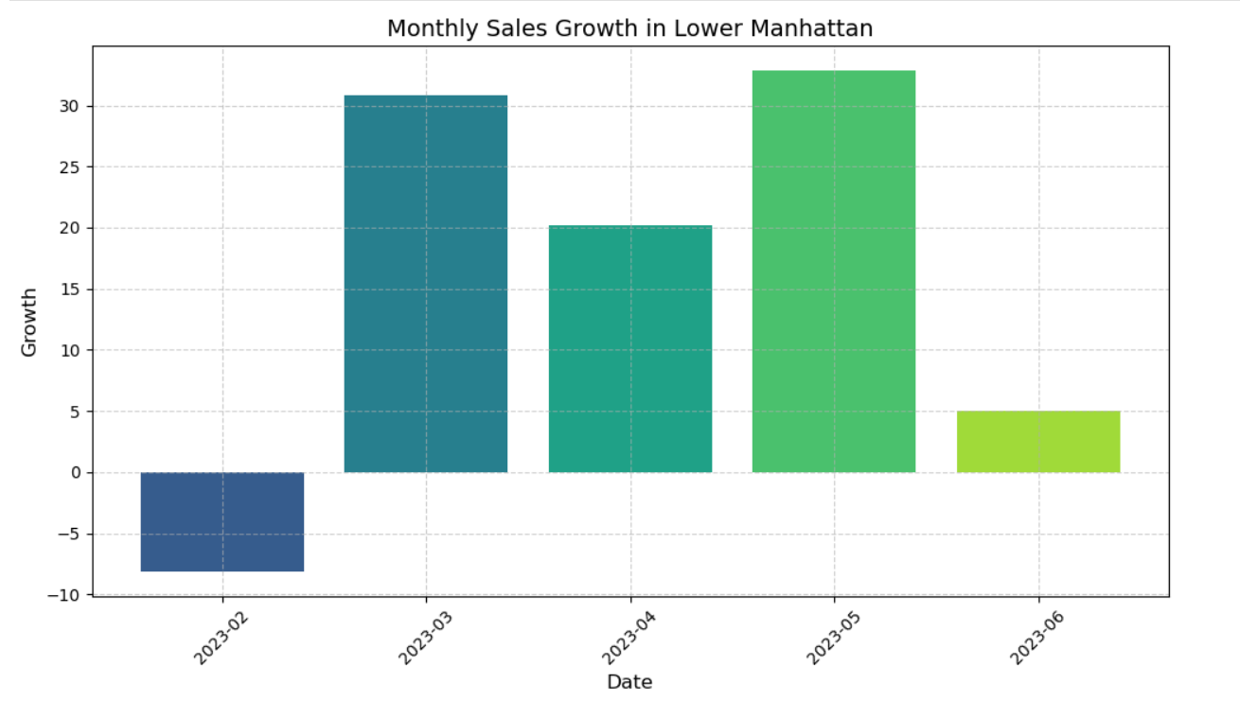
Monthly sales growth in lower manhattan
February 2023:
Growth is negative, around -5 units.
This suggests a decline in sales, possibly due to seasonal slowdown, post-holiday fatigue, or economic factors.
March 2023:
A sharp increase to +30 units.
This could indicate a bounce likely driven by spring promotions, tourism, or recovery from February’s dip.
April 2023:
Growth dips slightly to +20 units, still positive.
Momentum slows but remains strong. Could reflect stabilization after March’s surge.
May 2023:
Growth returns to +30 units, matching March.
Suggests another strong month possibly due to events, warmer weather, or strategic campaigns.
June 2023:
Growth drops to +5 units.
A noticeable slowdown. Might be early signs of summer fatigue or market saturation.

Slide 11
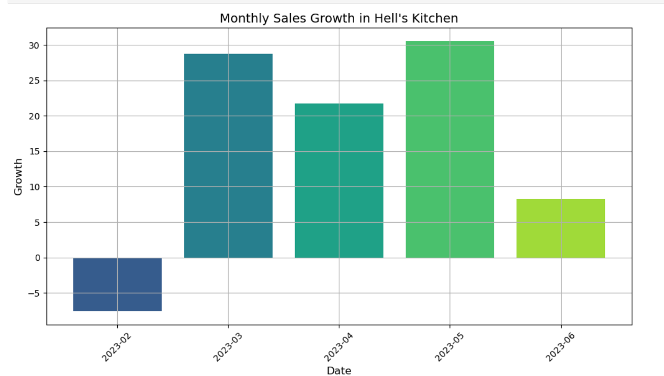
Monthly sales growth in hell’s kitchen
February 2023:
Growth is negative, around -5 units.
Likely reflects a post-holiday slump or adverse market conditions.
March 2023:
A dramatic surge to +30 units.
This Bounce could be driven by seasonal demand, marketing efforts, or local events.
April 2023:
Slight dip to +25 units, but still strong.
Indicates carry momentum, possibly from continued consumer engagement.
May 2023:
Peaks at +32 units, the highest in the dataset.
Suggests optimal conditions likely ideal weather, tourism, or successful promotions.
June 2023:
Drops to +10 units.
A noticeable slowdown, which might signal market saturation or shifting consumer behavior.

Slide 12
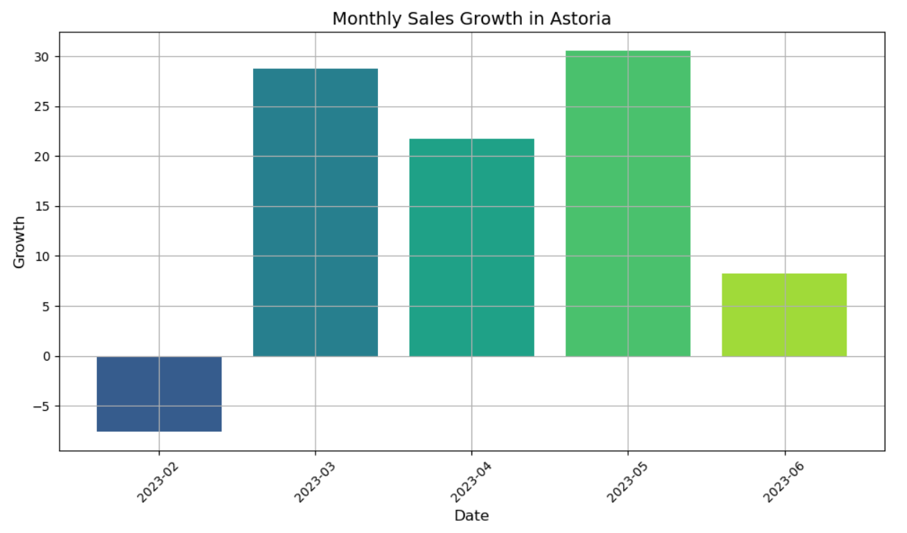
Monthly sales growth in astoria
February 2023:
Growth is negative, around -5 units.
Likely reflects a seasonal dip or post-holiday slowdown.
March 2023:
A sharp increase to +30 units.
Indicates a strong bounce possibly driven by spring demand or local events.
April 2023:
Slight dip to +25 units, still solid.
Suggests continued momentum, though growth is tapering slightly.
May 2023:
Peaks at +32 units, the highest in the dataset.
Could be due to optimal weather, tourism, or successful campaigns.
June 2023:
Drops to +8 units.
A noticeable slowdown possibly seasonal fatigue or shifting consumer patterns.

Slide 13
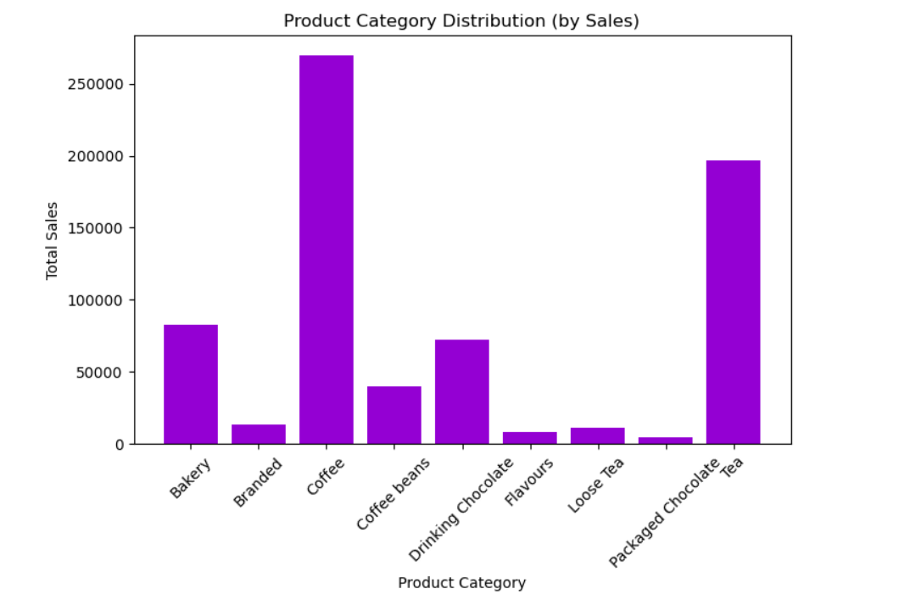
Product category distribution (by sales)
Top Performer: Coffee
Coffee dominates the chart with the highest total sales.
This suggests strong consumer demand and possibly a well-established product line or brand loyalty.
Strong Contenders: Tea & Bakery
Tea ranks second, showing it's a major revenue contributor.
"Bakery" products also perform well, indicating that brand recognition may be influencing purchasing behavior.
Mid-Tier Categories
Packaged Chocolate and Coffee Beans show moderate sales.
Low Sales Categories
Bakery, Drinking Chocolate, Flavours, and Loose Tea have significantly lower sales.

Slide 14
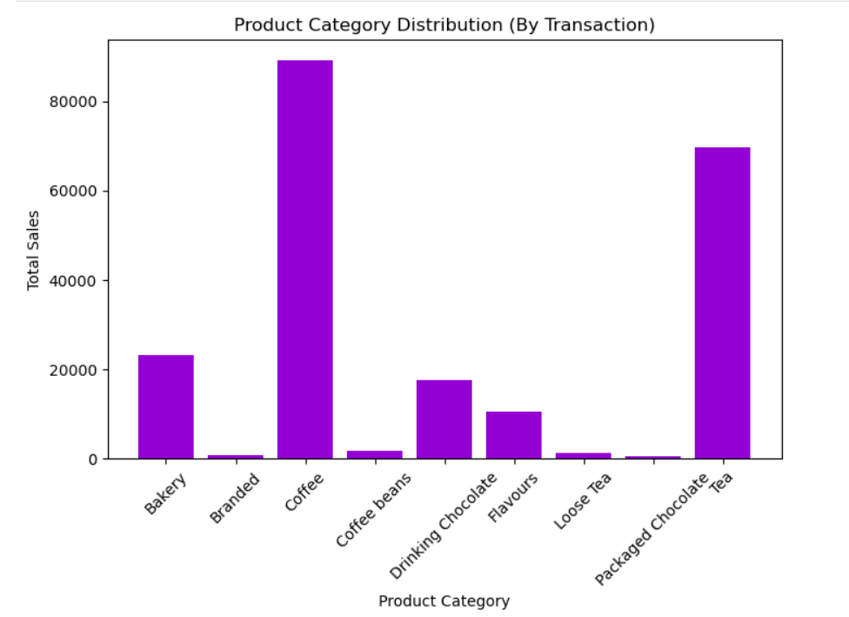
Product category distribution (by transaction)
# Top Performers
Coffee is the clear leader in total sales, compared above all other categories.
Tea and Bakery follows closely, showing strong consumer demand.
# Mid-Tier Categories
Coffee Beans, and Drinking Chocolate show moderate sales.
These might be complementary products to the top sellers.
Could benefit from strategies or targeted promotions.
# Low Performers
Branded, Flavours, Loose Tea, and Packaged Chocolate have relatively low sales.

Slide 15
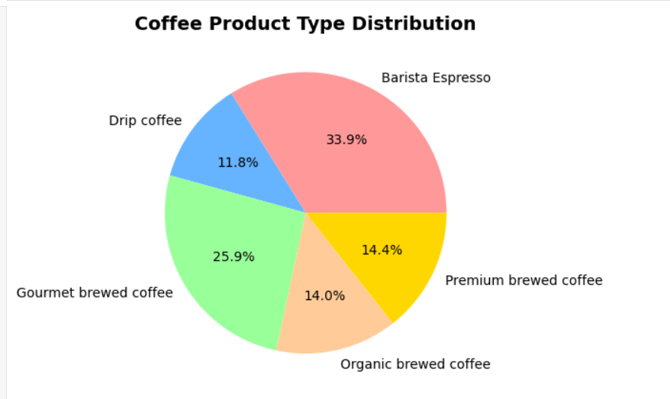
Coffee product type distribution
# Barista Espresso 1. Holds the largest share (33.9%). 2. This indicates that espresso-based beverages are the most popular among customers and contribute significantly to sales. # Gourmet Brewed Coffee 1. Accounts for 25.9%, the second-largest segment. 2. Suggests strong demand for high-quality brewed coffee, appealing to customers who prefer premium taste but not necessarily espresso. # Premium Brewed Coffee (14.4%) Organic Brewed Coffee (14.0%) 1. Both categories are nearly equal in share, together making up around 28.4% of the distribution. 2.This reflects a niche but steady market of health-conscious and quality-seeking customers. # Drip Coffee (11.8%) 1. Represents the smallest portion of the distribution. 2. Indicates relatively lower preference for traditional drip-style coffee compared to other specialty options.

Slide 16
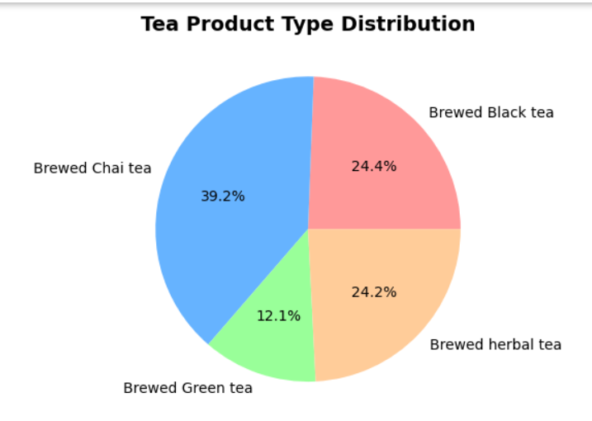
Tea product type distribution
# Brewed Chai Tea (39.2%)
1.Clearly the largest share of the tea sales.
2. Indicates strong customer preference for chai, possibly due to its cultural relevance, rich flavor, and wide appeal.
# Brewed Black Tea (24.4%) and Brewed Herbal Tea (24.2%)
1. Both hold almost equal shares and together contribute nearly half of the total distribution (48.6%).
2. Black tea reflects a demand for classic traditional flavors, while herbal tea indicates interest in health-conscious, caffeine-free alternatives.
# Brewed Green Tea (12.1%)
1. Represents the smallest portion of the market.
2. While it is less popular compared to other categories, it caters to a specific segment of health-focused customers.

Slide 17
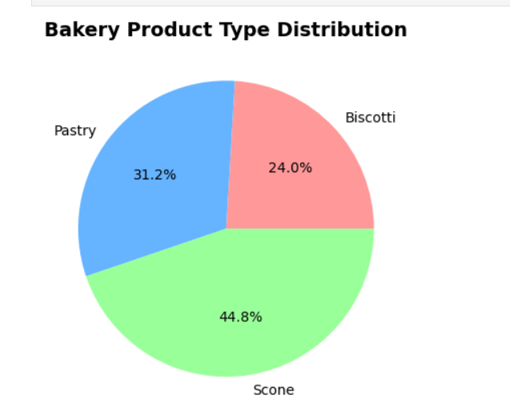
Bakery product type distribution
Scone is the highest-selling category, accounting for 44% of total bakery sales, indicating it is the most popular or highest revenue-generating product among the three.
Pastry holds the second-largest share with 31% of sales, demonstrating a significant contribution, though less than Scone.
Biscotti represents the smallest portion of sales at 24%, suggesting it is the least popular or lowest revenue-generating product among the three categories shown.
.

