Slide 1

6th Sem Self Study Phase -1 Evaluation
TOPIC
Analysis of text and audio reviews using ML algorithms
NAME USN
Ranjith G Hegde 1RV16CS112
Ujwalakavya J 1RV17CS435
Department of Computer Science & Engineering
R V College of Engineering, Bangalore

Slide 2
Presentation Outline
Identification of Problem
Application of Engineering Principles
Study of existing systems and Design Problem
Methodology
Correlation with Self Study subjects
Selection of appropriate tools, skills and techniques in solving the problem
Future work for phase 2
References (Recent IEEE/Springer/ACM/Elsevier papers to be referred)

Slide 3
Introduction
Text and Audio reviews analysis using Deep learning based sentiment analysis model and speech recognition.
Sentiment analysis is contextual mining of text which identifies and extracts subjective information in source material and helping a business to understand the social sentiment of their brand, product or service by monitoring online reviews.
Speech recognition is the ability of a machine or program to identify words and phrases in spoken language and convert them to a machine-readable format.

Slide 4
Identification of Problem
In the ever growing market of today customer feedback is very crucial in a company’s survival. The gathering and accurate analysis of data is very hard which is the problem that needs to be solved in the industry.
Customer feedback is an area in the current market which is not much focused on by many companies. So there is a huge scope for growth in this field which can be seized.

Slide 5
Application of Engineering Principles
Some shit no one cares

Slide 6
Study of existing systems and Design Problem
Existing methods of feedback collection are store receipt, Twitter Chats and Dedicated customer support account on Twitter, Facebook polls
Call customers and Visit to customers. Time needed to give the feedback and to collect the data.
Existing methods of data analysis are Sentiment Analysis as-a-Service Companies such as Microsoft, IBM and smaller emerging companies offer REST APIs that are easy to integrate and most popular commercially successful one is IBM Watson. Cost is a major problem along with the proper classification of the data that has been gathered also the level to which the data has to be analysed.

Slide 7
Methodology
Feedback option is provided in the android application itself which can take both audio and text as the input for feedback saving customers time.
Using Recursive Neural Tensor Networks and the Stanford Sentiment Treebank for better highly accurate data classification and picking up the keywords from the sentence.

Slide 8
Data Collection
Review is accepted from the customer through android application either in audio or text format.
Audio to Text Conversion
Using automatic speech recognition model the audio is converted to text.
Text Preparation
The extracted Text is filtered before analysis. It includes tokenizing, identifying and eliminating non-textual content(Stop words) and content that is irrelevant to the area of study from the data.
Sentiment Detection
At this stage, each sentence of the review and opinion is examined for subjectivity. Sentences with subjective expressions are retained and that which conveys objective expressions are discarded.
Sentiment Classification
Sentiments can be classified into groups, positive, negative and neutral. At this stage of analysis, each subjective sentence detected is classified into groups-positive, negative, neutral.
Presentation of Output
After the completion of analysis, the text results are displayed on website for further analysis and future prediction.

Slide 9
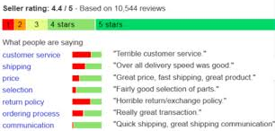
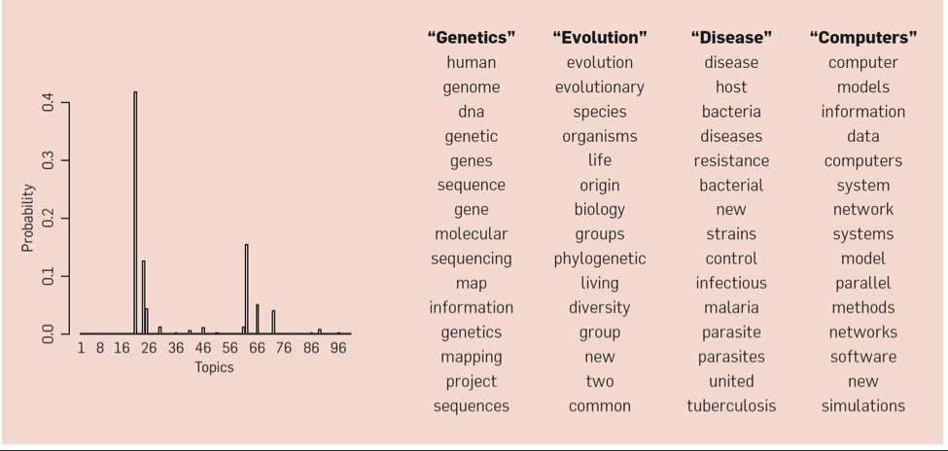

Slide 10
Correlation with Self Study subjects
Computer Networks is used to analyse the transfer of data between the client and the server to appropriately set the configuration after load analysis.
The front end is made in HTML, CSS, JavaScript embedded in the Java Server Pages with bootstrap used for delicate styling.
Compiler Design is basic as Java has both the compiler and the interpreter which makes it very robust to code in.

Slide 11
Selection of appropriate tools, skills and techniques in solving the problem
Java 8
CoreNLP

Slide 12
Future work for phase 2
Making the application Scalable for multiple users .

Slide 13
References
https://www.tutorialspoint.com/android/android_studio.htm
https://www.tutorialspoint.com/spring_boot/spring_boot_introduction.htm
https://spring.io/projects/spring-data-gemfire
https://stanfordnlp.github.io/CoreNLP/
Dataset- http://en.wikipedia.org/wiki/List_of_blogs
https://www.w3schools.com/html/html_css.asp

Slide 14
Thank You

