Slide 1
NORTHGRID ENERGY SERVICES | BOARD OF DIRECTORS
From Demand Volatility to Measurable Value
Findings and recommendations of the Data Science Consulting engagement
Ujwal Dasari - July 2026

Slide 2
SECTION 1
Executive summary: three fixes fund themselves
The problem
Peak demand events grew from 14 (2022) to 34 (2025). Leadership estimates $95-120M of exposure. Forecasting, infrastructure, and demand response are managed separately.
What your data shows
Weather is not the driver - demand spikes when residential, commercial, and industrial customer loads peak together. Risk is concentrated: 31 of 500 substations are critical. Demand response works, but the least efficient quarter of events consumed $141M for 10% of the results.
What we recommend
1) Fix demand response execution. 2) Target capital at the 31 critical substations. 3) Upgrade forecasting to a customer-segment model that warns of peaks before they arrive.
$45.8M/yr
expected value of recommendations
< 1 year
payback on ~$8M implementation
$98.5M
recoverable from DR spend alone
31
substations needing priority capital

Slide 3
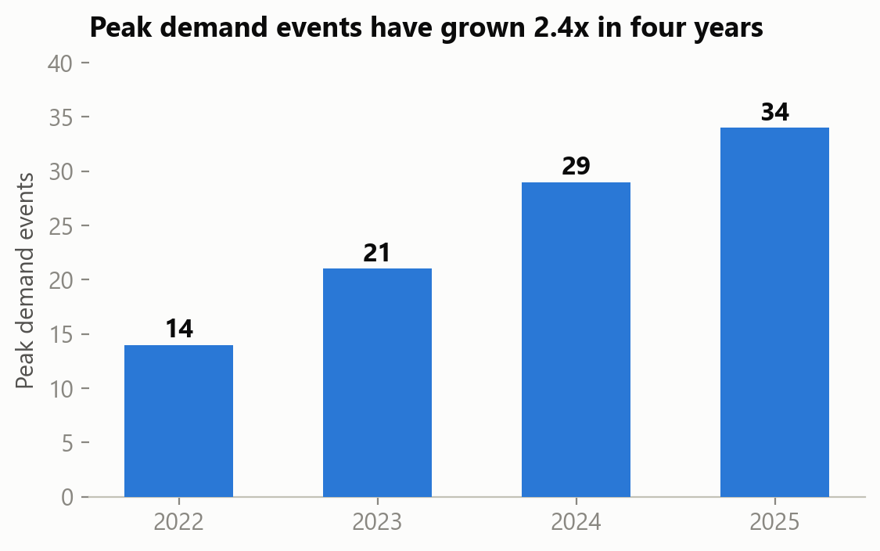
SECTION 2
Peak events keep climbing - and each one is expensive
2.4x growth in four years
Peak events force emergency power purchases at premium prices and push aging equipment past its comfort zone.
Stable customers, volatile demand
Customer growth has been steady. Volatility is coming from how demand behaves, not how many customers you serve.
$95-120M exposure
Leadership's own estimate across emergency purchases, deferred maintenance, upgrades, and regulatory risk.
Why now
Planning decisions for the next 3-5 year capital cycle are being made on tools that no longer explain what is happening.

Slide 4
SECTION 3
What we analyzed: three years of your own operations
Hourly demand & forecasts
25,000 hourly records, Jan 2023 - Nov 2025, across all five regions: demand, weather, customer loads, forecasts, and peak events.
Infrastructure risk & planning
All 500 substations: age, capacity, utilization, outage history, load growth projections, and risk scores.
Demand response results
8,000 program events: peak demand before and after, megawatts reduced, and cost.
Analyzed together for the first time
These three views were connected into one picture of how demand, assets, and programs interact - the integration leadership asked for.
Data honesty
About 2% of weather and forecast values are missing, and some weather sensors report impossible readings. We document every gap and none of them change the conclusions.
Everything traceable
Every number in this presentation reproduces from your files with a script - ready for finance or regulatory review.

Slide 5
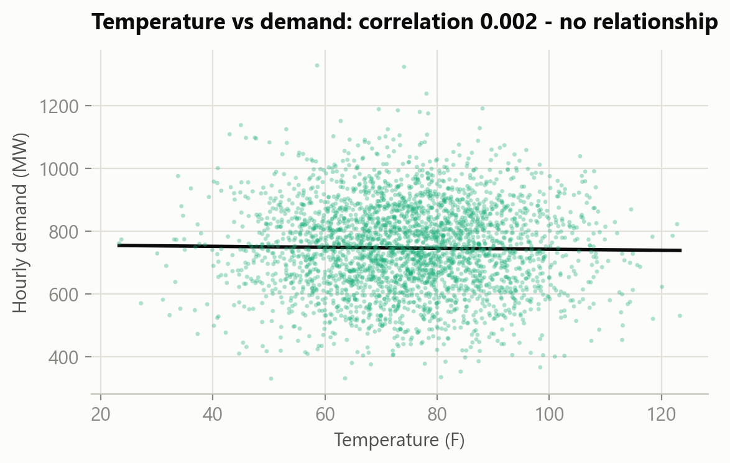
SECTION 4 - FINDING 1
The weather theory does not survive contact with your data
What we tested
The working theory was that heat waves and weather extremes drive demand spikes.
What the data shows
Hot hours, cold hours, and mild hours all see peak events at the same 10% rate. The relationship between temperature and demand is flat.
Why it matters
Money aimed at better weather forecasting would not reduce a single peak event. The driver is elsewhere - and we found it.
One caveat
Some weather sensors report impossible values, so we recommend a feed audit before treating this as permanent.

Slide 6
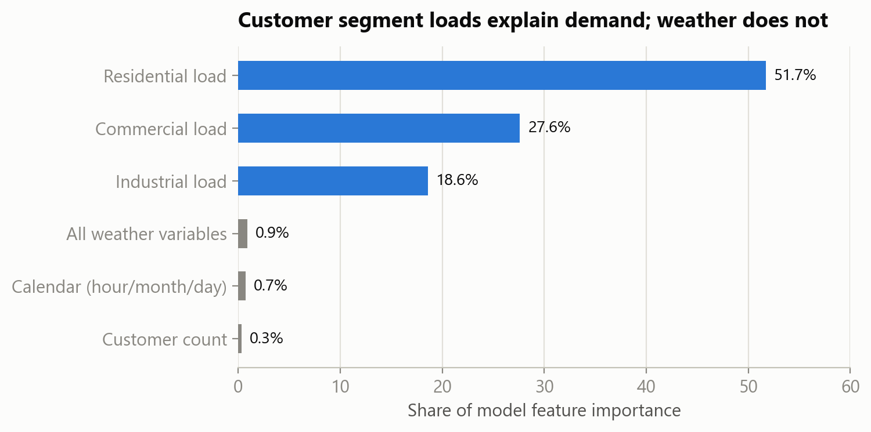
SECTION 4 - FINDING 2
Demand spikes when customer segments peak together
The real driver
System demand tracks the combined load of residential, commercial, and industrial customers almost perfectly.
Who moves the needle
Residential customers carry about half the predictive signal, commercial about a quarter, industrial about a fifth. Weather and calendar together: under 2%.
The implication
Your smart meters (AMI) already watch these segments in real time. The path to seeing peaks coming is segment-level load tracking, not weather models.

Slide 7
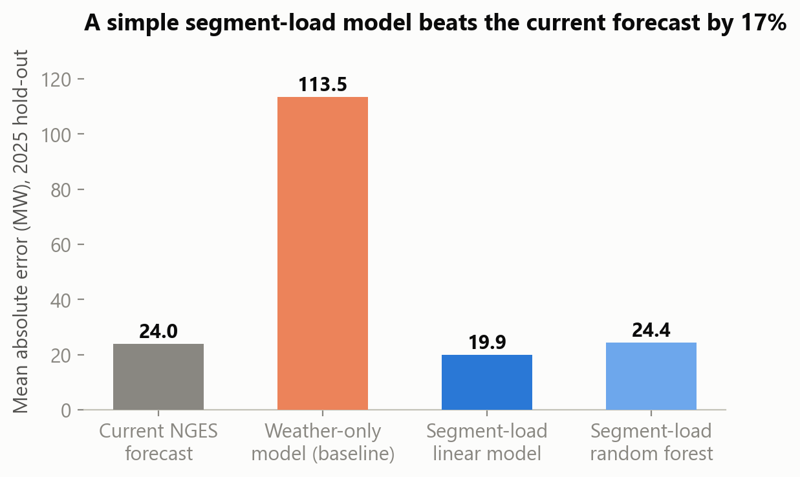
SECTION 5
We can see peak events coming before they arrive
Today
Your forecast misses by about 24 MW on an average hour - and by just as much during peak events, when a miss is most expensive.
What we built
A forecasting model based on customer segment loads. It cuts the error by 17% - and the winning model is simple and fully explainable, which matters in front of a regulator.
The operational win
Because peak events are simply the highest-demand hours, an accurate forecast doubles as an early-warning system: when the forecast approaches the peak threshold, demand response is triggered in advance.

Slide 8
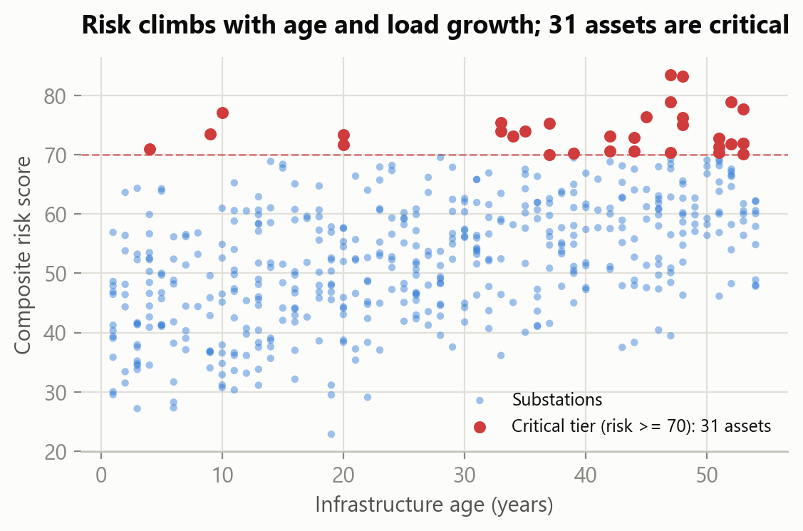
SECTION 6
Grid risk is concentrated in 31 substations - not spread everywhere
The critical tier
31 of 500 substations score in the critical risk band. Ten are in the North region, eight in the West - nearly 60% in two regions.
Running hot
162 substations operate above 85% of rated capacity; 35 are already past 100% and depend on favorable conditions every day.
What drives risk
Projected load growth (r = 0.55) and age (r = 0.52) are the top two drivers, essentially tied, followed by utilization and outage history - the risk score looks forward, not just backward.
The discipline
Every asset on the priority list gets engineering confirmation before commitment - the score guides, engineers decide.

Slide 9
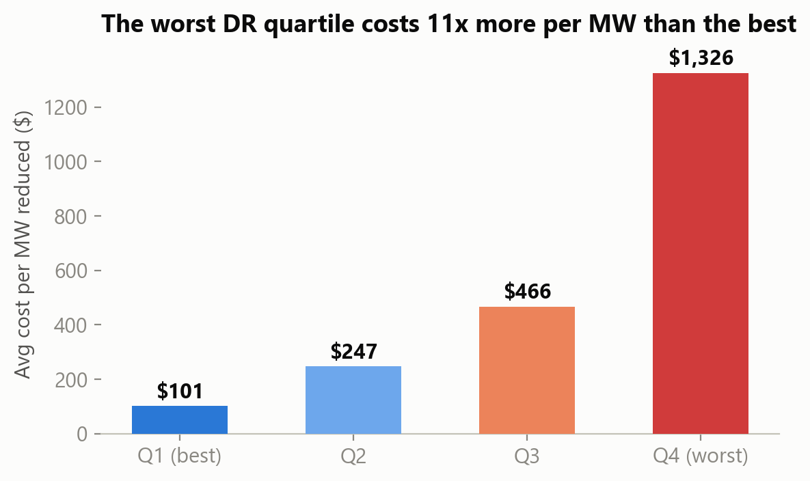
SECTION 7
Demand response works - but pays off very unevenly
The program is effective
8,000 events reduced 1.33 million MW of peak load. Every customer type - residential, commercial, industrial - performs about the same.
The problem is execution
The best quarter of events removes load at about $107 per MW. The worst quarter averages about $1,150 - eleven times more - and absorbed $141M of the $420M program while delivering 10% of the results.
What that means
This is not a recruitment problem. It is about when events are called, how they are sized, and how incentives are set - all fixable.

Slide 10
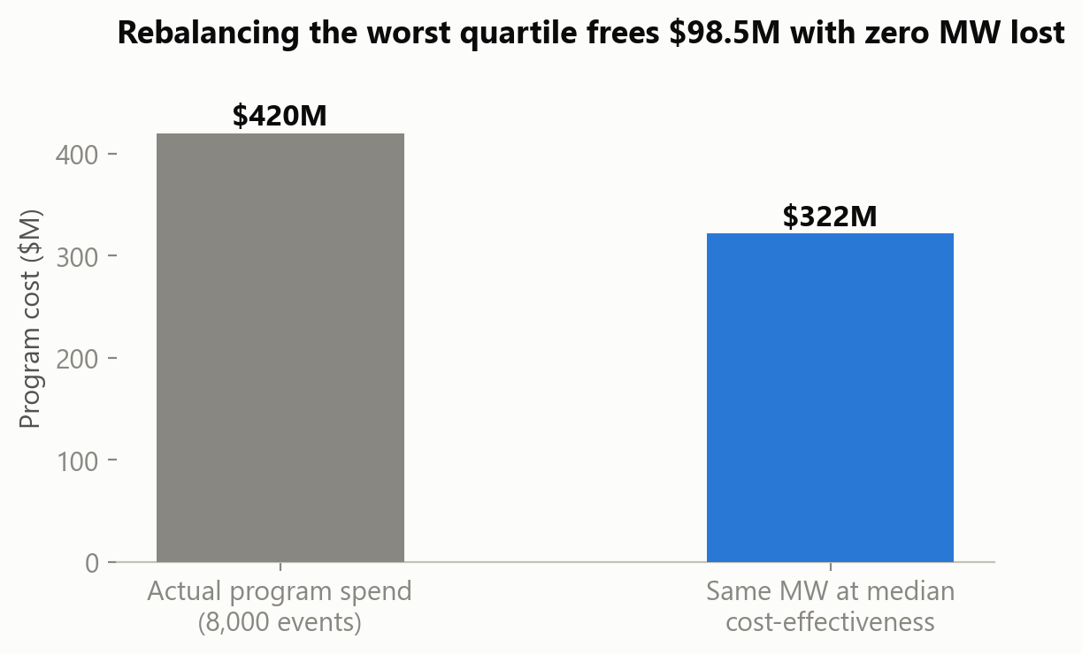
SECTION 7
The single biggest opportunity: $98.5M inside the existing DR budget
The standard already exists
Half of your events already deliver at $330 per MW or better. We are not proposing a theoretical benchmark - it is your own median performance.
The math
Delivering the worst quartile's megawatts at that median would have cost $42.8M instead of $141.3M. Same megawatts, $98.5M freed.
Note the coincidence
Leadership estimated $95-120M of exposure from demand volatility. Most of that money is recoverable from inside the demand response budget alone.

Slide 11
SECTION 8
Executive dashboard: the whole picture on one screen (live demo)
Executive KPI summary
Peak events, forecast accuracy, critical substations, DR performance, and expected value - the headline numbers, always stable.
Three analytics pages
Demand (including the weather scatter you just saw), infrastructure (critical tier in red, filterable by region), and demand response (cost-effectiveness quartiles).
Recommendation center
The three recommendations with their value, cost, and payback - the page a leader opens on Monday morning.
Built to refresh
The data extracts are scripted, so a monthly refresh is a scheduling task, not a rebuild.
LIVE POWER BI WALKTHROUGH
(Dashboard demonstrated live during the presentation; screenshots available as backup.)

Slide 12
SECTION 9
What NGES needs to do - three moves, in priority order
1. Fix demand response execution
Improve: standardize event sizing, timing, and incentives against your own median cost-effectiveness; retire or redesign chronically inefficient events.
Worth: $22-40M per year (expected $34.8M). Fastest payback - it is savings from money already being spent.
2. Target capital at the critical 31
Improve: a two-speed capital plan - upgrade the 31 critical substations over 3-5 years in ranked order; cover the elevated tier with monitoring and DR instead of immediate replacement.
Worth: $6-15M per year (expected $10M) from deferring $100-150M of lower-priority spend, plus reduced outage exposure in the North and West.
3. Upgrade forecasting & warning
Improve: replace the current forecast with the segment-load model fed by AMI data; trigger DR automatically when forecasts approach the peak threshold.
Worth: $0.5-2M per year directly - and it is the engine that makes recommendations 1 and 2 work day to day.

Slide 13
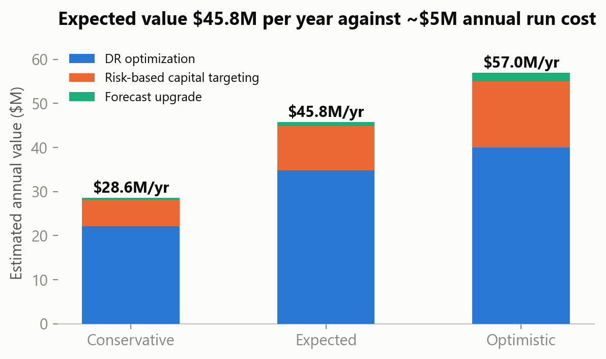
SECTION 10
The financial case: value in every scenario
Three scenarios, visible assumptions
Conservative $28.6M, expected $45.8M, optimistic $57.0M per year. Every assumption behind these numbers is written down for your finance team to challenge.
What it costs
About $8M one-time (forecasting platform, DR redesign, analytics staffing) plus roughly $5M per year to run.
Payback
Under one year in every scenario. Over the 3-year capital planning window, the expected case creates about $137M of value - more than neutralizing the $95-120M exposure.

Slide 14
SECTION 11
Implementation roadmap
Immediate (0-12 months)
- Stand up DR event standards: sizing, timing, incentive caps tied to $/MW.
- Audit weather feeds and fix sensor issues.
- Deploy the segment-load forecast alongside the current one and compare monthly.
- Launch the executive dashboard with monthly refresh.
- Begin engineering reviews of the top 10 priority substations.
Medium term (1-3 years)
- Execute upgrades on the first wave of critical substations (North and West first).
- Automate DR triggering from the peak-warning forecast.
- Retire or redesign chronically inefficient DR events; reinvest savings.
- Extend condition monitoring across the elevated tier.
Long term (3-5 years)
- Complete the 31-substation critical program.
- Re-score the fleet annually; refresh the priority list as growth shifts.
- Fold electrification and growth scenarios into segment-load forecasting.
- Revisit deferred assets as budgets free up.

Slide 15
THE BOARD'S QUESTION, ANSWERED
How can NorthGrid use forecasting, infrastructure planning, and demand response intelligence to improve reliability, optimize capital, and create measurable value?
By listening to what your own data says: demand volatility is a customer-load story, not a weather story. Fix how demand response events are executed and $98.5M comes back from money already being spent. Point capital at the 31 substations that actually carry the risk and defer the spending that can wait. Forecast from customer segments and peak events stop being surprises.
Expected value: $45.8M per year against about $5M per year to run - with payback in under a year.
Thank you - Questions welcome

Slide 16
APPENDIX
For the technically curious (backup)
Model evaluation
Time-based hold-out test (most recent 20% of hours). Current NGES forecast: MAE 24.0 MW, R-squared 0.956. Weather/calendar-only model: MAE 113 MW, R-squared ~0 (no signal). Segment-load linear model: MAE 19.9 MW, R-squared 0.969 - selected for accuracy plus explainability. Random forest: MAE ~24 MW (no improvement over the simple linear model).
Peak events
Defined in the data as the top 10% of hourly demand (threshold ~929 MW; peak hours average 997 MW vs 723 MW otherwise).
Key assumptions
Annualization over the 2.83-year data window; 7-8% cost of capital on deferrals; $100-200/MWh emergency power premium; DR savings priced at the program's own median of $330/MW.
Data limitations
~2% missing weather/forecast values (median-imputed); impossible humidity readings (audit recommended); demand-file substations do not join to the infrastructure file, so integration is regional, not asset-level.

