Slide 1



Off the Grid One Heart, One Hope Index Ujwal Iyer

Slide 2
What did you create and what does it do?
Create a new index system to track the giving trends zip-code wise.
The existing index built by BB - The backbaud index tracks the giving by receiving organization type and size. Data from Giving USA is limited and in form of pre-built reports only
This new index will track the donor data by ZIP code.
Analyze giving trends and map it to preference of local citizens to particular causes.
Now develop go-to-market techniques for under funded schemes
Gamify the data and pitch one community against the other by publishing index data publicly.

Slide 3
How did you come up with this idea?
Baby boomer generation ending, less children, less donors.
Most generous donors currently above 50 now- and next generation number of donors would be smaller in number.
So with less donors in next 5 years, need to maximize efforts to extract more from current donors
More in money
More in variety of causes donated to

Slide 4
Who benefits from this and how
Who?
Project Managers
Product Owners
Program Manager
How?
Find top problematic modules for users
Real time feedback on latest features released
Analyze top issues faced by users and create their detailed documents to distribute to clients

Slide 5
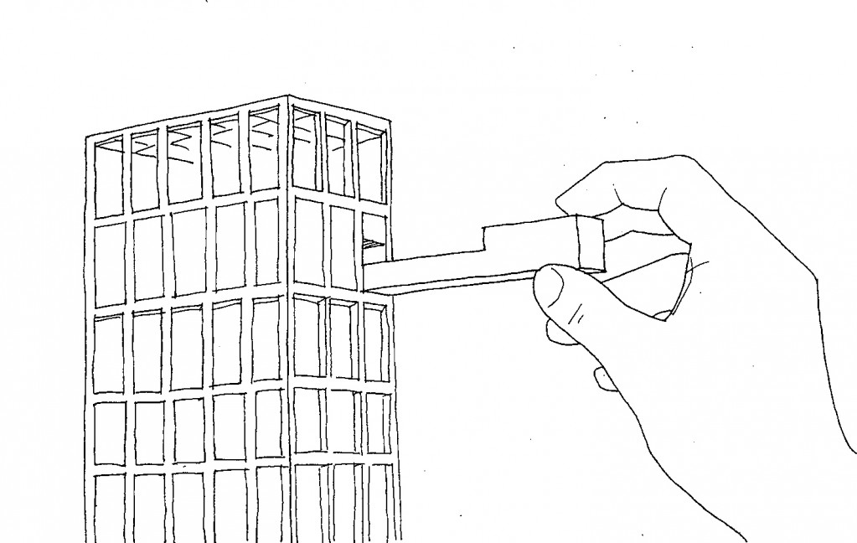
What would you see as the next steps for your creation?
Integrate more data by creating web services, to expose
currently existing- but fragmented forums such as
User Voice
Idea – Bank
Clarify Change Requests

Slide 6
Thank you!

