Slide 1
Entropy in VM
By,
Ujwal Komarla
Intern, Product Security Engineering
Mentor:
Dave King
Staff Security Engineer
Notes:
Entropy – Wiki Definition
Linux Kernel Entropy Gathering and Exposure through device drivers
In computing, entropy is the randomness collected by an operating system or application for use in cryptography (Disk encryption, Secure wipe of disks, Secure sw access points – session/public keys) or other uses(N/w seq numbers) that require random data. This randomness is often collected from hardware sources, either pre-existing ones such as mouse movements or specially provided randomness generators.
Weak can lead to session hijacking, disclosed secrets, and forged identities
The Linux kernel generates entropy from inter-arrival keyboard timings, mouse movements, and IDE timings, stored in individual pools. Relatively interleaved and exposed as a random character data available to other operating system processes through the special files /dev/random and /dev/urandom.

Slide 2
PR 850945
Qualms about entropy quality in VMs
Quantity of entropy in VMs
Notes:
Quoting the customer – Are my SSH keys and other security tokens generated by truly random numbers in a VM? Based on Fear, Uncertainty, Doubt(FUD) in future
Starvation is not unique to VMs and has been observed in similar ways on physical systems
Oracle Web logic fail to start when there is not enough random number in linux system. OpenSUSE fix – CPU state change additional

Slide 3
Tests
Across platform
Across distributions
Workload

Slide 4
Test 1 – Quantity test based on platforms
Host | Intel(R) Xeon(R) CPU E5620 @ 2.40GHz * 8; 10GiB Memory; 20GiB Hardware(SCSi)
NIST STS | Statistical Test Suite sts-2.1.2
data set size | 300MiB
stream length | 1000000
bitstreams | 1000
Kernel Version | 3.10
OS Architecture | 64 bit
Platform | CentOS
Physical | 523kB/s
ESXi | 498kB/s
Platform | Ubuntu
Physical | 347kB/s
ESXi | 337kB/s
Notes:
Matching the kernel version, hardware specifications(SCSi IDE)
Ttylinux doesn’t support SCSi. Making the test bed same.
Time to gather, time to run the test suite.
Seed file(Not first boot) But doesn’t change

Slide 5
Test 2 – Quantity test based on Distributions
Virtual Environment settings
Host | Intel(R) Xeon(R) CPU E5620 @ 2.40GHz * 8; 10GiB Memory; 20GiB Hardware(IDE)
ESXi version | ESXi 5.5.0 build-1331820
Ubuntu | Cent OS | Ttylinux | ESXi
336kB/s | 500kB/s | 421kB/s | 102kB/s
Notes:
, hardware specifications(SCSi IDE)
Ttylinux doesn’t support SCSi. Making the test bed same.
Difference between distributions is not due to additional usage of Havege.

Slide 6
Test 3 - Workload on Hypervisor
Hypervisor load (Core, Memory, Disk) | Ubuntu | CentOS | ttylinux | ESXi
Single VM (16,10GiB,20GiB) | 336kB/s | 500kB/s | 421kB/s | 102kB/s
Parallel VMs reading /dev/urandom (16,10GiB,20GiB) | 320kB/s | 482kB/s | 409kB/s | 98kB/s
Parallel VMs reading /dev/urandom (4,2GiB,20GiB) | 316kB/s | 509kB/s | 414kB/s | 96kB/s

Slide 7
Quality of urandom
All the test configuration produced identical results when run through NIST test suite.

Slide 8
Seed file
Linux urandom issue: Never blocks, even when not seeded properly.
Seed file fix.
FreeBSD fix.
Automated install
Controlled environment
Doesn’t affect the quantity if removed at shutdown

Slide 9
Observations
Network traffic does not affect urandom generation
No effect on block size
Server version of Ubuntu provided more entropy data than the desktop version
Notes:
Given more RAM/Cores/Processor speed, urandom generation rate would change accordingly. Emphasize that once seeded properly, can provide quality data for long.

Slide 10
/dev/random vs /dev/urandom
Secure because of source : PRNG vs True RNG
CSPRNG
Blocking : Estimator, computationally secure numbers.
Reseeding
Link to reference article
Notes:
Reference : http://www.2uo.de/myths-about-urandom/
Intuition, Misconception(PRNG is deterministic as computers are designed that way. But not necessarily true)
Come from exact same CSPRNG, differing in very few ways and have nothing to do with true randomness
Distillation and not direct hardware randomness
Estimator(and not exact)
Cryptographers often circumvent this philosophical debate by disregarding what it means for randomness to be “true”. They care about unpredictability. As long as nobody can get any information about the next random number, we're fine.
So just use those computationally-secure random numbers for your computationally-secure algorithms
Man page bashing:
Let's take Daniel Bernstein, better known as djb:
Cryptographers are certainly not responsible for this superstitious nonsense. Think about this for a moment: whoever wrote the /dev/random manual page seems to simultaneously believe that
(1) we can't figure out how to deterministically expand one 256-bit /dev/random output into an endless stream of unpredictable keys (this is what we need from urandom), but
(2) we _can_ figure out how to use a single key to safely encrypt many messages (this is what we need from SSL, PGP, etc.).
For a cryptographer this doesn't even pass the laugh test.

Slide 11
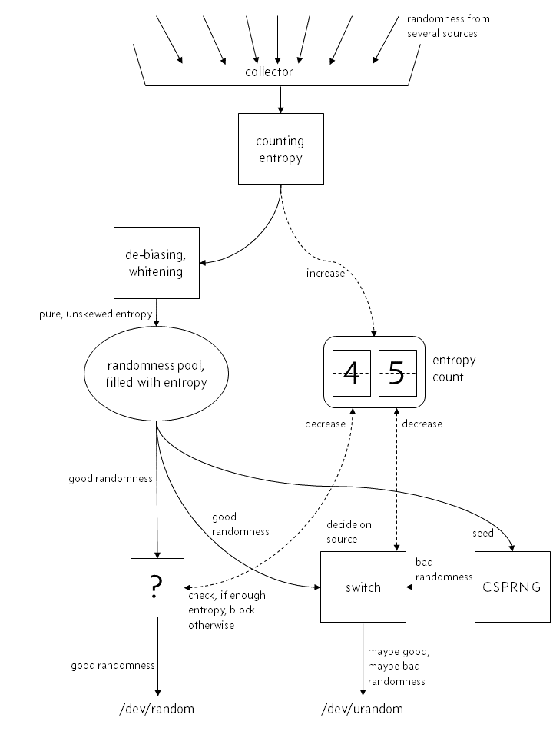
Incorrect View of random and urandom
Notes:
PRNG vs True RNG

Slide 12
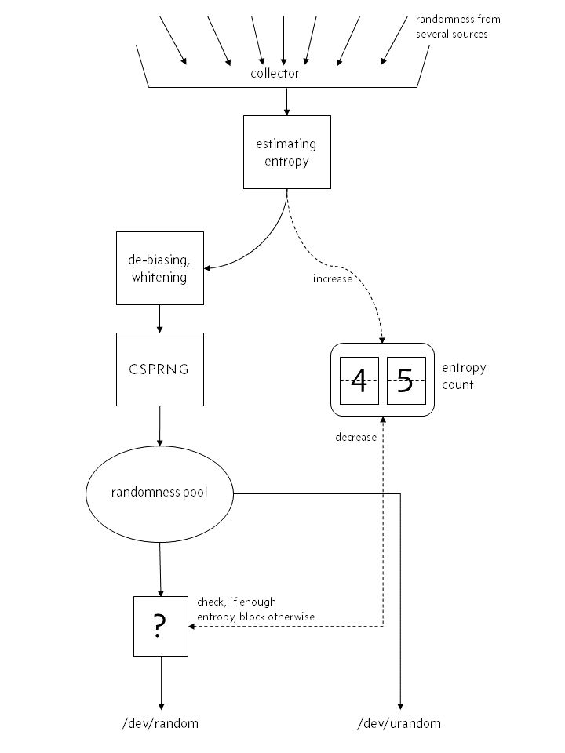
Correct view of random and urandom
Notes:
CSPRNG
Blocking : Estimator, computationally secure numbers.
Reseeding
The Linux kernel uses only the arrival times of events to estimate their entropy. It does that by interpolating polynomials of those arrival times, to calculate “how surprising” the actual arrival time was, according to the model. Whether this polynomial interpolation model is the best way to estimate entropy is an interesting question. There is also the problem that internal hardware restrictions might influence those arrival times. The sampling rates of all kinds of hardware components may also play a role, because it directly influences the values and the granularity of those event arrival times.
“looking random” is the basic requirement for a lot of our cryptographic building blocks

Slide 13
Work in progress
/dev/random quantity test for physical vs virtual. Have been running for 3 weeks now, as they generate about only 10KB per day.
223kB vs 168kB
Process data collected with ‘stats’ build configuration.
Automated cloning of VMs, logging the Random estimator value and the entropy drainers along with keeping a watch that the pool doesn’t hit the maximum.
Working on systemtap to get a deeper understanding of which sources contribute to the random pool.
With these, we will be able to test for overloading system(internal and also, the hypervisor)
Notes:
LSOF, inotifytools, stap,
Expect,ssh,scp

Slide 14
Future work
Correlation between cloned VMs
Can network interrupts be observed by an outsider
VMs – Cloning , Revert to a checkpoint
But doesn’t mean, use random. Instead proper reseeding.
Notes:
use more entropy sources : Audio, Video, Havege, Network, TPM, RNG(HW)
Cloud VMs – It can be any VM, not necessarily cloud.
Also, they still retain an external factor i.e., they have to go somewhere physical or over network.
So, the accesses will retain a timing element external to VM and VMM(Monitor) i.e, a physical device.
syscall getrandom(2) LibreSSL
OpenSUSE fix – CPU state change additional
Native driver

Slide 15
Questions?

Slide 16

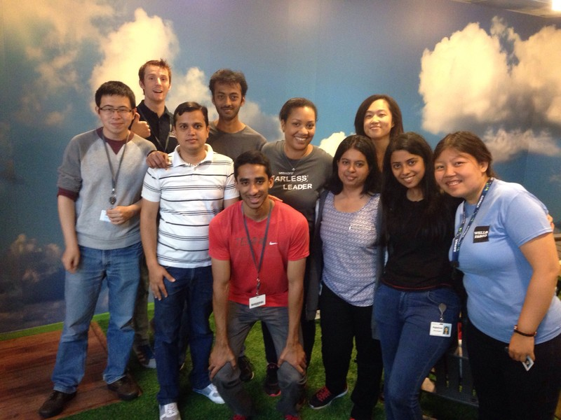
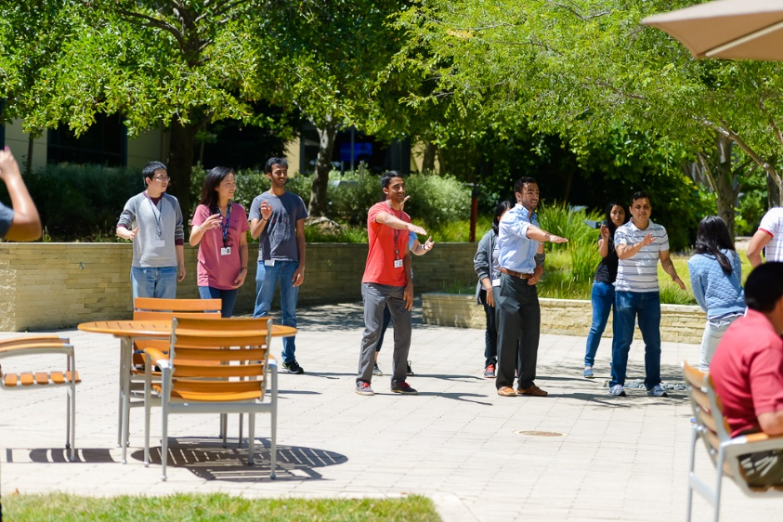
Internship at VMware, without fun? Impossible
Winners at the scavenger hunt

Slide 17
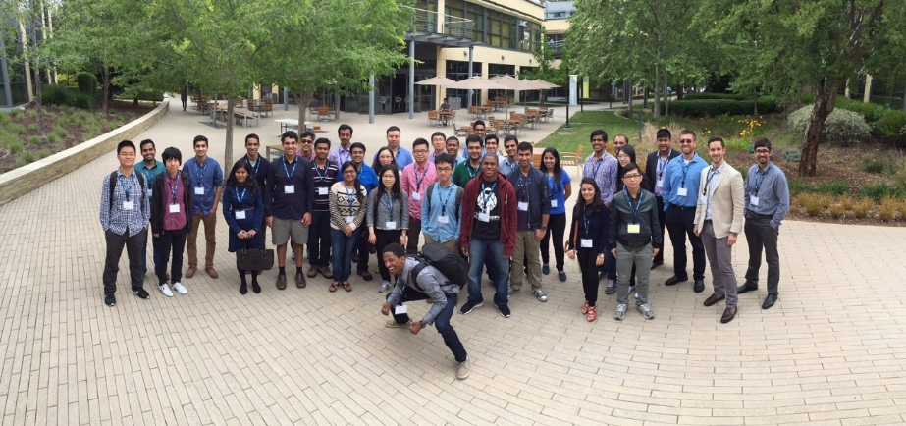
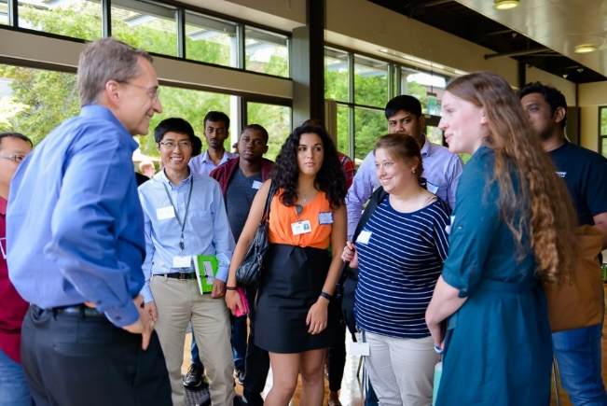

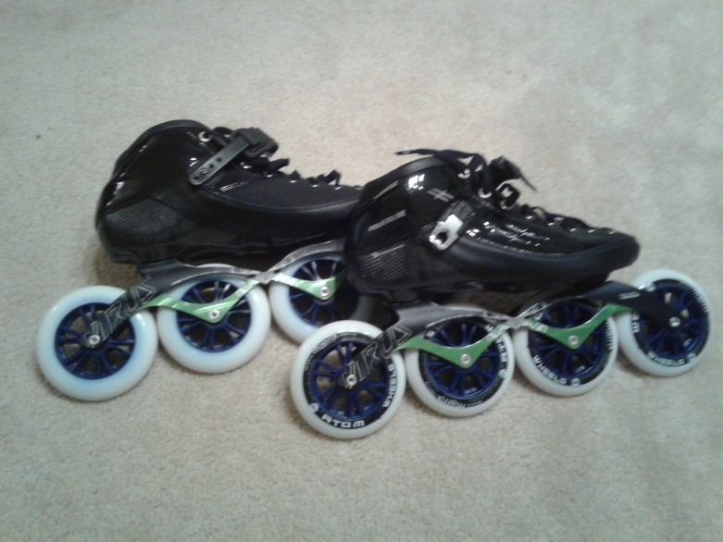
More pics

Slide 18
Thank you!

