Slide 1




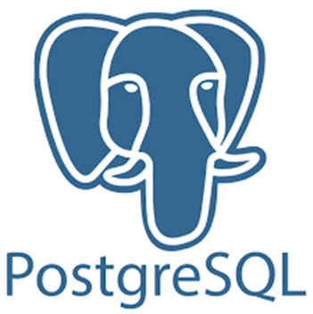



Flow chart
Kubernetes
Pod
Pod
Pod

Slide 2
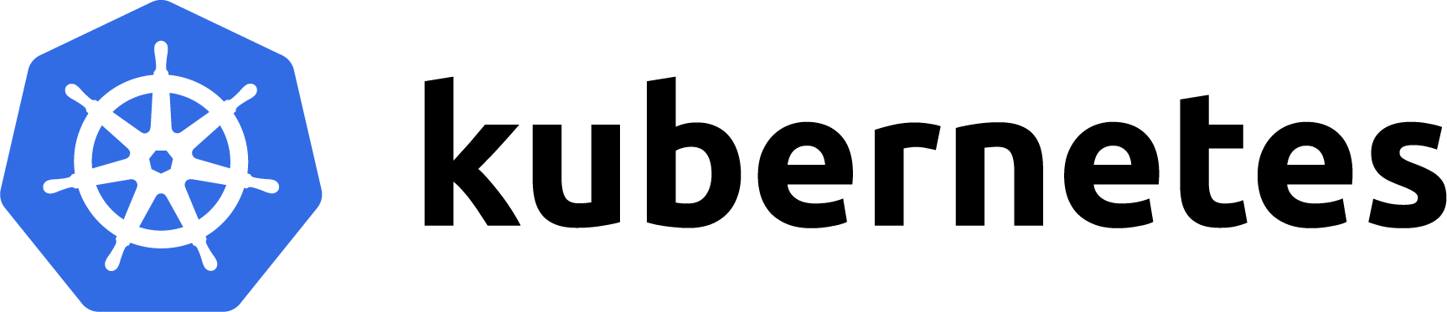

1 .Kubernetes
Learning Journey:
What Is Kubernetes?
Kubernetes workloads
Yaml files
PVC and Volumes
Services:
-Nodeport
-Headless
-ClusterIP
What is Helm? How to use it?
Started deploying applications
Challenges:
Minikube and Kind as k8s cluster
Imagepull error : Solved it by loading image to minikube cache before deploying.

Slide 3



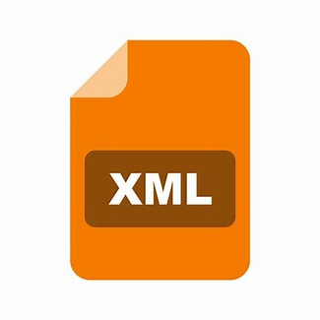

2: Spark + Delta Lake
Learning Journey:
Takes data
Writes data
getting started
-notebook or spark-shell ?
Errors:
CrashLoop
Delta Core compatibility
POD
Documentation:
- Spark documentation and articals
Finally getting started. -jupyter setup with spark and delta by building custom image.
Delta Lake : why and how?
Delta Lake :Worked on delta tables.
pySpark
Spark Cluster
Challenges:
Spark-submit wasn’t best way to run spark application. Takes long time to resubmit in Kubernetes
Had to rebuild the image several times in order to install jdbc, xml and other packages .
Delta Lake setup required version compatibility and spark conf initialisation

Slide 4


3:Superset
Learning Journey:
PostgreSQL
-my first db
Minor issues while connection:
-Used sqlalchemy instead of jdbc
Main pod dies:
-Changed the namespace
Superset : Deployed using Helm
Superset
-Created Charts and dashboards
Challenges:
Had some issues with reading delta table directly from superset because I couldn’t share volumes between two pods . Found out for cloud storage there is an efficient library implementation

