Slide 1
PROJECT TITLE
CAPSTONE PROJECT
Presented By: Ujwal Santoshbhai Nikumbe
Student Name : Ujwal Santoshbhai Nikumbe
College Name & Department : Diploma in Computer Technology in K.K. Wagh Polytechnic ,Nashik

Slide 2
OUTLINE
Problem Statement
Technology used
Wow factor
End users
Result
Conclusion
Git-hub Link
Future scope

Slide 3
Problem Statement
The project addresses the need for secure and covert communication by using image-based steganography. Traditional encryption can attract attention, while steganography hides data within images by modifying pixel values. The encoding script embeds secret text into an image, and the decoding script extracts the hidden message. This method ensures discreet data transmission without raising suspicion, making it useful for secure communication.

Slide 4
Technology used
The primary library used in this project is Pillow (PIL) for image processing. Other built-in Python libraries utilized include:
Itertools (implicitly used via iter()) for iterating over image pixel data.
OS (can be optionally used) for handling file operations.
Sys (if extended) for command-line argument handling.

Slide 5
Wow factors
What makes this pLeast Significant Bit (LSB) Steganography: Uses a precise LSB modification technique to embed data without noticeable changes to the image.
No External Dependencies Beyond PIL: Unlike some steganography projects requiring complex cryptographic libraries, this project keeps it lightweight and efficient.
Simple Yet Effective Encoding & Decoding: The scripts are straightforward, making them easy to understand and implement while maintaining security.

Slide 6
End users
Cybersecurity Professionals – Use steganography for secure communication and data protection.
Journalists & Whistleblowers – Hide sensitive information within images to avoid censorship and surveillance.
Military & Intelligence Agencies – Securely transmit confidential messages without drawing attention.

Slide 7
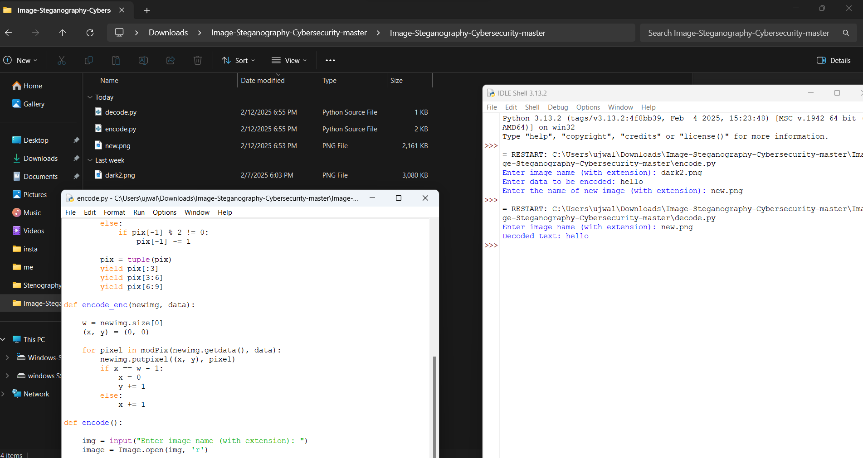
Results

Slide 8
Conclusion
This project demonstrates a simple yet effective approach to secure communication using image-based steganography. By modifying the least significant bits of image pixels, it enables covert data embedding without noticeable changes to the image. The encoding and decoding scripts provide a lightweight, efficient, and easy-to-use solution for hiding sensitive information. With applications ranging from cybersecurity to personal privacy, this method ensures secure and discreet data transmission, making it a valuable tool for various users.

Slide 9
GitHub Link
https://github.com/ujwalnikumbe/python_project.git

Slide 10
Future scope(optional)
Enhanced Security with Encryption – Integrating encryption before embedding the data will add an extra layer of security.
Support for Different Media Types – Expanding steganography to audio, video, or documents for broader applications.
Increased Data Capacity – Optimizing the algorithm to store larger amounts of hidden data without affecting image quality.

Slide 11
THANK YOU

