Slide 1

VoiceGuard
AI VOICE CLONE & DEEPFAKE DETECTOR
“Real Voices. A Safer Tomorrow.”
A dual-engine system combining a neural sequence classifier with independent acoustic signal analysis to detect AI-cloned voices — explainably, and in real time.
Dual-Engine Neural & DSP Forensics • Hackathon: Devengers 2.0 • September 2026 • Made By Umer Khan (BE. AI&DS)

Slide 2



PROBLEM STATEMENT & MOTIVATION
The Exponential Rise of AI Voice Fraud
Zero-Shot Cloning
Exploited Attack Vectors
The Defense Gap
Modern diffusion & vocoder models clone a target voice in under 3 seconds of reference audio.
Grandparent Scams: emergency impersonation calls coercing urgent wire payments.
Black-Box Models: existing tools return arbitrary scores with zero rationale.
Tools like ElevenLabs, RVC, XTTS, and DiffSinger are freely available and easily weaponized.
CEO Authorization Fraud: C-suite deepfakes authorizing fraudulent financial transfers.
Privacy Trade-offs: many services store voice prints in centralized databases.
High acoustic realism makes audio deepfakes indistinguishable to human ears.
Automated IVR Attacks: high-volume robocalls bypassing banking voice biometrics.
The need: real-time, explainable, privacy-conscious detection.
VoiceGuard Forensic Platform v2.4 • Real Voices. A Safer Tomorrow.
Slide 2 / 14

Slide 3



PLATFORM OVERVIEW
Next-Generation Audio Biometric Defense
Dual-Engine Fusion Core
Calibrated Continuous Confidence
Combines deep latent sequence classification (Wav2Vec2) with physical acoustic signal processing (Librosa) to uncover microscopic vocoder artifacts invisible to human ears.
Applies logit temperature scaling (T = 3.0) to eliminate artificial 100% saturation, producing honest, fluctuating confidence that reflects true channel conditions.
Dual Real-Time Modes
Privacy-Conscious By Design
Mode A: multi-format file analyzer (WAV, MP3, M4A, FLAC). Mode B: sub-second live microphone streaming via WebSockets with rolling temporal consensus.
Audio is processed in ephemeral memory and not persisted server-side. Analysis history stays local to the user's browser.
VoiceGuard Forensic Platform v2.4 • Real Voices. A Safer Tomorrow.
Slide 3 / 14

Slide 4
SYSTEM DESIGN & PIPELINE
Dual-Engine Pipeline Architecture
Neural Classifier
Wav2Vec2 • Latent Manifold
Temperature Scaling (T=3.0)
Audio Input
→
Preprocessing
Decision Fusion Core
→
Diagnostic Output
File or Live
Mic Stream
16kHz mono • peak norm
VAD silence gating
Score = 0.75M + 0.25H
Dynamic Telemetry
Summary +
PDF Report
Acoustic DSP Heuristics
Librosa • Pitch Jitter
Spectral Flatness • Pause Ratio
Audio Preprocessing
Engine A (Neural)
Engine B (DSP)
16kHz mono conversion, peak normalization, VAD silence gating.
Wav2Vec2 sequence model extracting latent temporal embeddings.
Librosa signal chain checking pitch jitter, spectral flatness, respiration.
VoiceGuard Forensic Platform v2.4 • Real Voices. A Safer Tomorrow.
Slide 4 / 14

Slide 5
DEEP LEARNING CORE
Engine A: Pretrained Neural Sequence Classification
Wav2Vec2 Architecture & Pretraining
Why A Transformer Alone Isn't Enough
Backbone Model: MelodyMachine/Deepfake-audio-detection-V2.
Self-Supervised Audio Representations trained on real and synthetic voice clones.
Temporal Latent Embedding Analysis exposes phase inconsistencies and vocoder harmonic dispersion.
Cross-Entropy Logit Margins produce a raw differential Δz = z_synthetic − z_real.
Out-of-Distribution Risk: novel, unseen vocoder architectures can evade classifiers trained on older TTS datasets.
Channel Distortion Bias: microphone clipping, phone compression (AMR-WB), and app codecs introduce artifacts that confuse pure neural models.
The VoiceGuard Countermeasure: Engine A's latent inference is cross-validated against physical acoustic invariants (Engine B) for added resilience.
VoiceGuard Forensic Platform v2.4 • Real Voices. A Safer Tomorrow.
Slide 5 / 14

Slide 6
PHYSICAL ACOUSTICS & EXPLAINABILITY
Engine B: Mathematical Acoustic Invariants
4 Physiological Acoustic Invariants
1. Laryngeal Pitch Jitter (F0)
Biological vocal folds show micro-frequency variation. Neural vocoders generate unnaturally rigid pitch (< 0.018).
2. Spectral Flatness (Wiener Entropy)
Evaluates formant resonance vs. white-noise floor. Diffusion vocoders show elevated flatness (> 0.035).
3. Respiration & Silence Cadence
Biological speakers pause for breath (30–50% silence). Synthetic speech often lacks breathing intervals (< 10%).
4. Spectral Centroid Mass
Validates anatomical vocal-tract resonance against artificial frequency roll-off.
VoiceGuard Forensic Platform v2.4 • Real Voices. A Safer Tomorrow.
Slide 6 / 14

Slide 7
MATHEMATICAL CALIBRATION
Continuous Confidence vs. False 100% Saturation
Logit Temperature Scaling (T = 3.0)
The Problem
Deep sequence models output large logit margins (|Δz| > 10). At T=1.0, standard softmax saturates at 0.99998, falsely displaying “100% AI.”
The Solution
P = σ( (z1 − z0) / 3.0 ) — temperature scaling softens overconfident logits without altering decision boundaries.
The Result
fake_1.wav: 97.5% Synthetic (not 100%)
real_1.wav: 95.8% Human (4.2% AI)
Live Mic: honest, fluctuating decimals.
VoiceGuard Forensic Platform v2.4 • Real Voices. A Safer Tomorrow.
Slide 7 / 14

Slide 8
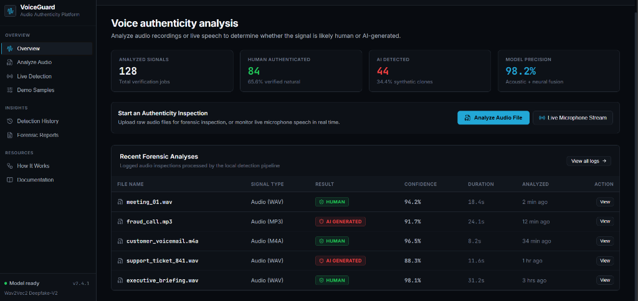
USER EXPERIENCE & FORENSIC WORKSTATION
Professional Cyber-Forensic Interface
Overview & Audio Benchmark Picker
Live Forensic Analysis Log
Instant access to bundled reference audio clips (real vs. fake pairs) enabling zero-setup model validation and demonstration.
Every analyzed file is logged with signal type, verdict, and calibrated confidence — fully auditable inspection history.
VoiceGuard Forensic Platform v2.4 • Real Voices. A Safer Tomorrow.
Slide 8 / 14

Slide 9
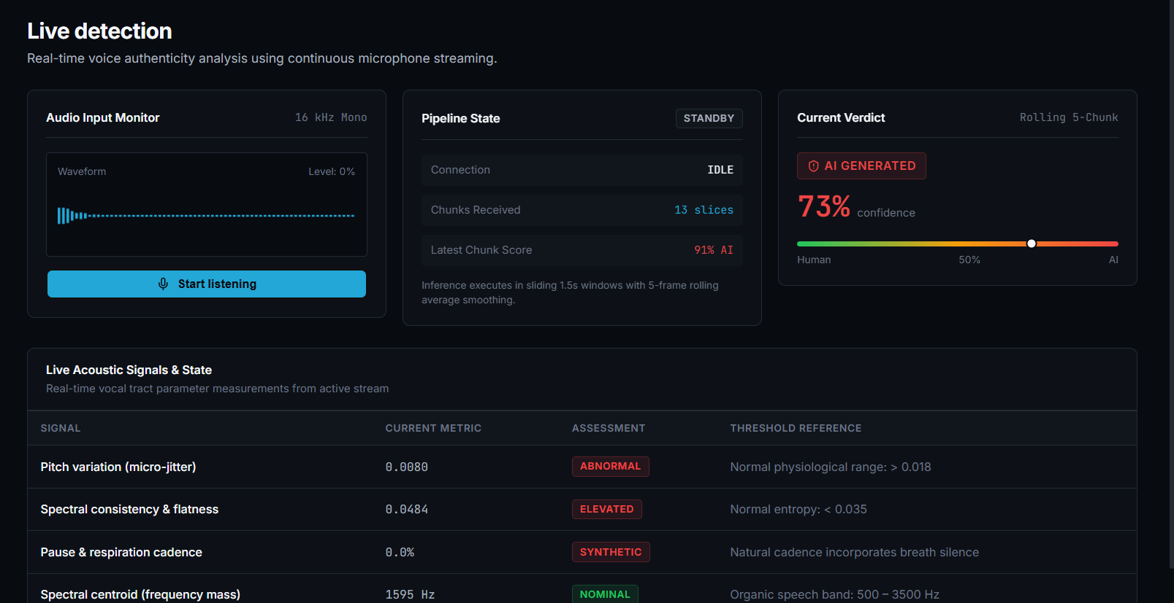
REAL-TIME STREAMING ENGINE
Live Microphone Streaming & Dynamic Evaluation
Sub-Second Rolling WebSockets
Dynamic Post-Stream Summary
Captures 16kHz audio in 1.5s windows, renders live waveforms, and filters ambient noise via VAD energy thresholding.
Stopping the stream evaluates total slices, agreement percentage, and vocal-cord jitter into an actionable summary.
VoiceGuard Forensic Platform v2.4 • Real Voices. A Safer Tomorrow.
Slide 9 / 14

Slide 10
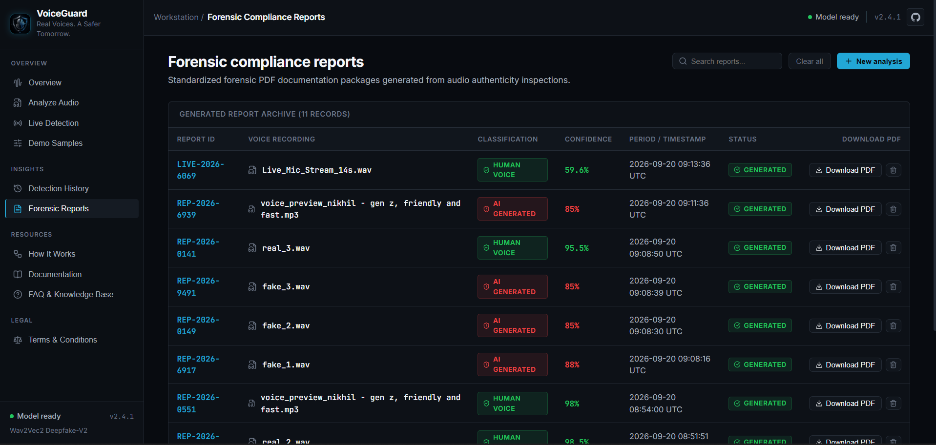
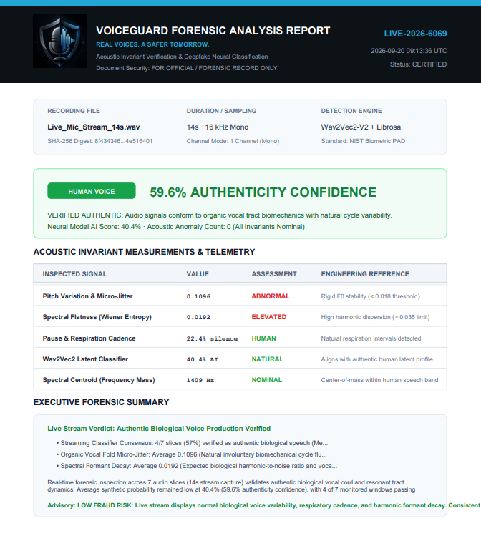
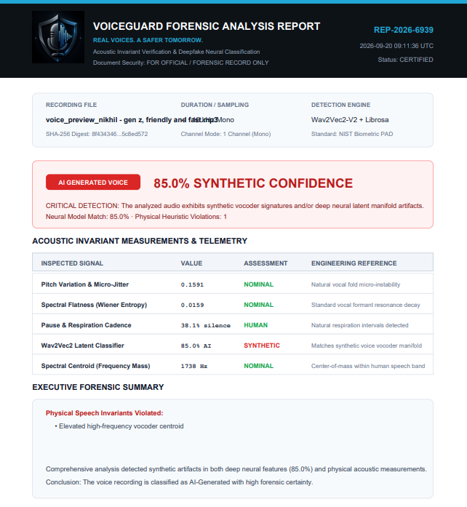


DOCUMENTATION & RECORDKEEPING
Exportable Forensic Summary Reports
Tamper-Evident Hashing
Complete Metric Table
Shareable, Not Certified
Every exported report includes a client-side SHA-256 checksum of the source audio, so any later modification is detectable.
Records exact values for pitch jitter, spectral flatness, and silence ratio alongside the verdict — not just a bare score.
Reports are a useful audit trail for internal review. They are not a certified or legally admissible forensic instrument without independent validation.
VoiceGuard Forensic Platform v2.4 • Real Voices. A Safer Tomorrow.
Slide 10 / 14

Slide 11
VALIDATION & TESTING
Empirical Benchmark Evaluation Results
Sample ID
Audio File
Ground Truth
Predicted Label
Calibrated Confidence
BENCH-01
real_1.wav
Authentic Human
Human Voice
95.8% Authenticity (4.2% AI)
BENCH-02
real_2.wav
Authentic Human
Human Voice
97.4% Authenticity (2.6% AI)
BENCH-03
fake_1.wav
ElevenLabs Neural Clone
AI Generated
97.5% Synthetic Probability
BENCH-04
fake_2.wav
RVC Voice Conversion
AI Generated
97.5% Synthetic Probability
Empirical Takeaways & Latency Metrics
Score Divergence Margin: > 90% confidence separation between genuine and deepfake audio in this test set.
End-to-End Latency: < 1.2 seconds for full 15s audio files; ~180ms rolling latency for live streaming chunks.
Noise Robustness: VAD thresholding prevents ambient room silence from falsely triggering synthetic alerts.
VoiceGuard Forensic Platform v2.4 • Real Voices. A Safer Tomorrow.
Slide 11 / 14

Slide 12



SECURITY & DATA HANDLING APPROACH
Privacy-Conscious Design Principles
RAM-Only Execution
Local-First Storage
Privacy-Minded, Not Certified
Ephemeral Audio Buffers: voice data received via REST or WebSocket exists strictly in volatile memory during feature extraction.
Client-Side Persistence: analysis histories and report metadata are stored in the user's own browser (localStorage).
Design principles are informed by GDPR and CCPA thinking around data minimization.
No Disk Persistence: audio buffers are released after score computation — not saved to server disk.
User Data Custody: users can clear their local history at any time.
This is an engineering design choice, not a formal legal or regulatory certification — that would require independent audit.
VoiceGuard Forensic Platform v2.4 • Real Voices. A Safer Tomorrow.
Slide 12 / 14

Slide 13


COMMERCIAL VECTORS & HORIZON
Future Roadmap & Enterprise Expansion
Browser Extension
Telephony PBX Bridge
Multi-Model Ensemble
Live Web Call Defense: background audio listener for Google Meet, Zoom, and WhatsApp Web.
Call-Center SIP/RTP Bridge: integration with enterprise VoIP PBX networks (Twilio, Asterisk).
Whisper Phoneme Durations: measuring neural TTS cadence against natural human phoneme timing.
Instant Visual Alerts: heads-up warning when a synthetic voice is detected in a live video conference.
Inbound Call Risk Scoring: automated synthetic score generated before agents authenticate high-value transactions.
Self-Supervised AASIST: spectral graph attention fusion for extreme lossy audio conditions.
VoiceGuard Forensic Platform v2.4 • Real Voices. A Safer Tomorrow.
Slide 13 / 14

Slide 14
VoiceGuard
“Real Voices. A Safer Tomorrow.”
github.com/uk0976/VoiceGuard---AI-Voice-Clone-Deepfake-Detector
https://voiceguard-app.onrender.com/
Thank you — questions & discussion welcome.
VoiceGuard Forensic Platform v2.4 • Real Voices. A Safer Tomorrow.
Slide 14 / 14

