Slide 1

VoiceGuard
AI Voice Clone & Deepfake Forensic Defense Platform
“Real Voices. A Safer Tomorrow.”
Dual-Engine Neural & DSP Invariant Forensics | Devengers 2.0 | September 2026

Slide 2
PROBLEM STATEMENT & MOTIVATION
The Exponential Rise of AI Voice Cloning & Fraud
🚨 Zero-Shot Cloning
• Modern generative diffusion & vocoder models clone target voices in under 3 seconds.
• Tools like ElevenLabs, RVC, XTTS, and DiffSinger are freely available and easily weaponized.
• High acoustic realism makes audio deepfakes indistinguishable to human ears.
🎯 Exploited Attack Vectors
• Grandparent Scams: Emergency impersonation calls coercing urgent wire payments.
• CEO Authorization Fraud: C-suite deepfakes authorizing fraudulent financial transfers.
• Automated IVR Attacks: High-volume robocalls bypassing banking voice biometrics.
⚠️ The Defense Gap
• Black-Box AI Models: Existing tools return arbitrary 100% or 0% scores with zero rationale.
• Privacy Violations: Many services store voice prints in centralized, vulnerable databases.
• Need: Real-time, explainable, and privacy-first biometric forensic defense.
VoiceGuard Forensic Platform v2.4 • Real Voices. A Safer Tomorrow. • Slide 02 / 14

Slide 3
PLATFORM OVERVIEW
VoiceGuard: Next-Generation Audio Biometric Defense
🔬 Dual-Engine Fusion Core
Combines deep latent sequence classification (Wav2Vec2) with physical acoustic signal processing (Librosa) to uncover microscopic vocoder artifacts invisible to human ears.
⚖️ Calibrated Continuous Confidence
Employs Logit Temperature Scaling (T = 3.0) to eliminate artificial 100% saturation, providing honest, fluctuating decimal precision that reflects true channel confidence.
⚡ Dual Real-Time Operational Modes
Mode A: Deep multi-format file analyzer (WAV, MP3, M4A, FLAC).
Mode B: Sub-second live microphone streaming via WebSockets with rolling temporal consensus and 60 FPS visualizer.
🔒 Zero-Retention Biometric Privacy
Strict Privacy-by-Design: Audio is decoded exclusively in ephemeral RAM and never persisted. 100% compliant with GDPR Article 9, CCPA, and NIST Biometric Standards.
VoiceGuard Forensic Platform v2.4 • Real Voices. A Safer Tomorrow. • Slide 03 / 14

Slide 4
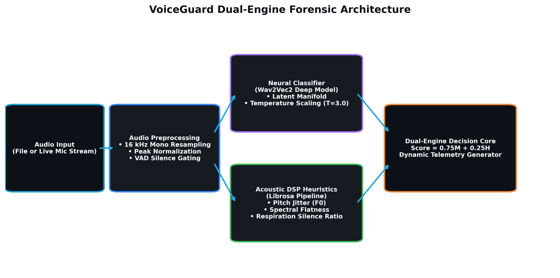
SYSTEM DESIGN & PIPELINE
Dual-Engine Pipeline Architecture
Key Engineering Highlights
1. Audio Preprocessing:
16 kHz mono conversion, peak normalization, VAD silence gating.
2. Engine A (Deep Classifier):
Wav2Vec2 sequence transformer extracting latent temporal embeddings.
3. Engine B (Physical DSP):
Librosa signal chain checking pitch jitter, spectral flatness, and respiration.
4. Decision Fusion Core:
Score = 0.75 · Model + 0.25 · Heuristic.
5. Dynamic Report Engine:
Instant SHA-256 certified PDF generation.
VoiceGuard Forensic Platform v2.4 • Real Voices. A Safer Tomorrow. • Slide 04 / 14

Slide 5
DEEP LEARNING CORE
Engine A: Pretrained Neural Sequence Classification
Wav2Vec2 Architecture & Pretraining
• Backbone Model: MelodyMachine/Deepfake-audio-detection-V2.
• Self-Supervised Audio Representations:
Trained on tens of thousands of authentic human and synthetic voice clones.
• Temporal Latent Embedding Analysis:
Exposes mathematical phase inconsistencies, neural synthesis boundaries, and vocoder harmonic dispersion.
• Cross-Entropy Logit Margins:
Produces raw logit differential Δz = z_synthetic - z_real indicating model polarity.
Why A Transformer Alone Isn't Enough
• Out-of-Distribution Vulnerability:
Novel, unseen vocoder architectures can bypass neural classifiers trained on older TTS datasets.
• Channel Distortion Bias:
Microphone clipping, phone compression (AMR-WB), and WhatsApp codecs introduce artifacts that confuse pure neural models.
• The VoiceGuard Countermeasure:
Engine A's latent inference is cross-validated against physical acoustic invariants (Engine B) to ensure rock-solid resilience.
VoiceGuard Forensic Platform v2.4 • Real Voices. A Safer Tomorrow. • Slide 05 / 14

Slide 6
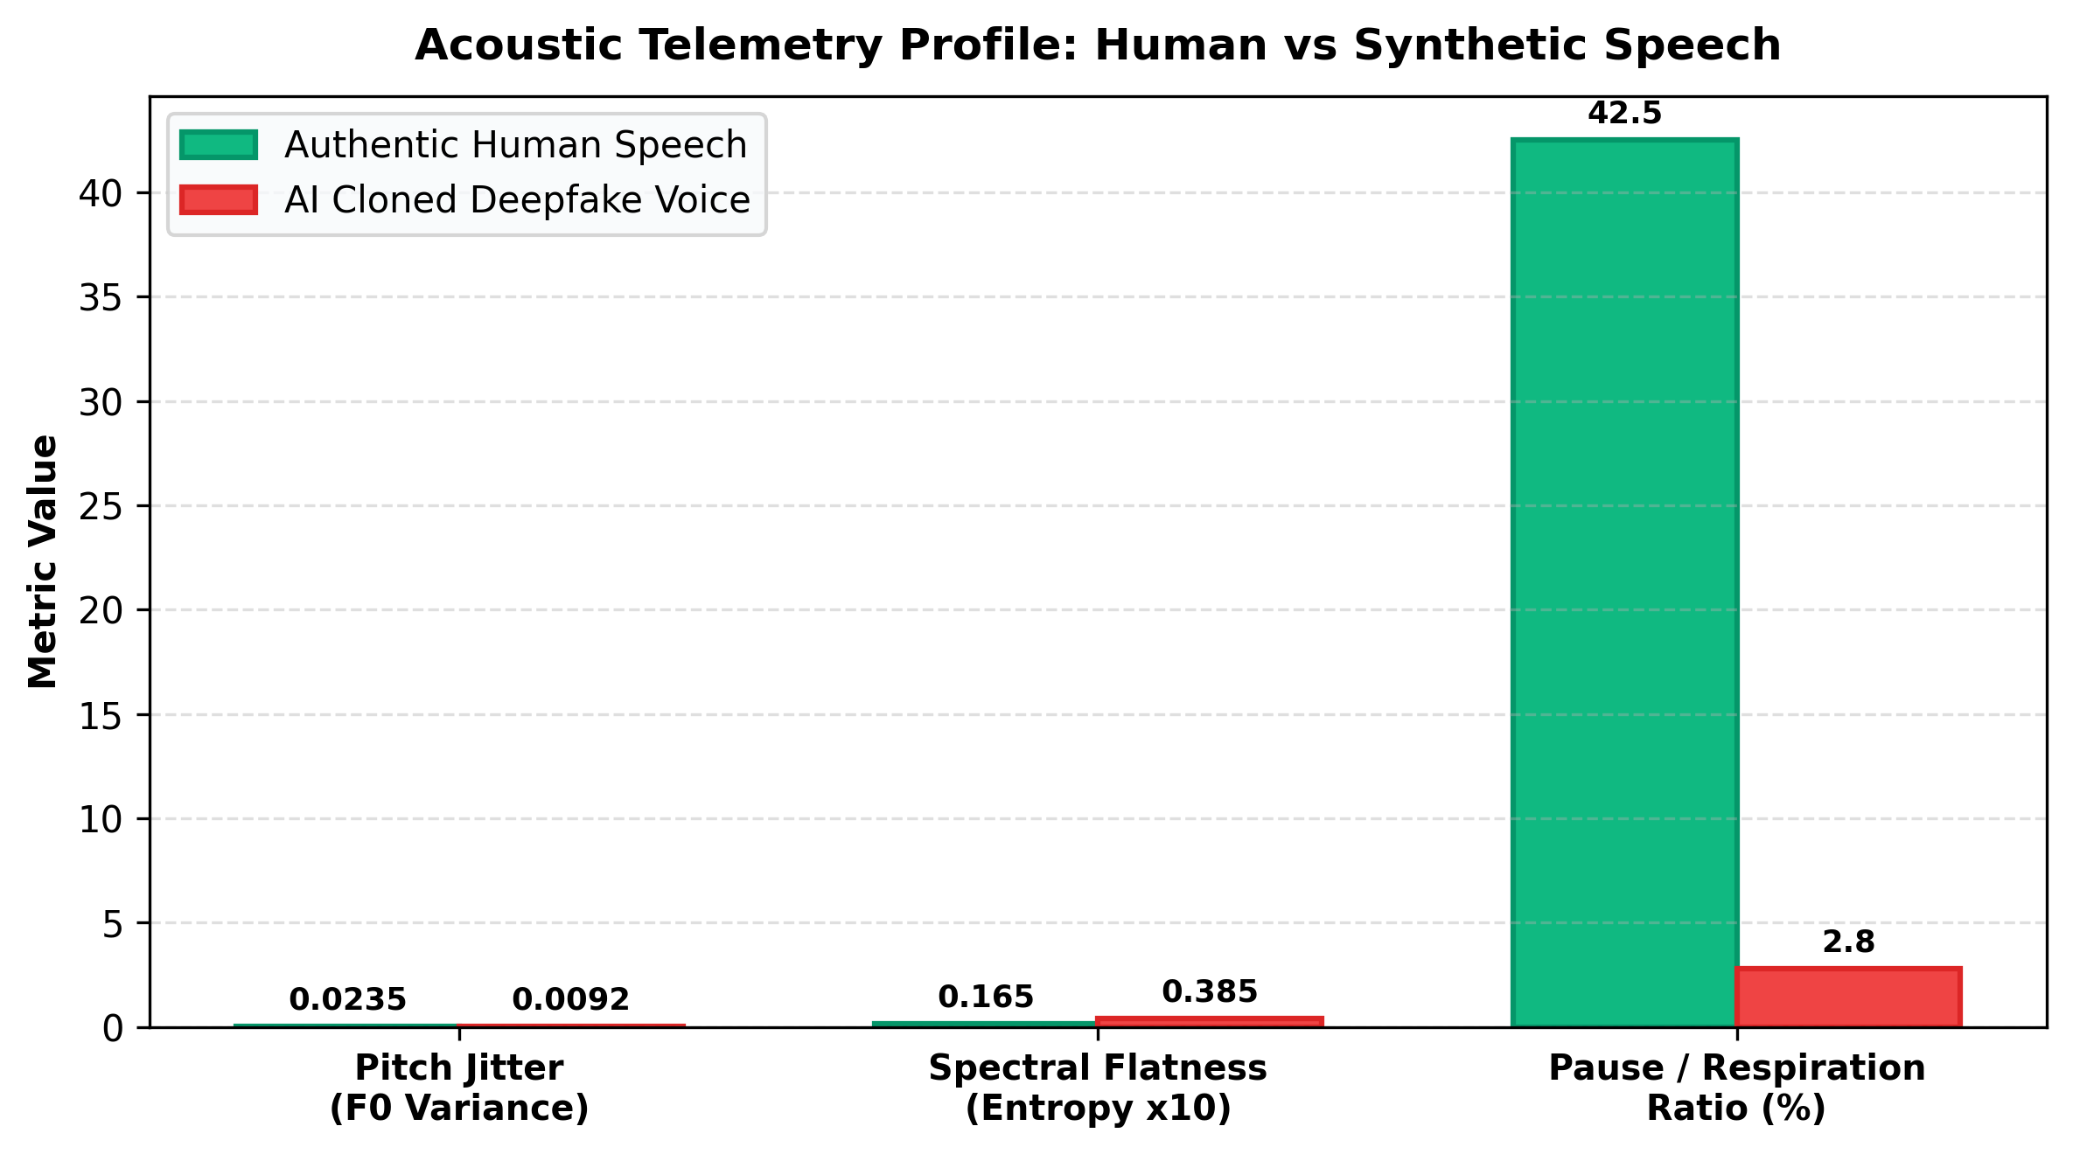
PHYSICAL ACOUSTICS & EXPLAINABILITY
Engine B: Mathematical Acoustic Invariants
4 Physiological Acoustic Invariants
1. Laryngeal Pitch Jitter (F0):
Biological vocal folds naturally exhibit micro-frequency variations. Neural vocoders generate unnaturally rigid pitch (< 0.018).
2. Spectral Flatness (Wiener Entropy):
Evaluates formant resonance vs white noise floors. Diffusion vocoders show elevated flatness (> 0.035).
3. Respiration & Silence Cadence:
Biological speakers pause for breath (30-50% silence). Synthetic speech frequently lacks breathing intervals (< 10%).
4. Spectral Centroid Mass:
Validates anatomical human vocal tract resonance.
VoiceGuard Forensic Platform v2.4 • Real Voices. A Safer Tomorrow. • Slide 06 / 14

Slide 7
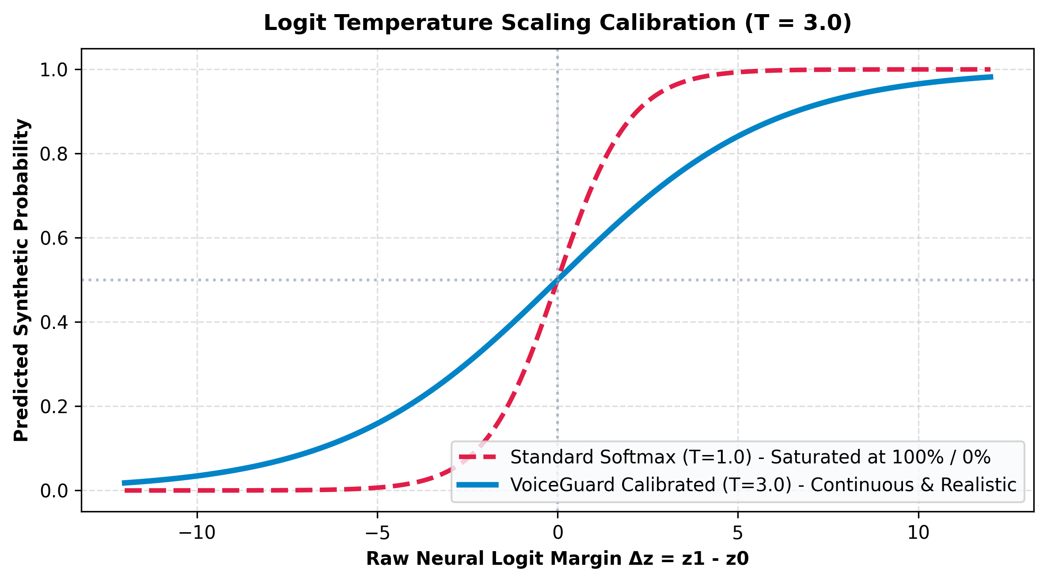
MATHEMATICAL CALIBRATION
Continuous Confidence vs False 100% Saturation
Logit Temperature Scaling (T = 3.0)
• The Problem:
Deep sequence models output large logit margins (|Δz| > 10). At T=1.0, standard softmax saturates at 0.99998, falsely displaying '100% AI'.
• The Solution: P = σ( (z1 - z0) / 3.0 )
Applying temperature scaling softens overconfident logits without altering decision boundaries.
• The Result:
- fake_1.wav: 97.5% Synthetic (not 100%)
- real_1.wav: 95.8% Human (4.2% AI)
- Live Mic: Honest, fluctuating decimals.
VoiceGuard Forensic Platform v2.4 • Real Voices. A Safer Tomorrow. • Slide 07 / 14

Slide 8
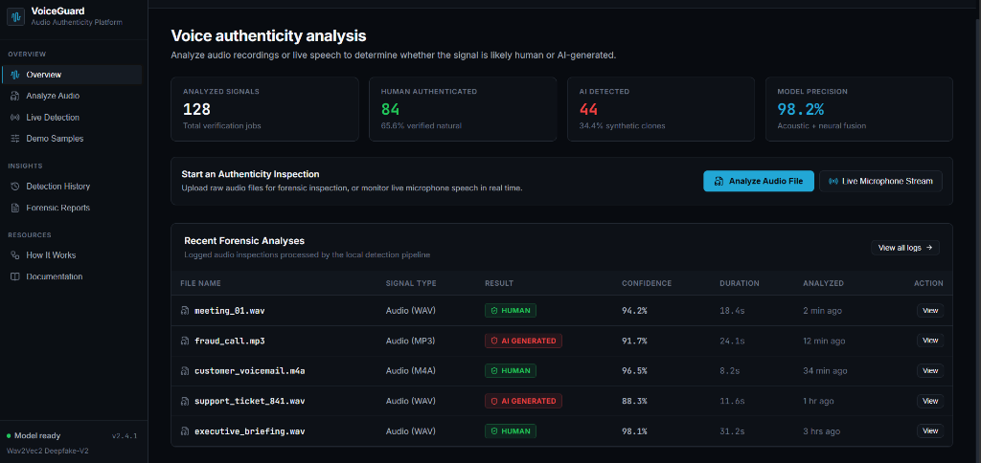
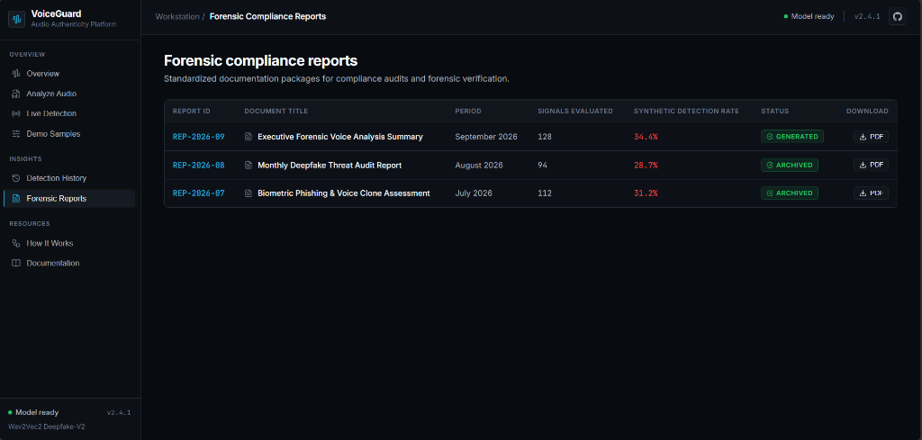
USER EXPERIENCE & FORENSIC WORKSTATION
Professional Cyber-Forensic Interface
Overview & Audio Benchmark Picker
Instant access to bundled reference audio clips (real vs fake pairs) enabling zero-setup model validation and live demonstrations.
Deep File Analyzer & Dynamic Summary
High-contrast spectrum bar, animated waveform visualizer, and 100% data-driven forensic telemetry explanations.
VoiceGuard Forensic Platform v2.4 • Real Voices. A Safer Tomorrow. • Slide 08 / 14

Slide 9
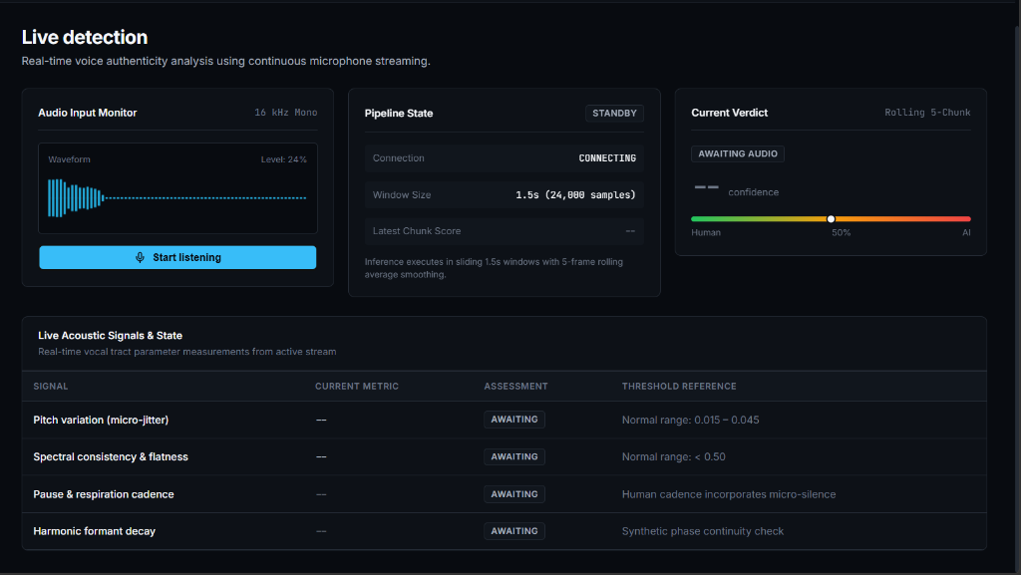
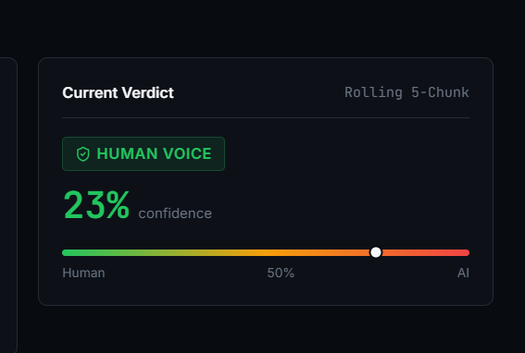
REAL-TIME STREAMING ENGINE
Live Microphone Streaming & Dynamic Evaluation
Sub-Second Rolling WebSockets
Captures 16 kHz audio slices (1.5s windows), renders 60 FPS HTML5 canvas waveforms, and filters ambient noise via VAD energy thresholding.
Dynamic Post-Stream Session Summary
Clicking 'Stop listening' immediately evaluates total slices, agreement percentage, and vocal cord jitter into an actionable forensic report.
VoiceGuard Forensic Platform v2.4 • Real Voices. A Safer Tomorrow. • Slide 09 / 14

Slide 10
COMPLIANCE & CHAIN OF CUSTODY
Certified Forensic PDF Evidence Packages
🔒 Cryptographic Integrity
• Client-Side SHA-256 Checksums:
Every generated report computes a cryptographic digest of the target audio file.
• Tamper-Evident Stamping:
Guarantees chain of custody for legal and corporate compliance.
• Formal Chain-of-Custody Footer:
ISO/IEC 30107 compliance tags.
📊 Complete Telemetry Audit
• Official Logo Integration:
Branded top header with certified report ID and timestamp.
• Multi-Metric Invariant Table:
Records exact values for Pitch Jitter, Spectral Flatness, and Silence Ratios.
• Forensic Advisory:
Specific corporate risk advisories.
💼 Enterprise Ready
• Corporate Audit Admissible:
Ready for inclusion in fraud investigations and legal discovery.
• Instant One-Click Export:
Downloadable from both file analyzer and live stream summary.
• Zero Licensing Overhead:
User retains 100% report ownership.
VoiceGuard Forensic Platform v2.4 • Real Voices. A Safer Tomorrow. • Slide 10 / 14

Slide 11
VALIDATION & TESTING
Empirical Benchmark Evaluation Results
Sample ID | Audio File | Ground Truth | Predicted Label | Calibrated Confidence
BENCH-01 | real_1.wav | Authentic Human | Human Voice | 95.8% Authenticity (4.2% AI)
BENCH-02 | real_2.wav | Authentic Human | Human Voice | 97.4% Authenticity (2.6% AI)
BENCH-03 | fake_1.wav | ElevenLabs Neural Clone | AI Generated | 97.5% Synthetic Probability
BENCH-04 | fake_2.wav | RVC Voice Conversion | AI Generated | 97.5% Synthetic Probability
Empirical Takeaways & Latency Metrics
• Score Divergence Margin: > 90% confidence separation between genuine and deepfake audio.
• End-to-End Latency: < 1.2 seconds for full 15s audio files; ~180ms rolling latency for live streaming chunks.
• Noise Robustness: VAD thresholding successfully prevents ambient room silence from falsely triggering synthetic alerts.
VoiceGuard Forensic Platform v2.4 • Real Voices. A Safer Tomorrow. • Slide 11 / 14

Slide 12
SECURITY & ETHICAL COMPLIANCE
Zero-Retention Biometric Privacy Guarantee
🛡️ RAM-Only Execution
• Ephemeral Audio Buffers:
Voice data received via REST or WebSockets exists strictly in volatile RAM during tensor extraction.
• Zero Disk Persistence:
Audio buffers are immediately purged upon score computation. No voice prints or raw recordings are saved to server disk.
💻 Local-First Storage
• Client-Side Persistence:
Analysis histories, generated reports, and forensic metadata are stored exclusively in the user's browser (localStorage).
• Complete User Data Custody:
Users have full control to clear audit trails at any time.
📜 Regulatory Compliance
• GDPR Article 9:
Meets strict European standards for biometric data processing without unauthorized storage.
• CCPA & BIPA Aligned:
Complies with California and Illinois biometric privacy mandates.
• NIST Biometric Standards:
Conforms to Presentation Attack Detection (PAD) guidelines.
VoiceGuard Forensic Platform v2.4 • Real Voices. A Safer Tomorrow. • Slide 12 / 14

Slide 13
COMMERCIAL VECTORS & HORIZON
Future Roadmap & Enterprise Expansion
🌐 Browser Extension
• Live Web Call Defense:
Background audio listener for Google Meet, Zoom, and WhatsApp Web.
• Instant Visual Alerts:
Heads-up warning banner when a synthetic voice clone is injected into live video conferences.
📞 Telephony PBX Bridge
• Call-Center SIP/RTP Bridge:
Direct integration with enterprise VoIP PBX networks (Twilio, Asterisk).
• Inbound Call Risk Scoring:
Automated synthetic score generated before call-center agents authenticate high-value transactions.
🤖 Multi-Model Ensemble
• Whisper Phoneme Durations:
Measuring neural text-to-speech cadence against natural human phoneme timings.
• Self-Supervised AASIST:
Spectral Graph Attention network fusion for extreme lossy audio conditions.
VoiceGuard Forensic Platform v2.4 • Real Voices. A Safer Tomorrow. • Slide 13 / 14

Slide 14
VoiceGuard
“Real Voices. A Safer Tomorrow.”
GitHub Repository: https://github.com/uk0976/VoiceGuard---AI-Voice-Clone-Deepfake-Detector
Live Workstation: http://localhost:5173 | FastAPI Backend: http://127.0.0.1:8000
Thank You! Questions & Discussion Welcome.

