Slide 1
Real Time Detection of DDoS -Architecture And Implementation
U T KA R S H K A J A R I A
M S D A T A S C I E N C E
U N I V E R S I T Y O F M I N N E S O T A
Notes:
My approach followed by a short demo.

Slide 2
O U T L I N E
Requirements
Technologies
Scalability: Web Servers
Scalability: Use Cases
Analysis
Demo
Takeaway

Slide 3
R E Q U I R E M E N T S
Ingest server log data from HDFS
A tool for putting the ingested data on to a message system
An application that analyzes the logs to identify if IP addresses are part of a DDoS attack
Store the identified IP addresses for possible downstream processing
Workflow latency of 1-2 minutes

Slide 4
T H I N K I N G A B O U T T E C H N O L O G I E S
Kafka
One of it’s kind: broadcast + message queue
High throughput, low latency
Scalable and fault-tolerant
Spark
Versatile: Streaming, ML (in addition to SQL and graph)
Integrates well with Hadoop
Used extensively hence good support with in the development community
Spark-streaming-kafka, a spark library
Notes:
As I started to research about Kafka, I realized that it is an amazingly powerful platform. We are talking about 2m writes/sec and end-to-end latency of 2ms.
Multiple consumer groups can be subscribed to the same topics thereby giving us broadcast like functionality. At the same time, messages with a consumer group can be divided between multiple consumers such as each group gets message exactly once, like a message queue system.
So then I decided I would write a Java class that will receive inputs in small windows, parse them to identify ip adresses and relevant info. Except then I realized I need that the time constraint would demand operations to happen in parallel otherwise the processing would be a huge bottleneck. Also it would not have been wise to write bulky code when there are abstraction available which brings me to Spark. I had prior familiarity with the framework which made it easier to think in terms of what operations will I need to perform in the processing phase. More on that later.
Next step was obviously to find a way to make these frameworks talk to each other.
Next step was to separate the steps involved and put think about them in context of Kafka abstractions.

Slide 5
P R O D U C E R S A N D C O N S U M E R S
Producer
Reads from HDFS
Creates a Kafka topic, if it does not exist
Puts the messages on the topic
Polls for new files and repeats
Consumer
Streaming application
Subscribed to a topic
Analyzes and extracts bad IPs
Stores the result in HDFS
Notes:
The next step was to understand all the terminologies associated with Kafka and more importantly put things into context of the given problem and quickly realized what my producer and consumers were going to be.
I began evaluating how many producers, consumers, brokers etc would be needed for this project:

Slide 6
T H I N K I N G A B O U T S C A L I N G : S E R V E R S
 | S I N G L E T O P I C | N E W T O P I C
S I N G L E P R O D U C E R | Single point of failure Contention for resources between web-servers Consumers cannot selectively consume a server log | Single point of failure Contention of resources between web servers Downstream applications (consumers) need to be restarted with new topic-list, or, new consumer must be started to consume the new topic. Consumers can selectively consume logs from a server
N E W P R O D U C E R | No single point of failure Greater parallelism => Greater throughput. Consumers cannot selectively consume a server log | No single point of failure Greater parallelism => Greater throughput. Downstream applications (consumers) need to be restarted with new topic-list, or, new consumer must be started to consume the new topic. Consumers can selectively consume logs from a server

Slide 7
T H I N K I N G A B O U T S C A L I N G : S E R V E R S
 | S I N G L E T O P I C | N E W T O P I C
S I N G L E P R O D U C E R | Single point of failure Contention for resources between web-servers Consumers cannot selectively consume a server log | Single point of failure Contention of resources between web servers. Downstream applications (consumers) need to be restarted with new topic-list, or, new consumer must be started to consume the new topic. Consumers can selectively consume logs from a server
N E W P R O D U C E R | No single point of failure Greater parallelism => Greater throughput. Consumers cannot selectively consume a server log | No single point of failure Greater parallelism => Greater throughput. Downstream applications (consumers) need to be restarted with new topic-list, or, new consumer must be started to consume the new topic. Consumers can selectively consume logs from a server
Notes:
Cons of a Single producer
-We obviously do not want to stop producing from one of the servers in order to include the new one.
-Also if there is just a single producer, increase in number of servers will make producer a bottleneck. Contention for resources between servers.
-In addition, if the producer goes down, everything stops. Single point of failure.
New Topic:
-We need a new consumer as well because no one is consuming it now. And cannot make existing consumers consume this topic without restarting.
*starting from kafka 0.10.2.0 : client can subscribe to a topic pattern.
-Does not make sense to start new consumers every time we add a new web server to the source. Downstream processes should not get affected.
-Essentially becomes one consumer per server: If that receiver goes down, the messages from that server stop getting processed.
So the most reasonable approach was a multiple producer and single topic corresponding to each use-case.
Cons of a single topic:
-We are not leaving an option for a consumer to consume logs of a particular server. Since we are storing all the server logs on a single topic. We could achieve this by having as many partitions as the number of servers so that logs from each server go to a specific partition and then have the consumer consume from that partition. But then scaling to more servers would mean increasing the number of partitions at runtime.

Slide 8
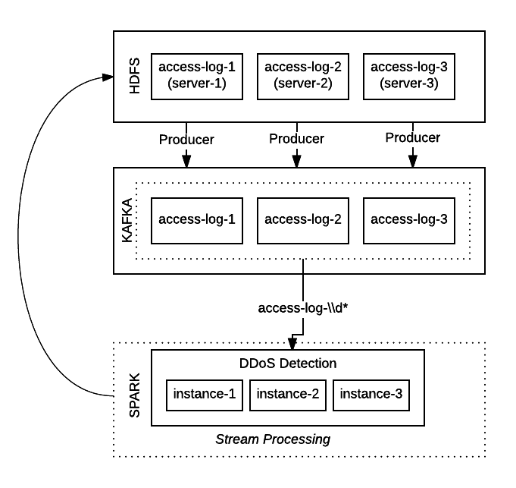
T H I N K I N G A B O U T S C A L I N G : S E R V E R S

Slide 9
T H I N K I N G A B O U T S C A L I N G : U S E C A S E S
Consumer group for each app
Can consume from same topics
Parallel instances in a group: Load balancing
Can be added dynamically
Partition
Distributed evenly over consumer instances
Round robin/hash-key based assignment
Can be added dynamically
Notes:
So new when producers add messages to an existing topic, it is automatically consumed

Slide 10
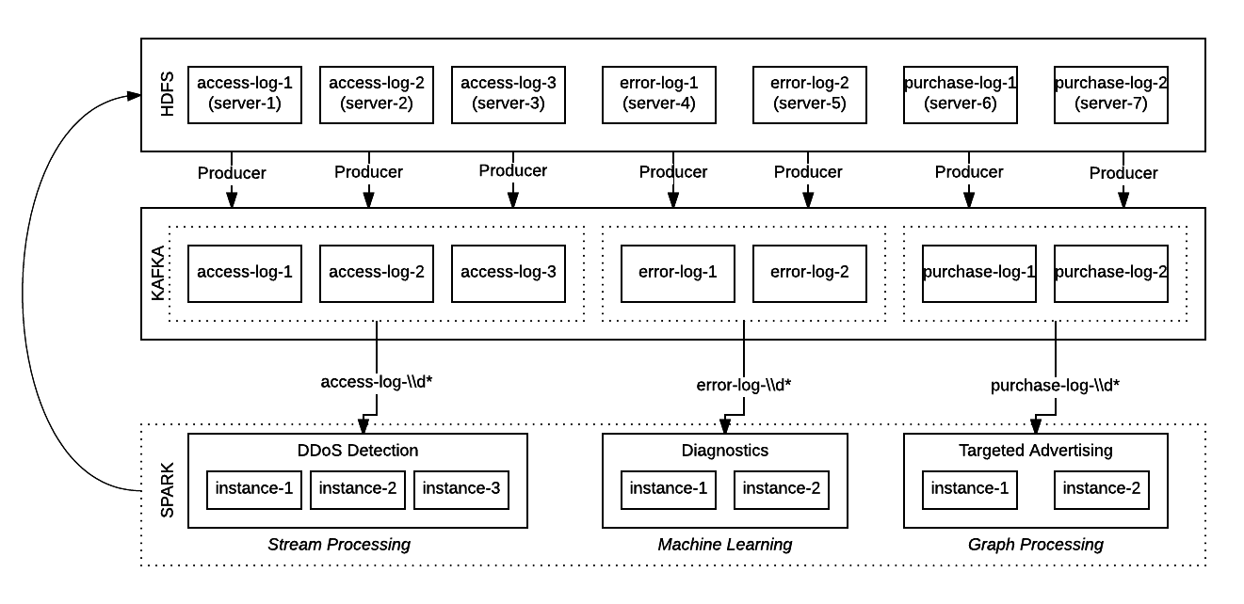
T H I N K I N G A B O U T S C A L I N G : U S E C A S E S
Notes:
The idea behind this architecture is:
A topic for each resource
Topics partitioned over multiple brokers
A consumer group for each use case
Partitions can be replicated across brokers: fault tolerance. But ignored for simplicity
Vision for high level architecture. For implementation I have only implemented a single topic, multi-broker, consumer-group for DDoS detection.

Slide 11
P R O C E S S I N G
Options
Number of requests/IP address in a time window
Bytes of data requested is high
Total requests exceed a threshold
Unusually high Response time for a request or Http response code 503
Classification: legitimate or bot
Anomaly detection using Time Series Analysis
Approach
Trigger: Total requests
Identification: Number of requests/IP address
Notes:
For bytes: We did not have background on the website. Hard to determine a threshold as content can be text, image, video etc.
Classification: We did not have labeled data to train a model. Only requests from attack was available
Anomaly detection: A little complicated and the goal was to keep it simple

Slide 12
Crunching Numbers
Yelp gets 150m requests a month
~ 58 requests/sec
Our measures
A window of 30 sec
~ 1500 requests triggers a job
~ 60 requests by each IP gets recorded
Notes:
A normal person would not be making 2 requests/sec, unless they are holding F5, in which case they should any ways be blocked

Slide 13
D E M O

Slide 14
Takeaways
Getting the dependencies right: ~50% of the work done.
Sticking to an older version without a solid reason is a bad idea
Doing a DDoS attack is actually pretty simple
World won’t be the same without free software
Building Big data pipelines is really cool.
Notes:
in a manner that all libraries work together

Slide 15
References
https://engineering.linkedin.com/kafka/benchmarking-apache-kafka-2-million-writes-second-three-cheap-machines

Slide 16
T H A N K Y O U Q U E S T I O N S ?

