Slide 1
EPICS Training
Scans
Tim Mooney
2/27/2015

Slide 2
The synApps SSCAN module
Where is it?
  http://www.aps.anl.gov/bcda/synApps/sscan/sscan.html
What’s in it?
  Code
    the sscan record
    the recDynLink library
    the saveData data-storage client
    the scanparm record
  EPICS databases
    scan databases
    scanParms and alignParms databases
  MEDM displays
    scan*.adl
    scan*_help.adl

Slide 3
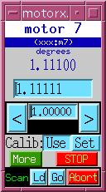
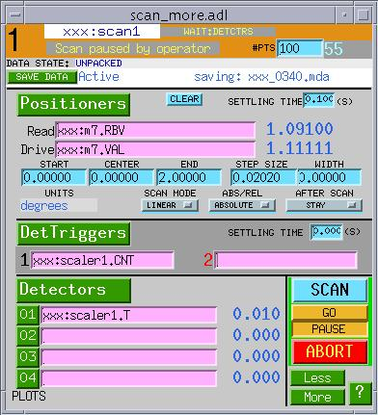
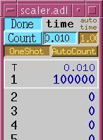
Simple scans
A one-dimensional scan:
  Do NPTS times:
    Set conditions e.g., move motors; wait for completion
    Trigger detectors e.g., start scaler; wait for completion
    Acquire data read detector signals; store in arrays
  Write data to disk

Slide 4
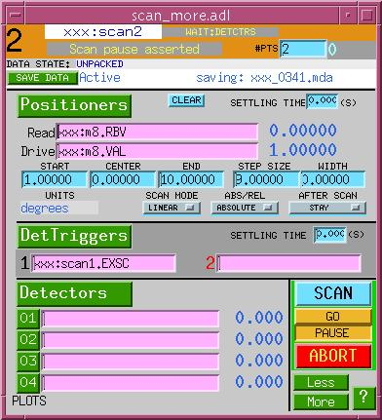
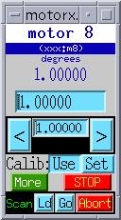
...Simple scans
Multidimensional scan:
  Outer-loop scan’s detector trigger executes inner-loop scan.
  saveData monitors a set of sscan records, determines scan dimension when scan starts, and writes data as it is acquired.
  No limit to the number of scan dimensions.
outer-loop scan
inner-loop scan

Slide 5
Scan features
0-4 positioners, 0-4 detector triggers, 0-70 detector signals
  Positioner and readback values are of type double
  Detector values are of type float
Acquisition from scalar and/or array PV's
  Array PV’s acquire .NPTS elements
Number of data points limited only by IOC memory
  Standard max. is 2000 (x_{i},y_{i}) points per scan dimension
  Can increase to ~ EPICS_CA_MAX_ARRAY_BYTES / 8
Detector/client wait, data-storage wait
  Can wait for multiple data-acquisition clients
  Only one data-storage client
Pause/resume, abort
  Data from aborted scans are written to disk
Double buffered: writes 1D acquired data after the scan is finished
  Can write during next 1D scan

Slide 6
…Scan features
saveData writes XDR-format (“.mda") files to disk.
  Files can be read on any type of computer
A positioner can have private scan parameters (scanparm record).
  Load preset scan parameters with one mouse click
  Useful for alignment
After-scan actions include move to peak, valley, +/-edge.
  Can, e.g., track a moving peak through a series of scans
scanparm record + after-scan action = automated 1-D alignment.

Slide 7
Scan implementation
The sscan record is a channel-access client
  scanned PV’s can be hosted by any ioc
  uses recDynLink library to manage connections with PV’s
  uses ca_put_callback() to set conditions, trigger detectors, and await completion
  uses ca_get_callback() before acquiring data
saveData is a channel-access client
  monitors sscan records and user-specified PVs
  saveData can make the sscan record wait until data are written
Scan acquisition/storage can run on vxWorks, Linux, or Windows.
The sscan record can be driven by any channel-access client.
  manual operation, via MEDM, is one option
  often driven by spec and python code
  can simplify user-written scan-control software

Slide 8
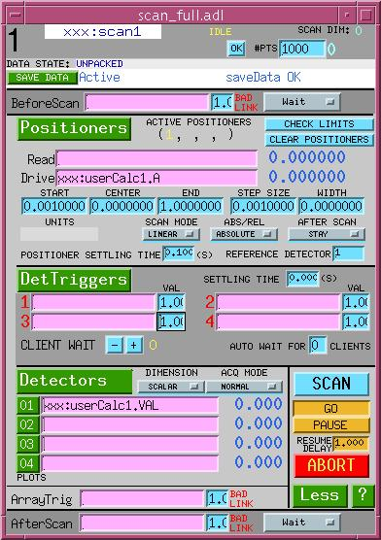
Before-scan / after-scan links
Can write a constant value to any numeric or menu PV before the scan starts and/or after the scan ends.
Can wait or not wait for completion of processing started by the write.
If this sscan record is part of a multidimensional scan, links function on each iteration.
Outer-loop sscan record can write to these links, and to the values they write.
These links can write to their own sscan record’s START, END, etc. fields, but not to its link fields.

Slide 9
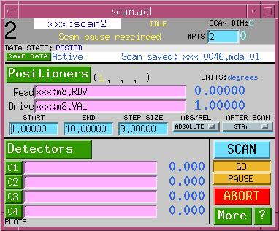
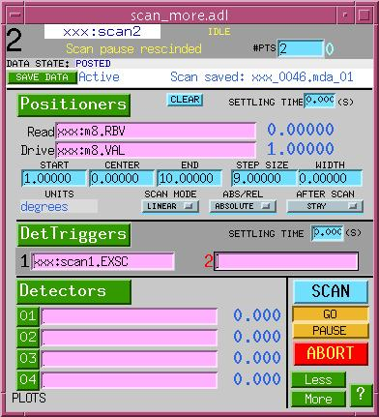
MEDM user interface

Slide 10
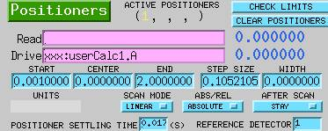
Positioner options
SCAN MODE (.PnSM - per positioner)
  Determines how and to where positioner moves
Absolute/Relative (.PnAR - per positioner)
  Determines how positioner locations are written
Positioner delay (.PDLY - affects all positioners)
  Delay while positioners are settling, after completing their moves
After-scan motion (.PASM - affects all positioners)
  Determines what, if anything, is done with positioners when scan is finished

Slide 11
...Positioner options
SCAN MODE (.PnSM - per positioner)
  LINEAR – Evenly spaced positions are calculated algorithmically
    You specify positioner locations by setting any three of
START | CENTER | END | WIDTH | STEP SIZE | # POINTS
.PnSP | .PnCP | .PnEP | .PnWD | .PnSI | .NPTS
    The sscan record reconciles unset parameters
  TABLE – Positioner locations are contained in the .PnPA array
    The array must contain at least .NPTS values
    You must arrange for the array to contain the desired positions before starting the scan.
    The .PnPA array is never overwritten by the sscan record

Slide 12
...Positioner options
...SCAN MODE (.PnSM - per positioner)
  FLY – data will be acquired while positioner moves
    You specify positions at which data are acquired by setting START, END, positioner speed, and detector acquisition time.
    The following algorithm is executed:
      Positioner sent to START; reports completion
      Detector triggered; reports completion
      First data point acquired
      Positioner sent to END
      NPTS-1 iterations of
        Detector triggered; reports completion
        Data point acquired
    The timing of data points is controlled by the detector’s acquisition time.
    Fly-mode positioners do not report completion. (The positioner may still be moving after the scan ends.)
    Note: timing of readback from a fly-mode positioner is inexact

Slide 13
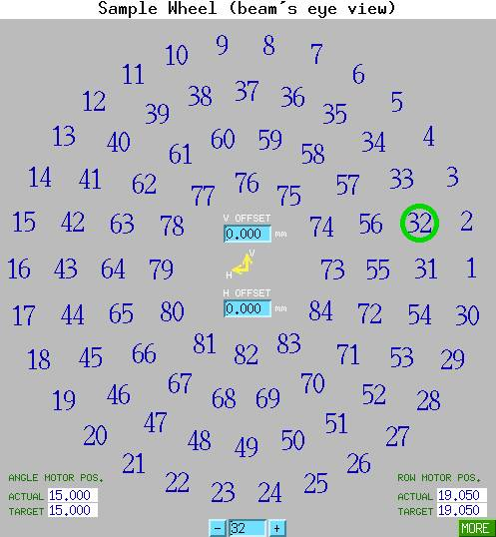
...Positioner options
...SCAN MODE (.PnSM - per positioner)
  OK to mix scan modes:
1
2
3
5
7
4
6
8
9
P1 (linear)
1
2
3
4
5
6
7
8
P2 (table)
9
  Don’t be limited by existing positioner modes
    A positioner is anything you can write to
    Can specify positions algorithmically, using calcout or transform
      E.g., sample-wheel
    Can write to positioner through interpolation table
      Use a spare positioner readback to get actual positions into the data file

Slide 14
...Positioner options
Absolute/Relative (.PnAR - per positioner)
  If .PnAR == “ABSOLUTE” (0), positions are sent exactly as given.
  If .PnAR == “RELATIVE” (1), positions are added to pre-scan position before being sent to positioner.
Settling time (.PDLY - affects all positioners)
  If any positioner PV is specified, then after all positioners report completion, the sscan record waits for .PDLY seconds before moving to next phase of sscan.
    Useful for positioners that “ring” after move is completed
    Useful work-around for positioners that cannot report completion
  If no positioners, then settling time is ignored.
  Settling time is adjusted to nearest multiple of system-clock period (typically 1/60Hz).

Slide 15
...Positioner options
After-scan motion (.PASM - affects all positioners)
  STAY – positioners are simply left where they ended up
  START POS – positioners are sent to their START positions
  PRIOR POS – positioners are sent to their pre-scan positions
  PEAK POS – data from the reference detector (number given by the .REFD field, in range [1..70]) is examined. If a peak is found, positioners are sent to where it was acquired.
  VALLEY POS – similar, but valley instead of peak
  +EDGE POS – peak of derivative of reference data
  -EDGE POS – valley of derivative of reference data
  CNTR OF MASS – center of mass: Σx(i)y(i)Δx(i) / Σy(i)Δx(i). If more than one positioner is active, data from the lowest numbered active positioner will be used in the calculation. The result will, nevertheless, be applied to all active positioners.

Slide 16

Detector triggers
0-4 detector triggers (.TnPV), intended to start data-acquisition
Similar to positioners, but value sent (.TnCD) is constant
Triggers execute after all positioners have completed, and after any positioner settling time has elapsed.
Detector settling time begins after all detector triggers have reported completion.
If no triggers, then settling time is ignored.

Slide 17
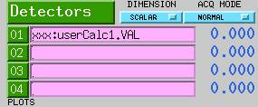
Detectors
PV’s to be acquired during scan
0-70 detectors (.D01PV - .D70PV)
Detector options
  Acquisition type (.ACQT)
    SCALAR
      scalar PV’s acquired at each positioner location
      Array PV’s (.NPTS elements) acquired at end of scan
    1D ARRAY
      use this mode only if ALL detectors are array valued
      Positioners are only sent to their START positions.
      In the future, array-valued positioners may be supported.
  Acquisition mode (.ACQM)
    NORMAL – store values as acquired
    ACCUMULATE – add detector values, starting with next scan
    ADD TO PREV – same, but starting with previous scan

Slide 18
Client wait
After all detector triggers have reported completion, and before acquiring data, the sscan record checks for client waits.
Clients can hold scan at this point by writing ‘1’ to .WAIT (this increments the wait-count field, .WCNT)
Several clients can use this field
When all clients have written ‘0’ to .WAIT, scan acquires data.
If clients are too slow to write to .WAIT, scan can set .WCNT for them, to the value .AWCT.
Scan will pause until .AWCT clients have written ‘0’ to .WAIT.
‘Client’ includes user, via MEDM

Slide 19
Array trigger/wait
After all data points have been acquired, scan can trigger software that prepares array PVs for acquisition (e.g., read from hardware).
When array trigger declares completion, array PVs are acquired.

Slide 20
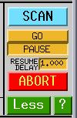
Scan controls
SCAN
  Writing ‘1’ starts this sscan record
  Writing ‘0’ stops this sscan record. (But with the supplied database, always use the ‘ABORT’ button to stop.)
GO/PAUSE
  Pause is immediate, Go occurs after delay
ABORT
  Writes ‘1’ to ‘xxx:allstop.VAL’, which should stop motors
  Sends “stop” message to all sscan records in the supplied database
    First ‘Abort’ attempt ends scan after outstanding completion callbacks have come in, and data-storage client has released the previous scan’s data arrays.
    Second ‘Abort’ attempt waits only for data-storage client.
    Third successive ‘Abort’ attempt kills scan with no regard for consequences.

Slide 21
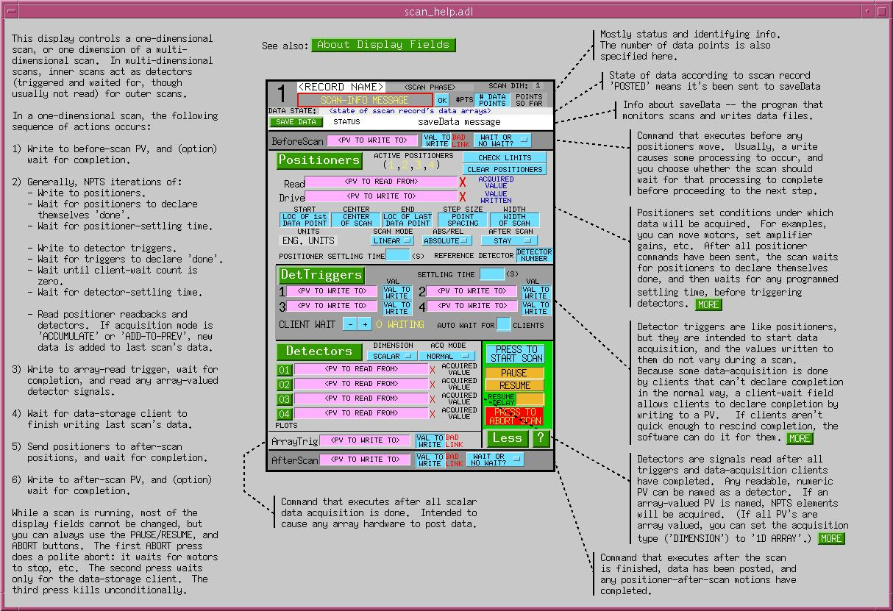
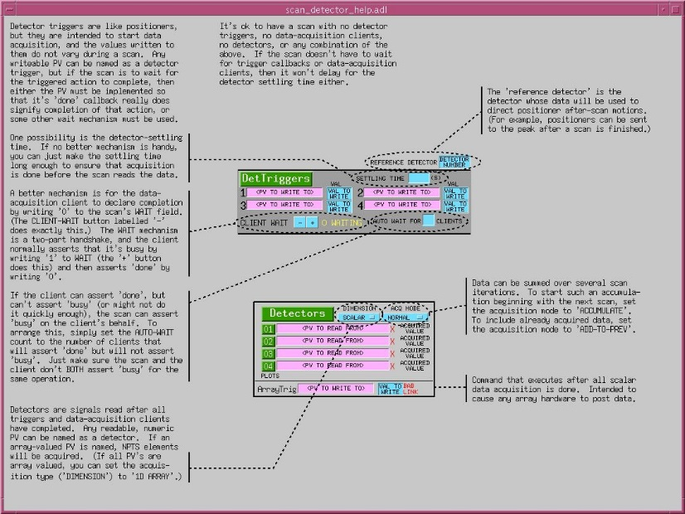
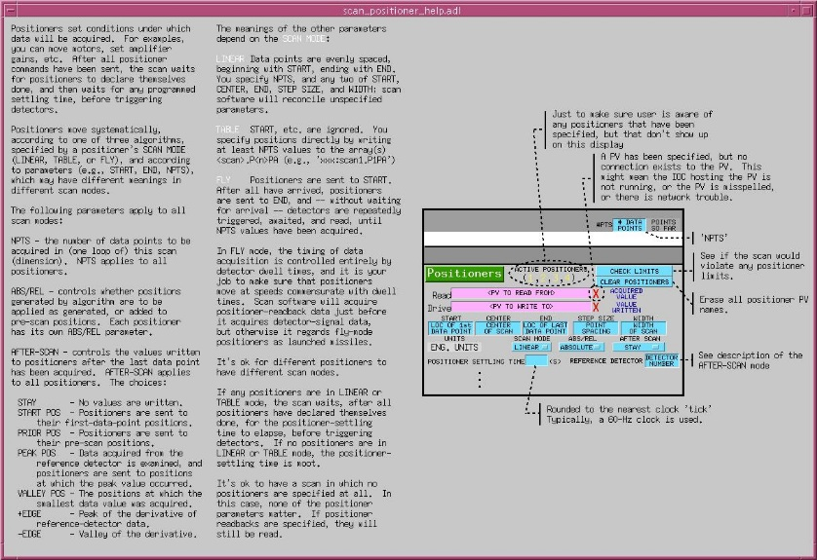
Scan user documentation
MEDM
displays

Slide 22
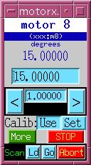

One-click scans
The scanparm record executes preprogrammed linear scans
  Holds scan parameters for a positioner
  Writes parameters to a particular sscan record
  Optionally executes the sscan record
  Useful for alignment

Slide 23
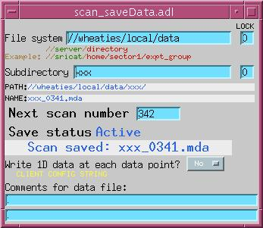
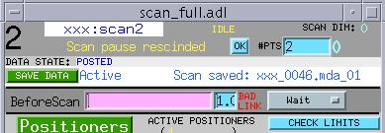
Data storage
saveData monitors sscan records and writes their data to numbered files.
Handshake permits pipelined operation.
saveData’s boot-time init can specify list of PV’s to write with every scan’s data
saveData writes “MDA” files
  MultiDimensional Archive
  Binary, cross-platform (XDR) format
  Format is optimized for run-time access.
  Format permits file to be closed after each set of writes.
Automatic file numbering
  e.g., ‘xxx_0123.mda’, ‘xxx_0124.mda’
  overlap is handled: ‘xxx_0123.mda_01’

Slide 24
...Data storage
Location of data files
  ‘File system’ + ‘subdirectory’
  vxWorks:
    File system is NFS-mount point
    ‘//<hostname>’ is required
  Linux, Solaris:
    saveData doesn’t mount the file system (system administrator does this)
    ‘//<hostname>’, if present, is ignored
Cannot write to ‘File system’ or ‘subdirectory’ while a scan is in progress. (See ‘LOCK’ PV.)
Don’t delete or rename the directory saveData is writing to.
Comment PV’s saved only if they are named in saveData.req

Slide 25
saveData.req init file
[prefix]
$(P)
[status]
$(P)saveData_status
...
[scanRecord]
$(P)scanH
$(P)scan1
$(P)scan2
$(P)scan3
$(P)scan4
[extraPV]
#<PV name> <description>
$(P)scaler1.TP “scaler preset (s)”
$(P)scaler1.NM1 “scaler chan 1 desc”
...
Section head
List of sscan records to monitor
List of PV’s to be saved with
every scan (Normally, this is the
only section you modify.)
Description
  If not supplied, .DESC field is used

Slide 26
MDA file format
Header
format version
scan number
scan dimension
(dim1,dim2,...)
is regular scan
pointer to extra
MDA FILE
header
scans
extra
PV
name
description
type
count
units
value
Extra
# extra PV’s
PV
PV
...

Slide 27
...MDA file format
scan head
scan rank
npts
actual pts
array of npts pointers to rank-1 scans (if any)
scan name
time stamp
# positioners
# detectors
# triggers
Scan
scan head
positioner 1
...
detector 1
...
trigger 1
...
data
MDA FILE
header
scan
(scan)
(scan)
extra
Scan
scan head
positioners
detectors
triggers
data
Scan
scan head
positioners
detectors
triggers
data
Scan
scan head
positioners
detectors
triggers
data

Slide 28
...MDA file format
positioner
number
name
description
scan mode
units
readback name
readback desc.
readback units
Scan
scan head
positioner
...
detector
...
trigger
...
data
MDA FILE
header
scan
extra
detector
number
name
description
units
trigger
number
name
command

Slide 29
...MDA file format
Scan
scan head
positioner 1
...
detector 1
...
trigger 1
...
data
MDA FILE
header
scan
extra
data
positioner 1 array
...
detector 1 array
...

Slide 30
Other data-acquisition-related software
Data-visualization tools for use with synApps
  scanSee
  mdaExplorer
  dview
  sview
areaDetector
  Allows any EPICS CA client to drive data acquisition.
  Support ca_put_callback(), as needed by the sscan record.
software to read, manipulate .mda files
  mda.py
  mdautils

Slide 31
Completion reporting
Simple prescription for databases contained within a single ioc:
  Use only PP links and forward links in execution chain.
Database operations spanning more than one ioc:
  Use records with put_callback links to span iocs:
    calcout with asynchronous device support
    sscan, swait (i.e., a synApps “userCalc”)
    sseq or sCalcout (with .WAIT* = “Wait”)
Cases in which a CA client performs part of the operation:
  Database sets a busy record via PP or put_callback link.
  CA client clears the busy record when operation is done.
Cases in which part of the operation is driven by a CP link:
  - Not different from above; a CP link is a CA client

Slide 32
...Completion reporting
Use only PP links and forward links in execution chain.
PUT_CALLBACK LINK
“BUSY”
PP LINK
“DONE”
SCAN

Slide 33
…Completion reporting
Same as before, but with an asynchronous record
PUT_CALLBACK LINK
“BUSY”
PP LINK
“DONE”
SCAN
AS

Slide 34
…Completion reporting
Premature “DONE” report, because CA-link execution is not traced
PUT_CALLBACK LINK
“BUSY”
PP LINK
“DONE”
CA LINK
SCAN

Slide 35
…Completion reporting
Premature-DONE problem fixed with a PUT_CALLBACK link
PUT_CALLBACK LINK
“BUSY”
PP LINK
“DONE”
SCAN

Slide 36
…Completion reporting
Premature “DONE” because CA-client processing is not traced
PUT_CALLBACK LINK
“BUSY”
PP LINK
“DONE”
CA PUT
CA MONITOR
CA CLIENT
SCAN

Slide 37
…Completion reporting
Premature “DONE” problem fixed with a ‘BUSY’ record
PUT_CALLBACK LINK
“BUSY”
PP LINK
“DONE”
CA PUT
CA MONITOR
CA CLIENT
SCAN
BUSY

Slide 38
…Completion reporting

