Slide 1
DRDO PROBLEM STATEMENT SIH26054 • TEAM ORIENTATION
MALE UAV Aero Piston Engine Digital Twin
Cyber-Physical Thermodynamic Modeling, PyTorch BiLSTM Prognostics & Tactical Ground Control Station
Target Platform: DRDO TAPAS-BH-201 (Rustom-II) | Powerplant: Rotax 914 Turbo (4-Cylinder DOHC)
Notes:
TEAM ONBOARDING OPENING:
Team, this is Project AeroTwin for DRDO Problem Statement SIH26054. India's military surveillance UAV (TAPAS-BH-201) relies on a turbocharged aero-piston engine. Our mission is to prevent in-flight engine failures using real-time physics residual tracking and deep learning prognostics.

Slide 2
MISSION BACKGROUND & CONTEXT
Why Traditional Aircraft Monitoring Fails in MALE UAVs
TRADITIONAL SCADA THRESHOLDS (FLAWED)
• Static Redlines: Triggers alarms only when a fixed value is crossed (e.g. CHT > 135°C), ignoring flight context.
• False Alarms during Climb: Aggressive takeoff/climb at 100% throttle naturally drives temperatures up, triggering false mission aborts.
• Zero Lead Time on Incipient Faults: By the time low-power cruise crossings occur, the cylinder head is warped or bearings are welded shut.
• No Actionable Directives: Simply beeps at the pilot without calculating life extension or emergency glide envelopes.
OUR PHYSICS-INFORMED DIGITAL TWIN
• Synchronized 1D Physics Baseline: Real-time mathematical Otto cycle calculates theoretical expected values dynamically based on throttle and altitude.
• Physics Residual Tracking (Δ): Computes Delta = Sensor - Expected. Filters out normal climb transients and isolates true mechanical leaks.
• BiLSTM Neural Prognostics: Predicts Remaining Useful Life (RUL) in minutes and classifies specific failure modes before physical limits are breached.
• Autonomous Tactical Advisory: Calculates exact life extension (e.g. +45 mins) and outputs Flight Control System directives (de-rate throttle, RTB glide).

Slide 3
ARCHITECTURE & PIPELINE
Full-Stack End-to-End Monorepo Architecture
1. Physics Simulator
backend/simulator.py
▪ 100ms Euler integration step (10Hz loop)
▪ Rotax 914 Turbocharged 4-cylinder engine
▪ Outputs: RPM, MAP, CHT 1-4, EGT 1-4, Oil P/T, Vib
▪ Stateful fault triggers (Coolant, Oil, Misfire)
2. Digital Twin Engine
backend/digital_twin.py & advisory.py
▪ 1D First-principles Otto baseline
▪ Multi-sensor residual analyzer (Δ)
▪ PyTorch 2-layer BiLSTM model (RUL)
▪ Autonomous Advisory & Life Extension
3. Tactical GCS UI
frontend/src/ (Next.js 15)
▪ 5Hz bi-directional WebSocket client
▪ Recharts multi-stream rolling graphs
▪ 4-Cylinder thermal schematics & spreads
▪ Interactive fault injection & throttle deck

Slide 4
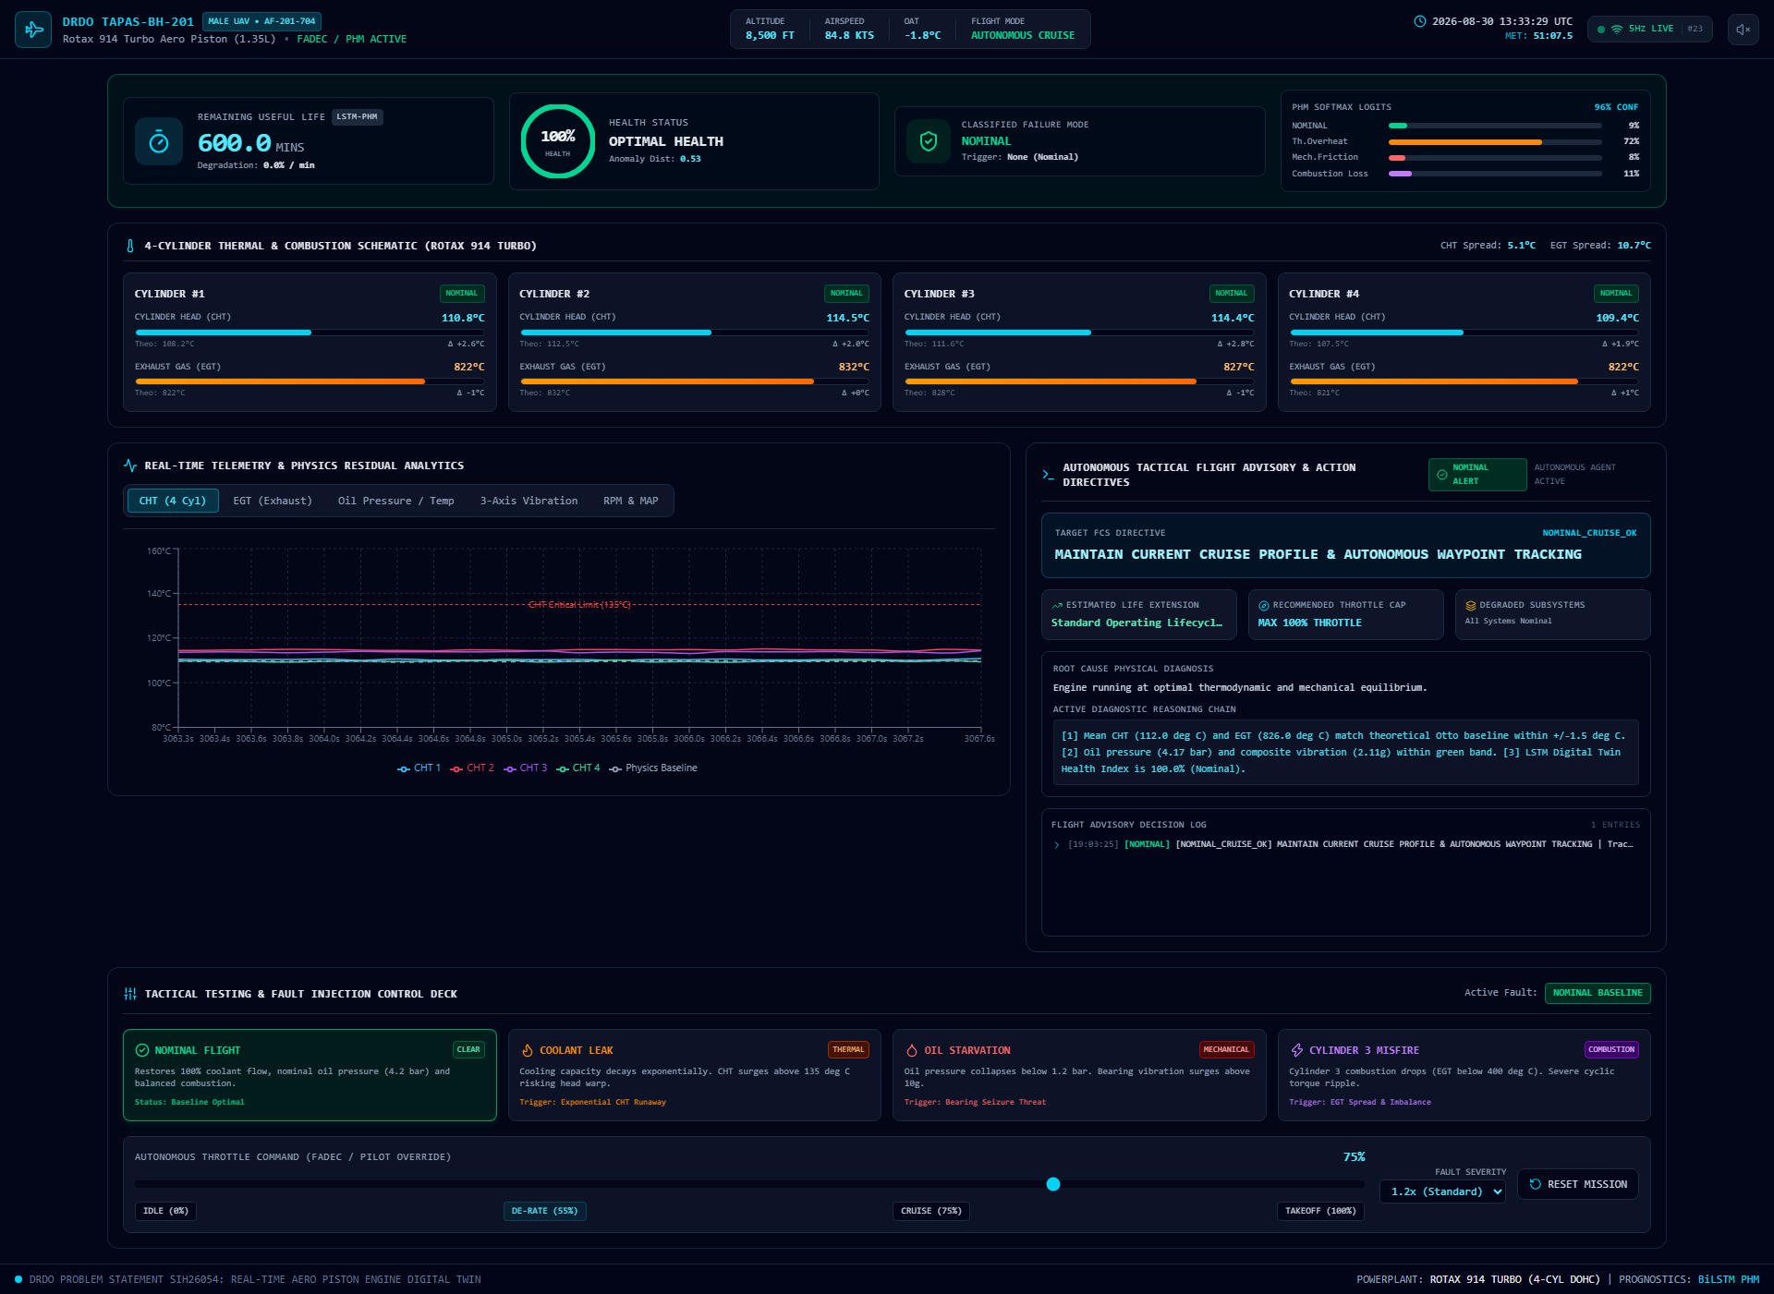
GROUND CONTROL STATION UI
Tactical GCS Interface & Real-Time Modules
CORE DASHBOARD MODULES
• Header HUD: Drone ID, Altitude, Airspeed, OAT, Flight Mode, UTC Clock, 5Hz Live Stream.
• Health & RUL Banner: Digital RUL countdown (mins), radial Health Gauge (0-100%), and PHM logits.
• 4-Cylinder Thermal Grid: Individual CHT/EGT progress bars with theoretical baseline deltas (ΔTheo).
• Recharts Analytics: 5 tabbed live rolling line graphs (CHT, EGT, Lubrication, Vibration, RPM/MAP).
• Advisory Terminal: Action Directives, Life Extension gains, and root-cause diagnostic trace log.
• Fault Testing Deck: 4 fault trigger cards, throttle slider (0-100%), and mission reset.

Slide 5
DEMONSTRATION SCENARIOS
In-Flight Fault Scenarios & Throttle Dynamics
🟢 NOMINAL BASELINE
Optimal stoichiometric combustion. CHT ~100°C, Oil P 4.2 bar, Vib 2.1g, RUL 600 mins. Directive: MAINTAIN CRUISE PROFILE.
🔴 COOLANT LEAK
Convective cooling decays exponentially. CHT surges past 135°C on Cyl 2 & 3. Directive: DE-RATE THROTTLE TO 55% FOR RAM AIR COOLING (+35m life).
🟠 OIL STARVATION
Loss of hydrodynamic film. Oil P drops <1.2 bar, bearing vibration surges to >13g. RUL collapses to 1.0 min. Directive: IMMEDIATE EMERGENCY RTB.
🟡 CYLINDER 3 MISFIRE
Ignition/injector failure on Cyl 3. EGT drops <400°C, EGT spread widens >350°C causing cyclic torque ripple. Directive: DUAL-CHANNEL IGNITION RESET.

Slide 6
HACKATHON STRATEGY
Team Demonstration Flow & Speaker Roles
THE 90-SECOND WINNING DEMO STRUCTURE
▶ Step 1 (0:00 - 0:25) - The Hook & Context
Introduce DRDO Problem Statement SIH26054, the TAPAS MALE UAV airframe, and why static redlines fail.
▶ Step 2 (0:25 - 0:50) - Live Nominal Flight
Show the live dashboard updating at 5Hz. Point out the 4-cylinder thermal schematic matching 1D Otto baseline.
▶ Step 3 (0:50 - 1:20) - The Fault Injection Trigger
Click 'OIL STARVATION'. Watch oil pressure collapse, vibration surge to 14g, and RUL plummet to 1.0 min.
▶ Step 4 (1:20 - 1:45) - The AI Advisory in Action
Highlight the Action Directive ('EMERGENCY RTB: GLIDE DESCENT') and the transparent diagnostic reasoning trace.
▶ Step 5 (1:45 - 2:00) - Recovery & Conclusion
Click 'NOMINAL FLIGHT' to show closed-loop recovery. Open the floor for jury Q&A with total confidence.

