Slide 1


Enabling TinyML Inference on Resource Constraint Edge Devices
Uttej Kallakuri (ukalla1@umbc.edu)
Energy Efficient and High Performance Systems Lab
Department of Computer Science and Electrical Engineering
University of Maryland Baltimore County

Slide 2
Overview
Intersection between machine learning (deep learning) and edge devices called TinyML.
TinyML enables deployment of small DL models into a tiny edge devices.
Analysis and interpretation of data locally on the devices and acts in real time.
Compress model for resource constrained deployment.
Quantization techniques
Pruning techniques
Led to inventions and is leading to the rapid growth of IoT fields
e.g., smart manufacturing, smart health, autonomous driving, etc.
Thus, it allows for real-time analysis and interpretation of data
massive advantages in terms of latency, privacy, and cost [1,2]
Notes:
Edge device: that has tough resource constraints e.g., limited computation (clock speed about tens of megahertz), small memory (hundreds of KB) and a few milliwatts (mW) of power.
Quantize: which are conversion techniques that convert float-point numbers to minimize precision numbers, intending to shrink the size of the DL model with minimal degradation of accuracy.
Prunning: allow removal of redundant structures of network and parameters [15,16].

Slide 3
The primary goal of TinyML is to improve the adequacy of DL systems
Requiring less computation and less data
This facilitates the giant market of edge AI and the IoT [17].
According to ABI Research, a total of 2.5 billion devices are expected to be shipped with a TinyML chipset by 2030.
Device focus on,
advanced automation
low cost
low latency in transmitting data
and ultra-power-efficient Artificial Intelligence (AI) chipsets.
These chipsets are known as edge AI or embedded AI
they perform AI inference almost fully on the board.
The training phase, for these devices, depends on servers or cloud.
Notes:
ABI: universal tech market advisory company

Slide 4
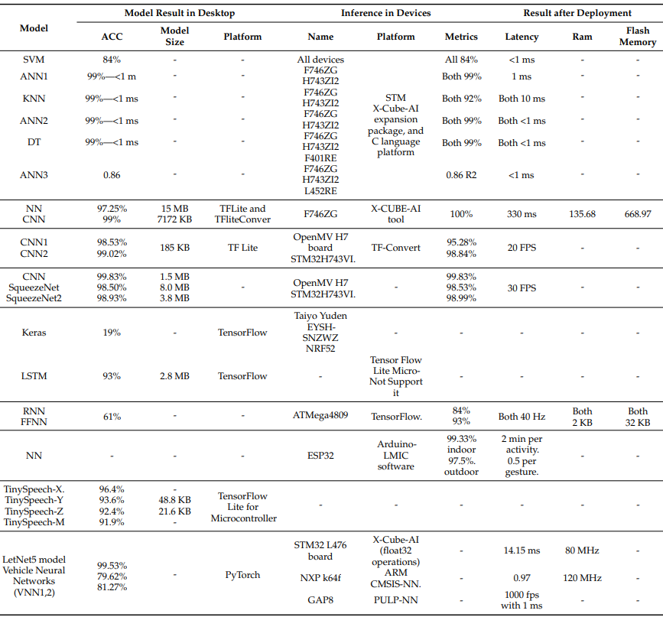
ML Deployment on MCUs
[9]
[10]
[11]
[12]
[13]
[14]
[15]
[16]
[17]
Table source [3]
Notes:
1. Six-Dataset; 2. HandwritRecog; 3. SignLangD; 4. FaceMaskD; 5. GestureR; 6. SpeechR; 7. Autonomous Mini Vech

Slide 5
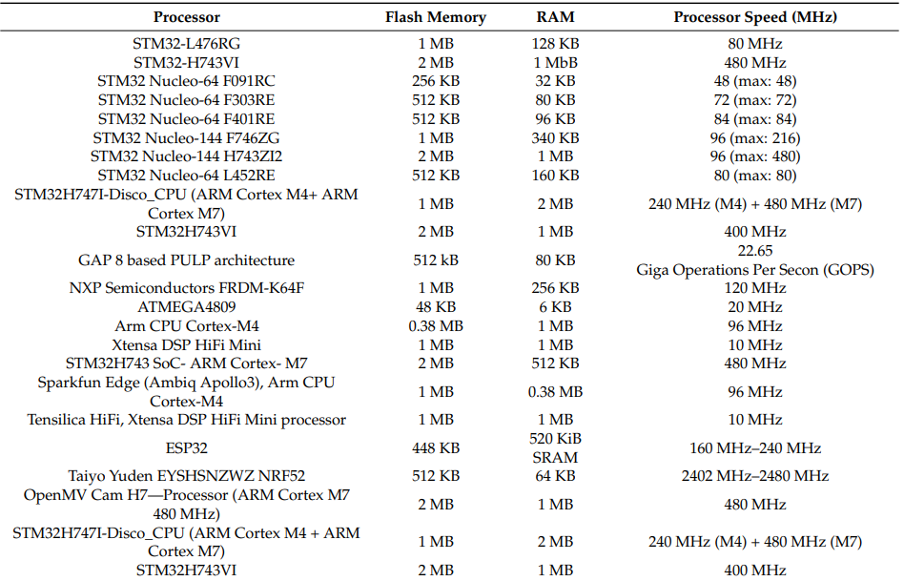
Summary of TinyML MCU Devices
Table source [3]

Slide 6
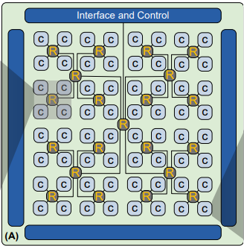
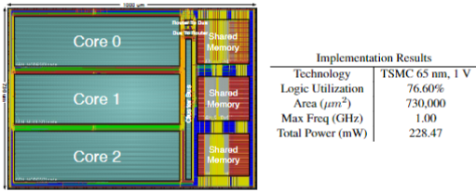
Domain Specific Manycore
In our previous work we present a domain-specific manycore platform
Consists of 64 clusters. Each cluster comprises of a cluster memory of 3072 words (6KB)
Memory is shared between 3 processing cores with a RISC-like ISA and a 6-stage pipeline
The cores have simplified data and instruction memory.
A single cluster was fully placed and routed in 65nm TSMC CMOS technology using Cadence SoC Encounter.
Figure source [4]
Fig: Manycore Architecture with 64 Clusters
Figure source [5]
Table source [5]
Fig: Layout view and post-layout implementation results of the Cluster
Notes:
Harvard architecture with multiple instruction, multiple data (MIMD)
A low-latency bus for inter-cluster and a hierarchical routing architecture for intra-cluster communication.
The cores operate on a 16-bit data-path.
Fig shows the post-layout view of a single cluster and the shared memory.
The post-layout implementation results for a single cluster are also summarized.

Slide 7
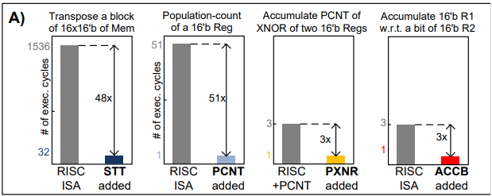
Domain Specific Instructions:
BiNMAC [4] developed specialized instructions such as
XNOR (1cycle)
PCNT (population-count) (1cycle)
PXNR (fused pop-count and xnor) (1cycle)
ACCB (bit-based accumulation) (1cycle)
and STT (store transpose of a block)
Figure source [4]
Fig: The optimization improvement factor for the new instructions as compared to an equivalent function implemented using basic RISC instructions
Notes:
data values stored in either local DMEM or the cluster memory, and the latter two instructions take multiple clock cycles.
Each of these instructions needs three data inputs read at a time, two of which are the two operands read from the dual-port DMEM and the third is read from the affiliated special purpose accumulators.

Slide 8
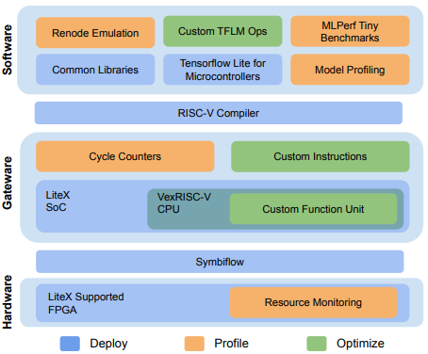
TinyML on Tiny FPGAs [6]
ML on embedded edge devices is gaining increased attention.
CFU Playground is a full-stack opensource framework for iteratively (deploy→profile→optimize) exploring the design space of lightweight accelerators.
Open-source toolchain bundles together
opensource software (TensorFlow Lite Micro, GCC)
open-source RTL generation IP and toolkits (LiteX, VexRiscv, Migen, nMigen)
open-source FPGA tools for synthesis, PnR (yosys and nextpnr)
Figure source [6]
Notes:
Given the need for energy efficiency when running ML on these embedded platforms, custom processor support and hardware accelerators for such systems could present the needed solutions.
The framework can be used to design custom function units (CFUs) for distinct ML operations. CFUs represent a novel design space that balances acceleration with flexibility and reduces the overhead associated with discrete accelerators.

Slide 9
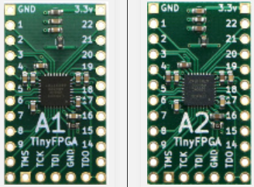
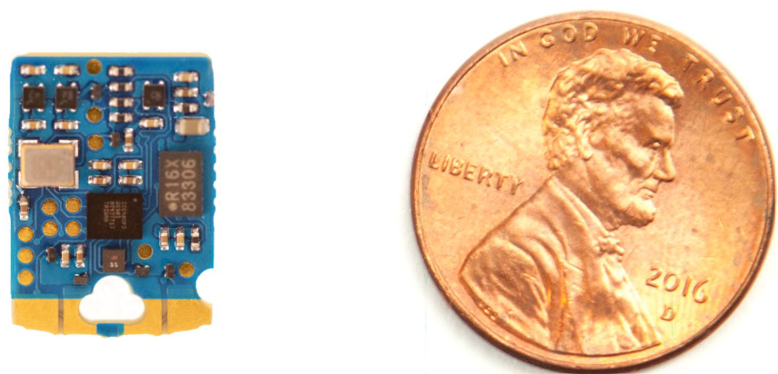
Why Tiny FPGAs
Processors on FPGA platform are customizable
ML computations, tend to be regular and repetitive.
Targeted improvement (custom instructions)
Custom Hardware for custom instructions (CFU)
A CFU can specialize operations.
Flexible, configurable storage allows data to be stored and reused locally.
An accelerator can be tightly coupled into the CPU pipeline.
This can be invoked by adding new custom instructions that complement the CPU’s standard functions.
Fig: TinyFPGAs A1 (left), AX2 (right)
Figure source [7]
Fig: FOMU FPGA
Figure source [8]
Notes:
To perform the application’s computation efficiently.
A small amount of custom hardware for these hotspots that exploit the bit-level flexibility of FPGAs can translate to large improvements. A custom function unit (CFU) can improve upon standard execution in many ways.
CFU: for constant operands, perform multiple operations per cycle through parallel computation of independent operations, perform a fusion of successive operations within a cycle, or pipeline the computations across multiple cycles.

Slide 10
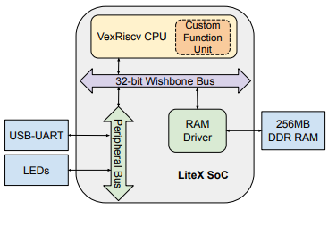
FPGAs, furthermore, allows bit-level flexibility.
CFU Playground runs a complete System-on-Chip (SoC).
Adaptable to a wide range of FPGA platforms.
The minimum requirements for the board and its FPGA include,
Some means of creating a TTY / UART connection to interact with the software on the board.
The FPGA must have enough resources to build variations of VexRiscv CPU cores.
The system must have enough RAM to provide working memory for the software.
There must be sufficient RAM and/or ROM to hold the code and any constant data such as the TensorFlow Lite model.
Figure source [6]
Fig: LiteX SoC with the CFU
Notes:
Hence, efficient implementation of operations on small data sizes and non-standard data representations, and even just packing, unpacking, and converting between different data types.
As such, FPGAs open up the complex design space exploration for customized microarchitectures that extend beyond the ML accelerator and include the CPU.
On an FPGA to capture the full-stack system effects of accelerating ML models. See Figure 2. Its gateware is built upon the LiteX framework [11].
LiteX provides a convenient and efficient infrastructure to create FPGA soft cores and SoCs. For any board to be used in CFU Playground, it must first have a LiteX description.
The soft core used in CFU Playground is VexRiscv, an implementation of a RISC-V CPU in SpinalHDL. The design of the VexRiscv is highly configurable, providing the ability to easily plugin or remove many different features for performance and functionality such as pipelining stages, caches, and floating point units.

Slide 11
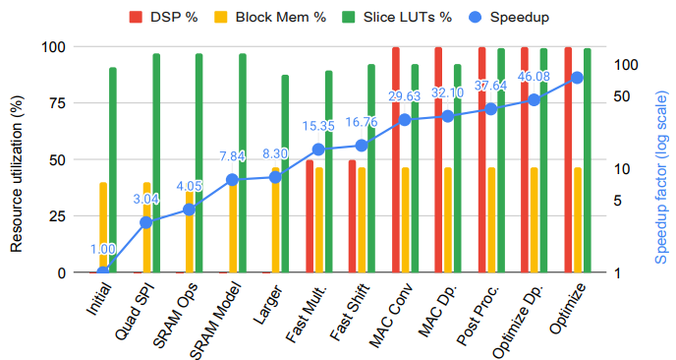
Evaluation of CFU-Playground:
[6]utilized CFU Playground to accelerate quantized (int8) inference of the MLPerf Tiny [18] Key-Word-Spotting model
Tiny Fomu FPGA board,
It combines an iCE40UP5k FPGA
5280 logic cells and 128 kB of on-chip RAM) with a 2 MB flash memory.
Figure source [6]
Fig: Speedup and resource usage on FOMU FPGA
Notes:
FOMU: which is roughly the size of a penny and fits inside a USB slot.
This example demonstrates resource allocation optimization among the CPU, memory system, and CFU on a resource-constrained tinyML device.

Slide 12
Preliminary Results
As a base line study, we are targeting a MobileNetV2 (MNV2) model.
We aim to accelerate this model on a Digilent Nexys-4 DDR Artix-7 FPGA.
The model is quantized down to 8-bit integers (int8).
Profiling the (MNV2) on the Artix-7 FPGA, the unaccelerated baseline application takes abut 220M clock cycles.
Notes:
MNV2: which is commonly used for efficient image classification
Arty A7-35T board, which has a Xilinx XC7A35T FPGA with 256 MB of external DDR3 memory.
Int8: as this is what the inference framework used (TFLite Micro) supports.
220M cycles = 2.8 seconds @75MHz

Slide 13
Potential Plan Ahead
To optimize for Latency
Profile for latency; obtain specific functions to accelerate (layerwise profiling).
Accelerate function using a CFU (eg: Depthwise Conv Layers).
Measure the improvement due to the new instruction
To optimize for power
Identify major power-hungry components(eg: MMCM, I/O).
Replace these components with equivalent simpler ones
Measure the improvement in power
To introduce structured pruning techniques to minimize storage and number of computations.

Slide 14
References
[1] Lin, J.; Chen, W.M.; Lin, Y.; Cohn, J.; Gan, C.; Han, S. MCUNet: Tiny Deep Learning on IoT Devices. arXiv 2020, arXiv:2007.10319v2 neural network quantization. In International Conference on Machine Learning, pages 11875–11886. PMLR, 2021
[2] Banbury, C.R.; Reddi, V.J.; Lam, M.; Fu, W.; Fazel, A.; Holleman, J.; Huang, X.; Hurtado, R.; Kanter, D.; Lokhmotov, A.; et al. Benchmarking TinyML Systems: Challenges and Direction. arXiv 2020, arXiv:2003.04821
[3] Norah N. Alajlan, Dina M. Ibrahim; et al. TinyML: Enabling of Inference Deep Learning Models on Ultra-Low-Power IoT Edge Devices for AI Applications
[4] Morteza, H.; Tinoosh, M.; et al. Binary Precision Neural Network Manycore Accelerator
[5] Varun, S.; Tinoosh, M.; et al. The design and Implementation of a Scalable Bus-Based Cluster with Shared Memory for a Programmable Manycore Platform
[6] Shvetank, P.; Tim, C.; Joseph, B.; Colby, B.; Alan, V. G.; Pete, W.; Tim, A.; Vijay, J.R.; et al. CFU Playground: Full-Stack Open-Source Framework for Tiny Machine Learning (tinyML) Acceleration on FPGAs
[7] https://tinyfpga.com/
[8] https://www.crowdsupply.com/sutajio-kosagi/fomu/
[9] Sakr, F.; Bellotti, F.; Berta, R.; De Gloria, A. Machine Learning on Mainstream Microcontrollers. Sensors 2020, 20, 2638
[10] Merenda, M.; Porcaro, C.; Iero, D. Edge Machine Learning for Ai-Enabled IoT Devices: A Review. Sensors 2020, 20, 2533
[11] Paul, A.J.; Mohan, P.; Sehgal, S. Rethinking Generalization in American Sign Language Prediction for Edge Devices with Extremely Low Memory Footprint. In Proceedings of the 2020 IEEE Recent Advances in Intelligent Computational Systems, RAICS, Thiruvananthapuram, India, 3–5 December 2020; pp. 147–152
[12] Mohan, P.; Paul, A.J.; Chirania, A. A Tiny Cnn Architecture for Medical Face Mask Detection for Resource-Constrained Endpoints. In Innovations in Electrical and Electronic Engineering; Springer: Singapore, 2020; pp. 657–670
[13] Coffen, B.; Mahmud, M.S. TinyDL: Edge Computing and Deep Learning Based Real-Time Hand Gesture Recognition Using Wearable Sensor. In Proceedings of the 2020 IEEE International Conference on E-Health Networking, Application & Services (HEALTHCOM), Shenzhen, China, 1–2 March 2021; pp. 1–6
[14]. Venzke, M.; Klisch, D.; Kubik, P.; Ali, A.; Missier, J.D.; Turau, V. Artificial Neural Networks for Sensor Data Classification on Small Embedded Systems. arXiv 2020, arXiv:2012.08403v1
[15] Orfanidis, C.; Hassen, R.B.H.; Kwiek, A.; Fafoutis, X.; Jacobsson, M. A Discreet Wearable Long-Range Emergency System Based on Embedded Machine Learning. In Proceedings of the 2021 IEEE International Conference on Pervasive Computing and Communications Workshops and Other Affiliated Events (PerCom Workshops), Kassel, Germany, 22–26 March 2021; pp. 182–187
[16] Wong, A.; Famouri, M.; Pavlova, M.; Surana, S. TinySpeech: Attention Condensers for Deep Speech Recognition Neural Networks on Edge Devices. arXiv 2020, arXiv:2008.04245v6
[17] De Prado, M.; Rusci, M.; Donze, R.; Capotondi, A.; Monnerat, S.; Benini, L.; Pazos, N. Robustifying the Deployment of TinyML Models for Autonomous Mini-Vehicles. Sensors 2021, 21, 1339.

Slide 15
Design Considerations
Software (compiler)
Reduce unnecessary MACs: Apply transforms
Increase PE utilization: Schedule loop order and tile data to increase data reuse in memory hierarchy
Hardware
Reduce time per MAC
Increase speed of PEs
Increase MACs per instruction using large aggregate instructions (e.g., SIMD)
→ requires additional hardware
Increase number of parallel MACs
Increase number of PEs on chip → area cost
Support reduced precision in PEs
Increase PE utilization
Increase on-chip storage → area cost
External memory BW → system cost
adapted from NeurIPS 2019-Vivienne Sze (@eems_mit)

Slide 16
Tiling Matrix Multiplication
Matrix multiplication tiled to fit in cache (i.e., on-chip memory) and computation ordered to maximize reuse of data in cache
Filters
CHW
Input fmaps
N
Output fmaps
N
Filters
CHW
Input fmaps
N
Output fmaps
N
CHW
N
N
^{F}0,0 | ^{F}0,1
^{F}1,0 | ^{F}1,1
 | ^{I}0,0 | ^{I}0,1
 | ^{I}1,0 | ^{I}1,1
F0,0I0,0 + F0,1I1,0 | F0,0I0,1 + F0,1I1,1
F1,0I0,0 | F1,0I0,1
+ | +
F1,1I1,0 | F1,1I1,1
^{F}0,0 | ^{F}0,1
^{F}1,0 | ^{F}1,1
^{I}0,0 | ^{I}0,1
^{I}1,0 | ^{I}1,1
F0,0I0,0 + F0,1I1,0 | F0,0I0,1 + F0,1I1,1
F1,0I0,0 | F1,0I0,1
+ | +
F1,1I1,0 | F1,1I1,1
CCHHW
CHW
×
W
=
×
=
M
M
M
M
Step 1
Step 2

Slide 17







Weight Stationary (WS)
[Chen, ISCA 2016]
Global Buffer
Psum
Activation
W0
W1
W2
W3
W4
W5
W6
W7
PE
Weight
Minimize weight read energy consumption
− maximize convolutional and filter reuse of weights
Broadcast activations and accumulate partial sums spatially
across the PE array
• Examples: TPU [Jouppi, ISCA 2017], NVDLA
adapted from NeurIPS 2019-Vivienne Sze (@eems_mit)

Slide 18










Output Stationary (OS)
[Chen, ISCA 2016]
Global Buffer
Activation Weight
P0
P1
P2
P3
P4
P5
P6
P7
PE
Psum
Minimize partial sum R/W energy consumption
− maximize local accumulation
Broadcast/Multicast filter weights and reuse activations spatially
across the PE array
• Examples: [Moons, VLSI 2016], [Thinker, VLSI 2017]
adapted from NeurIPS 2019-Vivienne Sze (@eems_mit)

Slide 19
Input Stationary (IS)
[Chen, ISCA 2016]
Global Buffer
Weight Psum
I0 I1 I2 I3 I4 I5 I6 I7
Act
PE
Minimize activation read energy consumption
− maximize convolutional and fmap reuse of activations
Unicast weights and accumulate partial sums spatially
across the PE array
• Example: [SCNN, ISCA 2017]
adapted from NeurIPS 2019-Vivienne Sze (@eems_mit)

Slide 20
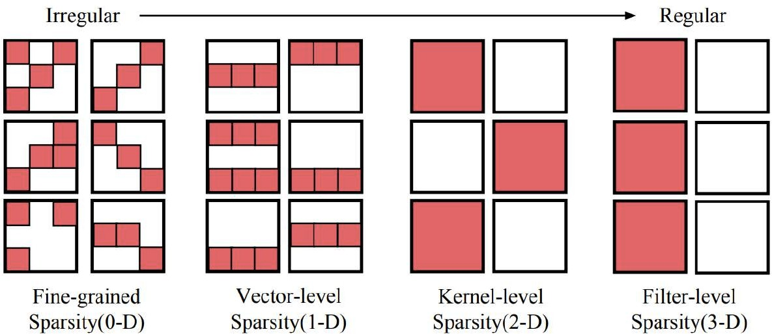
Unstructured or Structured Sparsity
Increase coarseness
Image Source: [Mao, CVPR Workshop 2017]
Benefits:
Increase coarseness → more structure in sparsity (easier for hardware) Less signaling overhead for location of zeros → better compression
adapted from NeurIPS 2019-Vivienne Sze (@eems_mit)

