Slide 1

Retail Insights from Superstore Data
Ukant Jadia
AICTE Internship Student Registration ID) : STU616311a1eeaaa1633882529

Slide 2
Index
Problem Statement
Project Description
Who are the End User?
Technology Used
Results
Identify the region and city with the highest sales.
Ship Mode's Impact on Profitability and Sales.
Analyze the category and subcategory with the highest profit.
Identify the segment with the highest profit and sales.
Thank You!!

Slide 3

PROBLEM STATEMENT
In today's tough business world, companies need useful insights to grow and make money. But without data analysis, making decisions can be hard. This project aims to look at sales and profit data to find trends and chances for improvement. Using these insights, businesses can improve strategies and lead the market.

Slide 4
Project Description
Identify the region and city with the highest sales.
Ship Mode's Impact on Profitability and Sales.
Analyze the category and subcategory with the highest profit.
Identify the segment with the highest profit and sales.

Slide 5

WHO ARE THE END USERS?
Managers and Stack Holders
Various Teams: Sales and Marketing, Supply chain team, etc.
Impact:
Data-driven decisions help businesses grow, innovate, and stay competitive.
This also lead to higher customer satisfaction and long-term profits.

Slide 6

Technology Used
Language
Python (v3.11.8)
Libraries
Numpy - v1.23.5
Matplotlib - v1.5.3
Pandas - v0.12.2
Seaborn - v3.7.0
Editor
Vs-code editor

Slide 7
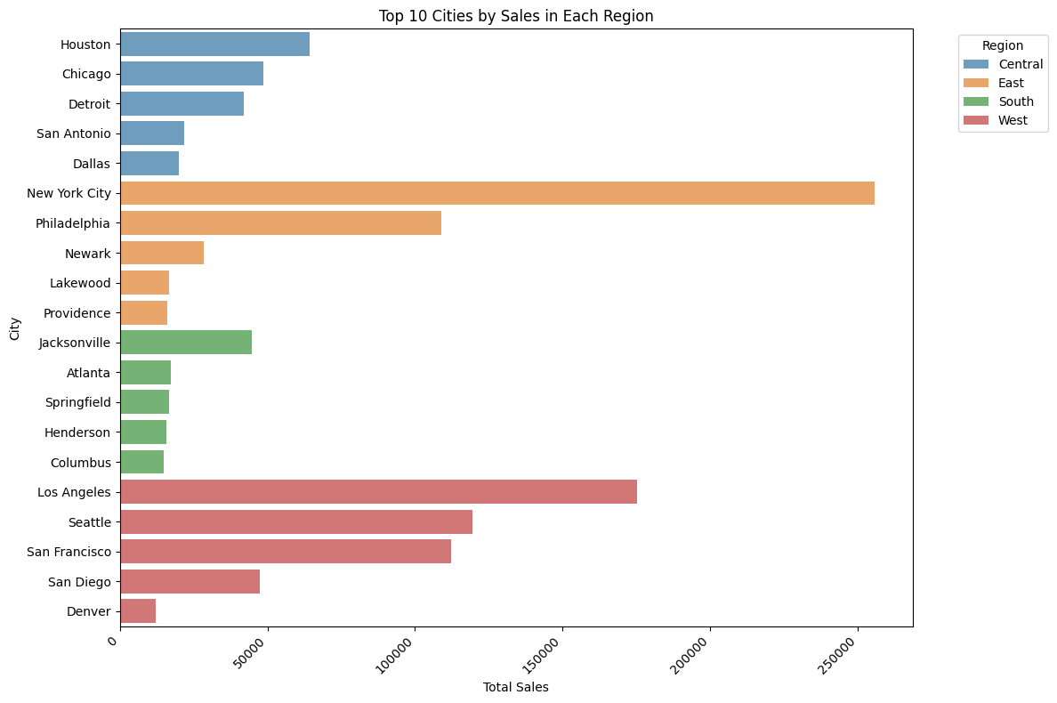
RESULTS
Identify the region and city with the highest sales.
Insight
Region East has the highest sales and Region South has the lowest sales.
New York City and Los Angeles have the highest sales.
Actions
Focuses on the East region to improve the Sales.
Reason behind the low sales In the South and Central Region.
Link

Slide 8
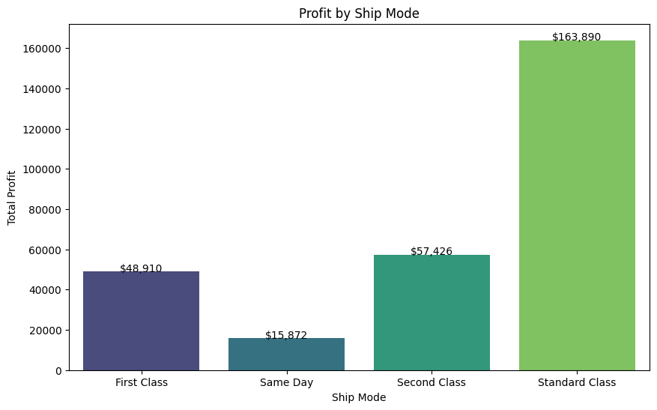
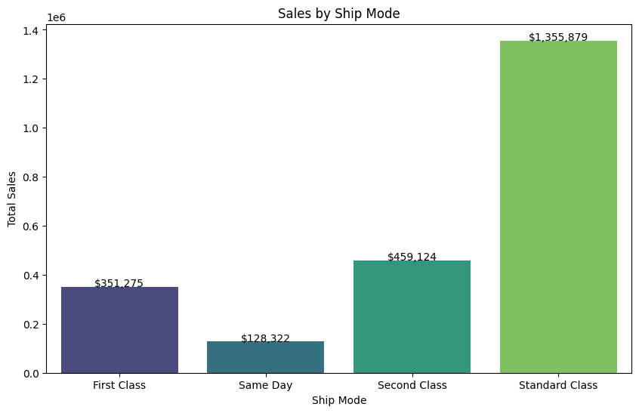

RESULTS
Ship Mode's Impact on Profitability and Sales.
Insight
Standard class ship mode has high sales and profit.
Profit Margin with class
NOTE: Profit Margin is calculated with available data, other conditions and data is not taken in concentration due to unavailability.
Formula: Profit margin = $\frac{Total Profit}{Total Sales}$
Ship Mode | Profit Margin(%)
Standard Class | 12.09
First Class | 13.93
Second Class | 12.50
Same Day | 12.37
Link

Slide 9
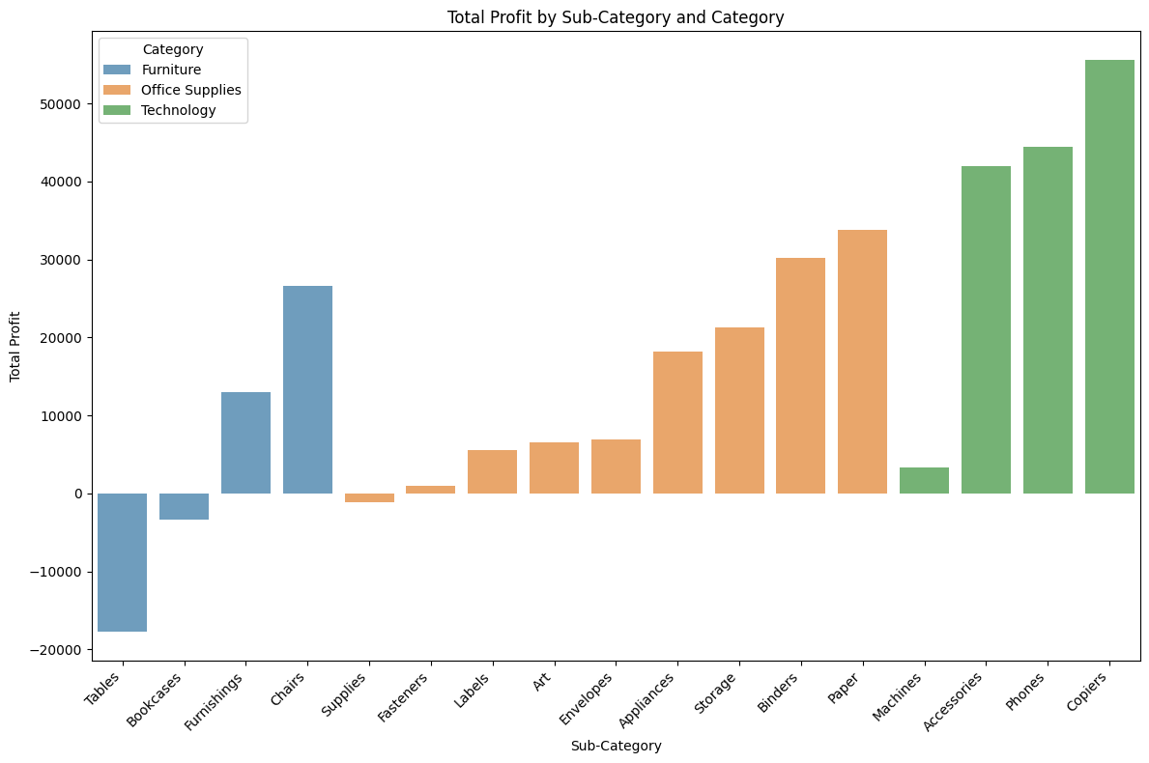
RESULTS
Analyze the category and subcategory with the highest profit and loss.
Insight
Category Technology has the highest profit and without any loss whereas category Furniture has the lowest profit with loss.
Sub-category copiers have the highest profit and tables have the lowest profit.
Link

Slide 10
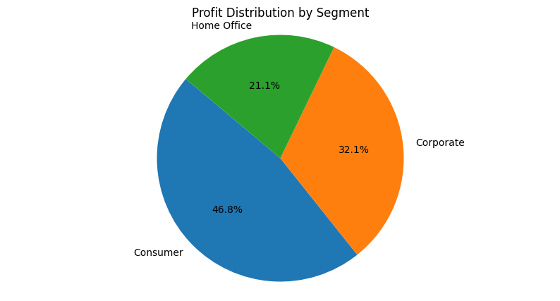
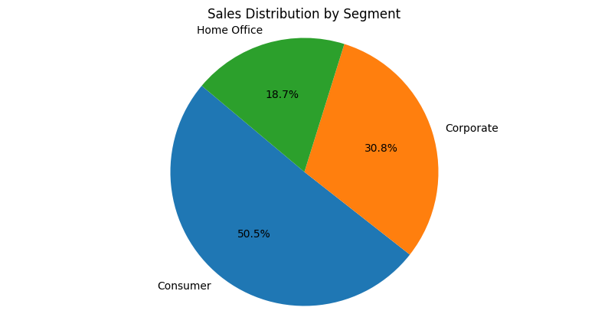
RESULTS
Identify the segment with the highest profit and sales.
Insight
Consumer segment has the highest profit and sales.
As the differences between the profit and sales segments are less, it shows a good healthy balance between profitability and sales performance.
Link

Slide 11
Thank you
LinkedIn Profile : ukantjadia
GitHub Profile: ukantjadia
Code Notebook: GitHub
.
.

