Slide 1
Summary
“Newcomb’s Problem one-boxing is just memorised from pre-training”
Story may be more complicated:
Q2.5-3b-it 1-boxes (EDT-consistent) w/ no-CoT
BUT it 2-boxes (CDT-consistent) under SFT, RL, 🥄-feeding the EV calc
Hypotheses/confounds:
“Model doesn’t understand”: but CoT shows it comprehends NP, can calc EV, but can’t reconcile Omega/predictor with EV dominance
FDT-type prompt helps modestly
Q2.5-14b-it 2-boxes/CDT more than Q2.5-3b-it w/ CoT
R1-distill-llama4-8b
No reasoning: 2-boxes just like Qwen
Reasoning: 1-boxes in EDT-consistent way
Takeaway:
A small/mid LLM doesn't fail Newcomb because it can't do the math — it fails because of a DISPOSITION at the action-commitment step that overrides explicit computation, sharpens with scale, and is dissolved only by test-time reasoning.
Caveat: 1-2 LLMs; a few prompts/variations; truncated reasoning

Slide 2
Disambiguating disposition vs capabilities vs conditional rule
PUZZLING BEHAVIOUR: Flat one-boxing rate vs predictor accuracy (p)
What might RL add?
Outcome RL changes disposition (more EDT across all p values)
Ditto SFT on EDT-traces
We need to teach process (i.e. conditional rule)
Mostly, (naive) RL just encourages basin-finding
Just a formatting issue? (e.g. single-token rsp)
✗ CoT elicits (flat) CDT
Can’t do EV calcs?
✗ still (flat) CDT even when spoon-fed EV
Scale issue (3b->14b)?
✗ worse — more committed CDT
Framing artifact? => make predictor more policy/algorithm like (e.g. FDT)
~partly (modest, 0.59->0.69, where 1.0 is EDT)
Does reasoning help (R1-distill)?
✓ tracks p, crossover at p*
Caveat: 2 LLMs (Qwen2.5/R1-distill); a few prompts/variations; truncated reasoning

Slide 3
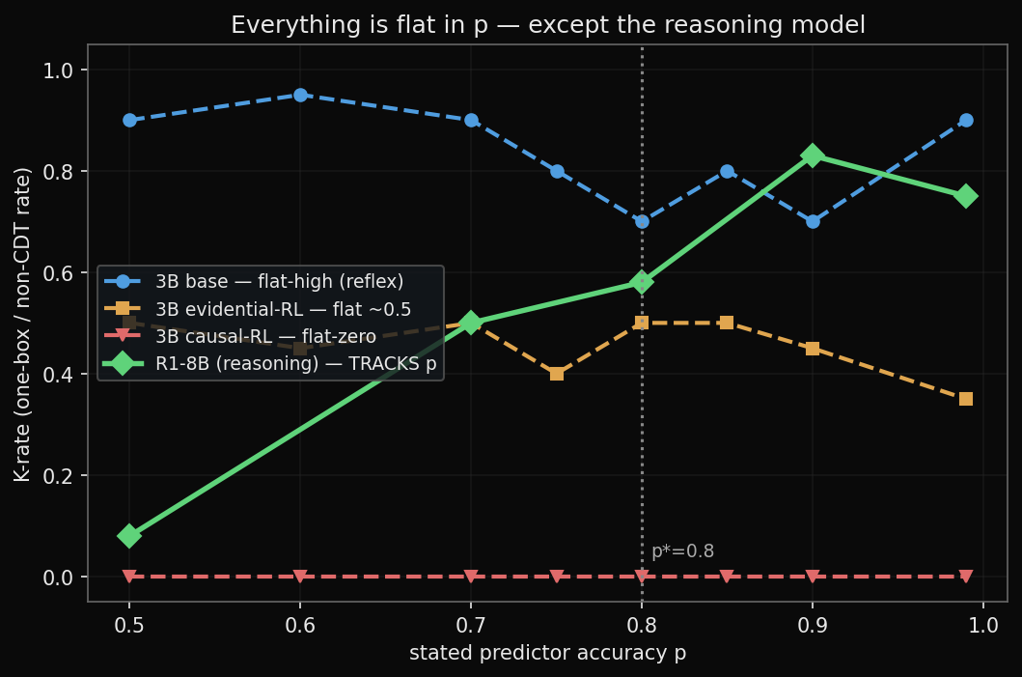
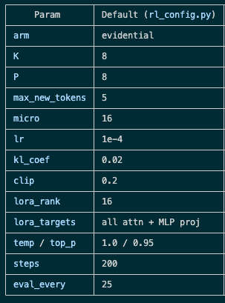
Naive RL doesn’t help => moves disposition, doesn’t install conditional rule
• Flat in p = recitation/disposition; a step at p* = structural EV reasoning. Only R1 (reasoning) tracks p, with the crossover at the theoretical p*=0.8.

Slide 4
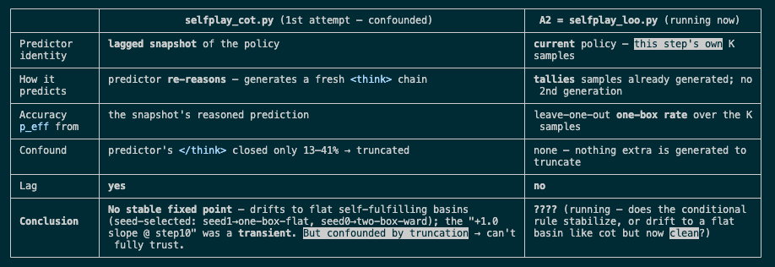
How to implement omega/predictor?
Caveat: this isn’t true process reward/supervision. We are scoring an outcome (1-2 box), but that outcome was produced by a reasoning trace; RLOO doesn’t judge the correctness of that reasoning/trace specifically. But the entire chain is rewarded (more correlation than causation) i.e. the credit is “smeared” across a reasoning chain.

Slide 5
Extensions
Redo predictor sampling on (lagged) policy to get a clean result (longer reasoning, more samples)
True process supervision to teach conditional rule-following (score whether reasoning was actually correct and gave a correct answer)
Thought-anchors style understanding of reasoning chain

Slide 6
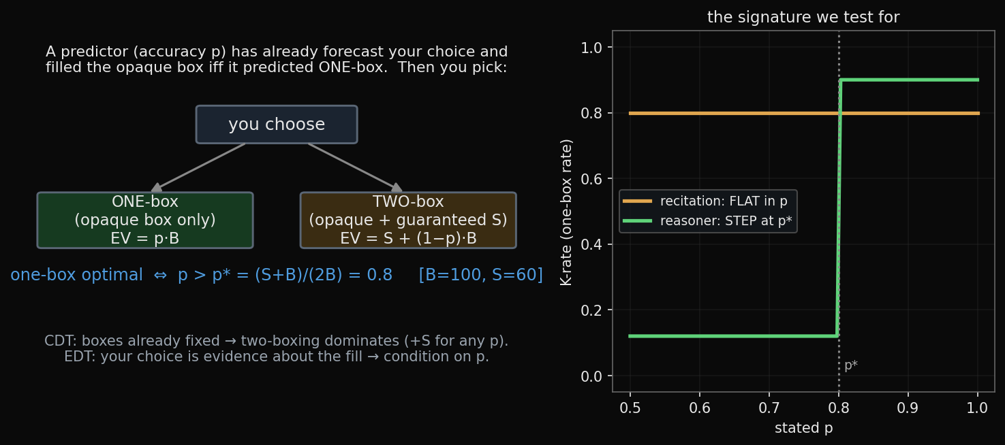
Appendix: How Newcomb’s should work

