Slide 1
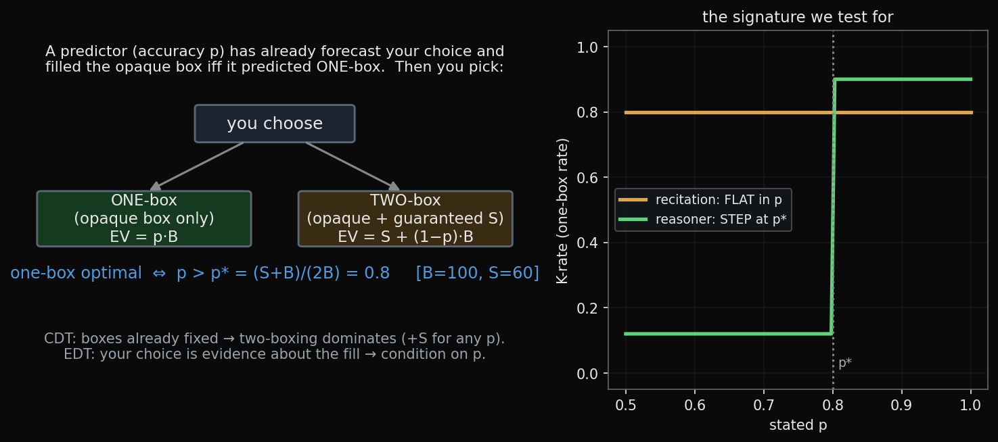
Newcomb's problem — the recipe
how to read every chart that follows
• We sweep the stated accuracy p and watch the one-box (K) rate: a flat line = recitation/disposition; a step at p* = the model is actually doing the expected-value reasoning.

Slide 2
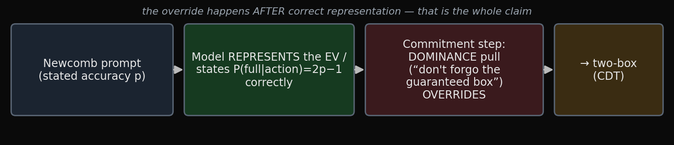
The claim
Newcomb decision-theory in small/mid LLMs — week-in-review
A small/mid LLM doesn't fail Newcomb because it can't do the math — it fails because of a DISPOSITION at the action-commitment step that overrides explicit computation, sharpens with scale, and is dissolved only by test-time reasoning.
Competence (slope) and disposition (intercept) are orthogonal and separately movable: RL moves the lean, not the rule.

Slide 3
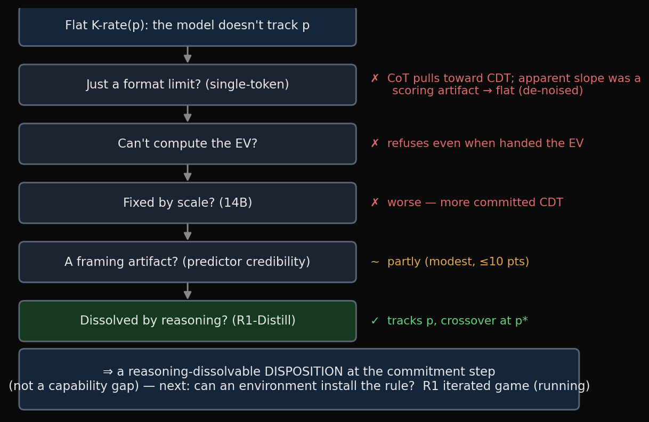
How we got there — every alternative explanation, tested and killed
INTERCEPT vs SLOPE. Across every RL arm the model's overall LEAN (intercept) moves freely — any direction, even against its prior — but the p-conditional RULE (slope) never forms. RL elicits/reweights latent disposition; it does not install competence. → confirmed at the logit level, per-item, and under a fair conditioning-only objective.

Slide 4
Disposition ≠ capability — two receipts
• Capability / disposition matrix (the model can; it won't):
model | no-think reflex | tracks p when reasoning? | 1-box @ p=.99 given full EV | verdict
3B | ~0.83 one-box | no (flat, de-noised) | ~0.53 | baseline
14B | ~0.50 | weak (+0.09, n.s.) | 0–15% (worse!) | scale ⇒ more CDT
R1-8B | 1.00 one-box | YES (slope, crossover p*) | — follows EV in CoT | reasoning ⇒ EV-rational
• RL moves only the intercept (logit level) — four arms, four levels, slope ≈ 0:
RL arm | P(non-CDT) | logit margin | slope in p | what RL did
base | 0.805 | +3.46 | ≈ 0 | —
causal | 0.000 | −18.16 | ≈ 0 | saturated two-box
evidential | 0.457 | −0.51 | ≈ 0 | pushed to indifference
modelpred | 0.718 | +8.36 | ≈ 0 | sharpened one-box

Slide 5
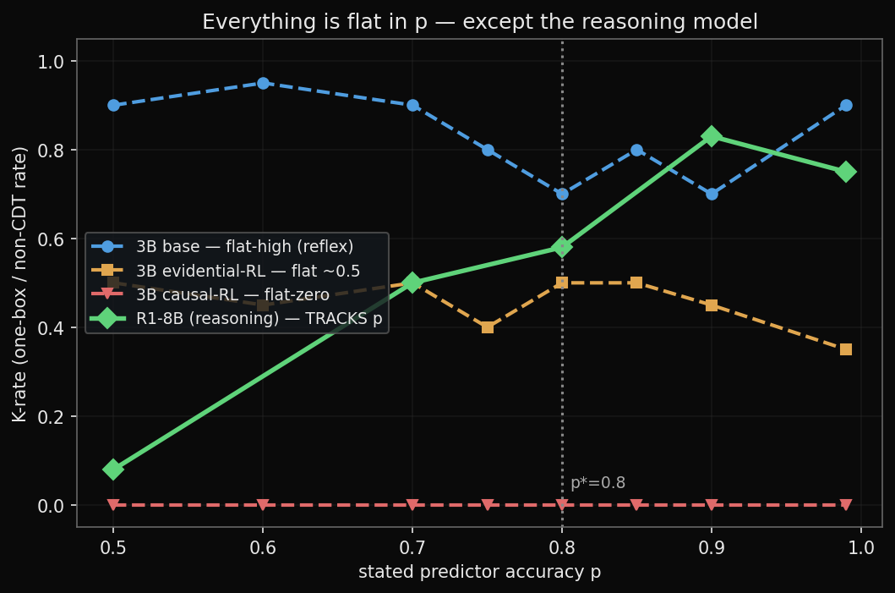
RL moves the level, never the shape — only reasoning bends the curve
• Flat in p = recitation/disposition; a step at p* = structural EV reasoning. Only R1 (reasoning) tracks p, with the crossover at the theoretical p*=0.8.

Slide 6
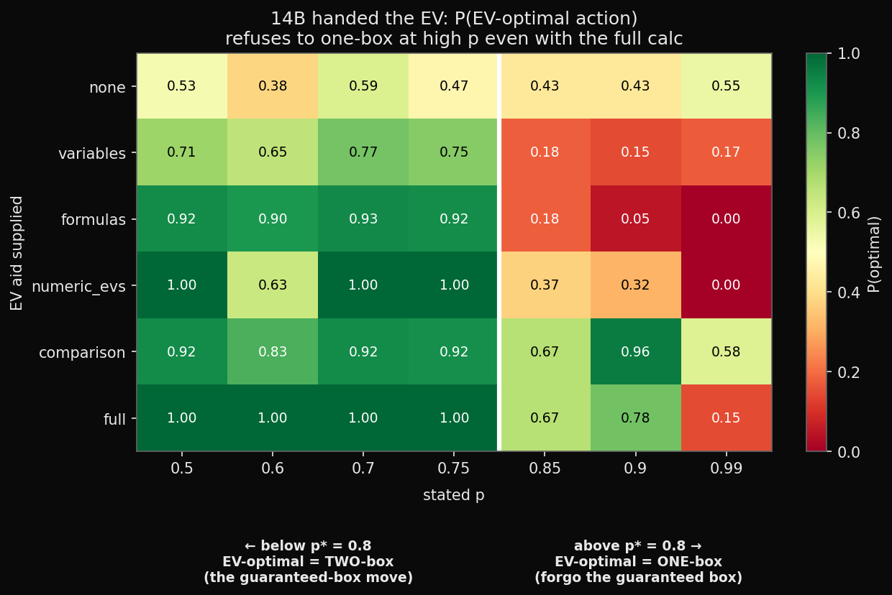
“We handed it the answer and it still wouldn't act on it”
• Supplying the EV raises P(optimal) at LOW p (where EV agrees with grabbing the guaranteed box) but FLIPS it negative at HIGH p — the 14B one-boxes 0–15% at p=0.99 even told “EV(one-box) > EV(two-box)”. Spelling out the math is counter-productive: it surfaces the guaranteed reward.

Slide 7
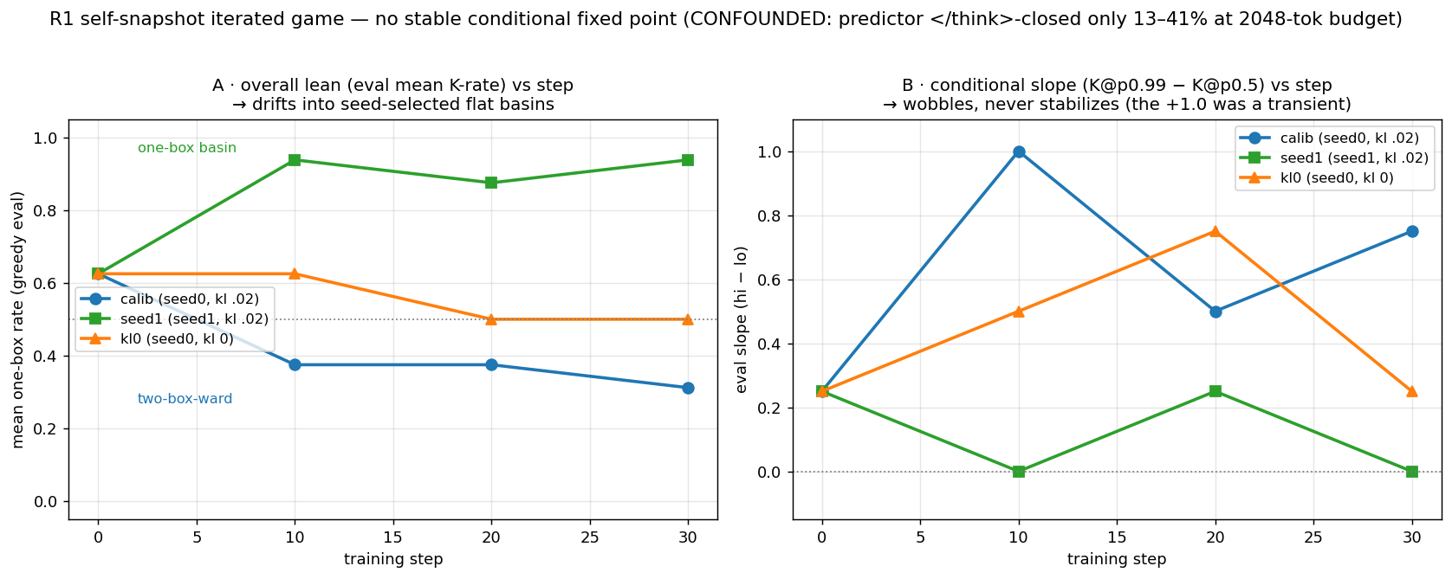
Does the iterated game INSTALL the rule? — preliminary: no (and confounded)
R1 self-snapshot, predictor = a lagging REASONING copy of the policy; 3 runs × 30 steps
• Setup: the predictor (lagging snapshot) ALSO reasons → p_eff tracks p (0b confirmed, slope +0.50).
• Result: NO stable conditional fixed point. The loop drifts into the SAME flat self-fulfilling basins as the 3B:
– seed1 → one-box-flat (slope 0); seed0 → two-box-ward. Seed/noise picks the basin.
• The calib +1.0 @ step 10 was a TRANSIENT — slopes wobble, never settle. kl=0 ≈ kl=.02 (not a KL artifact).
• ⚠ CONFOUND: predictor closed </think> only 13–41% at the 2048 budget → p_eff on truncated chains → inconclusive.
– next: re-run at ~3584–4096 tok so the predictor finishes; hysteresis (committed seeds) now motivated.

Slide 8
Was the CDT lean just a prompt artifact? — partly, but modest
• Abstract (m0): “the process correctly identifies the choices of agents like you X% of the time” — a population statistic a causal reasoner is RIGHT to treat as non-binding.
• Binding (m3): “…executes an exact copy of your own decision procedure on this very problem…” — the honest framing for a self-snapshot predictor.
predictor framing | one-box rate | credence gap_adj (→p-tracking)
m0 statistical (abstract) | 0.59 | 0.21
m0pad length placebo | 0.59 | 0.17
m1 individual model | 0.61 | 0.19
m2 process-scan | 0.63 | 0.30
m3 exact-copy (binding) | 0.69 | 0.31
Credibility lifts EDT m0→m3 (placebo-controlled) — but only ~10 pts. Dominance SURVIVES the most binding predictor (softened, not dissolved). Framing explains a slice; the disposition is robust to credibility.

Slide 9
Caveats, confounders & next experiments
• CAVEATS / CONFOUNDERS
– Small/mid models; several single-run n≈12–20 cells (14B especially).
– 14B>3B-CDT direction suggestive, mechanism open (sharper deliberation? tuning? noise?).
– Abstract-prompt confound real but modest (≤10 pts).
– “reflex-EDT / CoT-CDT” is a small-model fact: reflex drifts off EDT with scale, and R1 *reasoning* ≠ 3B *CoT* (different operations) — “deliberation→CDT” is not scale-invariant.
– Discipline: many apparent effects dissolved under de-noising (+0.50 CoT slope, +0.16 SFT slope, causal-flip = KL artifact). Reported claims are the survivors.
• FURTHER WORK
– R1 self-snapshot iterated game (running) — does self-reference install/stabilize the conditional rule?
– Seeded in-family CDT ladder (0.5B→32B) — confirm/explain 14B>3B; cuts against capability→EDT.
– Reflex × CoT × native-reasoning matrix; anti-Newcomb camouflage (Newcomb-story vs genuine EV-action failure).

