Slide 1
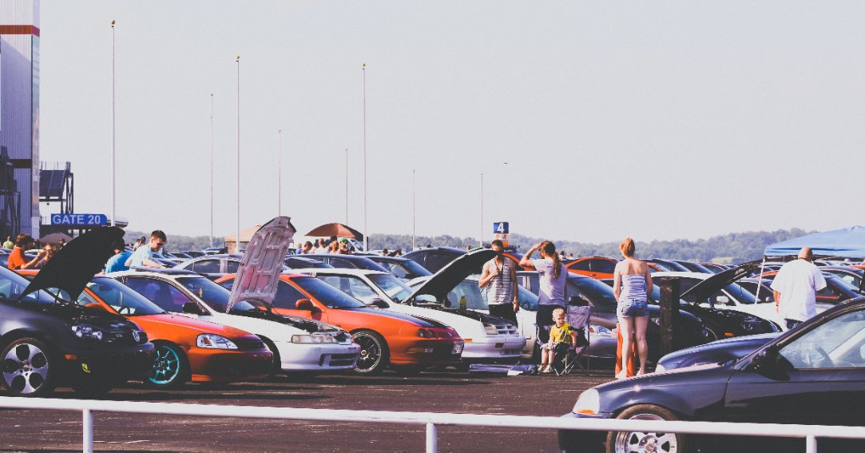
EDA for Car Risk

Slide 2
Basis of Analysis
This analysis is done in the purview of an Insurance Company insuring vehicles based on certain parameters.
It basically consists of three types of entities:
The specification of an auto in terms of various characteristics.
Its assigned insurance risk rating.
Its normalized losses in use as compared to other cars.
Cars are initially assigned a risk factor symbol associated with its price. Then, if it is riskier, this symbol is adjusted by moving it up (or down) the scale. Actuarians call this process "symboling".
A value of +3 indicates that the auto is risky, -3 that it is probably pretty safe.
The third factor is the relative average loss payment per insured vehicle year.

Slide 3
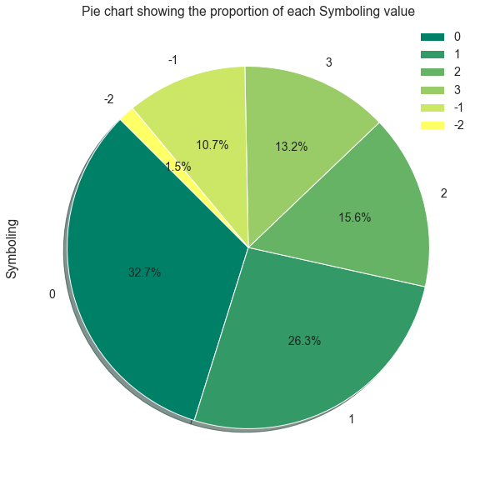
This Pie-Chart classifies the various brands into risk buckets -3 labelled as most safe and 3 as most unsafe
Notes:
32.7% of cars are neither safe or unsafe to be insured
57% of the cars are unsafe.
12% are safe.

Slide 4
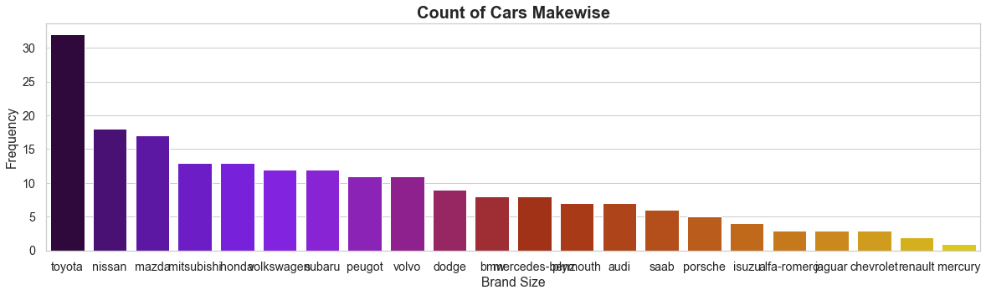
Cars of brand Toyota has the highest number of models and is nearly 50% higher than its nearest competitor Nissan which is little over 15.
Notes:
There are over 22 brands of cars.

Slide 5
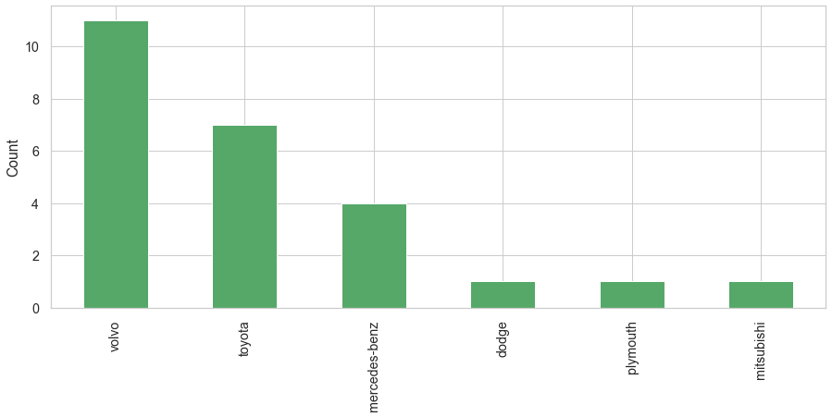
Top six safest brands
Notes:
Inline with Volvo’s global positioning,the data also reflects the same with over 10 models in the safest bracket.

Slide 6
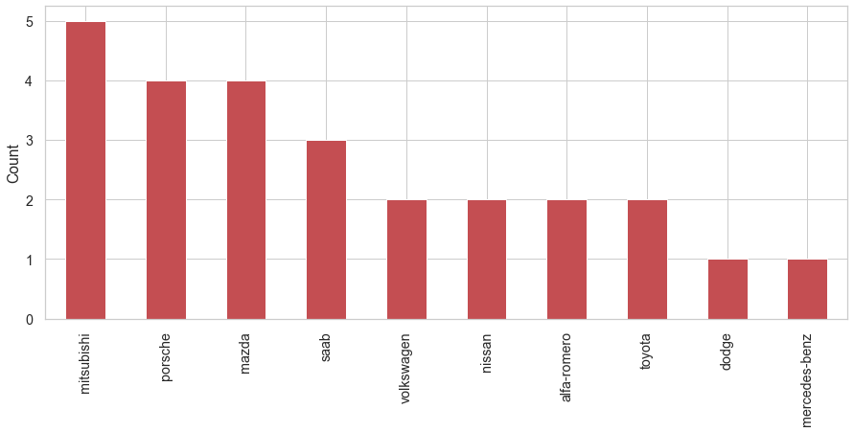
Top 10 risky car brands
Notes:
1. The most number of riskiest cars are that of brand - 'mistsubishi' followed by porsche, mazda and saab and at least one model of 'mercedes-benz’ falls in unsafe bracket. 2. As an insurance company, we would prefer insuring mercedes-benz, dodge, Toyota rather than misthibishi, porsche or mazda.

Slide 7
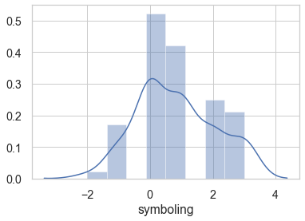
Notes:
The above figure shows symbolling averaging at 0 and can be termed mostly to neutral category i.e. not very safe or unsafe

Slide 8
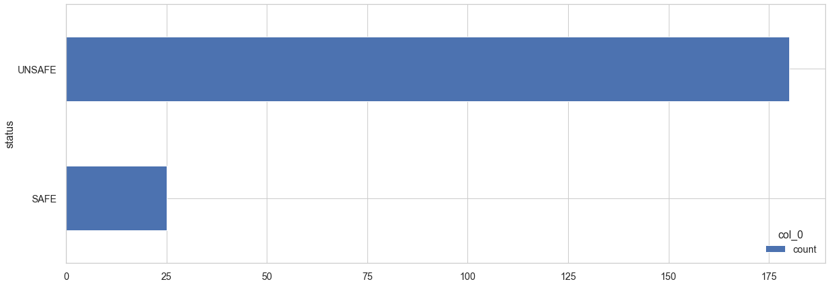
This Horizontal Bar Chart showing the number of safe and unsafe Car Risk
Notes:
This horizontal bar chart shows out of 205, 185 + cars are unsafe or neutral and only 25 cars are safe.

Slide 9
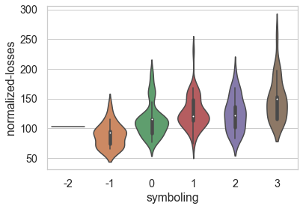
Showcase of symbolling and normalized-losses
Notes:
1. We can see a clear co-relation between safe cars having low normalized-losses and unsafe cars having high normalized losses with a long tail from the above violin plot. 2. The mean goes progressively for each category except between 1 and 3 which are close to each other but definitely higher than 0 and -1.

Slide 10
Understanding car brands / models

Slide 11
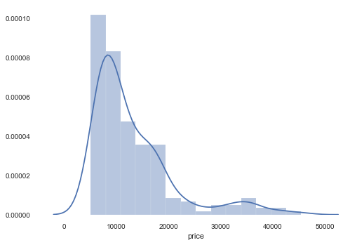
The above chart is positively skewed and clearly depicts that the mean price hovers around $10000 with some outliers extending up to $50000.

Slide 12
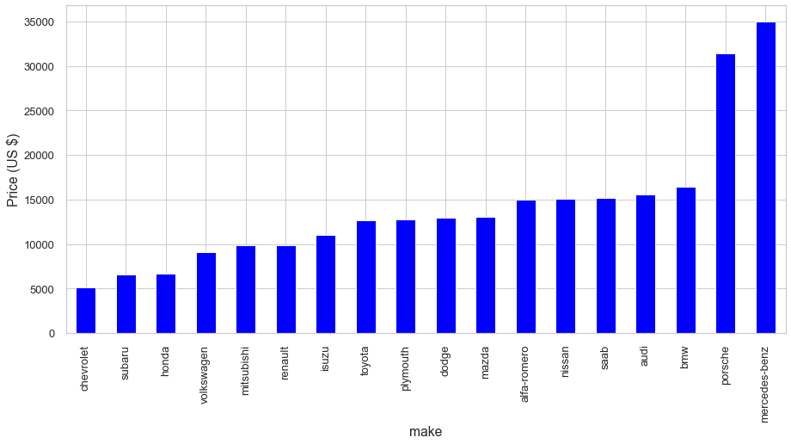
Price Vs Car brand
Notes:
1. The above bar chart shows 'mercedes-benz' tops the list with price of $35000 as the highest. 2. Mercedes and Porsche are performance cars. Hence that they are both expensive and inherently risky. 3. It seems that drivers of such vehicles are more prone to unsafe driving practices.

Slide 13
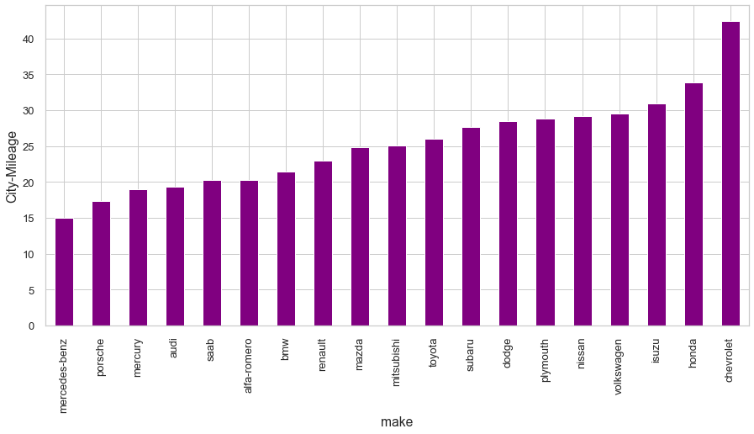
Mass cars typically show higher mileage
Notes:
Performance cars have low mileage and mass cars manufacturers focus on better mileage.

Slide 14
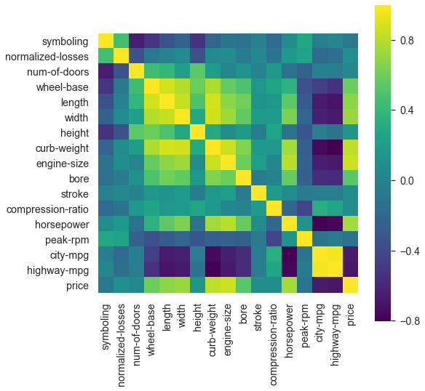
Correlation between different parameters

Slide 15
Observation:
Price is highly correlated with engine-size, curb-weight and is correlated with symboling.
City / highway mileage and peak-rpm are inversely co-related with price.
Symboling and number of doors are inversely co-related.
Peak-rpm and length is negatively corelated with width.
Number of Doors and Normalized-losses are negatively co-related.
Width, length and horsepower are highly corelated with price.

Slide 16
Conclusions:
There are total 205 entries, out of which only 25 i.e. 12.2% are safe and 185 are unsafe cars.
Most number of riskiest cars are that of brand mitsubishi followed by porsche, mazda and saab and the least one is that of mercedes-benz
The safest car is of make Volvo.
Most number of cars produced are that of make Toyota.
The costliest brand of cars is mercedes-benz followed by Porsche.
Among the safest cars, Toyota has both highest city and highway mileage and among the riskiest one is Davenport
Mostly the safe cars are the large ones with 4 doors and risky ones are with 2 doors

Slide 17
Actionable insights
The insurance company should be extremely careful while insuring vehicles as greater number of cars are unsafe or neutral especially performance cars. Further analysis basis revenue earned on price of the car would help establish better insurance norms.

