Slide 1
EICAT-AI
Can a large language model assess the environmental impacts of alien species?
Matthew Coole · UKCEH · OneSTOP Task 4.4

Slide 2
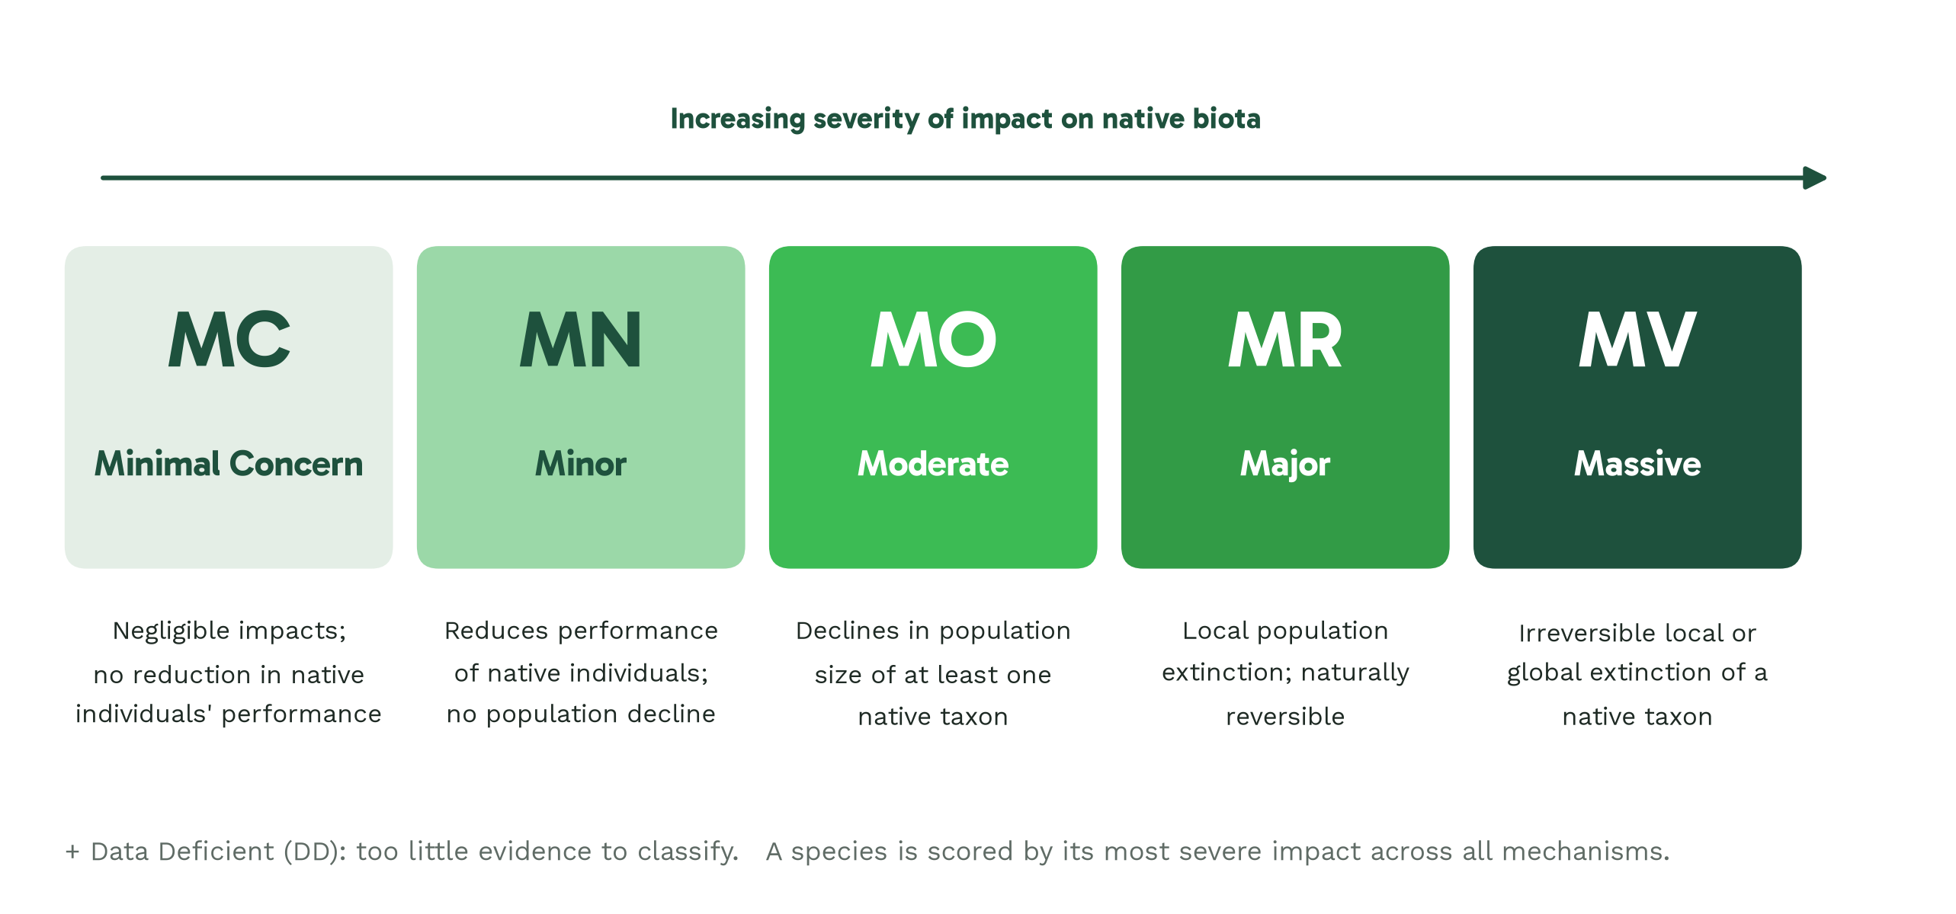
EICAT in brief
Notes:
Headline: EICAT scores a species by its worst documented impact.
EICAT is the IUCN standard for scoring how badly an alien species harms native biota. Each piece of evidence gets one of twelve mechanisms, such as competition, predation or hybridisation, and a severity from Minimal Concern up to Massive. A species is then scored by its worst documented impact. The scheme is simple; the evidence behind it is the hard part.

Slide 3
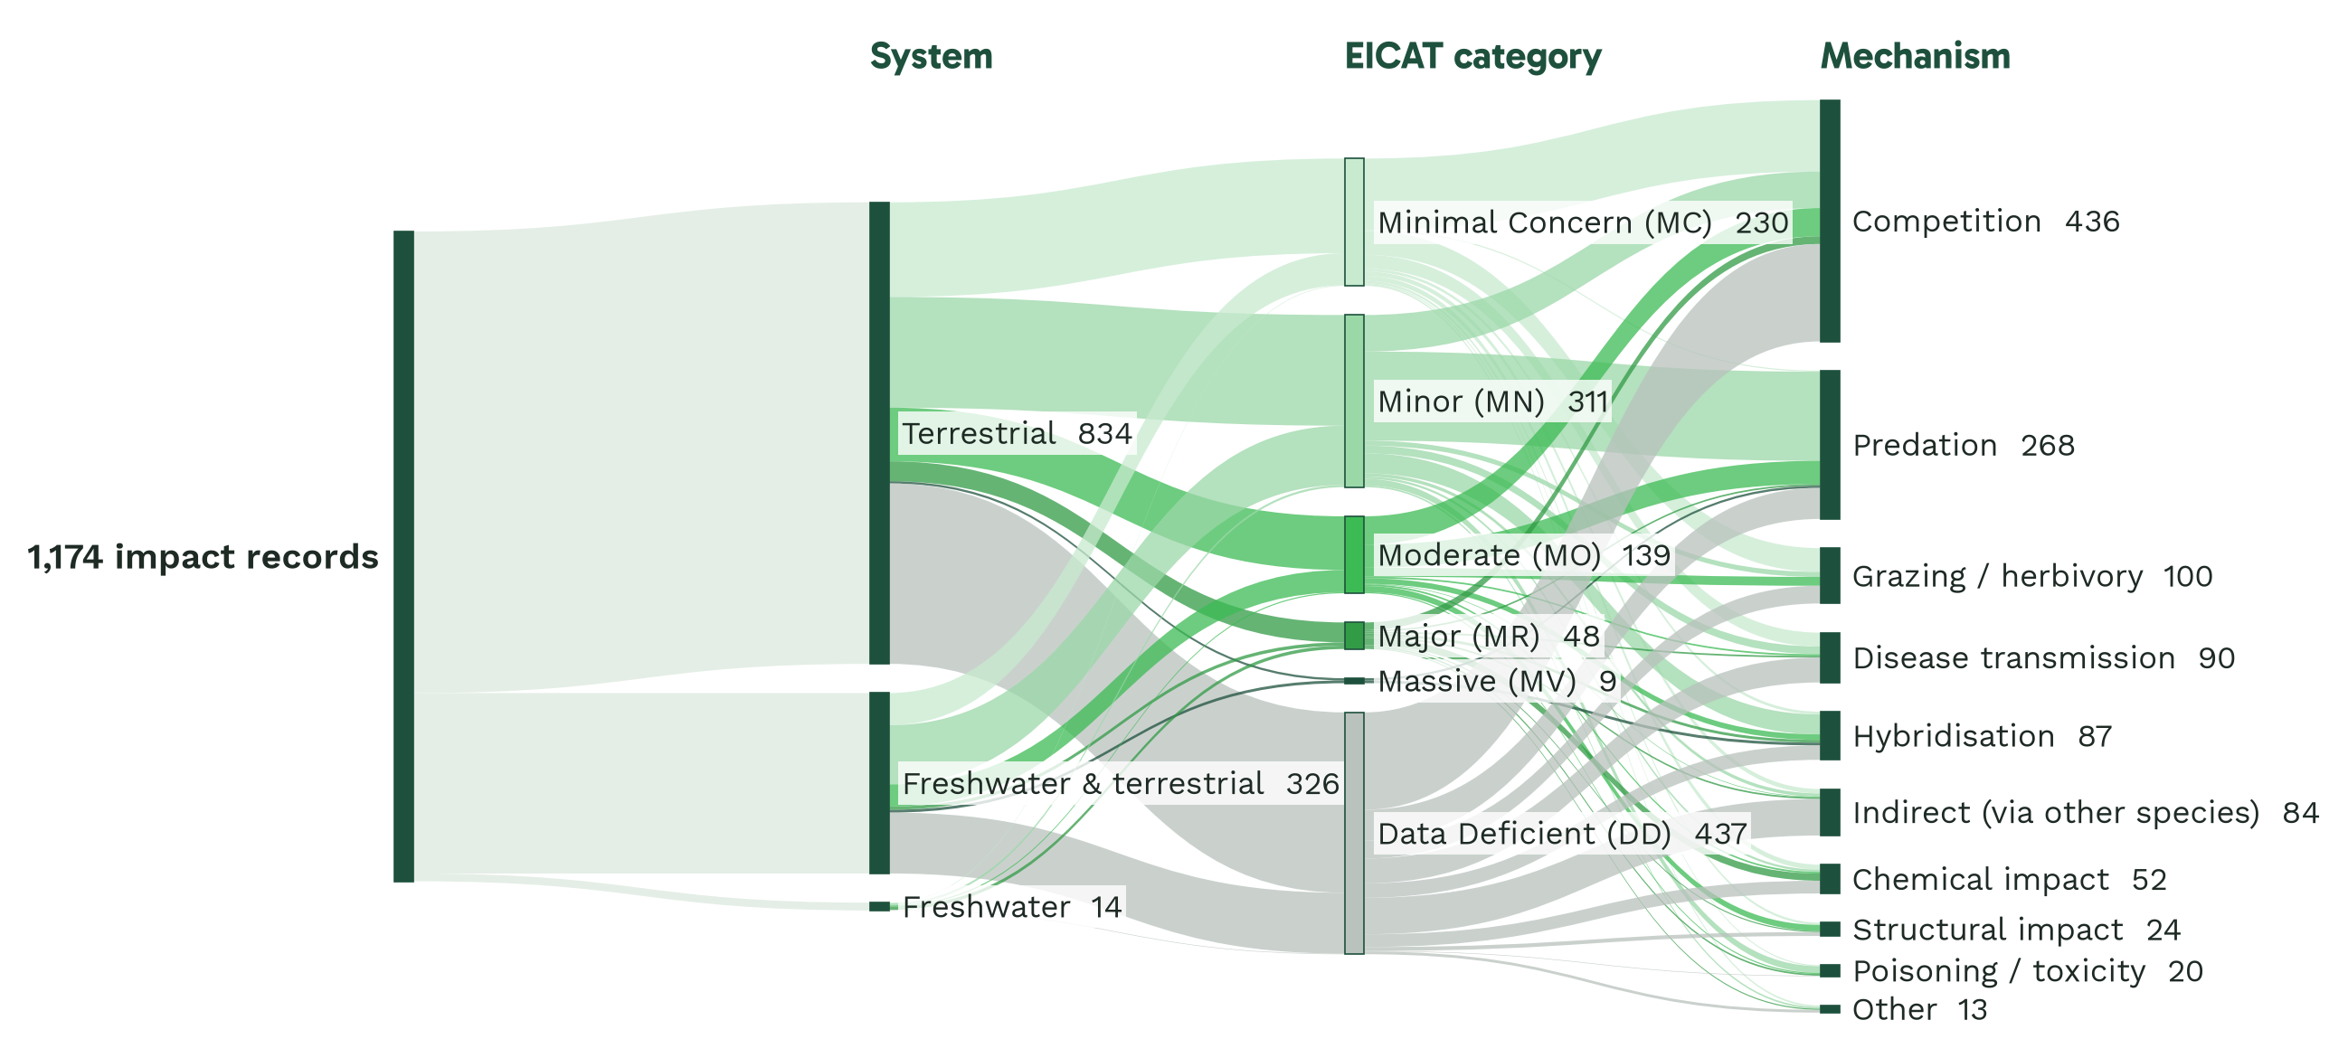
GISD impact records
Notes:
Headline: The bottleneck is reading.
GISD, our gold standard, holds about 1,200 EICAT impact records from 800 references, and every one of those rows is a person reading a paper and judging mechanism and severity. Follow the bands: 71 percent of records are terrestrial, competition and predation together account for 60 percent, and the largest single category is Data Deficient at 37 percent. Major and Massive impacts are only 5 percent of records. Keep those rare classes in mind, because they come back to haunt us in the results.

Slide 4
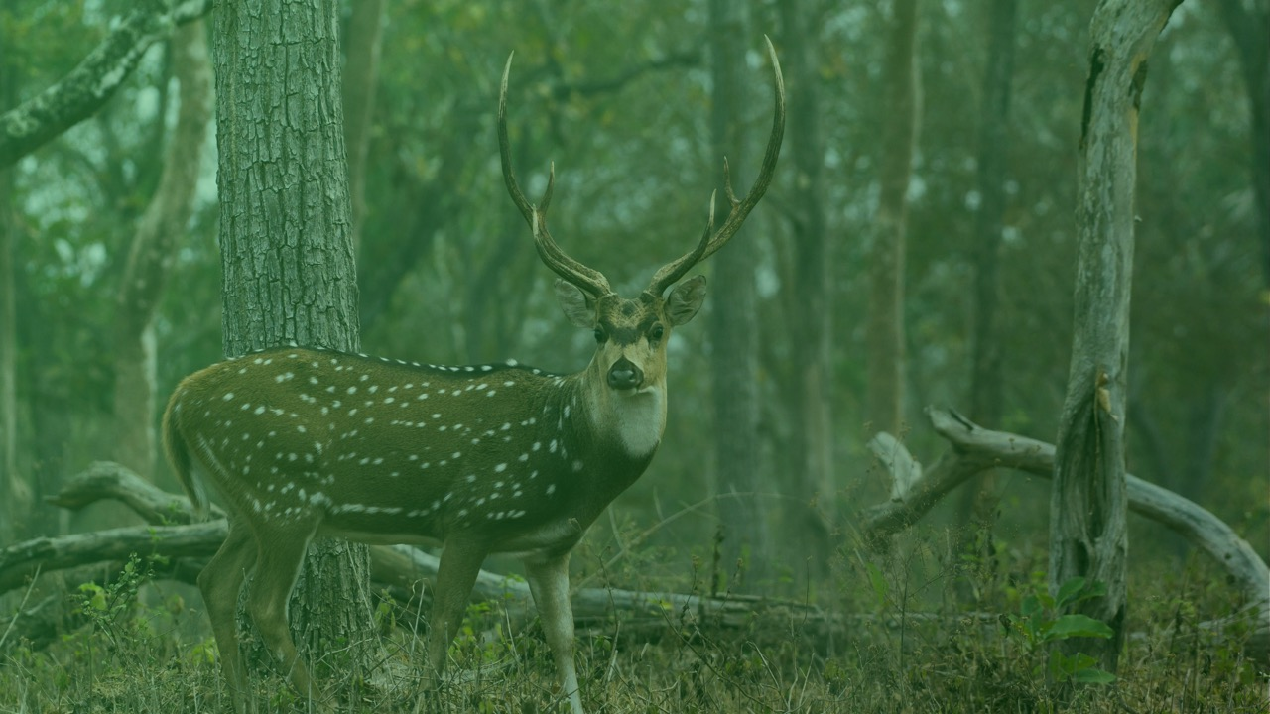
Building EICAT-AI
Notes:
So, can we hand some of that reading to a language model?

Slide 5
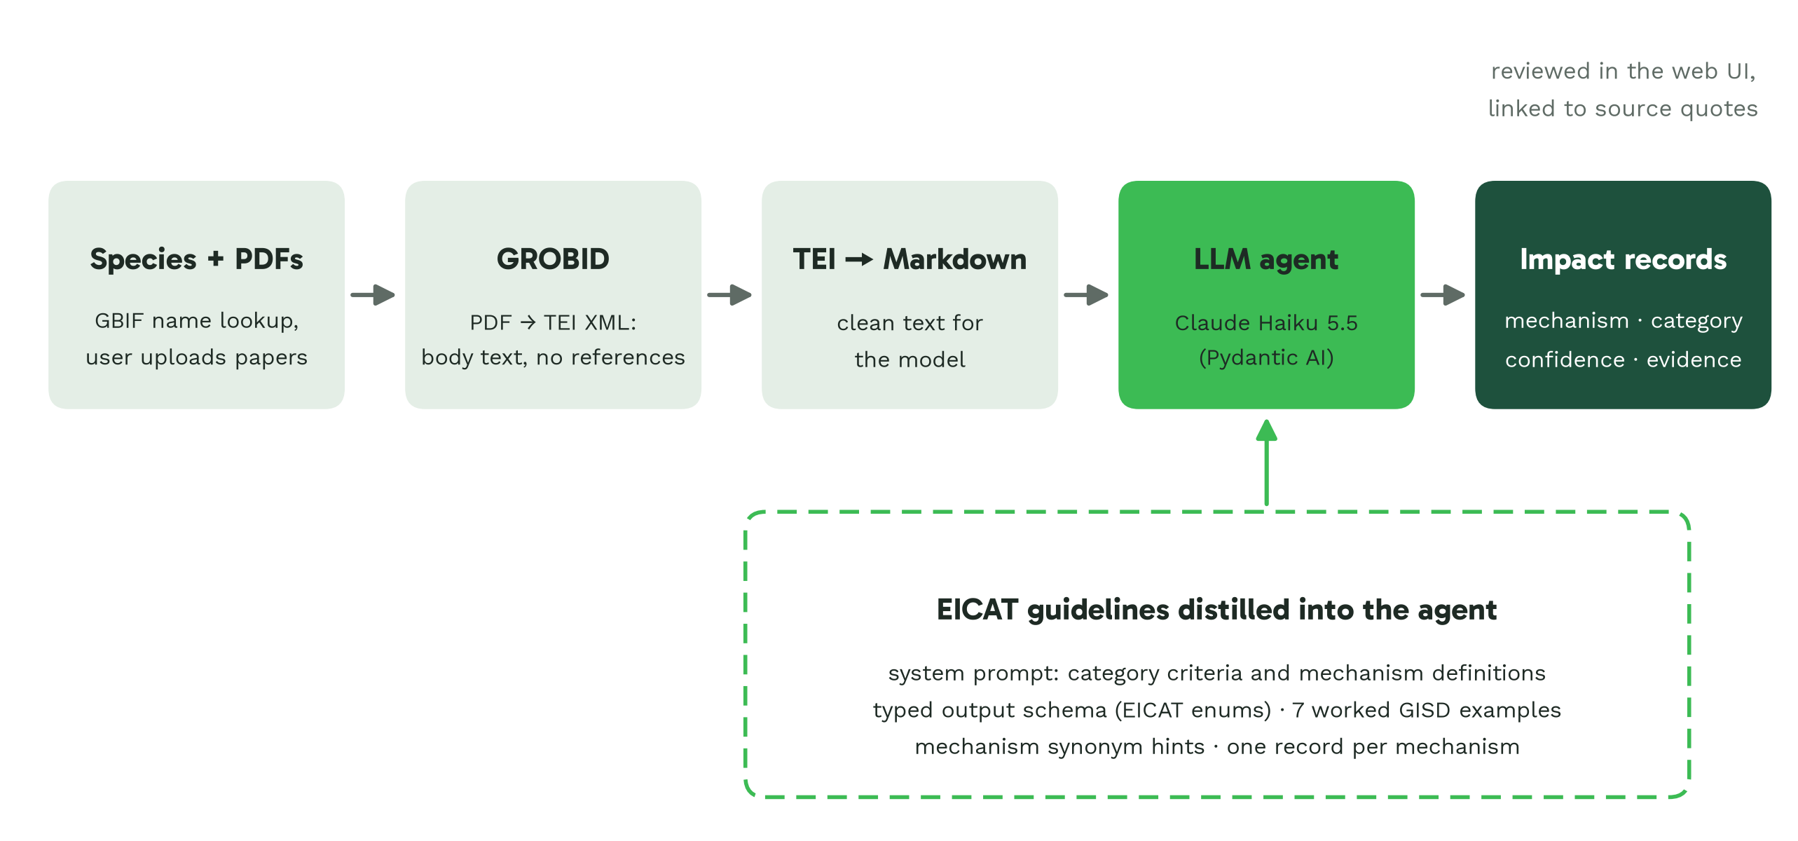
The pipeline
Notes:
Headline: From PDF to EICAT impact records.
The pipeline is deliberately boring, because boring is reproducible. PDFs go through GROBID for clean body text, then to an LLM agent. Rather than retrieval over the guidelines, we distilled EICAT directly into the prompt and into a typed output schema, so the model physically cannot invent a category. The latest version adds seven worked GISD examples. Everything runs on AWS Bedrock in five containers.

Slide 6
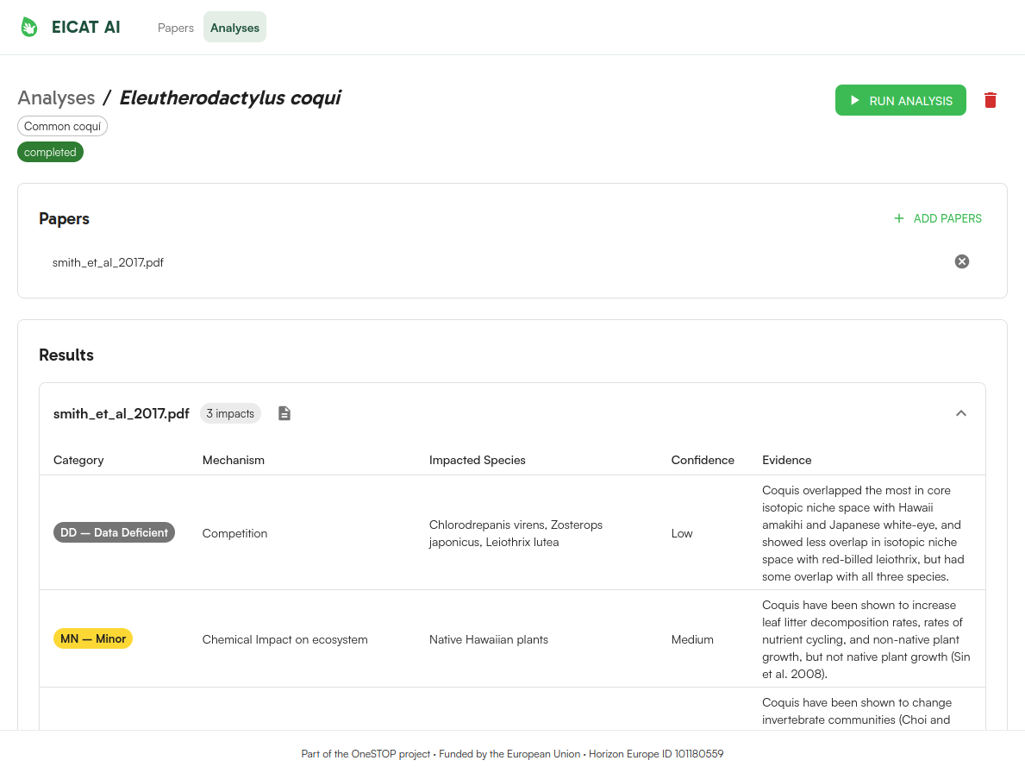
The app
Upload papers for a species
One click runs the analysis
Each record: category, mechanism, confidence, evidence quote
Assessor reviews, rather than reads from scratch
Notes:
Headline: Every impact is traceable to its evidence.
This is the web app. The key design choice is that every impact the model reports carries the exact quote it relied on, so an assessor can verify it in seconds. The intended use is triage and drafting, with the expert still signing off.
Video walkthrough (56 s, loops; the paper is Handal 2021 on the common myna, from the GISD):
0:00 Upload a paper. Drop in a PDF from the GISD reference list.
0:05 GROBID converts it to text. Waiting time is cut from the video.
0:06 Create an analysis for the species. Acridotheres tristis, common myna, then add the paper.
0:21 The LLM extracts EICAT impacts. One click on Run all; each row has a category, mechanism, impacted species, confidence and evidence.
0:30 Check the evidence in the paper. The quote is highlighted in the paper’s own text.
0:37 Verify it. The reviewer ticks the impact off.
0:40 Correct the severity. Change the category inline; the row is marked “AI, edited”.
0:49 Every decision is recorded. The history shows who changed what and when.

Slide 7
Evaluating against GISD
Notes:
Building it is the easy half. Does it actually agree with the experts?

Slide 8
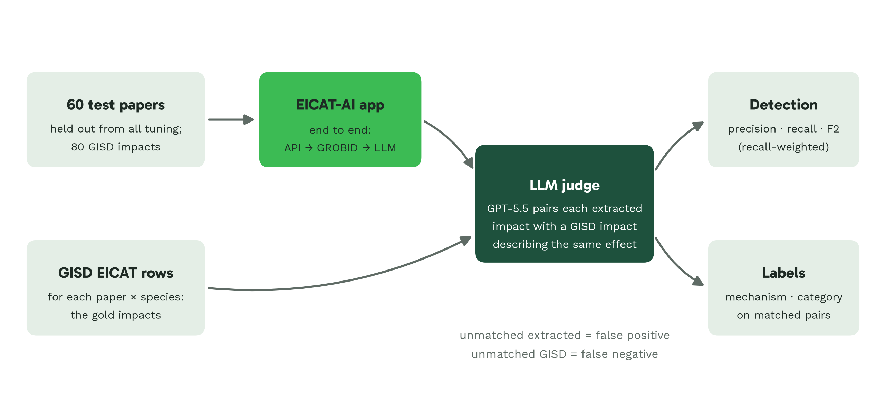
Evaluation design
Notes:
Headline: 60 unseen papers, scored with recall-weighted F2.
We held out 60 papers that were never touched during prompt development. Each one goes through the running app exactly as a user upload would. Free-text impacts can’t be matched by string comparison, so an independent model, GPT-5.5, pairs each extracted impact with the GISD impact describing the same effect. We report F2, which weights recall over precision: for an assessor, a missed impact costs more than a spurious one they can discard.

Slide 9
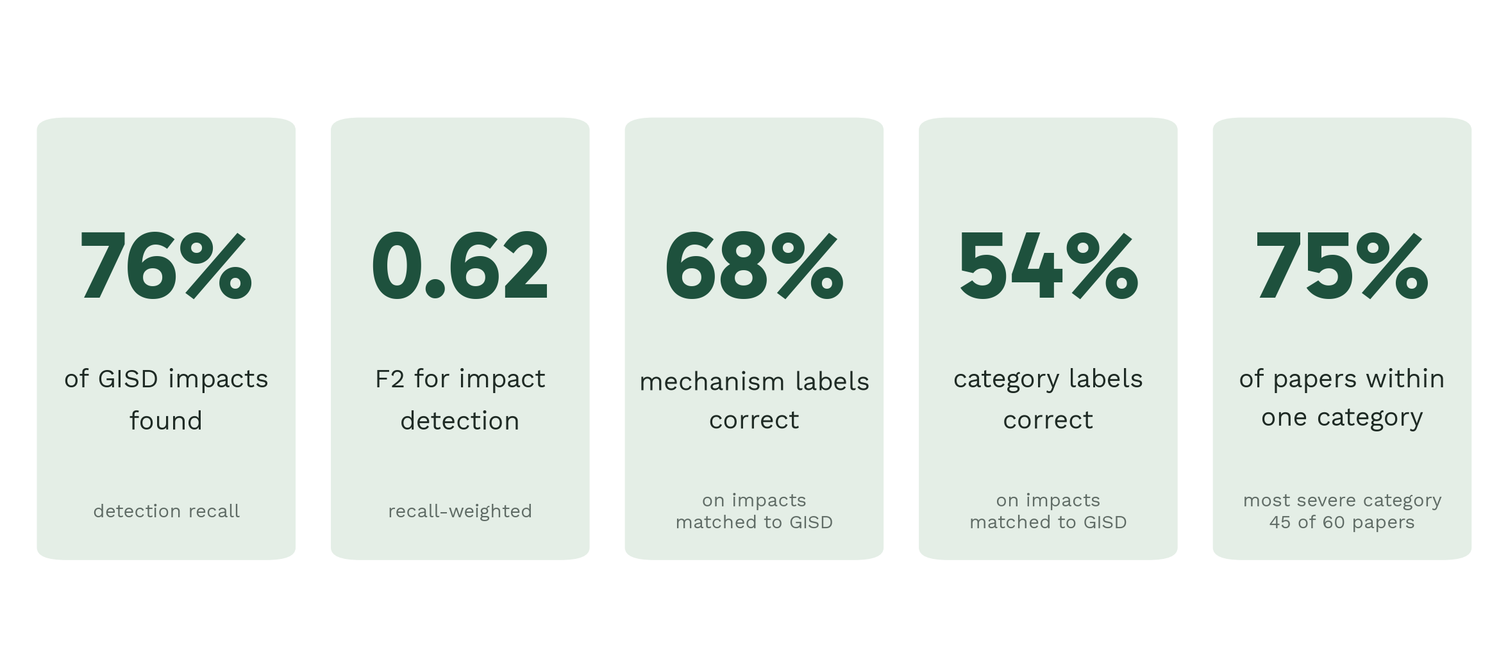
Best configuration
Notes:
Headline: Finds three-quarters of GISD impacts on unseen papers.
Headline numbers for the best setup, Claude Haiku 5.5 with the improved prompt. It finds three-quarters of the impacts GISD records. Mechanism labels are right about two-thirds of the time, category labels about half. And for three-quarters of papers, its most severe category is within one step of GISD’s.

Slide 10
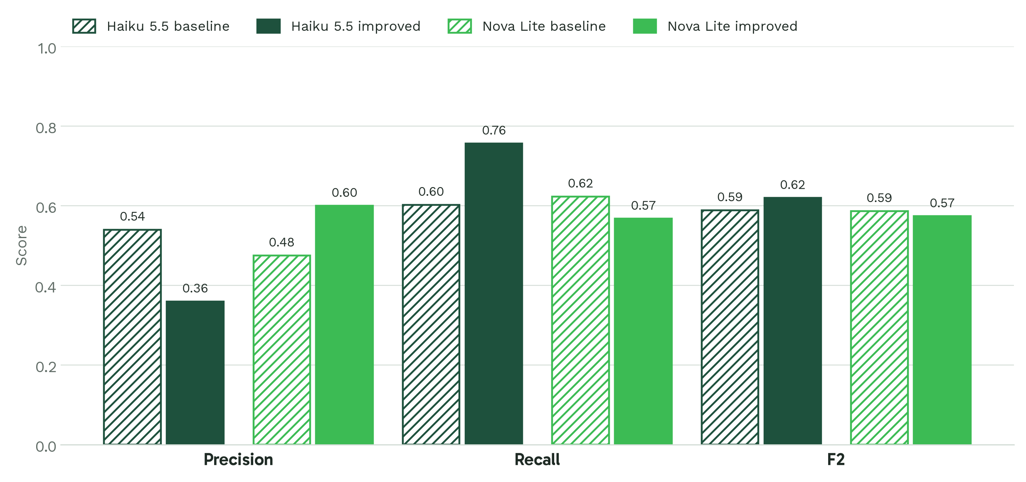
Model comparison
Notes:
Headline: Two models, two prompts: all land at F2 ≈ 0.6.
We compared two Bedrock models, Haiku 5.5 and Nova Lite, each with the original and the improved prompt. They all land at an F2 of about 0.6, and the confidence intervals overlap. The improved prompt mostly moves Haiku along the precision-recall trade-off: it finds more and over-reports more. The cost is roughly 0.4 cents per paper.

Slide 11
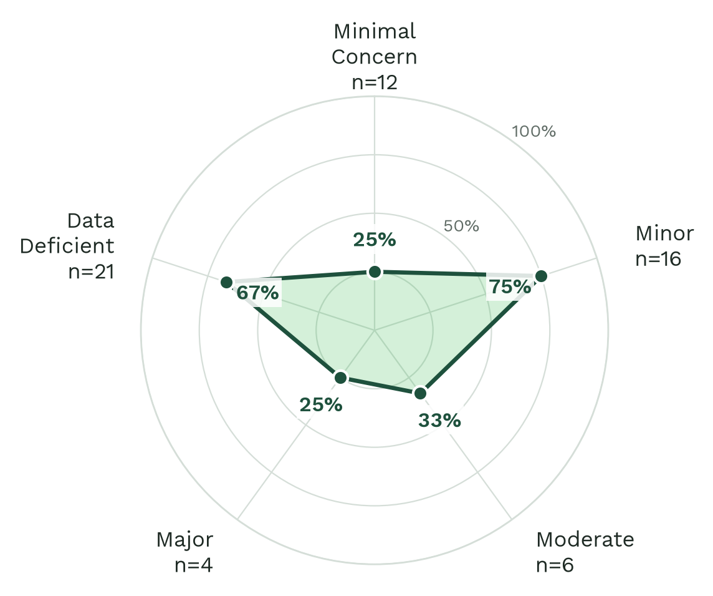
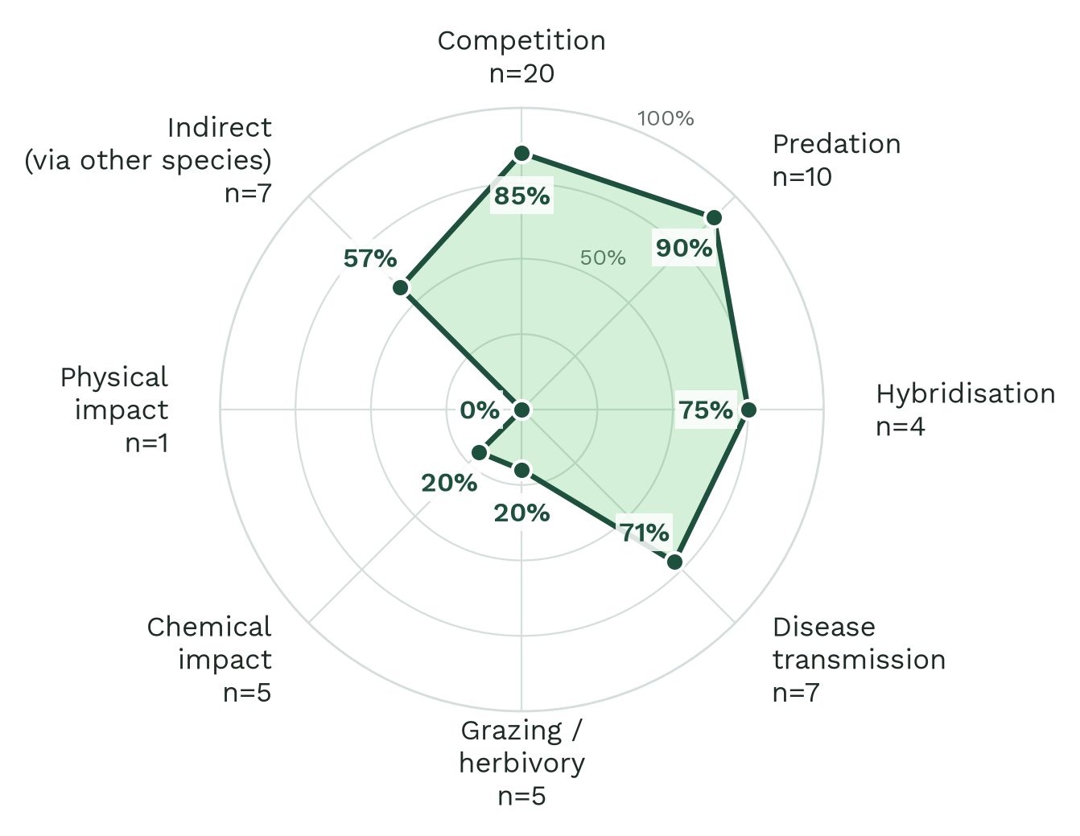
Label accuracy
Notes:
Headline: Stated mechanisms are easy; inferred ones are hard.
Accuracy is far from uniform. Predation and competition, which papers usually state outright, are above 85 percent. Chemical impacts and grazing, which need inference, sit around 20 percent. For categories, Minor and Data Deficient are recognised well; Minimal Concern and Major less so. Mind the small n on several spokes.

Slide 12
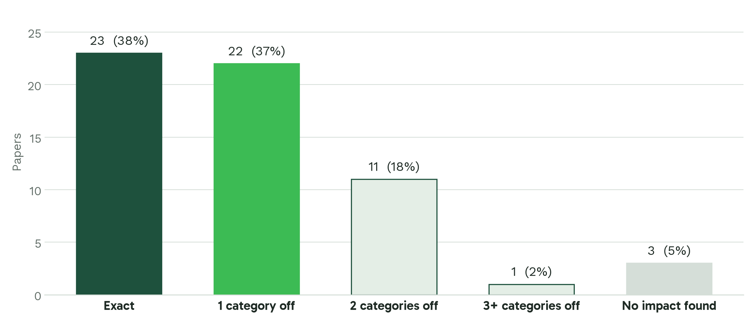
Severity
Notes:
Headline: Severity is usually close, rarely exact.
For the paper’s worst impact, 38 percent are exact and another 37 percent are one category out. So the model is in the right neighbourhood, but rarely at the right address. That raises the obvious question: how often do human experts land at the same address?

Slide 13
Inter-annotator agreement
Notes:
To judge the model fairly, we need a human baseline.

Slide 14
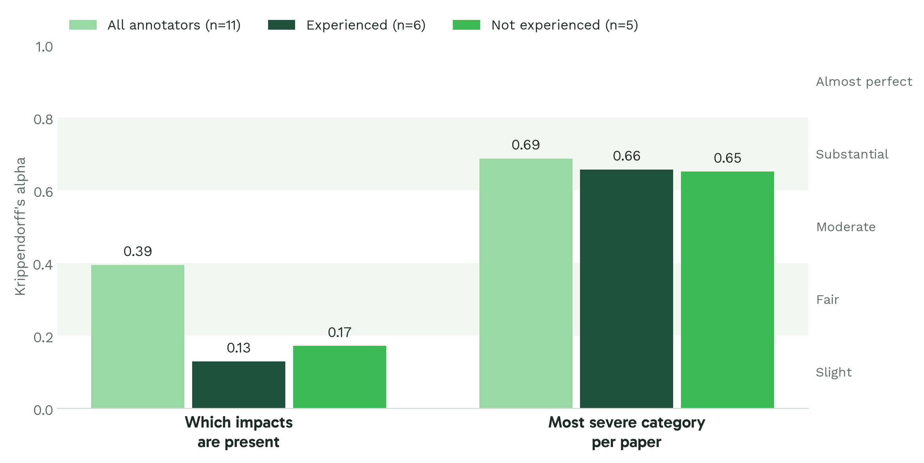
Human agreement
Notes:
Headline: Humans agree fairly on impacts, substantially on severity.
Eleven annotators, six experienced in EICAT and five not, each assessed the same six papers. Agreement on which impacts are present is only fair, with alpha at 0.39. Agreement on each paper’s worst category is substantial, at 0.69, yet only one of the six papers was unanimous. Within-group alpha for impacts looks low because the experienced annotators agree on almost everything they found, which leaves alpha little to credit; the next slide shows that more directly.

Slide 15
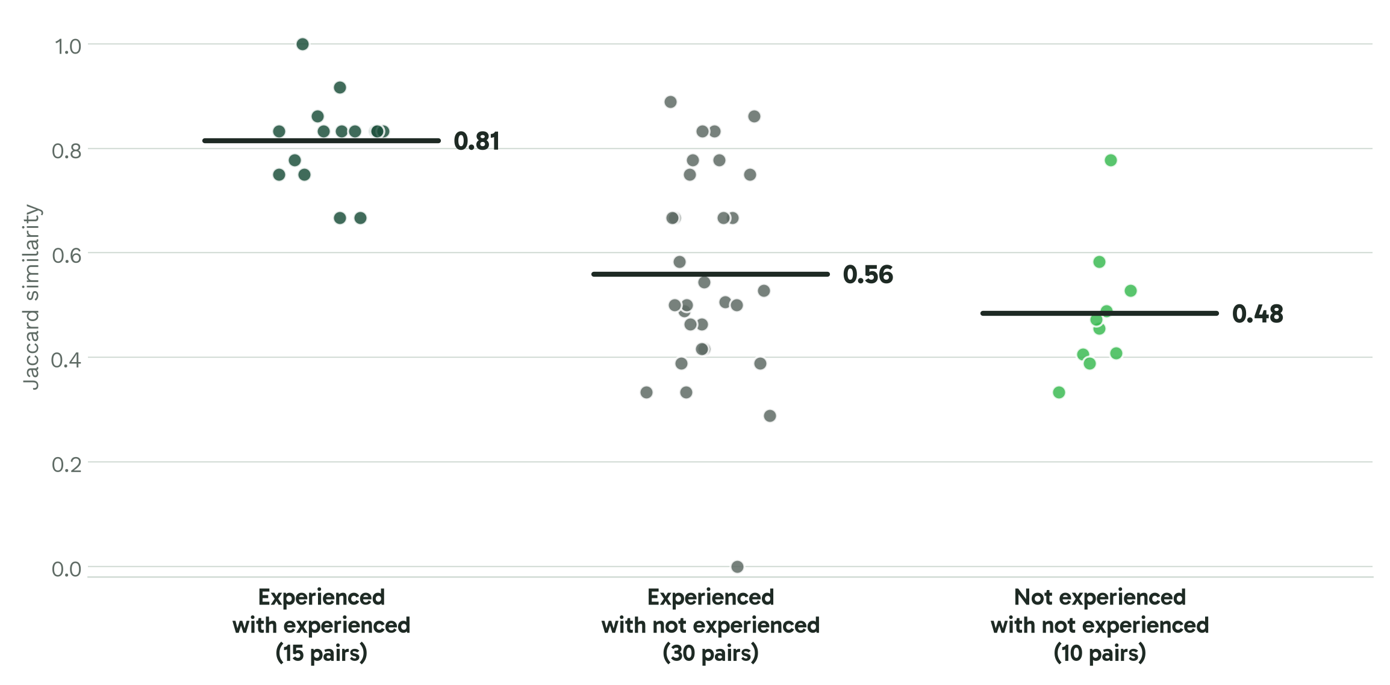
Annotator experience
Notes:
Headline: Experience shows in which impacts are found.
Each dot is a pair of annotators, scored by how much the impacts they found overlap. Experienced pairs overlap at 0.81, against 0.48 for inexperienced pairs; an exact permutation test puts that at p = 0.026. With groups of six and five this is indicative rather than definitive, but it suggests EICAT experience mainly helps people agree on which impacts count.

Slide 16
Take-home
Finds ¾ of GISD impacts for under a cent per paper
Over-reports: precision 0.36, so an expert stays in the loop
Mechanism ✓, severity ~: within one category for 75% of papers
Humans aren’t unanimous either: impacts α = 0.39, severity α = 0.69
Next: larger IAA round, compare the model directly against human agreement, sharpen precision
Notes:
Headline: A diligent but over-enthusiastic research assistant.
To summarise: the model is a diligent but over-enthusiastic research assistant. It finds most of what the experts found and cites its evidence, but it over-reports and its severity calls need checking. Human experts are not unanimous either, especially on which impacts a paper contains. Next we will scale up the agreement study, so the model can be benchmarked against the human ceiling rather than a single gold standard.

Slide 17
Thank you
Questions welcome
OneSTOP receives funding from the European Union’s Horizon Europe Research and Innovation Programme (ID No 101180559). Views and opinions expressed are those of the author(s) only and do not necessarily reflect those of the European Union or the European Research Executive Agency (REA). Neither the EU nor REA can be held responsible for them.
Notes:
Thank you. The code, evaluation scripts and these figures are all in the EICAT-AI repository. Happy to take questions.

