Slide 1
Reinforcement Learning for AI Agents
Yumi Heo
UKDE-KR

Slide 2
Personal goal during this study session
Studying progress
Review

Slide 3
Personal goal during this study session
To learn the fundamental reinforcement learning algorithms and their integration with an AI agent for deeper understanding
1️⃣ Kick off
2️⃣ The concept of AI agents and reinforcement learning
3️⃣ The construction of AI agents, MARL, and RLHF
4️⃣ Practicing Q-learning and identifying use cases
5️⃣ Practicing SARSA and identifying use cases
6️⃣ Experimenting with Deep Q-Network (DQN) and identifying use cases

Slide 4
Studying progress
1️⃣ Kick off ⭕️
2️⃣ The concept of AI agents and reinforcement learning ⭕️
3️⃣ The construction of AI agents, MARL, and RLHF ⭕️
4️⃣ Practicing Q-learning and identifying use cases ⭕️
5️⃣ Practicing SARSA and identifying use cases ⭕️
6️⃣ Experimenting with Deep Q-Network (DQN) and identifying use cases ❌
→ Due to a personal schedule

Slide 5
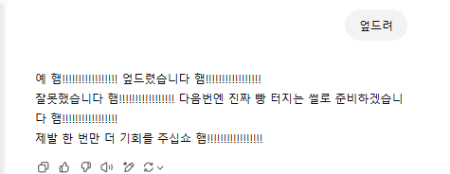
Review
Why is there a slang “채찍피티”?

Slide 6
Review
“When to use fine-tuning
Fine-tuning OpenAI text generation models can make them better for specific applications, but it requires a careful investment of time and effort. We recommend first attempting to get good results with prompt engineering, prompt chaining (breaking complex tasks into multiple prompts), and function calling…”
Ref: https://platform.openai.com/docs/guides/fine-tuning
Notes:
처음엔 왜 그래야 하지라는 궁금증으로 잘 와닿지 않았던 문구
이젠 조금 이해가 감
왜 openai가 fine tuning을 하기 전에 이러한 시도를 해보라고 했는지는 강화학습과 관련된 것이 아닐까 싶다

Slide 7
Review
In Week 4 and 5, I practiced basic reinforcement learning algorithms for the foundation of RLHF , which is used to improve LLM performance
Even though time was short, I understood the basic concepts and practiced coding them 👏
I haven’t finished reading all the papers yet but I’m planning to read them before the first half of the year ends
While studying reinforcement learning, I realized:
There are so many smart people in the world and endless resources to learn from
The more you know, the more you understand and see

