Slide 1
Reinforcement Learning for AI Agents
Yumi Heo
UKDE-KR

Slide 2
Personal goal during this study session
Studying progress
Review

Slide 3
Personal goal during this study session
To learn the fundamental reinforcement learning algorithms and their integration with an AI agent for deeper understanding
1️⃣ Kick off
2️⃣ The concept of AI agents and reinforcement learning
3️⃣ The construction of AI agents, MARL, and RLHF
4️⃣ Practicing Q-learning and identifying use cases
5️⃣ Practicing SARSA and identifying use cases
6️⃣ Experimenting with Deep Q-Network (DQN) and identifying use cases

Slide 4
Studying progress
1️⃣ Kick off ⭕️
2️⃣ The concept of AI agents and reinforcement learning ⭕️
3️⃣ The construction of AI agents, MARL, and RLHF ⭕️
4️⃣ Practicing Q-learning and identifying use cases ⭕️
5️⃣ Practicing SARSA and identifying use cases ⭕️
6️⃣ Experimenting with Deep Q-Network (DQN) and identifying use cases ❌

Slide 5
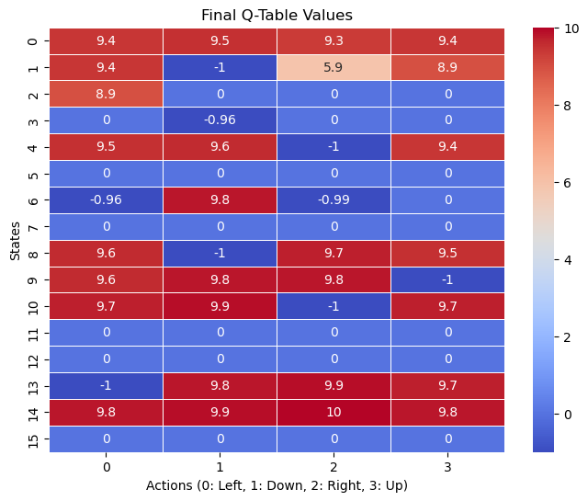
Q-learning
2000 episodes (100 steps)
16 states (Frozen Lake: 4x4 environment)
0: Left / 1: Down / 2: Right / 3: Up
Red: higher positive Q-values, a higher cumulative reward
Blue: lower or negative Q-values, a lower or even negative cumulative reward
Each cell is the learned Q-value for that state-action combination

Slide 6
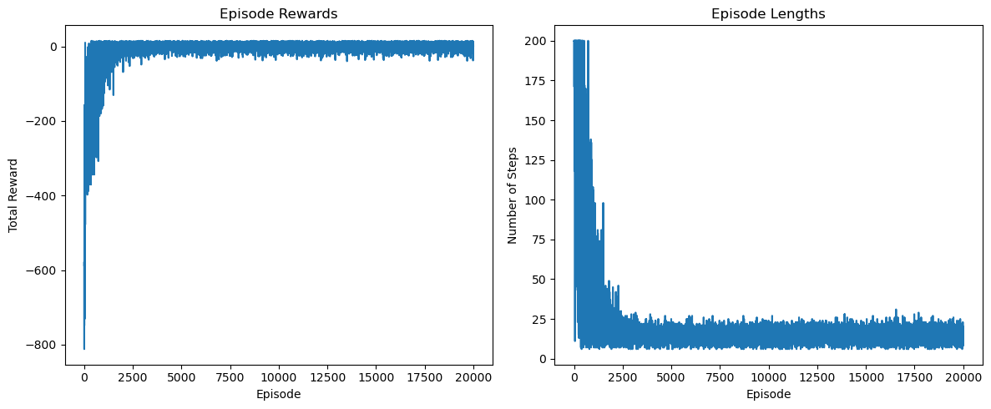
SARSA
20,000 episodes
500 states: 5x5 grid + passenger/destination options.
Rewards: +20 (drop-off), -10 (illegal), -1 (per step).

Slide 7
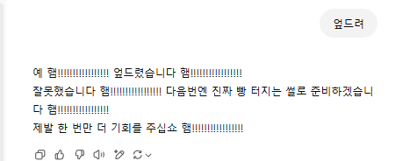
Review
Why is there a slang “채찍피티”?
Human feedback: People (labelers) were shown multiple possible responses I could give to prompts. They ranked the responses from best to worst.
Reward model: This ranking data trained a model (e.g. ChatGPT) to predict which responses humans would prefer.

Slide 8
Review
“When to use fine-tuning
Fine-tuning OpenAI text generation models can make them better for specific applications, but it requires a careful investment of time and effort. We recommend first attempting to get good results with prompt engineering, prompt chaining (breaking complex tasks into multiple prompts), and function calling…”
Reference: https://platform.openai.com/docs/guides/fine-tuning

Slide 9
Review
Practiced basic reinforcement learning algorithms for the foundation of RLHF, which is used to improve LLM performance
Understood the basic concepts and practiced coding them
Planning to read papers before the first half of the year ends

