Slide 1
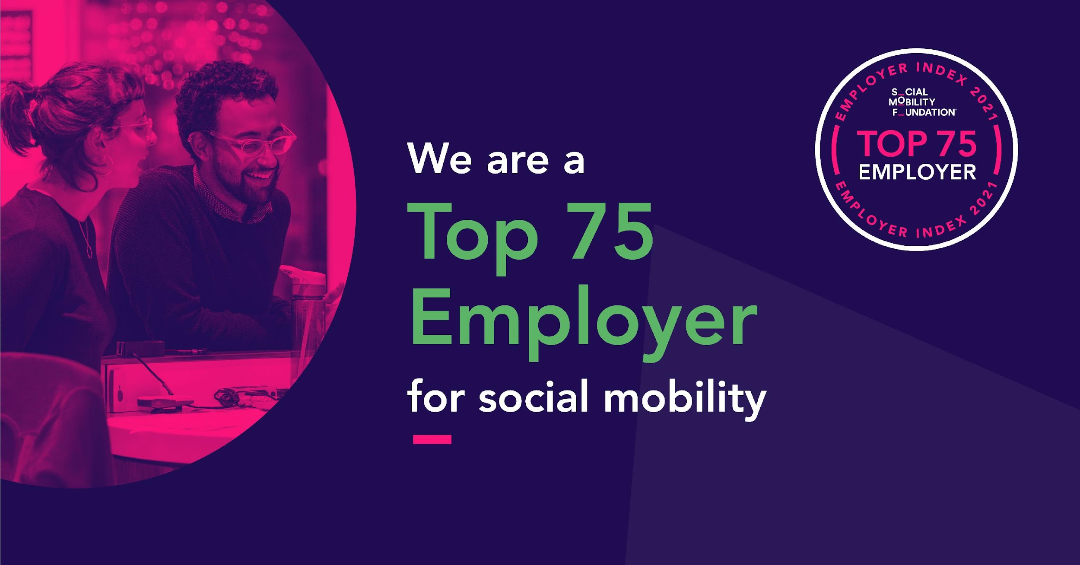
Employer event: SMC Masterclass: Mentoring as a tool to support social mobility
27 October 2022

Slide 2
Today’s session
Introduction – Paula Kemp, Head of Employer Engagement, SMC
Deep dive with – Eddie Fletcher, Head of Social Mobility, Ministry of Justice People Group
In conversation with – Mercy Abel, Rachel Dolby and Eddie Fletcher
Your Questions
Next steps … Resources and support

Slide 3




Workshop etiquette
Remain on mute
Use the Q&A function to ask questions
Webinar will be recorded
Closed captions available

Slide 4

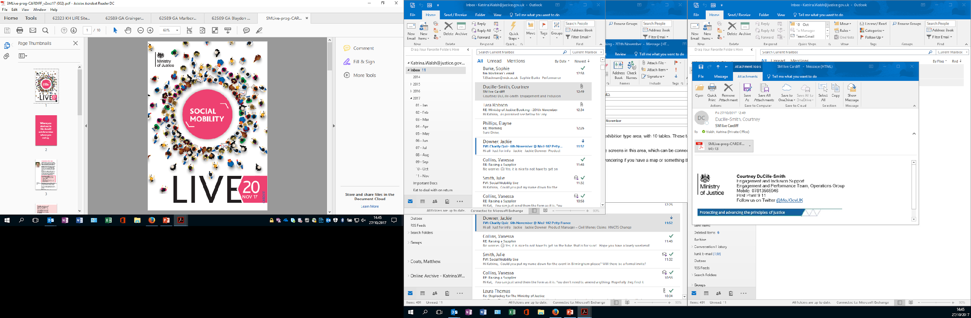


Civil Service Catapult Mentoring Programme
SMC Employer Session
27th October 2022
Eddie Fletcher
MoJ Head of Social Mobility

Slide 5
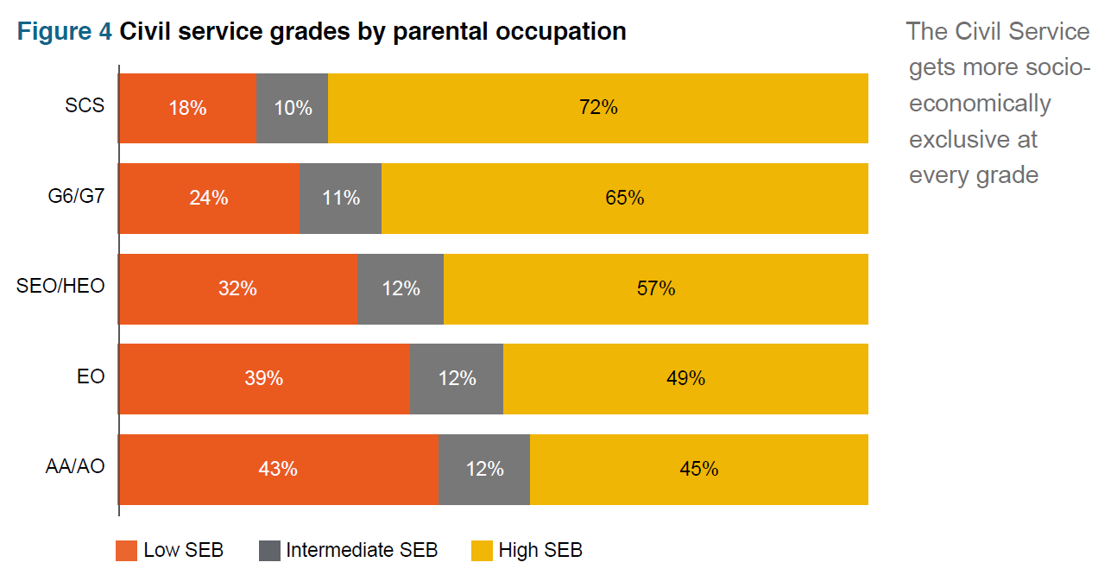
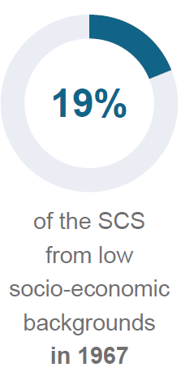
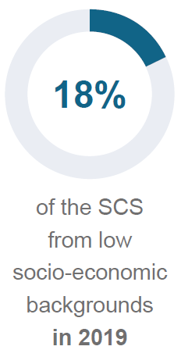
What is the issue?
“Evidence shows that organisations work better, and are more creative, when they have people from different backgrounds, offering different perspectives. This is even more imperative when one’s role, as in the Civil Service, is to shape what Britain looks like”.
People from High SEB are significantly over-represented in the Civil Service; 54% are from High SEB compared to 37% of UK workforce.
Those from low SEB are particularly under-represented in departments such as Treasury and DCMS, and within the policy profession
Even when those from LSEB ‘get in’ they struggle to ‘get on’: The Civil Service becomes more socially exclusive at every grade.
Source – Social Mobility Commission - Navigating the Labyrinth May 2021

Slide 6
Catapult Mentoring/Sponsorship Programme
Mentees are staff (below Grade 7) that come from a Lower Socio-Economic Background, Mentors are senior leaders (above Grade 7)
Minimum of 1 hour per month for 12 months
Additional optional development sessions available
Cohort 1 – 1,326 Matches, Cohort 2 – 1,712 Matches across 32 government organisations
Resources
Programme Manager (0.6 FTE), Admin (0.2 FTE)

Slide 7
Outcomes/Impact
Organisational Impact
Built strong links with academia, 42 NRG Universities engaged with GAP
Increased reputation as an inclusive and innovative organisation
Influence government departments e.g. 32 involved with Catapult
Influencing conversation around recruitment, retention and development
Engaging and attracting a diverse range of talent from around UK
Individual Impact
Over 90,000 students from over 1,000 educational establishments engaged
Over 1,000 WE placements for students from less privileged backgrounds
Over 3,000 Catapult Mentees supported, with 42% progressing their careers whilst on programme
Over 1,700 Ambassadors engaged in programmes
Cultural Impact
Using background promotes other diverse characteristics, e.g. 43% of Catapult Mentees from minority ethnic background, 26% have a disability, 60% female
Staff and leaders actively engaging with other gov depts sharing learning
Change in opinion of senior leaders in what talent looks like and how this impacts the work we do
Changing culture by actively engaging with those from different backgrounds
Promoting diversity of thought

Slide 8
Set-up and Pitfalls
‘Build it and they will come’
Don't try to build gold standard straight away
Communications are key
Support structures
Celebrate and communicate successes (and failures)

Slide 9
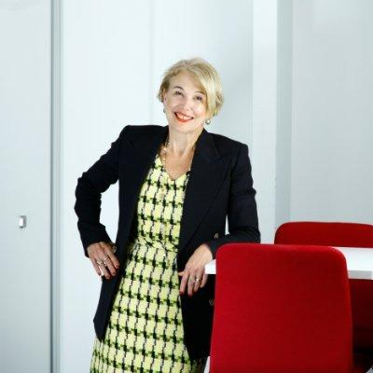

Next Events
Wednesday 9 November, 1.00pm
In conversation with Ann Francke OBE: The building blocks of social mobility in the workplace
Tuesday 29 November, 2.00pm
Employer Event: T Levels: What, why, where and how?
https://socialmobilityworks.org/events/

Slide 10

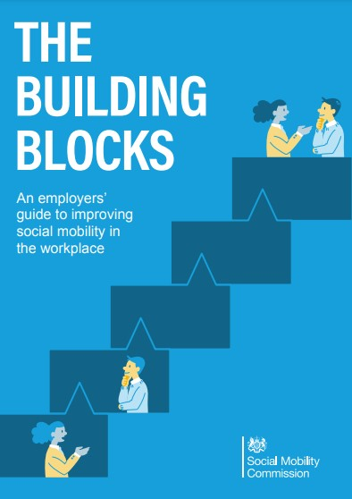

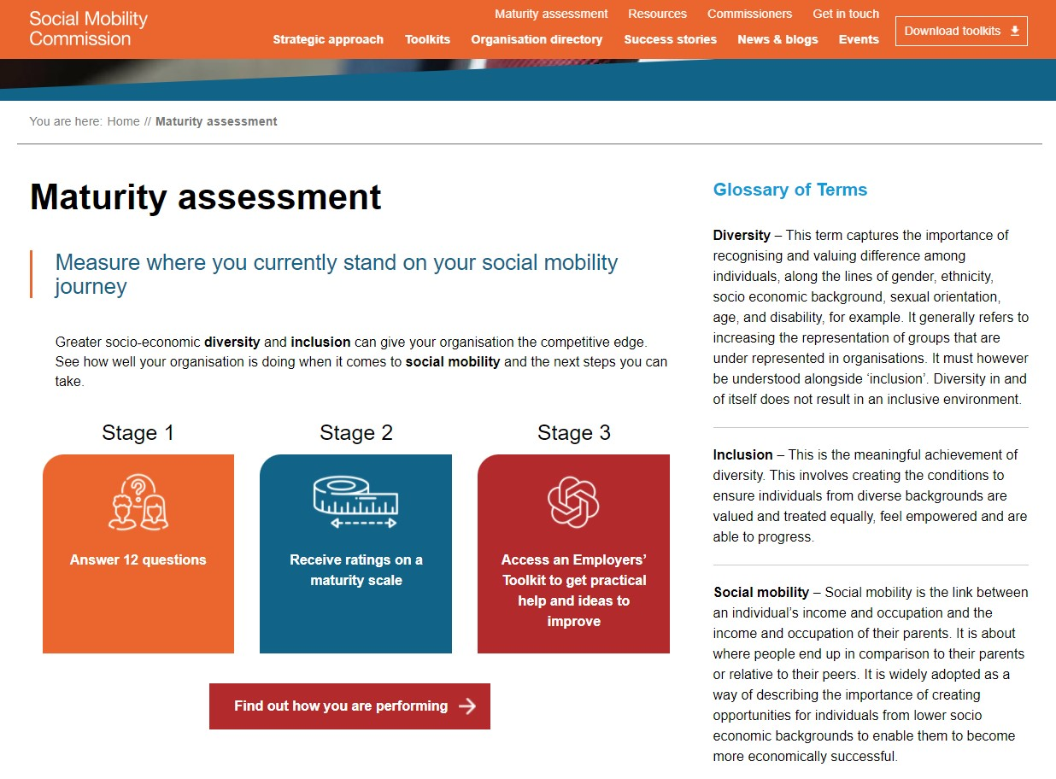
Further resources
socialmobilityworks.org
contact@socialmobilitycommission.gov.uk

