Slide 1


BASIC ELEMENTS OF C++

Slide 2
Objectives
Become familiar with the basic components of a C++ program, including functions, special symbols, and identifiers
Explore simple data types and examine the string data type
Discover how to use arithmetic operators
Examine how a program evaluates arithmetic expressions
Learn what an assignment statement is and what it does

Slide 3
Objectives
Discover how to input data into memory using input statements
Become familiar with the use of increment and decrement operators
Examine ways to output results using output statements
Learn how to use preprocessor directives and why they are necessary
Explore how to properly structure a program, including using comments
Learn how to write a C++ program

Slide 4
Reasons to Learn C++
Large amount of C and C++ code still running the world’s businesses, defense systems, embedded devices and operating systems.
Much new development also
All programmers are required to C++ to enter heaven
C++ makes you more attractive to the opposite sex

Slide 5
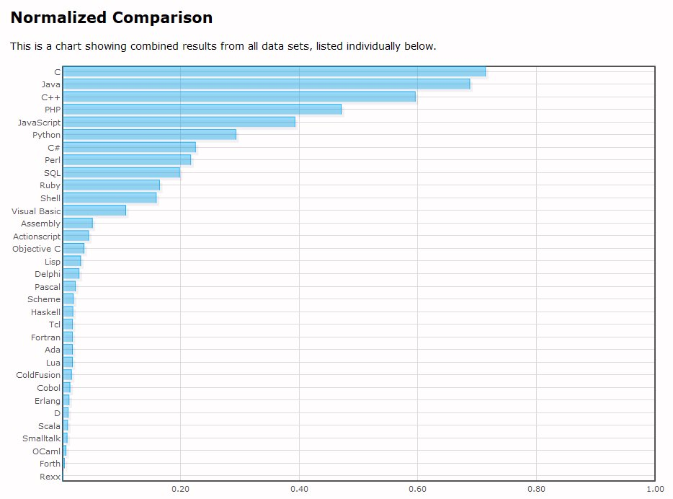
From langpop.com – various sources

Slide 6
Programming
Computer program - a sequence of statements designed to accomplish some task
Programming - a process of planning and creating a program
Syntax - rules that tell us which statements (instructions) are legal
Programming language - a set of rules, symbols, and special words
Semantic rules - determine the meaning of the instructions
Metalanguage - language used to write the syntax rules

Slide 7
C++ Programs
A C++ program is a collection of one or more subprograms, called functions, usually grouped in classes
A subprogram or a function is a collection of statements that when activated (executed) accomplishes something
Every C++ program has a function called main
The smallest individual unit of a program written in any language is called a token

Slide 8
Symbols
Special symbols include:
    +
    -
    *
    /
    .
    ;
    ?
    ,
    <=
    !=
    ==
    >=

Slide 9
Symbols
Word symbols
  are called reserved words, or keywords
  include: int, float, double, char, void, return

Slide 10
Identifiers
Consist of letters, digits, and the underscore character (_)
Must begin with a letter or underscore
C++ is case sensitive—uppercase and lower case letters are different
Some of the predefined identifiers are cout and cin
Unlike reserved words, predefined identifiers may be redefined, but it would not be wise to do so

Slide 11
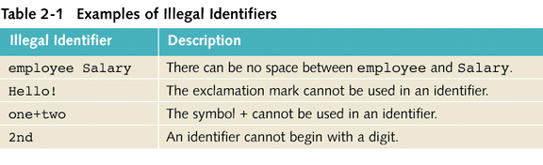
Legal and Illegal Identifiers
The following are legal identifiers in C++:
  first
  conversion
  payRate

Slide 12
Simple Data Types
Data Type - a set of values together with a set of operations is called a data type
C++ simple data can be classified into three categories
  integral - deals with integers, or numbers without a decimal part
  floating-point - deals with decimal numbers
  enumeration type - user-defined data type

Slide 13
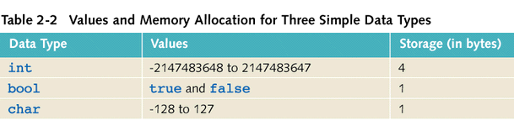
Values and Memory Allocation

Slide 14
int Data Type
Examples:
  -6728
  0
  78
Positive integers do not have to have a + sign in front of them
No commas are used within an integer
In C++ commas are reserved for separating items in a list

Slide 15
bool Data Type
The data type bool has two values, true and false
The central purpose of this data type is to manipulate logical (Boolean) expressions
True and false are called logical (Boolean) values
In C++ bool, true, and false are reserved words

Slide 16
char Data Type
The smallest integral data type
Used to represent characters, that is letters, digits, and special symbols
Each character is enclosed within single quote marks
Some of the values belonging to char data type are:
  'A', 'a', '0', '*', '+', '$', '&'
A blank space is a character and is written ' ', with a space left between the single quotes

Slide 17
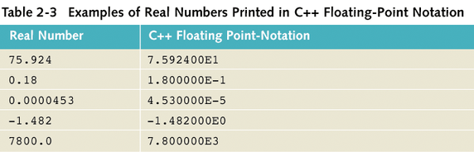
Floating-Point Data Types
To represent real numbers C++ uses scientific notation called floating-point notation

Slide 18
Floating-Point Data Types
Float - used in C++ to represent any real number between -3.4E+38 and 3.4E+38
The memory allocated for the float data type is 4 bytes
Double - used in C++ to represent any real number between -1.7E+308 and 1.7E+308
The memory allocated for the double data type is 8 bytes
On most newer compilers, the data types double and long double are the same

Slide 19
Floating-Point Data Types
The maximum number of significant digits (decimal places) in float values is 6 or 7
Float values are called single precision
The maximum number of significant digits in values belonging to the double type is 15
Double values are called double precision
The maximum number of significant digits is called the precision

Slide 20
string Data Type
Programmer-defined type supplied in the standard library
Sequence of zero or more characters
Enclosed in double quotation marks
A string with no characters is called a null or empty string
Every character has a relative position in the string
The position of the first character is 0, the position of the second character is 1, and so on
Length of a string is the number of characters in it

Slide 21
Arithmetic Operators
C++ Operators
  + addition
  - subtraction
  * multiplication
  / division
  % remainder (mod operator)
The operators +, -, *, and / can be used with both integral and floating-point data types
The % is used only with the integral data type to find the remainder in ordinary division
Unary operator - has only one operand
Binary Operator - has two operands

Slide 22
Order of Precedence
All operations inside of ( ) are evaluated first
The operators *, /, and % are at the same level of precedence and are evaluated next
The operators + and – have the same level of precedence and are evaluated last
When operators are all on the same level, they are performed from left to right

Slide 23
Mixed Expressions
Mixed expression - an expression that has operands of different data types
Contains both integers and floating-point numbers
Examples of mixed expressions:
  2 + 3.5
  6 / 4 + 3.9
  5.4 * 2 – 13.6 + 18 / 2

Slide 24
Evaluating Mixed Expressions
If the operator has the same types of operands, it is evaluated according to the type of the operands
If the operator has both types of operands,
  during calculation the integer is changed to a floating-point number with the decimal part of zero and the operator is evaluated
  the result is a floating-point number

Slide 25
Evaluating Mixed Expressions
The entire expression is evaluated according to the precedence rules
  the multiplication, division, and modulus operators are evaluated before the addition and subtraction operators
  operators having the same level of precedence are evaluated from left to right
  grouping is allowed for clarity

Slide 26
Assignment Statement
The assignment statement takes the form:
variable = expression;
The expression is evaluated and its value is assigned to the variable on the left side
In C++ = is called the assignment operator
A C++ statement like:
I = I + 2;
Evaluates whatever is in I, adds two to it, and assigns the new value to the memory location I

Slide 27
Declaring & Initializing Variables
Variables can be initialized when they are declared
For example:
int first=13, second=10;
char ch=' ';
double x=12.6, y=123.456;
This will declare first and second as integer and fill them with the values 13 and 10 respectively

Slide 28
Allocating Memory
Named Constant - memory location whose content is not allowed to change during program execution
Variable - a memory location whose content may change during program execution
The syntax to declare a named constant is:
const dataType identifier = value;
In C++, const is a reserved word

Slide 29
Input (Read) Statement
Syntax of cin together with >> is used to gather input
cin>>variable>>variable. . .;
The extraction operator is >>
For example, if miles is a variable of the type double the statement:
cin>>miles;
It causes the computer to get a value of the type double and place it in the memory cell miles

Slide 30
Input Statement
Using more than one variable in cin allows more than one value to be read at a time
For example, if feet and inch are variables of the type int a statement like:
cin>>feet>>inch;
Inputs two integers that are entered at the keyboard and places them in the memory location feet and inch, respectively

Slide 31
Increment & Decrement Operators
Increment operator - increment the value of a variable by 1
Decrement operator - decrement the value of a variable by 1
Pre-increment: ++variable
Post-increment: variable++
Pre-decrement: --variable
Post-decrement: variable--

Slide 32
Increment & Decrement Operators
For example:
++count; or count++; increments the value of count by 1
--count; or count--; decrements the value of count by
If you have x = 5; and y = ++x;
  after the second statement both x and y are 6.
If you have x = 5; and y = x++;
  after the second statement y is 5 and x is 6.

Slide 33
Output
The syntax of cout together with << is:
cout<<expression or manipulator<<expression or manipulator...;
This is called an output statement
The << operator is called the insertion operator or the stream insertion operator
Sometimes this is also called a cout statement

Slide 34
Output
In the example:
cout<<expression or manipulator<<expression or manipulator...;
Expression - is evaluated and its value is printed at the current cursor position on the screen
Manipulator - manipulates the output
endl - the simplest manipulator, which causes the cursor to move to the beginning of the next line

Slide 35
Output Example
The output of the C++ statement cout<<a; is meaningful provided the variable a has been given a value
  For example, the sequence of C++ statements,
a = 45;
cout<<a;
will produce an output of 45

Slide 36
Program Example
int a, b, c, d;
a = 65 ; //Line 1
b = 78 ; //Line 2
cout<<29/4<<endl; //Line 3
cout<<3.0/2<<endl; //Line 4
cout<<"Hello there.\n"; //Line 5
cout<<7<<endl; //Line 6
cout<<3+5<<endl; //Line 7
cout<<"3+5"; //Line 8
cout<<endl; //Line 9

Slide 37
Output of Statement
7 at Line 3
1.5 at Line 4
Hello there. at Line 5
7 at Line 6
8 at Line 7
3+5 at Line 8

Slide 38
The New Line Character
The new line character is “\n”
Without this character the output is printed on one line
This command tells the output to go to the next line
When \n is encountered in the string, the cursor is positioned at the beginning of the next line
A \n may appear anywhere in the string

Slide 39
Examples
Without the new line character:
  cout<<"Hello there.";
  cout<<"My name is Timmy!";
  Would output:
  Hello there.My name is Timmy!
With the new line character:
  cout<<"Hello there.\n";
  cout<<"My name is Timmy!";
  Would output
  Hello there.
  My name is Timmy!

Slide 40
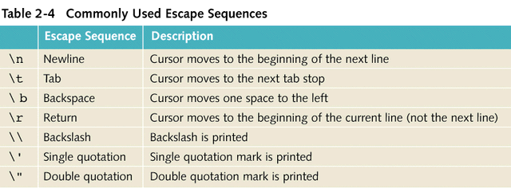
Common Escape Sequences

Slide 41
Preprocessor Directives
Only a small number of operations are explicitly defined in C++
Many of the functions and symbols that are necessary to run a C++ program are provided as a collection of libraries
Every library has a name and is referred to by a header file
Preprocessor directives are commands supplied to the preprocessor
All preprocessor commands begin with #
There is no semicolon at the end of these commands

Slide 42
Preprocessor Directive Syntax
The general syntax to include a header file (provided by the SDK) in a C++ program is:
#include <headerFileName>
The preprocessor directive causes the preprocessor to include the header file iostream in the program
The syntax is:
#include <iostream>

Slide 43
Header Files
In Standard C++, header files have the file extension .h
The descriptions of the functions needed to perform I/O are contained in the header file iostream.h
The syntax is:
  #include <iostream.h>
  #include <math.h>

Slide 44
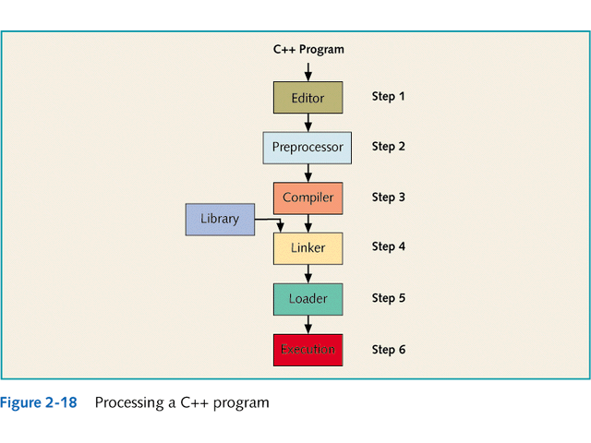

Slide 45
Program Style and Form
The Program Part
  every C++ program has a function main
  the basic parts of the function main are:
    The heading
    The body of the function
The heading part has the following form
typeOfFunction main(argument list)

Slide 46
Body and Syntax
The body of the function is enclosed between { and }
It has two types of statements
  declaration statements
  executable statements
Syntax
  Errors in syntax are detected during compilation.
  int x; //Line 1
  int y //Line 2: syntax error
  double z; //Line 3
  y = w + x; //Line 4: syntax error

Slide 47
Statements
Declaration Statements
  int a, b, c;
double x, y;
  Variables can be declared anywhere in the program, but they must be declared before they can be used
Executable Statements have three forms:
  a = 4; //assignment statement
cin>>b; //input statement
cout<<a<<endl<<b<<endl; //output statement

Slide 48
Special Characters
Use of Blanks
  one or more blanks are used to separate numbers when data is input
  blanks are also used to separate reserved words and identifiers from each other and other symbols
The blanks between the identifiers in the second statement are meaningless:
  int a,b,c;
  int a, b, c;
In the statement: inta,b,c;
no blank between the t and a changes the reserved word int and the identifier a into a new identifier, inta.

Slide 49
Semicolons, Brackets, & Commas
Commas are used to separate items in a list
All C++ statements terminate with a semicolon
The semicolon is also called a statement terminator
{ and } are not C++ statements

Slide 50
Semantics
It is possible to eradicate all syntax errors in a program and still not have it run
It is also possible that if it runs it still may not do what you meant it to do
For example,
  2 + 3 * 5 and (2 + 3) * 5
are both syntactically correct expressions, but have different meanings

Slide 51
Form and Style
Consider the following two ways of declaring variables:
Method 1
int feet, inch;
double x, y;
Method 2
  int a,b;double x,y;
Both are correct, however, the second declares all of the variables on one line

Slide 52
Documentation
Comments can be used to document the code
  Single line comments begin with // anywhere in the line
  Multiple line comments are enclosed between /* and */
Name identifiers with meaningful names
Run-together-words can be handled either by using CAPS for the beginning of each new word or an underscore just before the new word

Slide 53
Programming Example
Write a program that takes as input a given length expressed in feet and inches. It then converts and outputs the length in centimeters.
Input: Length in feet and inches.
Output: Equivalent length in centimeters.
The lengths are given in feet and inches
The program will need to find the equivalent length in centimeters
One inch is equal to 2.54 centimeters

Slide 54
Programming Example
The first thing the program needs to do is convert the length given in feet and inches to all inches
Next, use the conversion formula, 1 inch = 2.54 centimeters, to find the equivalent length in centimeters
To convert the length from feet and inches to inches, multiply the number of feet by 12, as 1 foot is equal to 12 inches, and add the given inches
Then apply the conversion formula, that is, 1 inch = 2.54 centimeters, to find the length in centimeters

Slide 55
Programming Example
The algorithm is as follows:
  get the length in feet and inches
  convert the length into total inches
  convert total inches into centimeters
  output centimeters

Slide 56
Variables and Constants
Variables
  int feet; //holds given feet
  int inches; //holds given inch
  int totalInches; //holds total inches
  double centimeters; // holds length in centimeters
Named Constant
  const double conversion = 2.54;
  const int inchesPerFoot = 12;

Slide 57
Main Algorithm
Prompt the user for the input
Without the prompt, the user will have a blank screen
Get the data
Echo the input
  output what the program read as input
  without this step the input would not be seen once the program is run
Find the length in inches
Output the length in inches
Convert the length to centimeters
Output the length in centimeters

Slide 58
Putting It Together
The program will begin with comments that document its purpose and functionality
The system resources will be used for input/output
The program will use input statements to get data into the program and output statements to print the results
The data will be entered from the keyboard and the output will be displayed on the screen, the program must include the header file iostream
The first statement of the program, after the comments as described above, will be the preprocessor directive to include this header file

Slide 59
Putting It Together
This program requires two types of memory locations for data manipulation: named constants and variables.
Named constants are usually placed before the function main so that they can be used throughout the program.
This program has only one function, the function main, which will contain all of the programming instructions in its body.
The program needs variables to manipulate data, and these variables will be declared in the body of the function main.

Slide 60
Body of the Function
The body of the function main has the following form:
int main ()
{
declare variables
statements
return 0;
}

Slide 61
Writing a Complete Program
Begin the program with comments for documentation
Include header files, if any are used in the program
Declare named constants, if any
Write the definition of the function main

