Slide 1
16.1 Introduction
Exceptions
  Indicate problems that occur during a program’s execution
  Occur infrequently
Exception handling
  Can resolve exceptions
    Allow a program to continue executing or
    Notify the user of the problem and
    Terminate the program in a controlled manner
  Makes programs robust and fault-tolerant

Slide 2
16.2 Exception-Handling Overview
Intermixing program and error-handling logic
  Pseudocode example
  Perform a task
  If the preceding task did not execute correctly
  Perform error processing
  Perform next task
  If the preceding task did not execute correctly
  Perform error processing
  …
  Makes the program difficult to read, modify, maintain and debug

Slide 3
16.2 Exception-Handling Overview (Cont.)
Exception handling
  Removes error-handling code from the program execution’s “main line”
  Programmers can handle any exceptions they choose
    All exceptions,
    All exceptions of a certain type or
    All exceptions of a group of related types

Slide 4
16.3 Example: Handling an Attempt to Divide by Zero
Class exception
  Is the standard C++ base class for all exceptions
  Provides its derived classes with virtual function what
    Returns the exception’s stored error message

Slide 5
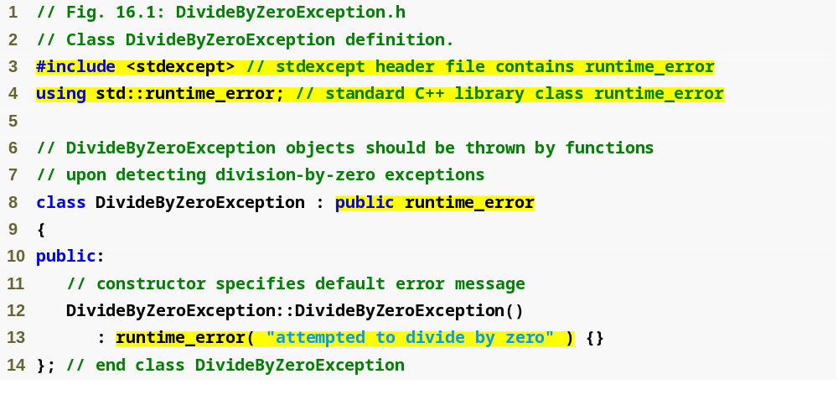
Outline
DivideBy
ZeroException.h
(1 of 1)

Slide 6
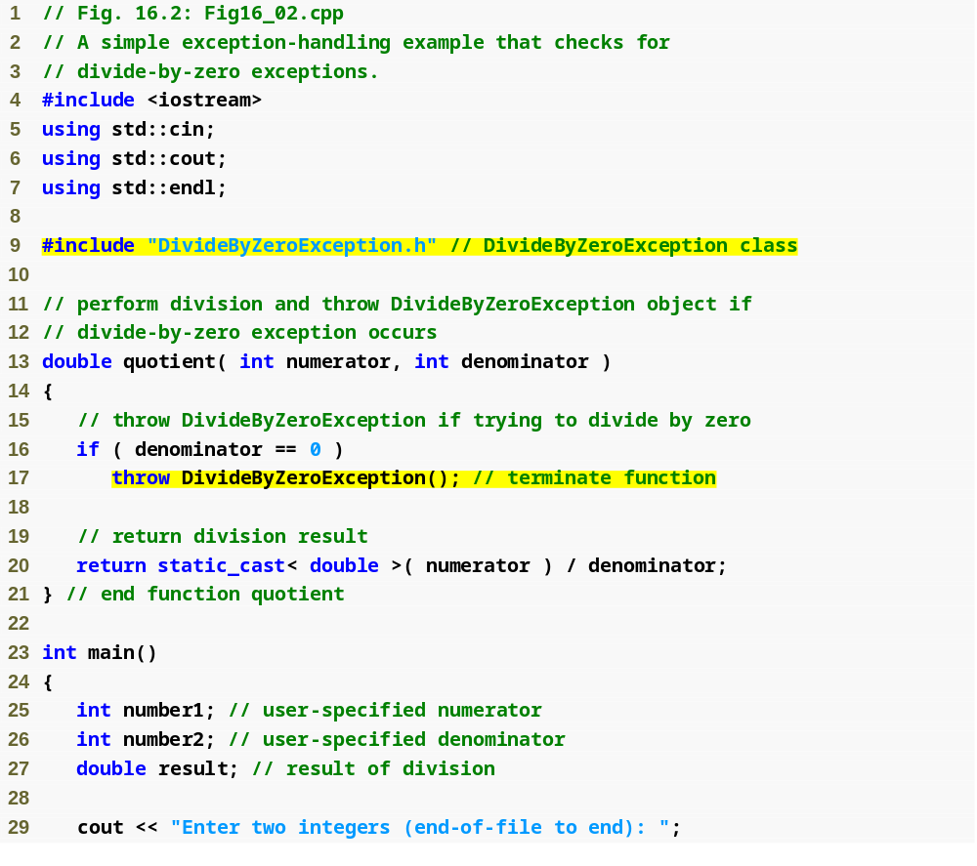
Outline
Fig16_02.cpp
(1 of 3)

Slide 7
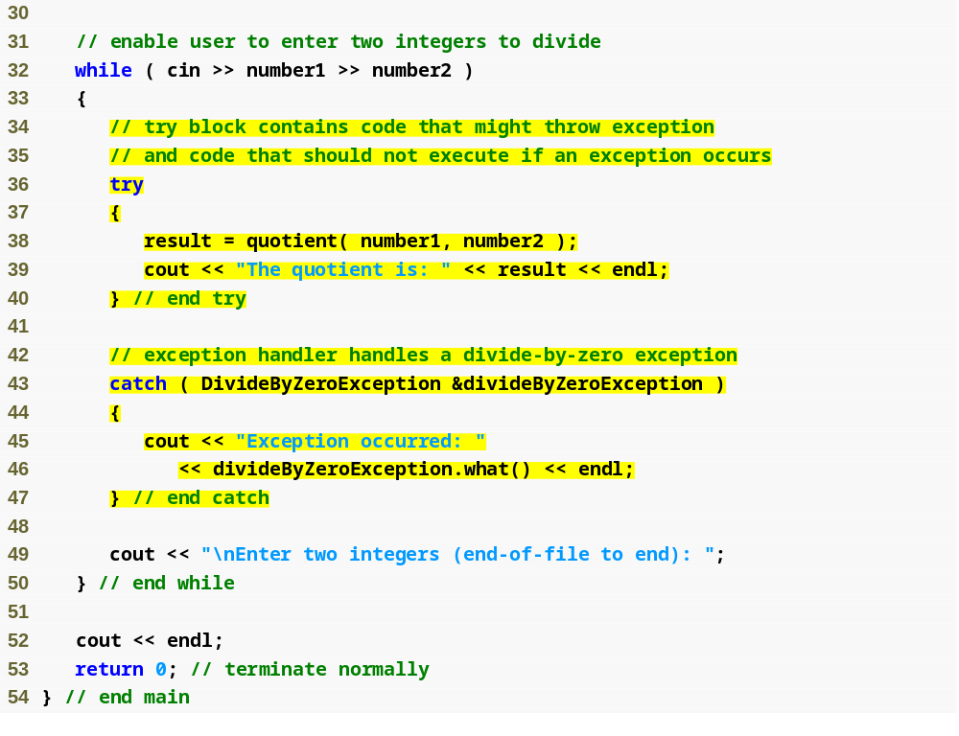
Outline
Fig16_02.cpp
(2 of 3)

Slide 8
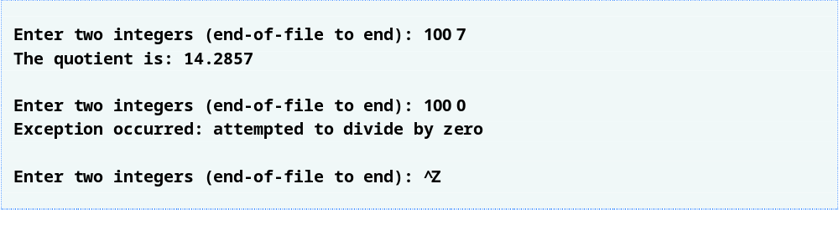
Outline
Fig16_02.cpp
(3 of 3)

Slide 9
16.3 Example: Handling an Attempt to Divide by Zero (Cont.)
try Blocks
  Keyword try followed by braces ({})
  Should enclose
    Statements that might cause exceptions and
    Statements that should be skipped in case of an exception

Slide 10
16.3 Example: Handling an Attempt to Divide by Zero (Cont.)
catch handlers
  Immediately follow a try block
    One or more catch handlers for each try block
  Keyword catch
  Exception parameter enclosed in parentheses
    Represents the type of exception to process
    Can provide an optional parameter name to interact with the caught exception object
  Executes if exception parameter type matches the exception thrown in the try block
    Could be a base class of the thrown exception’s class

Slide 11
16.3 Example: Handling an Attempt to Divide by Zero (Cont.)
Termination model of exception handling
  try block expires when an exception occurs
    Local variables in try block go out of scope
  The code within the matching catch handler executes
  Control resumes with the first statement after the last catch handler following the try block
    Control does not return to throw point
Stack unwinding
  Occurs if no matching catch handler is found
  Program attempts to locate another enclosing try block in the calling function

Slide 12
16.3 Example: Handling an Attempt to Divide by Zero (Cont.)
Throwing an exception
  Use keyword throw followed by an operand representing the type of exception
    The throw operand can be of any type
      If the throw operand is an object, it is called an exception object
  The throw operand initializes the exception parameter in the matching catch handler, if one is found

Slide 13
16.4 When to Use Exception Handling
When to use exception handling
  To process synchronous errors
    Occur when a statement executes
  Not to process asynchronous errors
    Occur in parallel with, and independent of, program execution
  To process problems arising in predefined software elements
    Such as predefined functions and classes
    Error handling can be performed by the program code to be customized based on the application’s needs

Slide 14
16.5 Rethrowing an Exception
Rethrowing an exception
  Empty throw; statement
  Use when a catch handler cannot or can only partially process an exception
  Next enclosing try block attempts to match the exception with one of its catch handlers

Slide 15
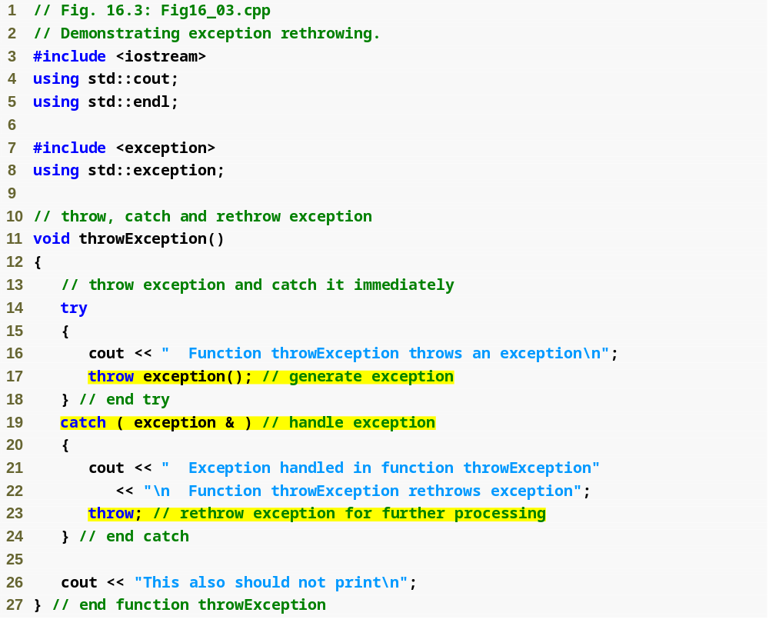
Outline
Fig16_03.cpp
(1 of 2)
Rethrow the exception

Slide 16
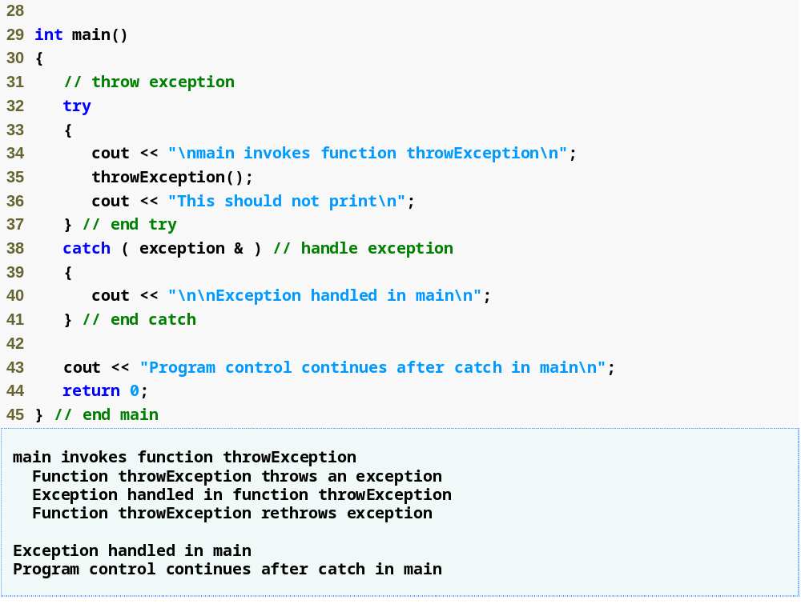
Outline
Fig16_03.cpp
(2 of 2)
Catch rethrown exception

Slide 17
16.6 Exception Specifications
Exception specifications (a.k.a. throw lists)
  Keyword throw
  Comma-separated list of exception classes in parentheses
  Example
    int someFunction( double value )
    throw ( ExceptionA, ExceptionB,
    ExceptionC )
    {
    …
    }
      Indicates someFunction can throw exceptions of types ExceptionA, ExceptionB and ExceptionC

Slide 18
16.6 Exception Specifications (Cont.)
Exception specifications (Cont.)
  A function can throw only exceptions of types in its specification or types derived from those types
    If a function throws a non-specification exception, function unexpected is called
      This normally terminates the program
  No exception specification indicates the function can throw any exception
  An empty exception specification, throw(), indicates the function can not throw any exceptions

Slide 19
16.7 Processing Unexpected Exceptions
Function unexpected
  Called when a function throws an exception not in its exception specification
  Calls the function registered with function set_unexpected
  Function terminate is called by default
Function set_unexpected of <exception>
  Takes as argument a pointer to a function with no arguments and a void return type
  Returns a pointer to the last function called by unexpected
    Returns 0 the first time

Slide 20
16.7 Processing Unexpected Exceptions (Cont.)
Function terminate
  Called when
    No matching catch is found for a thrown exception
    A destructor attempts to throw an exception during stack unwinding
    Attempting to rethrow an exception when no exception is being handled
    Calling function unexpected before registering a function with function set_unexpected
  Calls the function registered with function set_terminate
  Function abort is called by default

Slide 21
16.7 Processing Unexpected Exceptions (Cont.)
Function set_terminate
  Takes as argument a pointer to a function with no arguments and a void return type
  Returns a pointer to the last function called by terminate
    Returns 0 the first time
Function abort
  Terminates the program without calling destructors for automatic or static storage class objects
    Could lead to resource leaks

Slide 22
16.8 Stack Unwinding
Stack unwinding
  Occurs when a thrown exception is not caught in a particular scope
  Unwinding a function terminates that function
    All local variables of the function are destroyed
    Control returns to the statement that invoked the function
  Attempts are made to catch the exception in outer try…catch blocks
  If the exception is never caught, function terminate is called

Slide 23
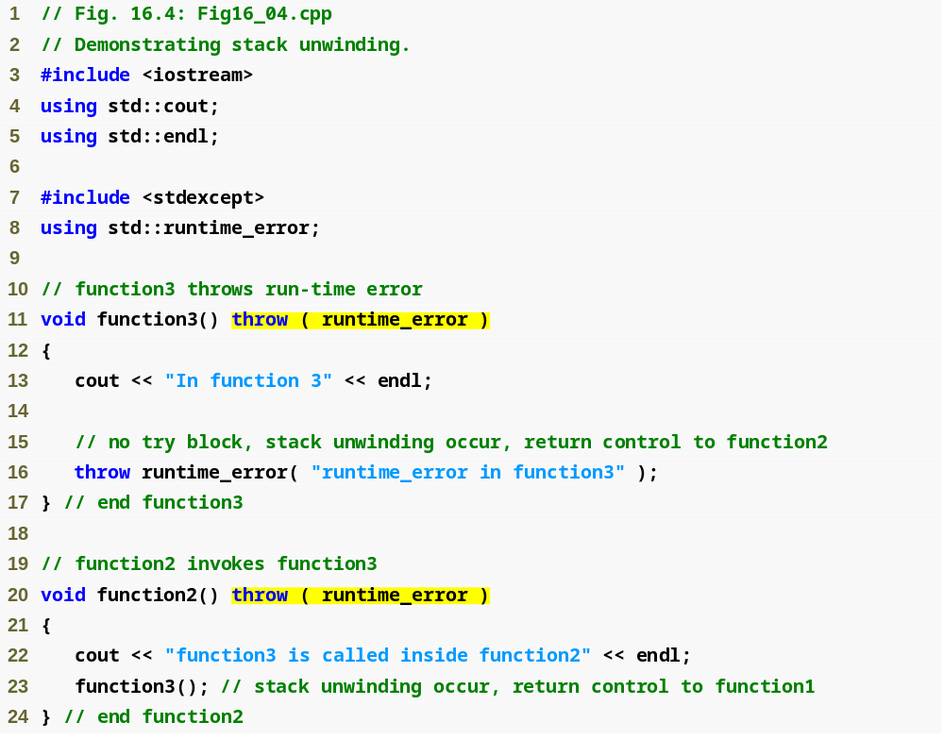
Outline
Fig16_04.cpp
(1 of 3)

Slide 24
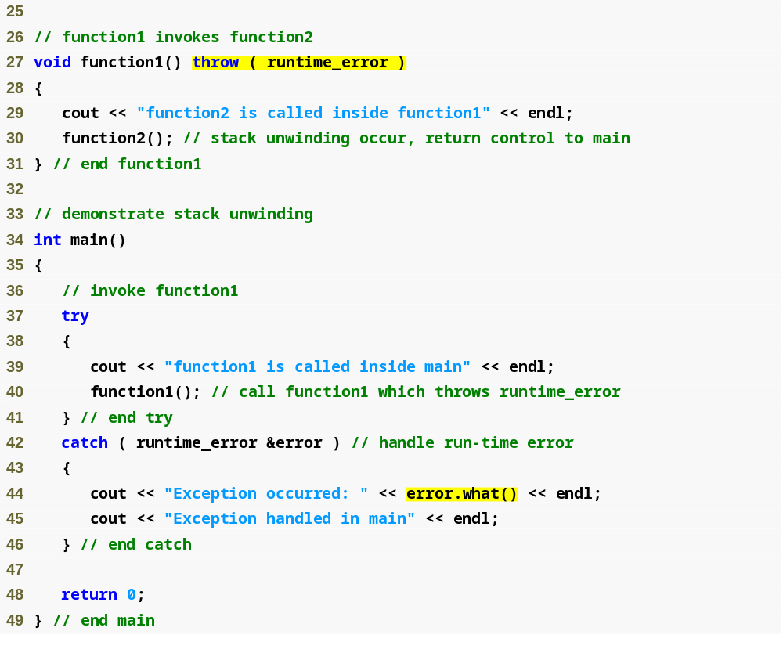
Outline
Fig16_04.cpp
(2 of 3)

Slide 25
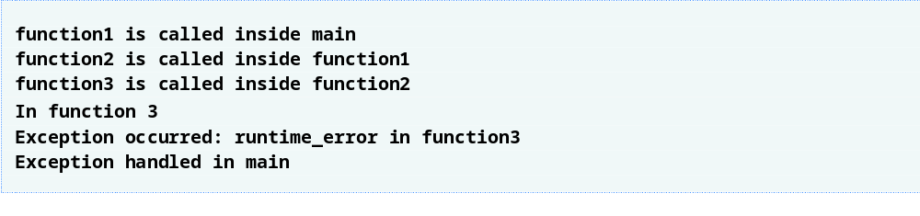
Outline
Fig16_04.cpp
(3 of 3)

Slide 26
16.9 Constructors, Destructors and Exception Handling
Exceptions and constructors
  Exceptions enable constructors, which cannot return values, to report errors to the program
  Exceptions thrown by constructors cause any already-constructed component objects to call their destructors
    Only those objects that have already been constructed will be destructed
Exceptions and destructors
  Destructors are called for all automatic objects in the terminated try block when an exception is thrown
    Acquired resources can be placed in local objects to automatically release the resources when an exception occurs
  If a destructor invoked by stack unwinding throws an exception, function terminate is called

Slide 27
16.10 Exceptions and Inheritance
Inheritance with exception classes
  New exception classes can be defined to inherit from existing exception classes
  A catch handler for a particular exception class can also catch exceptions of classes derived from that class

Slide 28
16.11 Processing new Failures
new failures
  Some compilers throw a bad_alloc exception
    Compliant to the C++ standard specification
  Some compilers return 0
    C++ standard-compliant compilers also have a version of new that returns 0
      Use expression new( nothrow ), where nothrow is of type nothrow_t
  Some compilers throw bad_alloc if <new> is included

Slide 29
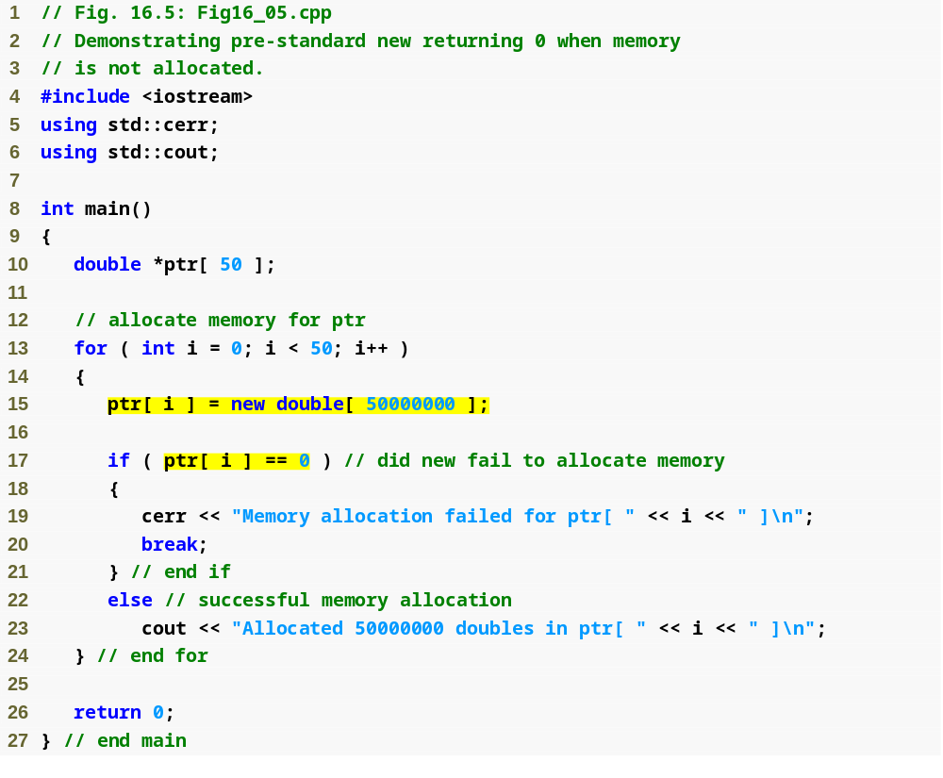
Outline
Fig16_05.cpp
(1 of 2)
Allocate 50000000 double values
new will have returned 0 if the memory allocation operation failed

Slide 30

Outline
Fig16_03.cpp
(2 of 2)

Slide 31
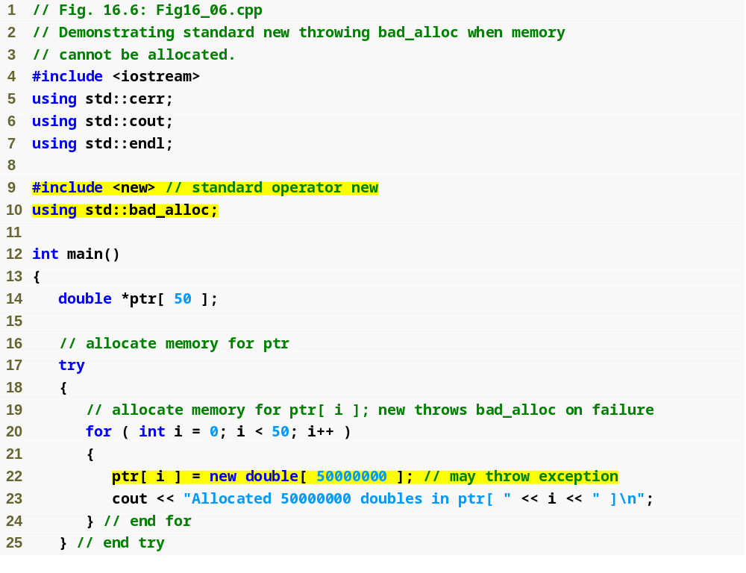
Outline
Fig16_06.cpp
(1 of 2)
Allocate 50000000 double values

Slide 32
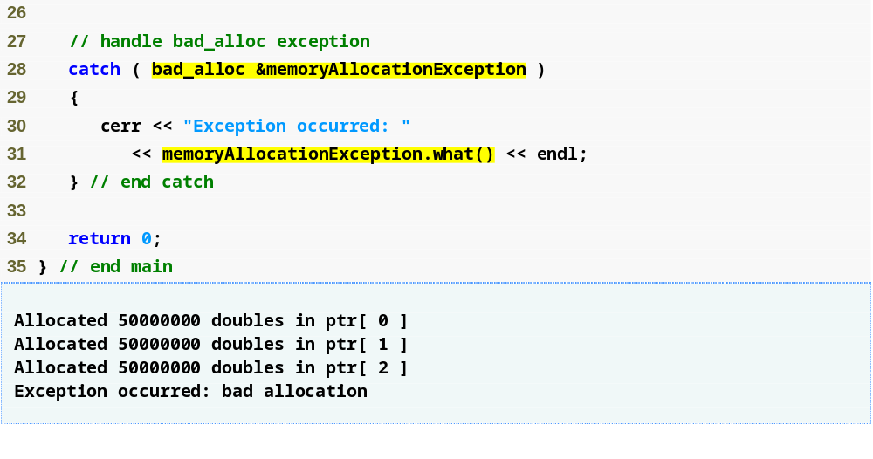
Outline
new throws a bad_alloc exception if the memory allocation operation failed
Fig16_06.cpp
(2 of 2)

Slide 33
16.11 Processing new Failures (Cont.)
new failures (Cont.)
  Function set_new_handler
    Registers a function to handle new failures
      The registered function is called by new when a memory allocation operation fails
    Takes as argument a pointer to a function that takes no arguments and returns void
    C++ standard specifies that the new-handler function should:
      Make more memory available and let new try again,
      Throw a bad_alloc exception or
      Call function abort or exit to terminate the program

Slide 34
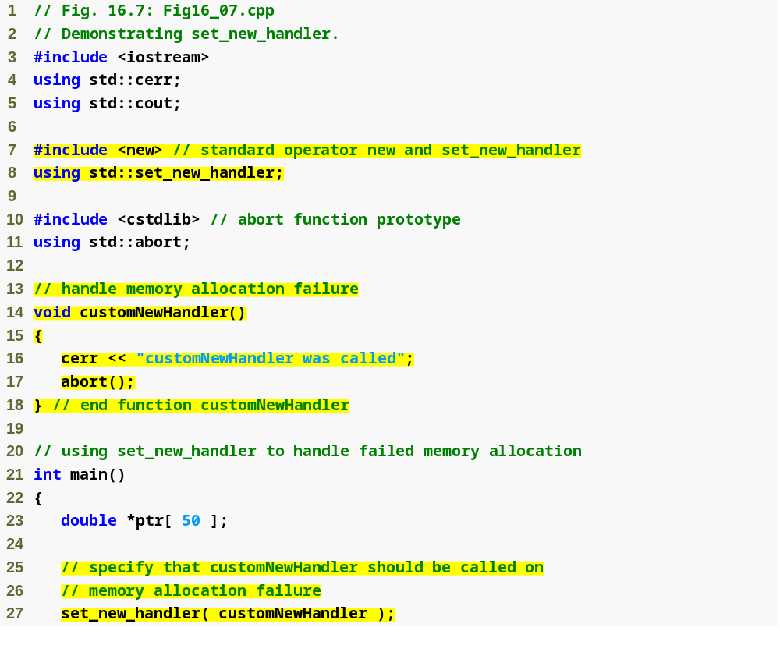
Outline
Fig16_07.cpp
(1 of 2)
Create a user-defined new-handler function customNewHandler
Register customNewHandler with set_new_handler

Slide 35
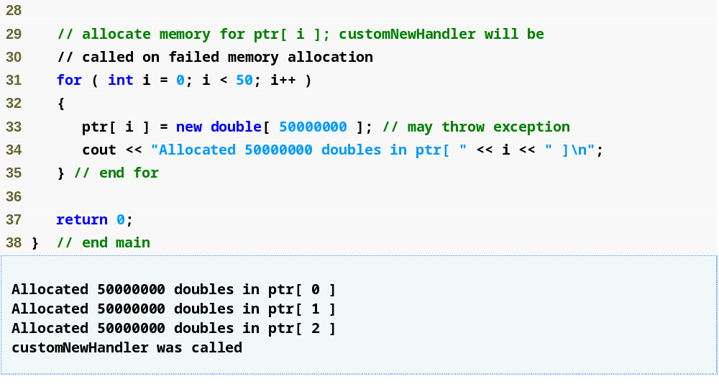
Outline
Allocate 50000000 double values
Fig16_07.cpp
(2 of 2)

Slide 36
16.12 Class auto_ptr and Dynamic Memory Allocation
Class template auto_ptr
  Defined in header file <memory>
  Maintains a pointer to dynamically allocated memory
    Its destructor performs delete on the pointer data member
      Prevents memory leaks by deleting the dynamically allocated memory even if an exception occurs
    Provides overloaded operators * and -> just like a regular pointer variable
    Can pass ownership of the memory via the overloaded assignment operator or the copy constructor
      The last auto_ptr object maintaining the pointer will delete the memory

Slide 37
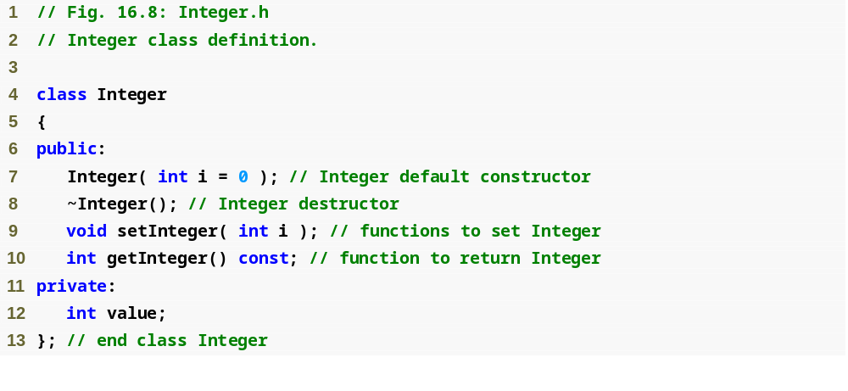
Outline
Integer.h
(1 of 1)

Slide 38
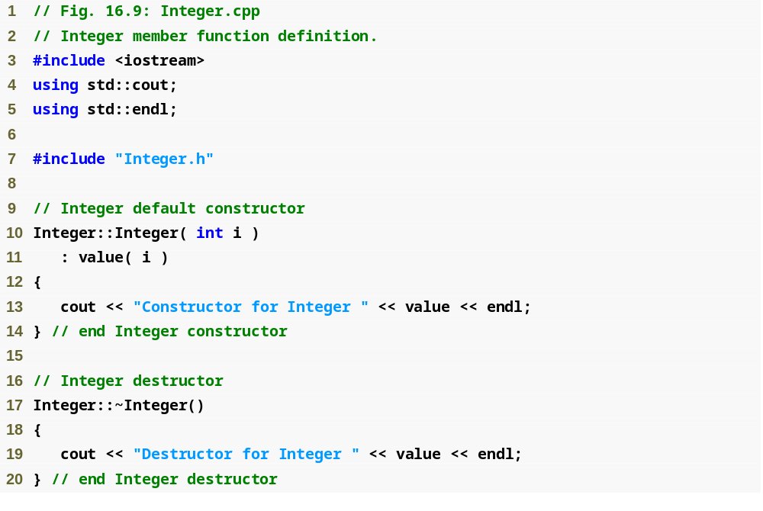
Outline
Integer.cpp
(1 of 2)

Slide 39
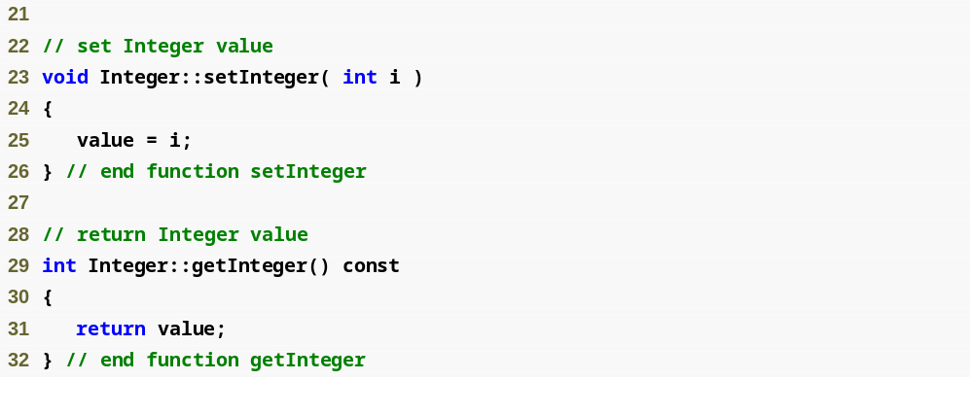
Outline
Integer.cpp
(2 of 2)

Slide 40
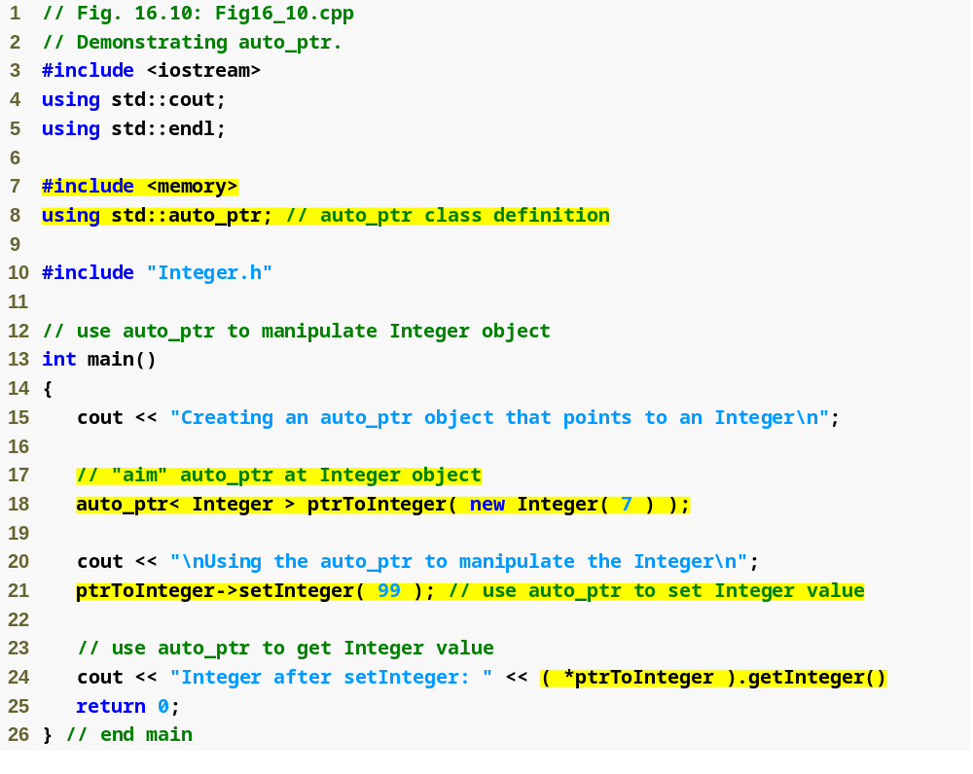
Outline
Fig16_10.cpp
(1 of 2)
Create an auto_ptr to point to a dynamically allocated Integer object
Manipulate the auto_ptr as if it were a pointer to an Integer
The dynamically allocated memory is automatically deleted by the auto_ptr when it goes out of scope

Slide 41
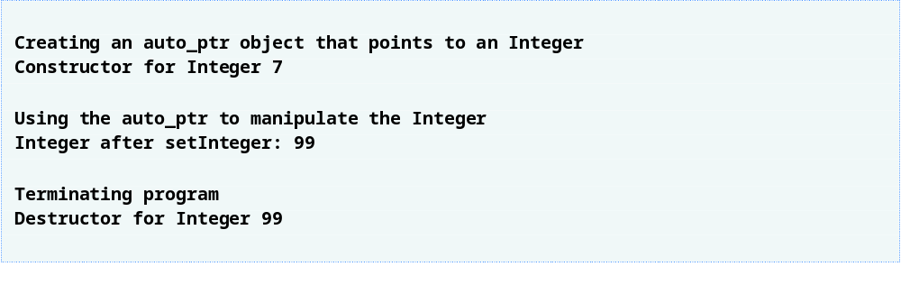
Outline
Fig16_10.cpp
(2 of 2)

Slide 42
16.13 Standard Library Exception Hierarchy
Exception hierarchy classes
  Base-class exception
    Contains virtual function what for storing error messages
    Exception classes derived from exception
      bad_alloc – thrown by new
      bad_cast – thrown by dynamic_cast
      bad_typeid – thrown by typeid
      bad_exception – thrown by unexpected
        Instead of terminating the program or calling the function specified by set_unexpected
        Used only if bad_exception is in the function’s throw list

Slide 43
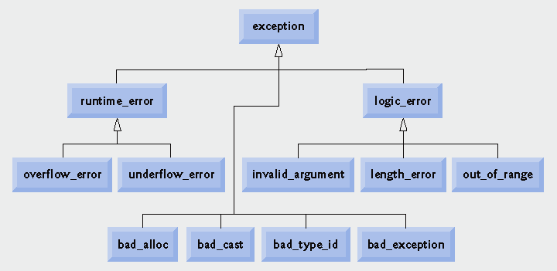
Fig. 16.11 | Standard Library exception classes.

Slide 44
16.13 Standard Library Exception Hierarchy (Cont.)
Exception hierarchy classes (Cont.)
  Class logic_error, derived from exception
    Indicates errors in program logic
    Exception classes derived from logic_error
      invalid_argument
        Indicates an invalid argument to a function
      length_error
        Indicates a length larger than the maximum size for some object was used
      out_of_range
        Indicates a value, such as an array subscript, exceeded its allowed range

Slide 45
16.13 Standard Library Exception Hierarchy (Cont.)
Exception hierarchy classes (Cont.)
  Class runtime_error, derived from exception
    Indicates execution-time errors
    Exception classes derived from runtime_error
      overflow_error
        Indicates an arithmetic overflow error – an arithmetic result is larger than the largest storable number
      underflow_error
        Indicates an arithmetic underflow error – an arithmetic result is smaller than the smallest storable number

Slide 46
16.14 Other Error-Handling Techniques
Other error-handling techniques
  Ignore the exception
    Devastating for commercial and mission-critical software
  Abort the program
    Prevents a program from giving users incorrect results
    Inappropriate for mission-critical applications
    Should release acquired resources before aborting
  Set error indicators
  Issue an error message and pass an appropriate error code through exit to the program’s environment

Slide 47
16.14 Other Error-Handling Techniques (Cont.)
Other error-handling techniques (Cont.)
  Use functions setjump and longjump
    Defined in library <csetjmp>
    Used to jump immediately from a deeply nested function call to an error handler
      Unwind the stack without calling destructors for automatic objects
  Use a dedicated error-handling capability
    Such as a new_handler function registered with set_new_handler for operator new

