Slide 1
Functions
Functions are like building blocks
They allow complicated programs to be divided into manageable pieces
Some of the advantages of functions are:
  A programmer can focus on just that part of the program and construct it, debug it, and perfect it
  Different people can work on different functions simultaneously
  If a function is needed in more than one place in a program, or in different programs, you can write it once and use it many times

Slide 2
Functions
are often referred to as
  Modules
  Subroutines
  Subprograms
  Procedures
  Methods (in OO programming)
are like small scale programs
can be put together to form a larger program

Slide 3
Standard Functions
In college algebra a function is defined as a rule or correspondence between values, called the function’s arguments, and the unique value of the function associated with the arguments
If f(x) = 2x + 5, then f(1) = 7, f(2) = 9, and f(3) = 11
1, 2, and 3 are arguments
7, 9, and 11 are the corresponding values

Slide 4
Standard C/C++ Functions
Some of the predefined mathematical functions are:
  sqrt(x)
  pow(x,y)
  floor(x)
Predefined functions are organized into separate libraries
I/O functions are contained in the header file iostream
Math functions are contained in the header file cmath

Slide 5
The Power Function (pow)
pow(x,y) calculates xy, for example: pow(2,3) = 8.0
Is of the type double or the function pow returns a value of the type double
x and y are called the parameters (or arguments) of the function pow
Function pow has two parameters

Slide 6
The sqrt and floor Functions
The square root function sqrt(x)
  calculates the non-negative square root of x for x >= 0.0
  sqrt(2.25) is 1.5
  It is of the type double and has only one parameter
The floor function floor(x)
  calculates the largest whole number not greater than x
  floor(48.79) is 48.0
  It is of the type double and has only one parameter
  Essentially floor truncates the double so the decimal part is removed

Slide 7
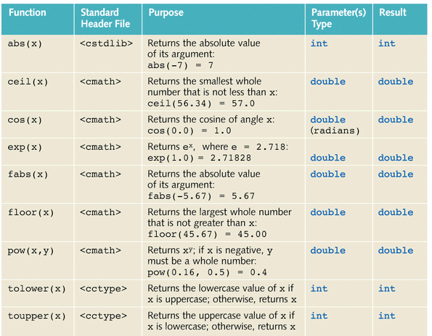

Slide 8
User-Defined Functions
Void functions - functions that do not have a data type
Value-returning functions - functions that have a data type
To use these functions you need to:
  include the correct header file (if necessary)
  know the name of the function
  know the number of parameters, if any
  know the data type of each parameter
  know the data type of the value computed by the function, called the type of the function

Slide 9
User-Defined Functions
Since the value returned by a value-returning function is unique, we:
  save the value for further calculation
  use the value in some calculation
  print the value
A value-returning function is either used in an assignment statement or in an output statement such as cout
There is one more thing that is associated with a function:
  the code that is required to accomplish the task

Slide 10
User-Defined Functions
The these form the header of the function
  Return type
  Name
  Formal parameters (number, order, type)
Then a block of code forms the body of the function
These properties form the function definition
To use predefined functions, we only need to know the return type, name and parameters
Formal Parameter - A variable declared in the function heading
Actual Parameter - A variable or expression listed in a call to a function

Slide 11
Value-returning Functions
The syntax is:
functionType functionName(formal parameter list)
{
statements
}
functionType - type of the value returned by the function
functionType - also called the data type of the value-returning function

Slide 12
Syntax
The syntax of the formal parameter list is:
dataType identifier, dataType identifier, ...
int AVar, double AnotherVar
The syntax for a function call is:
functionName(actual parameter list)
The syntax for the actual parameter list is:
expression or variable,expression or variable, ...
But not always…in some cases the actual parameter must be a variable (later)

Slide 13
Functions
The formal parameter list can be empty
If the formal parameter list is empty
  the parentheses are still needed
  the function heading of the value-returning function takes either of the following forms:
    functionType functionName()
    functionType functionName(void)
  in a function call the actual parameter is empty
A call to a value-returning function with an empty formal parameter list is: functionName()

Slide 14
Value-Returning Functions
To call a value-returning function:
  Use its name, with the actual parameters (if any) in parentheses
  There is a one-to-one correspondence between actual and formal parameters
A value-returning function is called in an expression
The expression may be part of an assignment statement or an output statement
A function call in a program results in the execution of the body of the called function

Slide 15
The return Statement
Once the function computes the value, the function returns this value via the return statement
The syntax of the return statement is:
return expression or variable;
(or just return in a void function)
(although not required at the end of a void function but if you want to return before reaching the end it is)
When a return statement executes in a function, the function immediately terminates and the control goes back to the caller
When a return statement executes in the function main, the program terminates

Slide 16
Function Prototype
Function Prototype - function heading without the body of the function
The syntax is:
functionType functionName(parameter list);
It is not necessary to specify the variable name in the parameter list
The data type of each parameter must be specified
Put function prototype at the top of the file in which they used
Put the function’s body after main

Slide 17
Flow of Execution
When the program is executed (run), execution always begins at the first statement in the function main no matter where it is placed in the program
Other functions are executed only when they are called
Function prototypes appear before any function definition, so the compiler translates these first
The compiler can then correctly translate a function call

Slide 18
Flow of Execution
A function call statement results in the transfer of control to the first statement in the body of the called function
After the last statement of the called function is executed, the control is passed back to the point immediately following the function call
A value-returning function returns a value
After executing the function when the control goes back to the caller, the value that the function returns replaces the function call statement

Slide 19
Value Parameters
In C/C++ there are three basic types of parameters to functions:
  Value parameters
  Reference parameters
  Address parameters
Value parameters in a function receive a copy of the actual parameter.
  If the value parameter changes inside the function the change is not reflected in the actual parameter
    Unless it returned by the function and assigned in the calling function
  Therefore, actual value parameters may be constants, variables or expressions

Slide 20
Examples of Value Parameters
int myABS(int n){
if(n<0)
return -n;
return n;
}
Returns the absolute value of n
int myintPOW(int base,
int exp){
int temp = base;
for(int i=1; i<exp;i++)
temp = temp * base;
return temp;
}
Raises base to exp

