Slide 1
Pointers and new
Dynamic variables

Slide 2
Pointers
A pointer is the memory address of a variable
Memory addresses can be used as names for
variables
  If a variable is stored in three memory locations, the address of the first can be used as a name for the variable.
  When a variable is used as a call-by-reference
  argument, its address is passed

Slide 3
Pointers Tell
Where To Find A Variable
An address used to tell where a variable is stored in memory is a pointer
  Pointers "point" to a variable by telling where the variable is located

Slide 4
Declaring Pointers
Pointer variables must be declared to have a
pointer type
  Example: To declare a pointer variable p that can "point" to a variable of type double:
  double *p;
  The asterisk identifies p as a pointer variable

Slide 5
Multiple Pointer Declarations
To declare multiple pointers in a statement, use the asterisk before each pointer variable
  Example:
  int *p1, *p2, v1, v2;
  p1 and p2 point to variables of type int
  v1 and v2 are variables of type int

Slide 6
The address of Operator
The & operator can be used to determine the address of a variable which can be assigned to a pointer variable
  Example: p1 = &v1;
  p1 is now a pointer to v1
  v1 can be called v1 or "the variable pointed to by p1"

Slide 7
The Dereferencing Operator
C++ uses the * operator in yet another way with pointers
  The phrase "The variable pointed to by p" is
  translated into C++ as *p
  Here the * is the dereferencing operator
    p is said to be dereferenced

Slide 8
A Pointer Example
v1 = 0;
p1 = &v1;
*p1 = 42;
cout << v1 << endl;
cout << *p1 << endl;
output:
42
42
v1 and *p1 now refer to
the same variable

Slide 9
Pointer Assignment
The assignment operator = is used to assign
the value of one pointer to another
  Example: If p1 still points to v1 (previous slide) then
  p2 = p1;
  causes *p2, *p1, and v1 all to
  name the same variable

Slide 10
Caution! Pointer Assignments
Some care is required making assignments to pointer variables
  p1= p2; // changes the location that p1 "points" to
  *p1 = *p2; // changes the value at the location
  that p1 "points" to

Slide 11
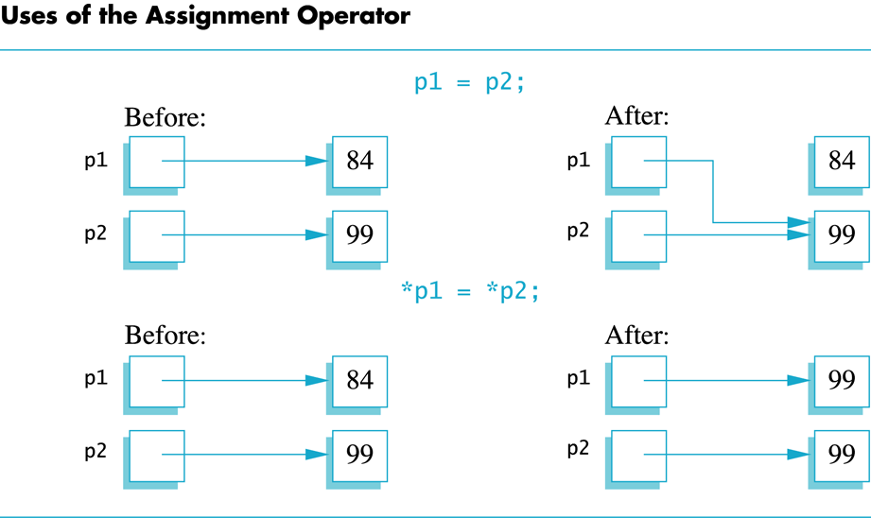

Slide 12
The new Operator
Using pointers, variables can be manipulated even if there is no identifier for them
  To create a pointer to a new "nameless" variable of type int:
  p1 = new int;
  The new variable is referred to as *p1
  *p1 can be used anyplace an integer variable can
  cin >> *p1;
  *p1 = *p1 + 7;

Slide 13
Dynamic Variables
Variables created using the new operator are called dynamic variables
  Dynamic variables are created and destroyed while the program is running

Slide 14
int *p1, *p2;
p1 = new int;
*p1=25;
p2= p1;
cout << "p1 = " << *p1 << endl;
cout << "p2 = " << *p2 << endl;
cout << "address of p1 = " << p1 << endl;
cout << "address of p2 = " << p2 << endl << endl;
*p2 = 101;
cout << "p1 = " << *p1 << endl;
cout << "p2 = " << *p2 << endl;
cout << "address of p1 = " << p1 << endl;
cout << "address of p2 = " << p2 << endl << endl;
p1 = new int;
*p1=77;
cout << "p1 = " << *p1 << endl;
cout << "p2 = " << *p2 << endl;
cout << "address of p1 = " << p1 << endl;
cout << "address of p2 = " << p2 << endl << endl;
cout << "deleting p1...."<<endl;
delete p1;
cout << "p1 = " << *p1 << endl;
cout << "p2 = " << *p2 << endl;
cout << "address of p1 = " << p1 << endl;
cout << "address of p2 = " << p2 << endl;

Slide 15
new and Class Types
Using operator new with class types calls aconstructor as well as allocating memory
  If MyType is a class type, then
  MyType *myPtr; // creates a pointer to a
  // variable of type MyType
  myPtr = new MyType;
  // calls the default constructor
  myPtr = new MyType (32.0, 17);
  // calls Mytype(double, int);

Slide 16
Basic Memory Management
An area of memory called the heap is reserved for dynamic variables
  New dynamic variables use memory in the freestore
  If all of the heap is used, calls to new will fail
Unneeded memory can be recycled
  When variables are no longer needed, they can be deleted and the memory they used is returned to the heap

Slide 17
The delete Operator
When dynamic variables are no longer needed, delete them to return memory to the freestore
  Example:
  delete p;
  The value of p is now undefined and the memory used by the variable that p pointed to is back in the heap

Slide 18
Dangling Pointers
Using delete on a pointer variable destroys the dynamic variable pointed to
If another pointer variable was pointing to the dynamic variable, that variable is also undefined
Undefined pointer variables are called dangling pointers
  Dereferencing a dangling pointer (*p) is usually disastrous

Slide 19
Automatic Variables
Variables declared in a function are created by C++ and destroyed when the function ends
  These are called automatic variables because their creation and destruction is controlled automatically
The programmer manually controls creation and destruction of pointer variables with operators new and delete

Slide 20
Type Definitions
A name can be assigned to a type definition,
then used to declare variables
The keyword typedef is used to define new
type names
  Syntax:
  typedef Known_TypeDefinition New_Type_Name;
    Known_Type_Definition can be any type

Slide 21
Defining Pointer Types
To avoid mistakes using pointers, define a
pointer type name
  Example: typedef int* IntPtr;
  Defines a new type, IntPtr, for pointer
  variables containing pointers to int
  variables
  IntPtr p;
  is equivalent to
  int *p;

Slide 22
Multiple Declarations Again
Using our new pointer type defined as
typedef int* IntPtr;
  Prevent this error in pointer declaration:
  int *P1, P2; // Only P1 is a pointer variable
with
IntPtr P1, P2; // P1 and P2 are pointer
// variables

Slide 23
Pointer Reference Parameters
A second advantage in using typedef to define a pointer type is seen in parameter lists
  Example:
  void sample_function(IntPtr& pointer_var);
  is less confusing than
  void sample_function( int*& pointer_var);

Slide 24
Dynamic Arrays

Slide 25
Dynamic Arrays
A dynamic array is an array whose size is
determined when the program is running, not when you write the program

Slide 26
Pointer Variables and Array Variables
A dynamic array is an array whose size is determined when the program is running, not when you write the program
Array variables are actually pointer variables
that point to the first indexed variable
  Example: int a[10];
  typedef int* IntPtr;
  IntPtr p;
    Variables a and p are the same kind of variable
Since a is a pointer variable that points to a[0],
p = a;
causes ‘p’ to point to the same location as ‘a’

Slide 27
Creating Dynamic Arrays
Normal arrays require that the programmer determine the size of the array when the program is written
  What if the programmer estimates too large?
    Memory is wasted
  What if the programmer estimates too small?
    The program may not work in some situations
Dynamic arrays can be created with just the right size while the program is running

Slide 28
Creating Dynamic Arrays
Dynamic arrays are created using the new
operator
  Example: To create an array of 10 elements of type double:
  typedef double* DoublePtr;
  DoublePtr d;
  d = new double[10];
    d can now be used as if it were an ordinary array!

Slide 29
Dynamic Arrays (cont.)
Pointer variable d is a pointer to d[0]
When finished with the array, it should be
deleted to return memory to the freestore
  Example: delete [ ] d;
    The brackets tell C++ a dynamic array is being deleted so it must check the size to know how many indexed variables to remove
    Forgetting the brackets, is not illegal, but would tell the computer to remove only one variable

Slide 30
Pointer Arithmetic
Arithmetic can be performed on the addresses
contained in pointers
  Using the dynamic array of doubles, d, declared previously, recall that d points to d[0]
  The expression d+1 evaluates to the address of d[1] and d+2 evaluates to the address of d[2]
    Notice that adding one adds enough bytes for one
    variable of the type stored in the array

Slide 31
Pointer Arthmetic Operations
You can add and subtract with pointers
  The ++ and - - operators can be used
  Two pointers of the same type can be subtracted to obtain the number of indexed variables between
    The pointers should be in the same array!
  This code shows one way to use pointer
  arithmetic:
  for (int i = 0; i < array_size; i++)
  cout << *(d + i) << " " ;
  // same as cout << d[i] << " " ;

Slide 32
Void Pointers
The void type of pointer is a special type of pointer. In C++, void represents the absence of type, so void pointers are pointers that point to a value that has no type (and thus also an undetermined length and undetermined dereference properties).
This allows void pointers to point to any data type, from an integer value or a float to a string of characters.
But in exchange they have a great limitation: the data pointed by them cannot be directly dereferenced (which is logical, since we have no type to dereference to), and for that reason we will always have to cast the address in the void pointer to some other pointer type that points to a concrete data type before dereferencing it.

Slide 33
Void Pointer
// increaser
#include <iostream>
using namespace std;
void increase (void* data, int psize) {
if ( psize == sizeof(char) ) {
char* pchar;
pchar=(char*)data;
++(*pchar);
}
else if (psize == sizeof(int) ) {
int* pint;
pint=(int*)data;
++(*pint);
}
}
int main () {
char a = 'x';
int b = 1602;
increase (&a,sizeof(a)); increase (&b,sizeof(b));
cout << a << ", " << b << endl;
return 0;
}

Slide 34
Null pointer
A null pointer is a regular pointer of any pointer type which has a special value that indicates that it is not pointing to any valid reference or memory address. This value is the result of type-casting the integer value zero to any pointer type.
int * p;
p = 0; // p has a null pointer value
A null pointer is a value that any pointer may take to represent that it is pointing to "nowhere", while a void pointer is a special type of pointer that can point to somewhere without a specific type. One refers to the value stored in the pointer itself and the other to the type of data it points to.

