Slide 1
Basic Tree Concepts
A family tree shows the descendants of a common ancestor.
In computer science, a tree is a hierarchical data structure composed of nodes.
Each node has a sequence of child nodes.
The root is the node with no parent.
A leaf is a node with no children.
A tree class holds a reference to a root node.
Each node holds:
  A data item
  A list of references to the child nodes

Slide 2
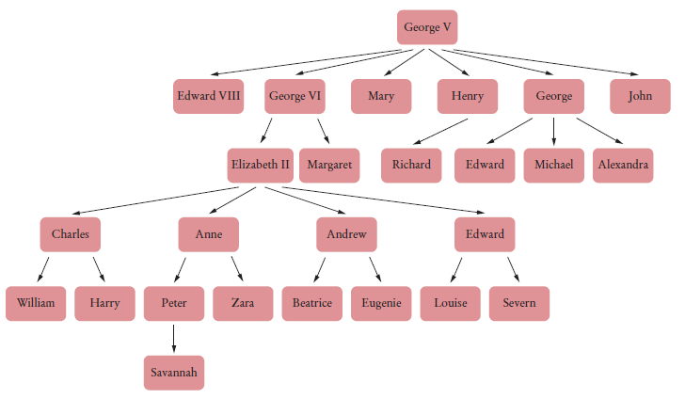
Basic Tree Concepts
British royal family tree
Figure 1 A Family Tree

Slide 3
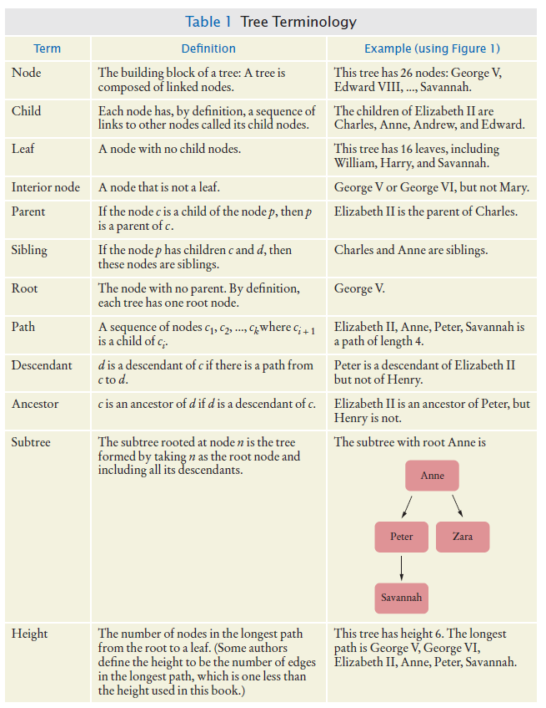
Basic Tree Concepts
Some common tree terms:

Slide 4
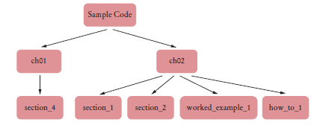
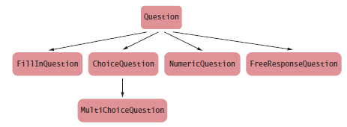
Trees in Computer Science
Figure 2 A Directory Tree
Figure 3 An Inheritance Tree

Slide 5
Basic Tree Concepts - Recursion
When computing tree properties, it is common to recursively visit smaller and smaller subtrees.
Recursion – a function or method calling itself directly or indirectly.
A recursive computation solves a problem by using the solution of the same problem with simpler values.
Two key requirements for successful recursion:
  Every recursive call must simplify the computation in some way
  There must be special cases to handle the simplest computations directly

Slide 6
LISP Factorial function
(defun fact (n)
(if (< n 2)
1
(* n (fact (- n 1)))))
C Factorial function
int fact(int n) {
if (n < 2)
return 1;
return n * fact(n-1);
}

Slide 7
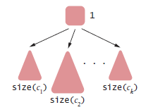
Basic Tree Concepts
Size of tree with root r whose children are c₁ ... c_{k}
  size(r) = 1 + size(c₁) + ... + size(c_{k})

Slide 8
Basic Tree Concepts
The size method in the Tree class:
  int size(Node *node){
  if(node==0)
  return 0;
  else
  return (size(node->left) + 1 + size(node->right));
  }

Slide 9
Self Check 17.1
What are the paths starting with Anne in the tree shown in Figure 1?
Answer: There are four paths:
Anne
Anne, Peter
Anne, Zara
Anne, Peter, Savannah

Slide 10
Self Check 17.2
What are the roots of the subtrees consisting of 3 nodes in the tree shown in Figure 1?
Answer: There are three subtrees with three nodes— they have roots Charles, Andrew, and Edward.

Slide 11
Self Check 17.3
What is the height of the subtree with root Anne?
Answer: 3

Slide 12
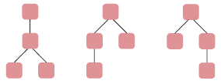
Self Check 17.4
What are all possible shapes of trees of height 3 with two leaves?
Answer:

Slide 13
Self Check 17.5
Describe a recursive algorithm for counting all leaves in a tree.
Answer:
  If n is a leaf, the leaf count is 1.
  Otherwise
  Let c₁ ... c_{n} be the children of n.
  The leaf count is leafCount(c₁) + ...+ leafCount(c_{n}).

Slide 14
Binary Trees
In a binary tree, each node has a left and a right child node either of which or both may be 0 / null / nada / nil / rien / nichts / empty.
Common use -
  A decision tree contains questions used to decide among a number of options.
  In a decision tree:
    Each non-leaf node contains a question
    The left subtree corresponds to a “yes” answer
    The right subtree to a “no” answer
    Every node has either two children or no children

Slide 15
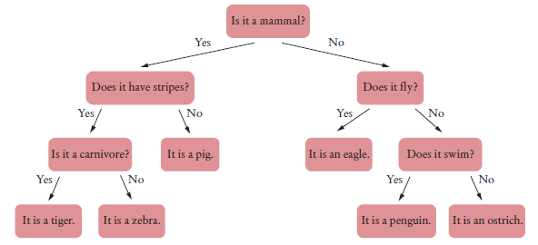
Binary Tree Examples - Decision Tree
Figure 4 A Decision Tree for an Animal Guessing Game

Slide 16
Binary Tree Examples – Huffman Tree
In a Huffman tree:
  The leaves (leaf nodes) contain symbols that we want to encode.
To encode a particular symbol:
  Walk along the path from the root to the leaf containing the symbol, and produce
  A zero for every left turn
  A one for every right turn
Huffman coding is a lossless data compression technique that assigns the shortest path to the most common (frequently used) input characters and longer codes to the least common input.

Slide 17
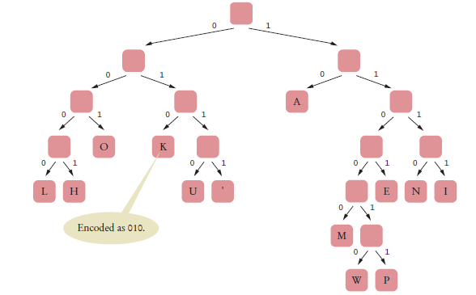
Binary Tree Examples – Huffman Tree
ALOHA = 10 0000 001 0001 10 in Huffman coding (15 bits)
ALOHA = requires 35 bits (assuming 7 bit encoding, 40 bits in 8 bit) in ASCII
Figure 5 A Huffman Tree for Encoding the Thirteen Characters of Hawaiian Alphabet

Slide 18
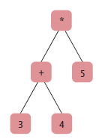
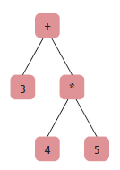
Binary Tree Examples – Expression Tree
An expression tree shows the order of evaluation in an arithmetic expression.
The leaves of the expression trees contain numbers.
Interior nodes contain the operators
(3 + 4) * 5
3 + 4 * 5
Figure 6 Expression Trees

Slide 19
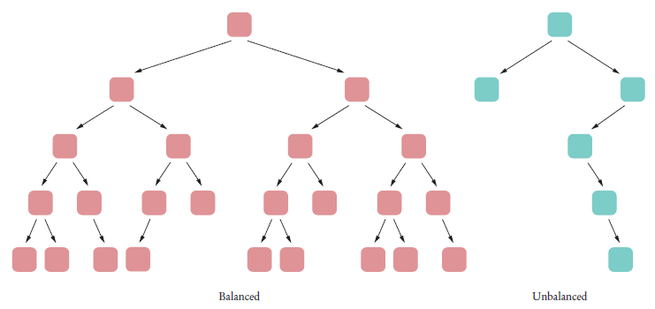
Balanced Trees
In a balanced binary tree, each subtree has approximately the same number of nodes.
Figure 7 Balanced and Unbalanced Trees

Slide 20
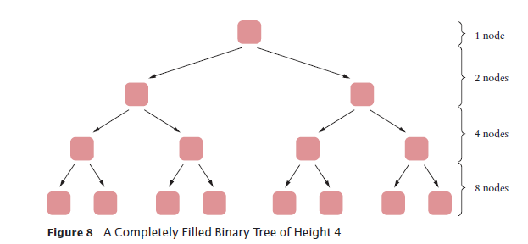
Balanced Trees
A binary tree of height h can have up to n = 2^{h} – 1 nodes.
A completely filled binary tree of height 4 has 1 + 2 + 4 + 8 = 15 = 2⁴ – 1 nodes.

Slide 21
Balanced Trees
For a completely filled binary tree: h = log₂(n + 1) For a balanced tree: h ≈ log₂(n)
Example: the height of a balanced binary tree with1,000 nodes Approximately 10 (because 1000 ≈ 1024 = 2¹⁰).
Example: the height of a balanced binary tree with1,000,000 nodes approximately 20 (because 10⁶ ≈ 2²⁰)
You can find any element in this tree in about 20 steps

Slide 22
A Binary Tree Implementation
Binary tree node has a pointer:
  to a right child
  to a left child
  either can be null
Leaf: node in which both children are null.

Slide 23
Basic Tree Concepts
A Tree class:
class BinaryTree {
  Node*root;
public:
  BinaryTree();
  void insert(int val);
  void printPostOrder();
  void printSorted();
  int size();
  int maxDepth();
private:
Node* NewNode(int val);
Node* insert(Node* node, int val);
void printPostOrder(Node *node);
void printSorted(Node *node);
int size(Node *node);
int maxDepth(Node *node);
};
If you look up from your phone for a second you notice two distinct sets of methods:
  public methods hardly any parameters (only insert)
  private methods all with at least one parameter
The reason is that the most efficient (one might say elegant) solution to binary trees require recursively traveling the tree. Pretty hard to do recursion without the "node" being different from call to call
So the public methods satisfy OOP
and the private methods satisfy recursive binary tree processing

Slide 24
A Binary Tree Implementation
The Node struct:
struct Node {
int data;
Node *left, *right;
//optionally provide a constructor
};

Slide 25
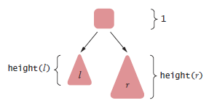
A Binary Tree Implementation
To find the height of a binary tree t with left and right children l and r
  Take the maximum height of the two children and add 1
  height(t) = 1 + max(height(l), height(r))

Slide 26
A Binary Tree Implementation
Make a static recursive helper method height in the Tree class:
int maxDepth(Node *node){
if(node==0)
return 0;
else {
int leftDepth = maxDepth(node->left);
int rightDepth = maxDepth(node->right);
if(leftDepth>rightDepth)
return leftDepth+1;
else
return rightDepth+1;
}
}

Slide 27
A Binary Tree Implementation
Provide a public height method in the Tree class:
int maxDepth(){
return maxDepth(root);
}

Slide 28
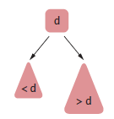
Binary Search Trees
All nodes in a binary search tree fulfill this property:
  The descendants to the left have smaller data values than the node data value,
  The descendants to the right have larger data values.

Slide 29
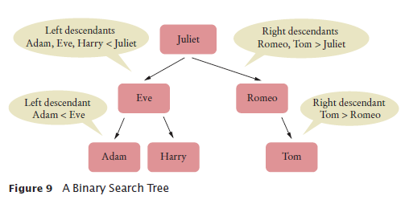
Binary Search Trees

Slide 30
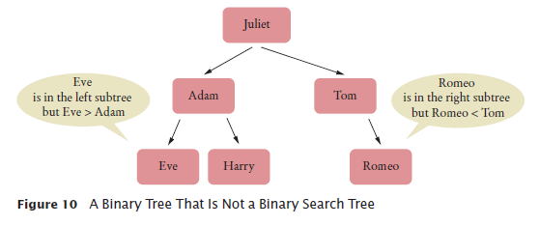
Binary Search Trees

Slide 31
Binary Search Trees
To ensure a binary tree is a BST apply this algorithm for insertion:
Algorithm to insert data:
  If you encounter a non-null node reference, look at its data value.
  If the data value of that node is larger than the value you want to insert,
    Continue the process with the left child.
  If the node’s data value is smaller than the one you want to insert,
    Continue the process with the right child.
  If the node’s data value is the same as the one you want to insert,
    You are done. A set does not store duplicate values. (but you might want to count it)
  If you encounter a null node reference, replace it with the new node.

Slide 32
Binary Search Trees - Insertion
//the actual insert method
Node* insert(Node* node, int val){
if(node==0)
return NewNode(val);
else
if(val <= node->data )
node->left = insert(node->left, val);
else
node->right = insert(node->right, val);
return node;
}

Slide 33
Binary Search Trees - Insertion
The method provided to clients is
void insert(int val){
root=insert(root, val);
}

Slide 34
Verify the Tree is a BST
The public method
bool isBST(){
return isBST(root, INT_MIN, INT_MAX);
}
The private code
bool isBST(Node* node, int min, int max){
if(node == 0)
return true;
if(node->data<min || node->data>max) return false;
return isBST(node->left, min, node->data) &&
isBST(node->right, node->data, max);
}

Slide 35
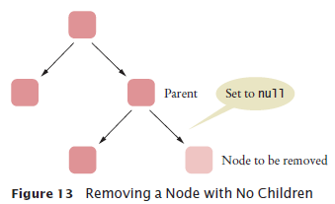
Binary Search Trees - Removal
First, find the node.
Case 1: The node has no children
  Set the link in the parent to null

Slide 36
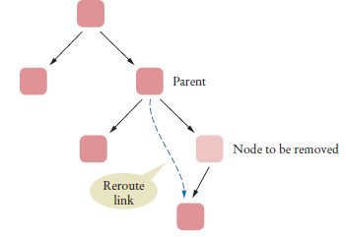
Binary Search Trees - Removal
Case 2: The node has 1 child
  Modify the parent link to the node to point to the child node
Figure 14 Removing a Node with One Child

Slide 37
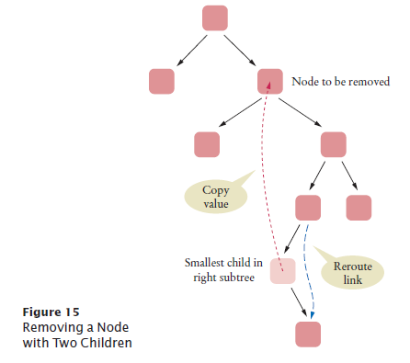
BST – Removal – a summer project for you
Case 3: The node has 2 children
  Replace it with the smallest node of the right subtree

Slide 38
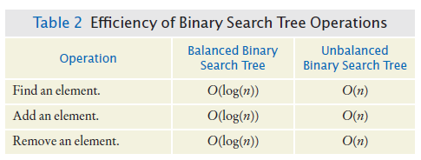
Binary Search Trees - Efficiency of the Operations
If a binary search tree is balanced, then adding, locating, or removing an element takes O(log(n)) time.

Slide 39
Self Check 17.13
What is the difference between a tree, a binary tree, and a balanced binary tree?
Answer: In a tree, each node can have any number of children. In a binary tree, a node has at most two children. In a balanced binary tree, all nodes have approximately as many descendants to the left as to the right.

Slide 40
Self Check 17.14
Are the left and right children of a binary search tree always binary search trees? Why or why not?
Answer: Yes––because the binary search condition holds for all nodes of the tree, it holds for all nodes of the subtrees.

Slide 41
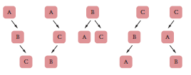
Self Check 17.15
Draw all binary search trees containing data values
A, B, and C.
Answer:

Slide 42
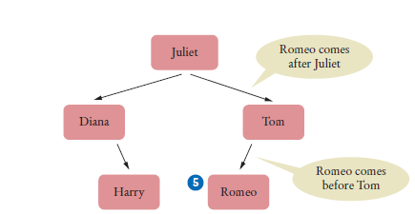
Self Check 17.16
Give an example of a string that, when inserted into the tree of Figure 12, becomes a right child of Romeo.
Answer: For example, Sarah. Any string between Romeo and Tom will do.

Slide 43
Self Check 17.17
Trace the removal of the node Tom from the tree in Figure 12.
Answer: Tom has a single child. That child replaces Tom in the parent Juliet.

Slide 44
Self Check 17.18
Trace the removal of the node Juliet from the tree in Figure 12.
Answer: Juliet has two children. We look for the smallest child in the right subtree, Romeo. The data replaces Juliet, and the node is removed from its parent Tom.

Slide 45
Tree Traversal - Inorder Traversal
To print a Binary Search Tree in sorted order
  Print the left subtree.
  Print the root data.
  Print the right subtree.
This called an inorder traversal.

Slide 46
Tree Traversal - Inorder Traversal
Recursive helper method for printing the tree.
class BinaryTree {
Node* root;
...
  void printInOrder(Node *node){
  if(node == 0) return;
  printSorted(node->left);
  cout << node->data << endl;
  printSorted(node->right);
  }
Public print method starts the recursive process at the root:
  void printSorted(){
  printSorted(root);
  }

Slide 47
Preorder and Postorder Traversals
Preorder
  Visit the root
  Visit left subtree
  Visit the right subtree
Postorder
  Visit left subtree
  Visit the right subtree
  Visit the root
A postorder traversal of an expression tree results in an expression in reverse Polish notation.

Slide 48
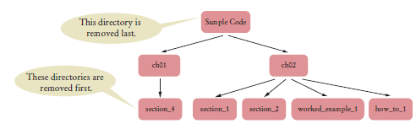
Preorder and Postorder Traversals
Use postorder traversal to remove all directories from a directory tree.
  A directory must be empty before you can remove it

Slide 49
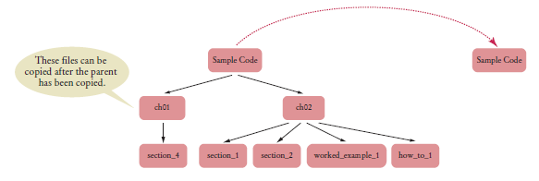
Preorder and Postorder Traversals
Use preorder traversal to copy a directory tree.
Can have pre- and post-order traversal for any tree.
Only a binary tree has an inorder traversal.

Slide 50
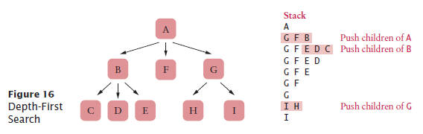
Depth-First Search
Iterative traversal can stop when a goal has been met. Depth-first search uses a stack to track the nodes that it still needs to visit.
Algorithm:
  Push the root node on a stack.
  While the stack is not empty
  Pop the stack; let n be the popped node.
  Process n.
  Push the children of n on the stack, starting with the last one.

Slide 51
Breadth-First Search
Breadth-first search first visits all nodes on the same level before visiting the children.
Breath-first search uses a queue.

Slide 52
Self Check 17.19
What are the inorder traversals of the two trees in Figure 6?
Answer: For both trees, the inorder traversal is
3 + 4 * 5.

Slide 53
Self Check 17.20
Are the trees in Figure 6 binary search trees?
Answer: No—for example, consider the children of +. Even without looking up the Unicode values for 3, 4, and +, it is obvious that + isn't between 3 and 4.

Slide 54

Self Check 17.22
Answer: When the method returns to its caller, the caller can continue traversing the tree. For example, suppose the tree is
Let’s assume that we want to stop visiting as soon as we encounter a zero, so visit returns false when it receives a zero. We first call inorder on the node containing 2. That calls inorder on the node containing 0, which calls inorder on the node containing –1. Then visit is called on 0, returning false. Therefore, inorder is not called on the node containing 1, and the inorder call on the node containing 0 is finished, returning to the inorder call on the root node. Now visit is called on 2, returning true, and the visitation continues, even though it shouldn't. See Exercise E17.10 for a fix.

Slide 55
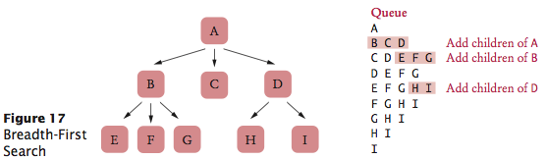
Self Check 17.23
In what order are the nodes in Figure 17 visited if one pushes children on the stack from left to right instead of right to left?
Answer: AGIHFBEDC

Slide 56
Self Check 17.24
What are the first eight visited nodes in the breadth-first traversal of the tree in Figure 1?
Answer: That’s the royal family tree, the first tree in the chapter: George V, Edward VIII, George VI, Mary, Henry, George, John, Elizabeth II.

