Slide 1
Repetition
CONTROL STRUCTURES II
while, for, do while
goto

Slide 2
Objectives
In this chapter you will:
Learn about repetition (looping) control structures
Explore how to construct and use count-controlled, sentinel-controlled, flag-controlled, and EOF-controlled repetition structures
Examine break and continue statements
Discover how to form and use nested control structures

Slide 3
Why Use Repetition?
Repetition allows you to efficiently use variables
Can input, add, and average multiple numbers using a limited number of variables
For example, you can add five numbers together by:
  declaring a variable for each number, inputting the numbers and adding the variables together
  creating a loop that reads a number into a variable and adds it to a variable that contains the sum of the numbers and looping until all numbers are read

Slide 4
The while Loop
The general form of the while statement is:
while(expression)
statement
while is a reserved word
The statement can be simple or compound
The expression acts as a decision maker and is usually a logical expression
The statement is called the body of the loop
The parentheses are part of the syntax

Slide 5
The while Loop
The expression provides an entry condition
The statement executes if the expression initially evaluates to true
The loop condition is then reevaluated
If it is still true, the statement executes again
The statement continues to execute until the expression is no longer true
An infinite loop continues to execute endlessly and can be avoided by making sure that the loop’s body contains statement(s) that assure that the exit condition will eventually be false

Slide 6
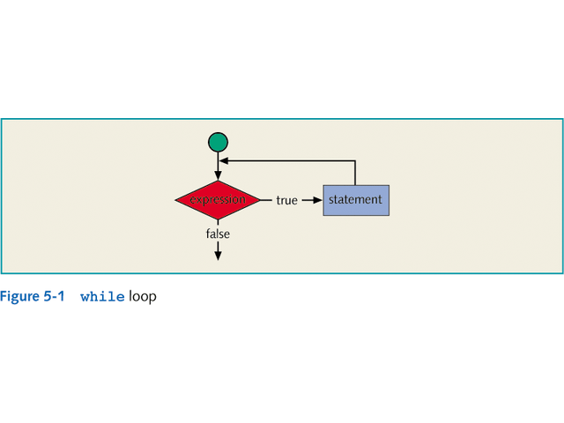

Slide 7
Sentinel-Controlled while Loops
A sentinel variable is tested in the condition and the loop ends when the sentinel value is encountered
The syntax is:
cin>>variable;
while(variable != sentinel)
{
.
cin>> variable;
.
}

Slide 8
Flag-Controlled while Loops
A flag-controlled while loop uses a Boolean variable to control the loop
The flag-controlled while loop takes the form:
found = false;
while(!found)
{
.
if(expression)
found = true;
.
}

Slide 9
EOF-Controlled while Loops
An input stream variable, such as cin, returns a value, after reading data, as follows:
  If the program has reached the end of input data, the input stream variable returns the logical value false
  If the program reads a faulty data the input stream enters into the fail state which means that any further I/O operations using that stream are considered to be null operations and cin returns the value false
  In cases other than the above, it returns the logical value true
The logical value returned by cin can determine if the program has ended input

Slide 10
The eof Function
The function eof with an input stream variable can also be used to determine the end of file status
Like the I/O functions, such as get, ignore, and peek, the function eof is also a member of data type istream
The syntax to use the function eof is:
istreamVar.eof()
where istreamVar is an input stream variable, such as cin

Slide 11
The for Loop
The general form of the for statement is:
for(initial statement; loop condition;
update statement)
statement
The initial statement, loop condition, and update statement (called for loop control statements) that are enclosed within the parentheses control the body of the for statement

Slide 12
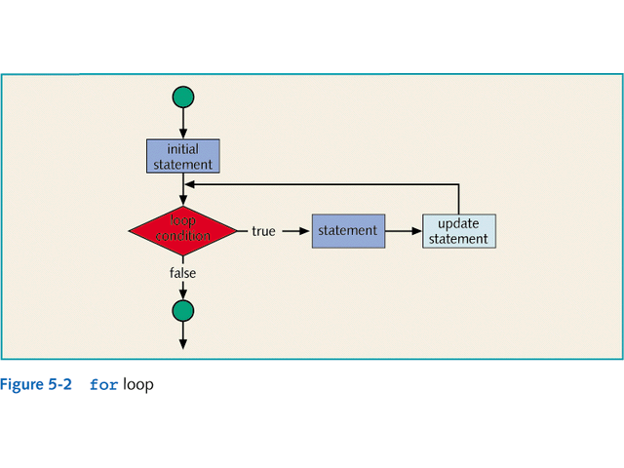

Slide 13
The for Loop
The for loop executes as follows:
  The initial statement executes
  The loop condition is evaluated
    if the loop condition evaluates to true
      execute the for loop statement
      execute the update statement (the third expression in the parentheses)
  Repeat the previous step until the loop condition evaluates to false
The initial statement initializes a variable
The initial statement in the for loop is the first to be executed and is executed only once

Slide 14
The for Loop
If the loop condition is initially false, the loop body does not execute
The update expression, when executed, changes the value of the loop control variable which eventually sets the value of the loop condition to false
The for loop executes indefinitely if the loop condition is always true

Slide 15
The for Loop
Fractional values
  can be used for loop control variables of the double type or any real data type
  should be avoided because different computers can give different results for the variables
A semicolon at the end of the for statement (just before the body of the loop) is a semantic error, in this case, the action of the for loop is empty
If the loop condition is omitted it is assumed to be true

Slide 16
The for Loop
In a for statement, all three statements—initial statement, loop condition, and update statement can be omitted
The following is a legal for loop:
for(;;)
cout<<"Hello"<<endl;

Slide 17
The do…while Loop
The general form of a do...while statement is:
do
statement
while(expression);
The statement executes first, and then the expression is evaluated
If the expression evaluates to true, the statement executes again
As long as the expression in a do...while statement is true, the statement executes

Slide 18
The do…while Loop
To avoid an infinite loop, the loop body must contain a statement that ultimately makes the expression false and assures that it exits
The statement can be a simple or a compound statement
If it is a compound statement, it must be enclosed between braces
Because the while and for loop has an entry condition, it may never activate, whereas, the do...while loop, which has an exit condition, always goes through at least once

Slide 19
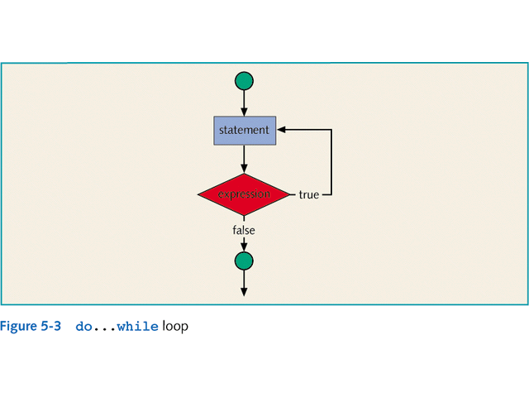

Slide 20
Break & Continue Statements
A break and continue statement alters the flow of control
The break statement, when executed in a switch structure, provides an immediate exit from the switch structure
The break statement can be used in while, for, and do...while loops
When the break statement executes in a repetition structure, it immediately exits from these structures

Slide 21
Break & Continue Statements
The break statement is typically used for two purposes:
  1. To exit early from a loop
  2. To skip the remainder of the switch structure
After the break statement executes, the program continues to execute with the first statement after the structure
The use of a break statement in a loop can eliminate the use of certain (flag) variables

Slide 22
Break & Continue Statements
The continue statement is used in while, for, and do-while structures
When it is executed in a loop, it skips the remaining statements and proceeds with the next iteration of the loop
In a while and do-while structure, the expression (loop-continue test) is evaluated immediately after the continue statement
In a for structure, the update statement is executed after the continue statement, and then the loop condition executes

Slide 23
Nested Control Structures
Suppose we want to create the following pattern
*
**
***
****
*****
In the first line we want to print one star, in the second line two stars and so on

Slide 24
Nested Control Structures
Since five lines are to be printed, we start with the following for statement
for(i = 1; i <= 5 ; i++)
The value of i in the first iteration is 1, in the second iteration it is 2, and so on
We can use the value of i as the limiting condition in another for loop nested within this loop to control the number of starts in a line

Slide 25
Nested Control Structures
The syntax would be:
for(i = 1; i <= 5 ; i++)
{
for(j = 1; j <= i; j++)
cout<<"*";
cout<<endl;
}

Slide 26
Nested Control Structures
What pattern does the code produce if we replace the first for statement with the following?
for(i = 5; i >= 1; i--)
Answer:
*****
****
***
**
*

