Slide 1
C++ Programming:
Program Design Including
Data Structures, Third Edition
Chapter 10: Records (structs)

Slide 2
Objectives
In this chapter you will:
Learn about records (structs)
Examine various operations on a struct
Explore ways to manipulate data using a struct
Learn about the relationship between a struct and functions
Discover how arrays are used in a struct
Learn how to create an array of struct items

Slide 3
Records (structs)
Struct: collection of a fixed number of components, accessed by name
Components may be of different types
Components of a struct are called the members of the struct
struct is a reserved word

Slide 4
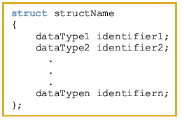
Records (structs) (continued)
The general syntax of a struct is:

Slide 5
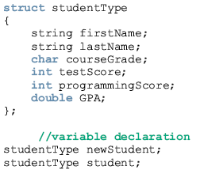

Slide 6
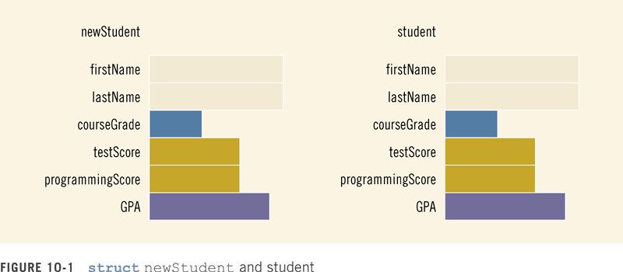

Slide 7

Accessing struct Members
The syntax for accessing a struct member is:
The dot (.) is an operator, called the member access operator

Slide 8

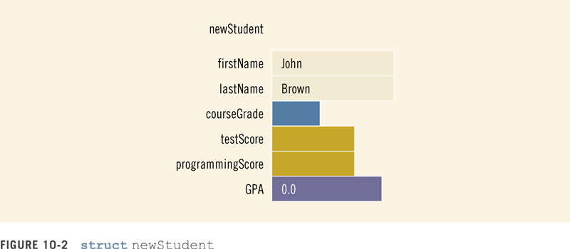

Slide 9
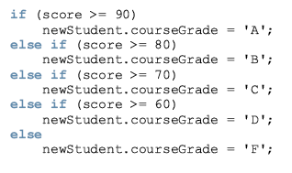
cin >> newStudent.firstName;
cin >> newStudent.testScore
>> newStudent.programmingScore;
score = (newStudent.testScore +
newStudent.programmingScore) / 2;

Slide 10
Assignment
Value of one struct variable can be assigned to another struct variable of the same type using an assignment statement
The statement:
student = newStudent;
copies the contents of newStudent into student

Slide 11
Assignment
The assignment statement:
student = newStudent;
is equivalent to the following statements:
student.firstName = newStudent.firstName;
student.lastName = newStudent.lastName;
student.courseGrade = newStudent.courseGrade;
student.testScore = newStudent.testScore;
student.programmingScore =
newStudent.programmingScore;
student.GPA = newStudent.GPA;

Slide 12

Comparison (Relational Operators)
Compare struct variables member-wise
To compare the values of student and newStudent:

Slide 13
Input/Output
No aggregate input/output operations on a struct variable
Data in a struct variable must be read one member at a time
The contents of a struct variable must be written one member at a time

Slide 14
Input/Output (continued)
cout << newStudent.firstName
<< " " << newStudent.lastName
<< " " << newStudent.courseGrade
<< " " << newStudent.testScore
<< " " << newStudent.programmingScore
<< " " << newStudent.GPA << endl;

Slide 15
struct Variables and Functions
A struct variable can be passed as a parameter by value or by reference
A function can return a value of type struct

Slide 16
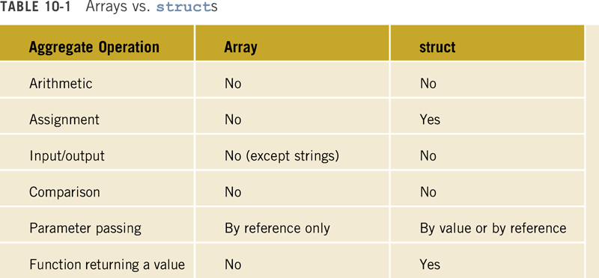

Slide 17
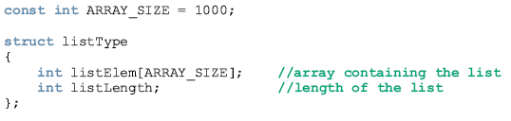
Arrays in structs
Two key items are associated with a list:
  Values (elements)
  Length of the list
Define a struct containing both items:

Slide 18
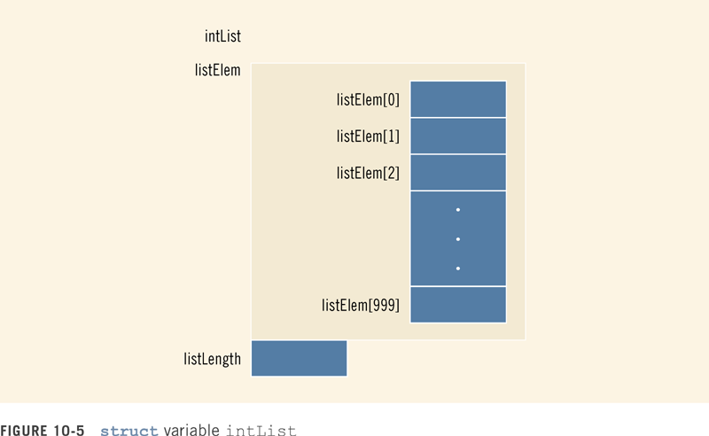

Slide 19


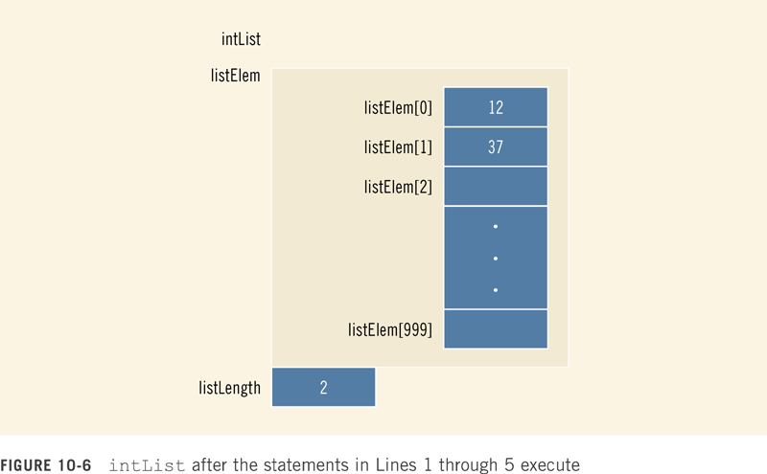

Slide 20
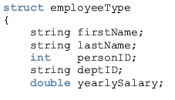


Slide 21
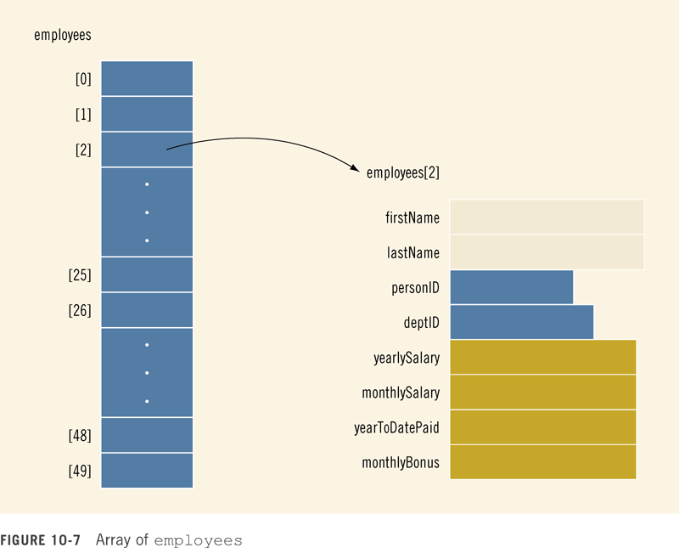

Slide 22
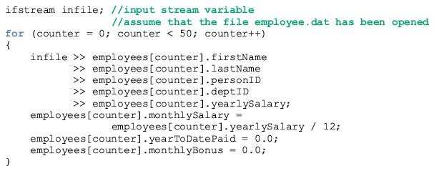
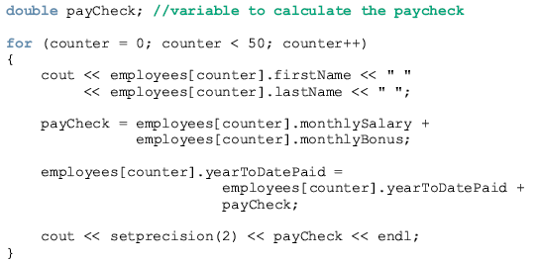

Slide 23
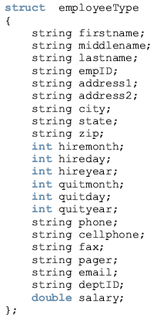

Slide 24
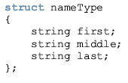
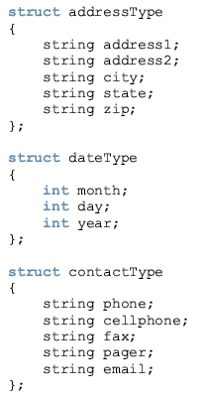

Slide 25
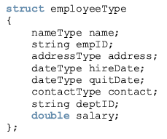

Slide 26
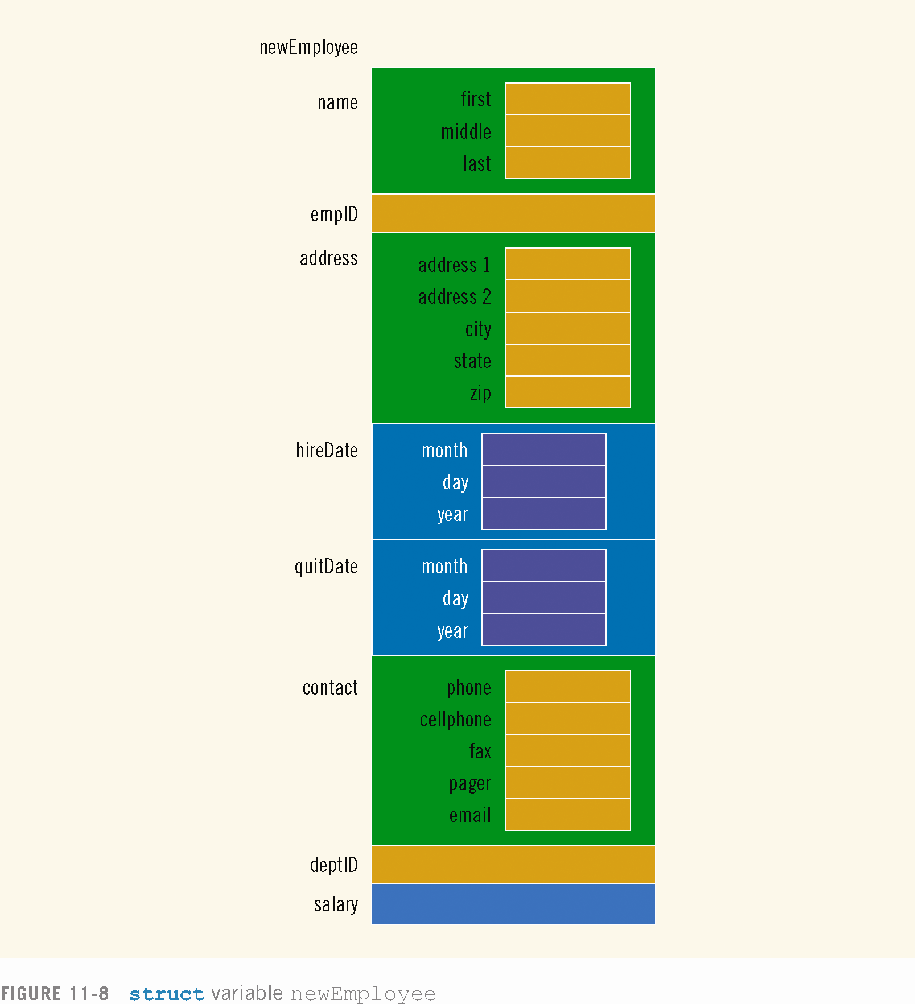

Slide 27
Programming Example
A company has six salespeople
Every month they go on road trips to sell the company’s product
At the end of each month, the total sales for each salesperson, salesperson’s ID, and the month, are recorded in a file
At the end of each year, the manager of the company asks for a report

Slide 28
Output Format
----------- Annual Sales Report -------------
ID QT1 QT2 QT3 QT4 Total
_______________________________________________________________
12345 1892.00 0.00 494.00 322.00 2708.00
32214 343.00 892.00 9023.00 0.00 10258.00
23422 1395.00 1901.00 0.00 0.00 3296.00
57373 893.00 892.00 8834.00 0.00 10619.00
35864 2882.00 1221.00 0.00 1223.00 5326.00
54654 893.00 0.00 392.00 3420.00 4705.00
Total 8298.00 4906.00 18743.00 4965.00
Max Sale by SalesPerson: ID = 57373, Amount = $10619.00
Max Sale by Quarter: Quarter = 3, Amount = $18743.00
QT1 stands for quarter 1 (months 1 to 3), QT2 for quarter 2 (months 4 to 6), QT3 for quarter 3 (months 7 to 9) and QT4 for quarter 4 (months 10 to 12)

Slide 29
Programming Example
The salespeople IDs are stored in one file; sales data are stored in another file
The sales data is in the following form:
salesPersonID month saleAmount
Sales data are not ordered

Slide 30
Input/Output
Input: file containing each salesperson’s ID, and a second file containing the sales data
Output: file containing annual sales report in the above format

Slide 31
Problem Analysis
Main components for each salesperson:
  ID
  Quarterly sales amount
  Total annual sales amount
Because the components are of different types, group them in a struct

Slide 32
Program Analysis (continued)
There are six people, so an array of 6 components is used
Because the program requires the company’s total sales for each quarter
  We need an array of four components to store the data

Slide 33
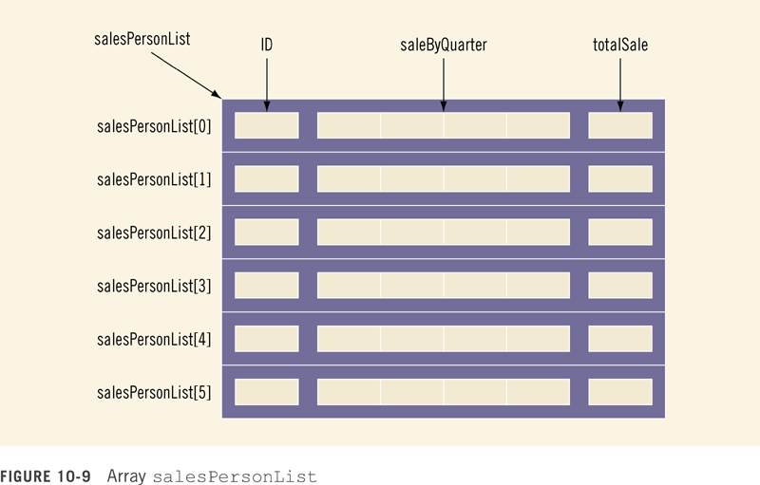

Slide 34
Program Analysis (continued)
Read the salespeople IDs into the array salesPersonList
Initialize the quarterly sales and total sales for each salesperson to 0

Slide 35
Program Analysis (continued)
For each entry in the file containing the sales data
  Read ID, month, sale amount for the month
  Search salesPersonList to locate the component corresponding to this salesperson
  Determine the quarter corresponding to the month
  Update the sales for the quarter by adding the sale amount for the month

Slide 36
Program Analysis (continued)
Once the sales data file is processed
  Calculate the total sale by salesman
  Calculate the total sale by quarter
  Print the report

Slide 37
Algorithm Design
Translates into the following algorithm
  Initialize the array sales
  Process the sales data
  Calculate the total sale by salesman
  Calculate the total sale by quarter
  Print the report
  Calculate and print maximum sale by salesman
  Calculate and print maximum sale by quarter

Slide 38
Main Algorithm
Declare the variables
Prompt user to enter name of file containing the salesperson’s ID data
Read the name of the input file
Open the input file
If input file does not exist, exit
Initialize the array salesPersonList by calling the function initialize

Slide 39
Main Algorithm (continued)
Close input file containing salesperson’s ID
Prompt user to enter name of file containing sales data
Read the name of the input file
Open the input file
If input file does not exist, exit
Prompt user to enter name of output file
Read the name of the output file

Slide 40
Main Algorithm (continued)
Open the output file
Output data to two decimal places
Process sales data
  Call the function getData

Slide 41
Main Algorithm (continued)
Calculate the total sale by quarter by calling the function saleByQuarter
Calculate the total sale by salesman by calling the function totalSaleByPerson
Print the report in the tabular form; call the function printReport
Find and print the salesperson who produces the maximum sales for the year by calling the function maxSaleByPerson

Slide 42
Main Algorithm (continued)
Find and print the quarter producing the maximum sale for the year by calling the function maxSaleByQuarter
Close files

Slide 43
Summary
Struct: collection of a fixed number of components
Components can be of different types
struct is a reserved word
No memory is allocated for a struct; memory is allocated for struct variables when declared
Components of a struct are called members

Slide 44
Summary (continued)
struct components are accessed by name
Dot (.) operator is called the member access operator
Members of a struct are accessed using the dot (.) operator
The only built-in operations on a struct are the assignment and member access

Slide 45
Summary (continued)
Neither arithmetic nor relational operations are allowed on structs
struct can be passed by value or reference
A function can return a value of type struct
A struct can be a member of another struct

