Slide 1
C++ Programming:
Program Design Including
Data Structures, Third Edition
Chapter 11: Classes and Data Abstraction

Slide 2
Objectives
In this chapter you will:
Learn about classes
Learn about private, protected, and public members of a class
Explore how classes are implemented
Examine constructors and destructors
Learn about the abstract data type (ADT)

Slide 3
Objectives (continued)
Explore how classes are used to implement ADTs
Learn about information hiding
Explore how information hiding is implemented in C++
Learn about the static members of a class

Slide 4

Classes
Class: collection of a fixed number of components
The components of a class are called members
The general syntax for defining a class:

Slide 5
Classes (continued)
Class member can be a variable or a function
If a member of a class is a variable
  It is declared like any other variable
In the definition of the class
  Cannot initialize a variable when you declare it
If a member of a class is a function
  Function prototype is listed
Function members can (directly) access any member of the class

Slide 6
Classes (continued)
class is a reserved word
Class defines a data type, no memory is allocated
Don’t forget the semicolon after the closing brace of the class

Slide 7
Classes (continued)
Three categories of class members:
  private
  public
  protected
By default, all members of a class are private
If a member of a class is private
  It cannot be accessed outside the class

Slide 8
Classes (continued)
A public member is accessible outside the class
To make a member of a class public
  Use the label public with a colon
private, protected, and public are reserved words

Slide 9
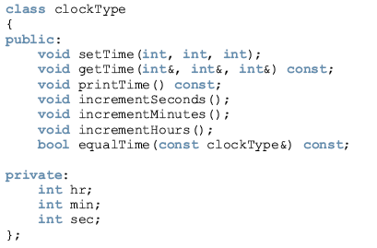

Slide 10
The class clockType has seven member functions: setTime, getTime, printTime, incrementSeconds, incrementMinutes, incrementHours, and equalTime. It has three member variables: hr, min, and sec.
The three member variables—hr, min, and sec—are private to the class and cannot be accessed outside the class.
The seven member functions—setTime, getTime, printTime, incrementSeconds, incrementMinutes, incrementHours, and equalTime—can directly access the member variables (hr, min, and sec).
In the function equalTime, the formal parameter is a constant reference parameter. That is, in a call to the function equalTime, the formal parameter receives the address of the actual parameter, but the formal parameter cannot modify the value of the actual parameter.
The word const at the end of the member functions getTime, printTime, and equalTime specifies that these functions cannot modify the member variables of a variable of type clockType.

Slide 11
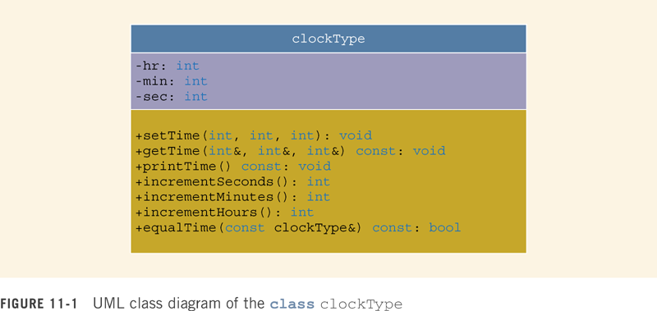

Slide 12
The top box contains the name of the class.
The middle box contains the member variables and their data types.
The last box contains the member function name, parameter list, and the return type of the function.
A + (plus) sign in front of a member name indicates that this member is a public member;
A - (minus) sign indicates that this is a private member.
The symbol # before the member name indicates that the member is a protected member.

Slide 13
Variable (Object) Declaration
Once a class is defined, you can declare variables of that type
In C++ terminology, a class variable is called a class object or class instance
The syntax for declaring a class object is the same as for declaring any other variable
clockType myClock;
clockType yourClock;

Slide 14
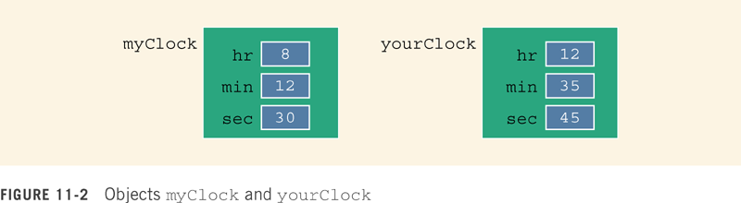

Slide 15

Accessing Class Members
Once an object is declared
  It can access the public members of the class
Syntax to access class members:
The dot (. ) is called the member access operator

Slide 16
Accessing Class Members (continued)
The class members that a class object can access depend on where the object is declared.
  If the object is declared in the definition of a member function of the class, then the object can access both the public and private members.
  If the object is declared elsewhere (for example, in a user’s program), then the object can access only the public members of the class.

Slide 17


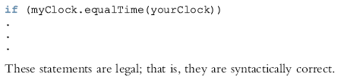

Example 11-1

Slide 18
Built-in Operations on Classes
Most of C++’s built-in operations do not apply to classes
Arithmetic operators cannot be used on class objects unless the operators are overloaded
You cannot use relational operators to compare two class objects for equality
The two built-in operations that are valid for class objects are member access (.) and assignment (=)

Slide 19

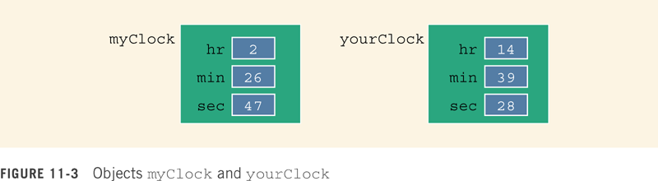
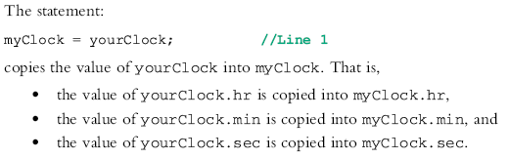

Slide 20
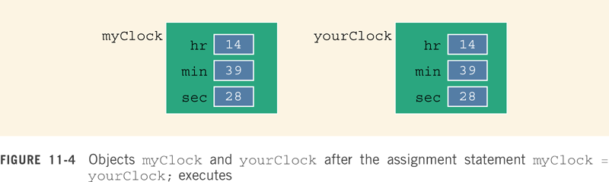

Slide 21
Class Scope
An object can be automatic or static
A member of the class is local to the class
You access a class member outside the class by using the class object name and the member access operator (.)

Slide 22
Functions and Classes
Objects can be passed as parameters to functions and returned as function values
As parameters to functions
  Objects can be passed by value or by reference
If an object is passed by value
  Contents of data members of the actual parameter are copied into the corresponding data members of the formal parameter

Slide 23
Reference Parameters & Variables
Passing by value might require a large amount of storage space and a considerable amount of computer time to copy the value of the actual parameter into the formal parameter
If a variable is passed by reference
  The formal parameter receives only the address of the actual parameter

Slide 24
Reference Parameters & Variables (continued)
Pass by reference is an efficient way to pass a variable as a parameter
If a variable is passed by reference
  Then the actual parameter changes when the formal parameter changes
You can pass a variable by reference and still prevent the function from changing its value
  Use the keyword const in the formal parameter declaration

Slide 25
The identifiers setTime, printTime, and so forth are local to the class; we cannot reference them (directly) outside the class.
In order to reference these identifiers, we use the scope resolution operator, :: (double colon).
In the function definition’s heading, the name of the function is the name of the class, followed by the scope resolution operator, followed by the function name.

Slide 26
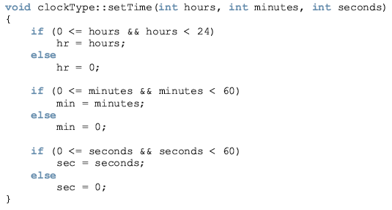

Slide 27
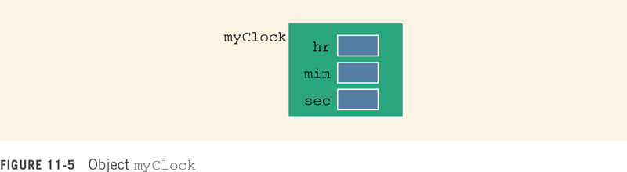
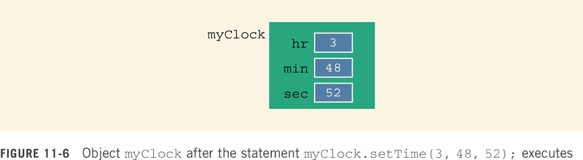

Slide 28
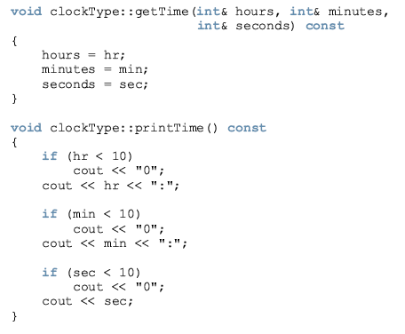

Slide 29
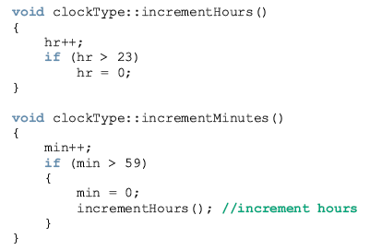

Slide 30
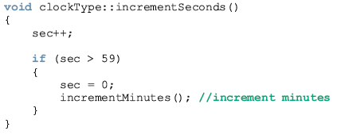

Slide 31
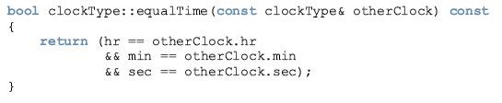

Suppose that myClock and yourClock are objects of type clockType, as declared previously. Further suppose that we have myClock and yourClock as shown in Figure 11-7.

Slide 32
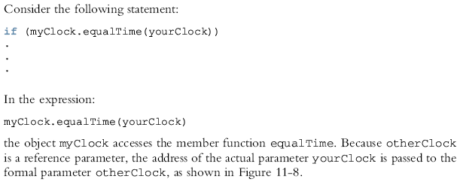
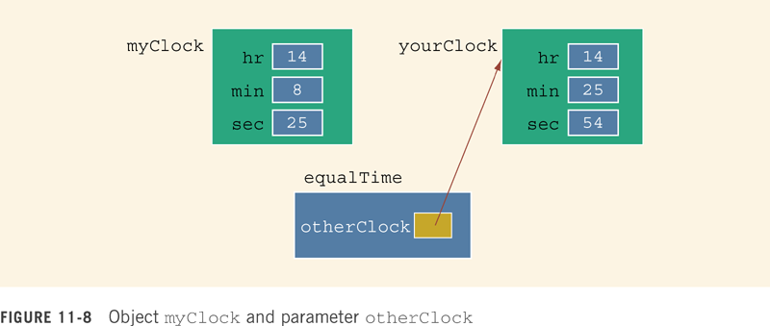

Slide 33
Within the definition of this function, the object otherClock accesses the member variables hr, min, and sec.
However, these member variables are private. So is there any violation? The answer is no.
The function equalTime is a member of the class clockType and hr, min, and sec are the member variables.
otherClock is an object of type clockType.
Therefore, the object otherClock can access its private member variables within the definition of the function equalTime.

Slide 34
Once a class is properly defined and implemented, it can be used in a program.
A program or software that uses and manipulates the objects of a class is called a client of that class.
When you declare objects of the class clockType, every object has its own copy of the member variables hr, min, and sec.
In object-oriented terminology, variables such as hr, min, and sec are called instance variables of the class because every object has its own instance of the data.

Slide 35
Accessor and Mutator Functions
Accessor function: member function that only accesses (does not modify) the value(s) of the member variable(s)
Mutator function: member function that modifies the value(s) of the member variable(s)
Constant function:
  Member function that cannot modify member variables
  Include reserved word const in function heading

Slide 36
Order of public and private Members of a Class
C++ has no fixed order in which you declare public and private members
By default all members of a class are private
Use the member access specifier public to make a member available for public access

Slide 37
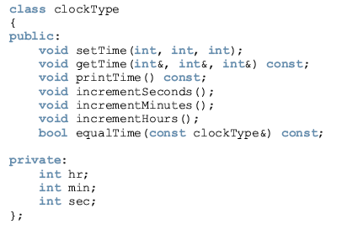
Example 11-3

Slide 38
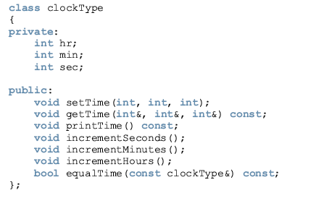
Example 11-4

Slide 39
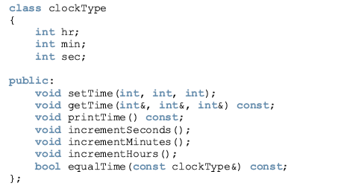
Example 11-5

Slide 40
Constructors
Use constructors to guarantee that data members of a class are initialized
Two types of constructors:
  With parameters
  Without parameters
Constructor without parameters is called the default constructor

Slide 41
Constructors (continued)
The name of a constructor is the same as the name of the class.
A constructor, even though it is a function, has no type. That is, it is neither a value-returning function nor a void function.
A class can have more than one constructor. However, all constructors of a class have the same name.
If a class has more than one constructor, the constructors must have different formal parameter lists.
Constructors execute automatically when a class object enters its scope. Because they have no types, they cannot be called like other functions.
Which constructor executes depends on the types of values passed to the class object when the class object is declared.

Slide 42
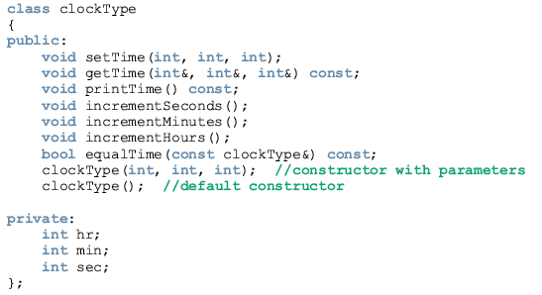

Slide 43
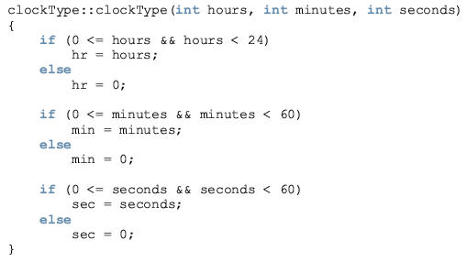

Slide 44
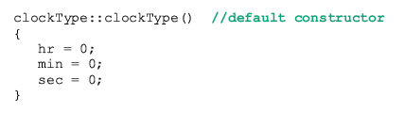

We can write the definition of the constructor with parameters by calling the function setTime, as follows:

Slide 45

Invoking a Constructor
A constructor is automatically executed when a class variable is declared
To invoke the default constructor:
The statement:
clockType yourClock;
declares yourClock to be an object of type clockType. In this case, the default constructor executes and the member variables of yourClock are initialized to 0.

Slide 46
where argument1, argument2, and so on, is either a variable or an expression.
Note the following:
The number of arguments and their type should match the formal parameters (in the order given) of one of the constructors.
If the type of the arguments does not match the formal parameters of any constructor (in the order given), C++ uses type conversion and looks for the best match. For example, an integer value might be converted to a floating-point value with a zero decimal part. Any ambiguity will result in a compile-time error.

Slide 47
If you replace the constructors of the class clockType with the constructor in Line 1 (the constructor with the default parameters), then you can declare clockType objects with zero, one, two, or three arguments as follows:
clockType clock1; //Line 2
clockType clock2(5); //Line 3
clockType clock3(12, 30); //Line 4
clockType clock4(7, 34, 18); //Line 5

Slide 48
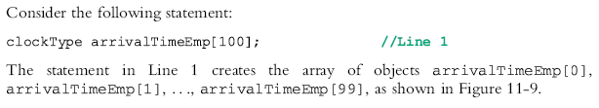
If a class has constructors and you declare an array of that class’s objects, the class should have the default constructor.
The default constructor is typically used to initialize each (array) class object.

Slide 49
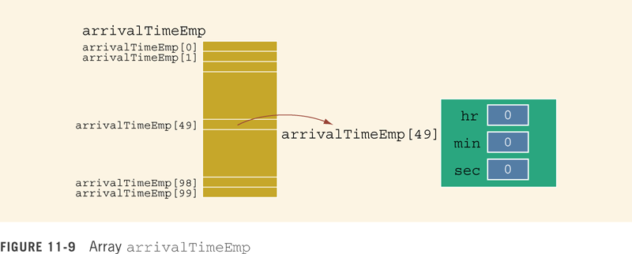

Slide 50
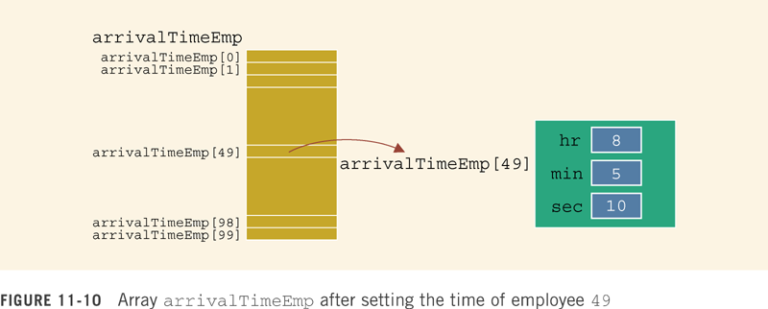

Slide 51
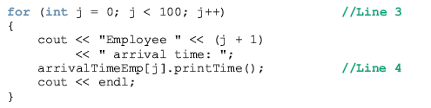
The statement in Line 4 outputs the arrival time of an employee in the form hr:min:sec.

Slide 52
Classes and Constructors: A Precaution
If a class has no constructor(s)
  C++ automatically provides the default constructor
  However, object declared is still uninitialized
If a class includes constructor(s) with parameter(s) and does not include default constructor
  C++ does not provide default constructor

Slide 53
Arrays of Class Objects (Variables) and Constructors
If a class has constructors and you declare an array of class objects
  The class should have the default constructor
The default constructor is used to initialize each (array) class object
For example:
clockType clocks[100];

Slide 54
Destructors
Destructors are functions without any type
The name of a destructor is the character '~' followed by class name
The name of the destructor clockType:
~clockType();
A class can have only one destructor
  It has no parameters
The destructor is automatically executed when the class object goes out of scope

Slide 55
Data Abstract, Classes, and Abstract Data Types
Abstraction
  Separating design details from usage
  Separating the logical properties from the implementation details
Abstraction can also be applied to data

Slide 56
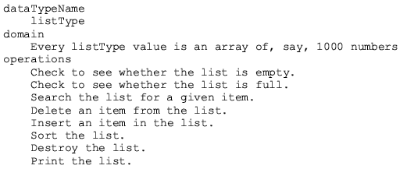
Example 11-8
A list is defined as a set of values of the same type.
Because all values in a list are of the same type, a convenient way to represent and process a list is to use an array.
You can define a list as an ADT as follows:

Slide 57
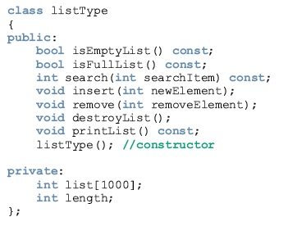

Slide 58
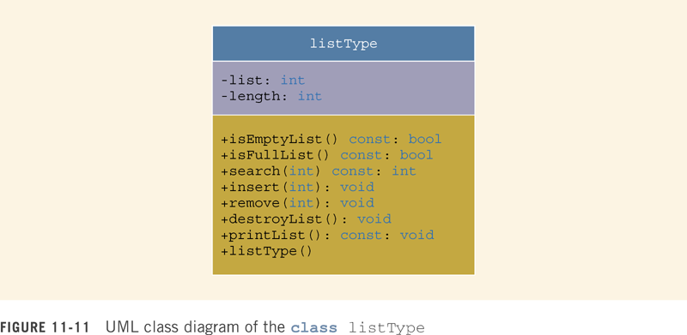

Slide 59
A struct Versus a Class
By default, members of a struct are public
By default, members of a class are private
The member access specifier private can be used in a struct to make a member private
Classes and structs have the same capabilities

Slide 60
A struct Versus a Class (continued)
The definition of a struct was expanded to include member functions, constructors, and destructors
If all member variables of a class are public and there are no member functions
  Use a struct

Slide 61
Information Hiding
Information hiding: hiding the details of the operations on the data
Interface (header) file: contains the specification details
Implementation file: contains the implementation details

Slide 62
Information Hiding (continued)
Include comments in the header file with the function prototypes that briefly describe the functions
  Specify any preconditions and/or postconditions

Slide 63
Information Hiding (continued)
Precondition: A statement specifying the condition(s) that must be true before the function is called
Postcondition: A statement specifying what is true after the function call is completed

Slide 64
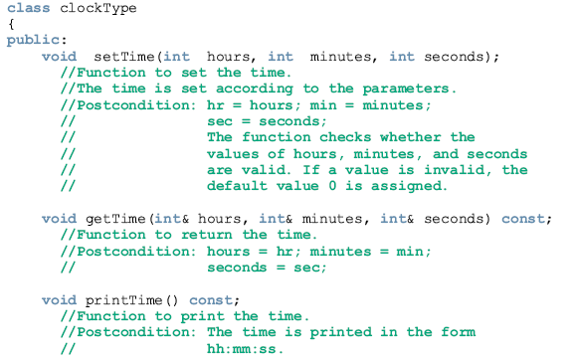

Slide 65
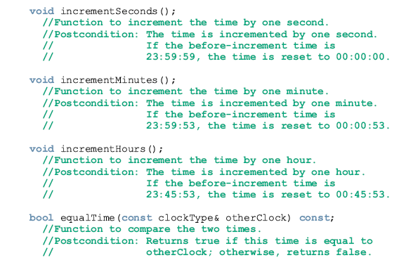

Slide 66
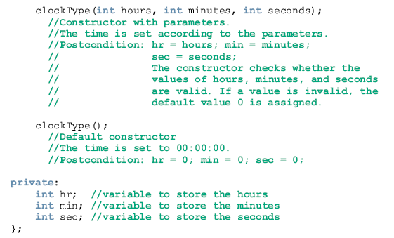

Slide 67
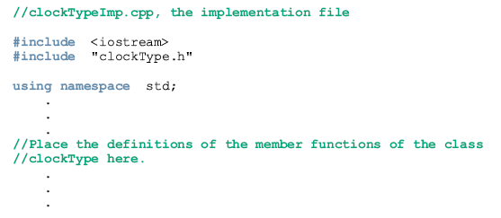

Slide 68
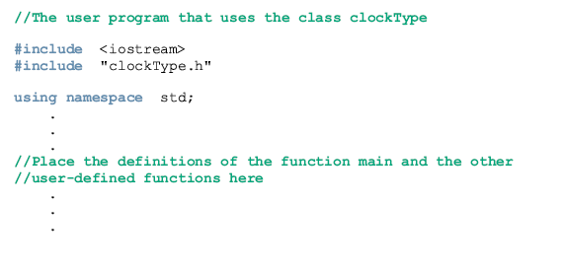

Slide 69
Information Hiding (continued)
Header file has an extension .h
Implementation file has an extension .cpp
Implementation file must include header file via include statement
In an include statement
  User-defined header files are enclosed in double quotes
  System-provided header files are enclosed between angular brackets

Slide 70
Executable Code
To use an object in a program
  The program must be able to access the implementation
Visual C++, C++ Builder, and CodeWarrior put the editor, compiler, and linker into a package
With one command, the program is compiled and linked with the other necessary files
These systems also manage multiple file programs in the form of a project

Slide 71
Executable Code (continued)
A project consists of several files, called the project files
These systems usually have a command called build, rebuild, or make

Slide 72
Executable Code (continued)
When the build, rebuild, or make command is applied to a project
  System automatically compiles and links all files required to create the executable code
When one or more files in the project change
  You can use these commands to recompile and relink the files

Slide 73
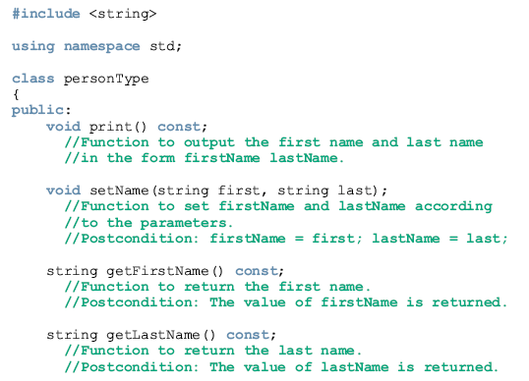
Example 11-9

Slide 74
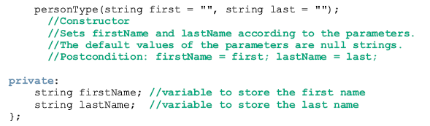
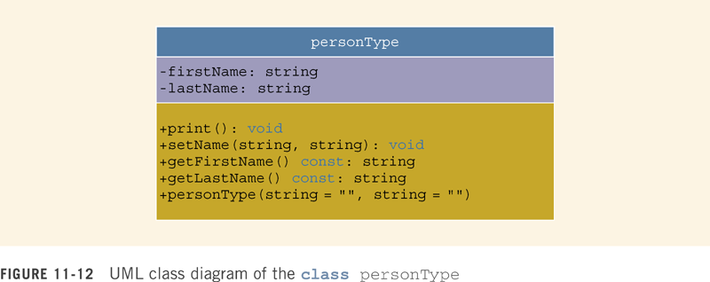

Slide 75
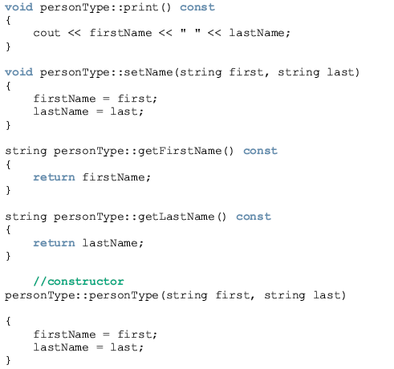

Slide 76
Static Members of a Class
Use the keyword static to declare a function or variable of a class as static
A public static member, function or data, of a class can be accessed using the class name and the scope resolution operator

Slide 77
Programming Example
A common place to buy candy is the candy machine
This candy machine currently sells candies, chips, gum, and cookies
A new candy machine is bought for the gym, but it is not working properly
You have been asked to write a program so it can be put into operation

Slide 78
Programming Example (continued)
The program should:
  Show the customer the different products sold
  Let the customer make the selection
  Show the customer the cost of the item
  Accept money from the customer
  Release the item
Input: item selection and cost of the item
Output: selected item

Slide 79
Problem Analysis
A candy machine has two main components
  A built-in cash register
  Several dispensers to hold and release the product

Slide 80
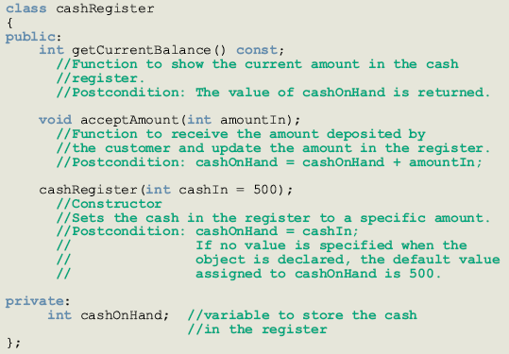

Slide 81
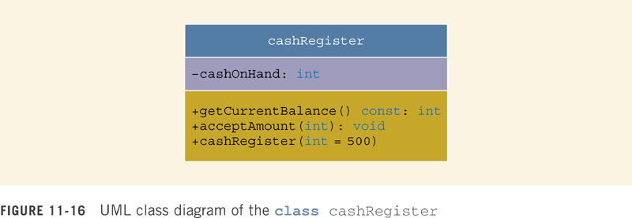


Slide 82

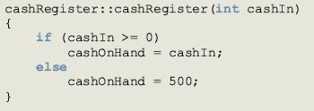

Slide 83
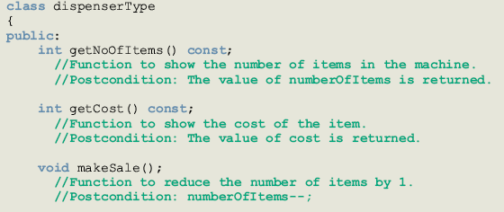

Slide 84
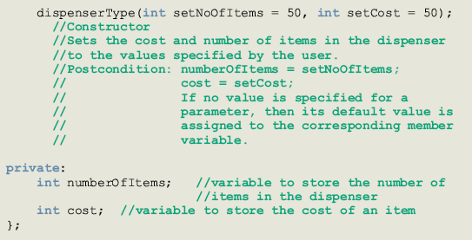

Slide 85
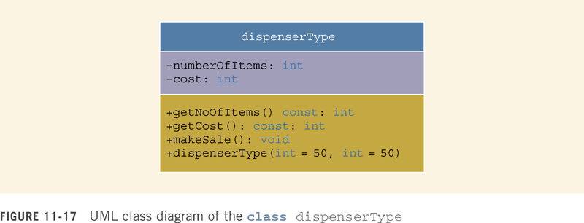

Slide 86
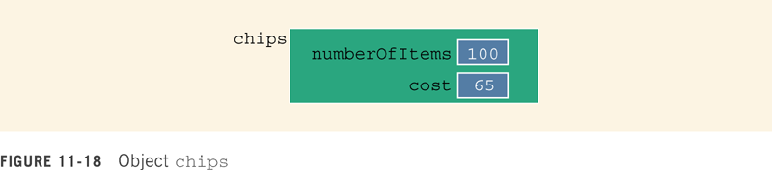

Slide 87




Slide 88
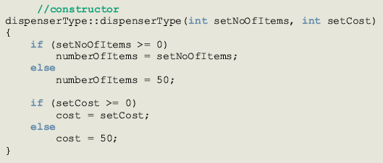

Slide 89
Main Program
When the program executes, it must
  Show the different products sold
  Show how to select a particular product
  Show how to terminate the program
These instructions must be displayed after processing each selection
Once the user has made a selection
  Candy machine must act accordingly

Slide 90
Main Program (continued)
If the user wants to a buy a product and the product is available
  Candy machine should show product cost and ask the user to deposit money
If the money deposited is at least the cost of the item
  Candy machine should sell the item and display an appropriate message

Slide 91
Menu
Show the selection to the customer
Get selection
If selection is valid and the dispenser corresponding to the selection is not empty, sell the product

Slide 92
Menu (continued)
The menu (showSelection) looks like:
*** Welcome to Shelly's Candy Shop ***"
To select an item, enter
1 for Candy
2 for Chips
3 for Gum
4 for Cookies
9 to exit

Slide 93
sellProduct
If the dispenser is nonempty:
  Prompt customer to enter the item cost
  Get the amount entered by the customer
  If the amount entered by the customer is less than the cost of the product
    Prompt customer to enter additional amount
    Calculate total amount entered by the customer

Slide 94
sellProduct (continued)
  If amount entered by the customer is at least the cost of the product
    Update the amount in the cash register
    Sell the product, that is, decrement the number of items in the dispenser by 1, and display an appropriate message

Slide 95
sellProduct (continued)
  If the amount entered by user is less than the cost of the item
    Ask user to deposit additional money
  If the dispenser is empty
    Tell the user that this product is sold out

Slide 96
The Function main
Create the cash register; declare a variable of type cashRegister
Create four dispensers; declare and initialize four objects dispenserType
For example:
  The statement
  dispenserType candy(100, 50);
  creates a dispenser object, candy, to hold candies
  The number of items in the dispenser is 100 and the cost of an item is 50 cents

Slide 97
The Function main (continued)
Declare additional variables as necessary
Show menu
Get the selection
While not done (9 exits)
  Sell product (sellProduct)
  Show selection (showSelection)
  Get selection

Slide 98
Summary
Class: collection of a fixed number of components
Members: components of a class
Members are accessed by name
Members are classified into one of three categories: private, protected, and public
Class variables are called class objects or, simply, objects

Slide 99
Summary (continued)
The only built-in operations on classes are the assignment and member selection
Constructors guarantee that the data members are initialized when an object is declared
A constructor without parameters is called the default constructor
Destructors automatically execute when a class object goes out of scope
A class can have only one destructor, and the destructor has no parameters

Slide 100
Summary (continued)
Abstract data type (ADT): data type that separates the logical properties from the implementation details
A public static member, function or data, of a class can be accessed using the class name and the scope resolution operator
Static data members of a class exist even when no object of the class type exists
Instance variables: non-static data members

