Slide 1
C++ Programming:
Program Design Including
Data Structures, Third Edition
Inheritance and Composition

Slide 2
Objectives
In this chapter you will:
Learn about inheritance
Learn about derived and base classes
Explore how to redefine the member functions of a base class
Examine how the constructors of base and derived classes work
Learn how to construct the header file of a derived class

Slide 3
Objectives (continued)
Become familiar with the C++ stream hierarchy
Explore three types of inheritance: public, protected, and private
Learn about composition
Become familiar with the three basic principles of object-oriented design

Slide 4
Inheritance and Composition
The two common ways to relate two classes in a meaningful way are:
  Inheritance (“is-a” relationship)
  Composition (“has-a” relationship)

Slide 5
Inheritance
Inheritance is an “is-a” relationship
For instance,“every employee is a person”
Inheritance lets us create new classes from existing classes
New classes are called the derived classes
Existing classes are called the base classes
Derived classes inherit the properties of the base classes

Slide 6
Inheritance (continued)
Single inheritance: derived class has a single base class
Multiple inheritance: derived class has more than one base class
Can be viewed as a tree (hierarchy) where a base class is shown with its derived classes
Public inheritance: all public members of base class are inherited as public members by derived class

Slide 7
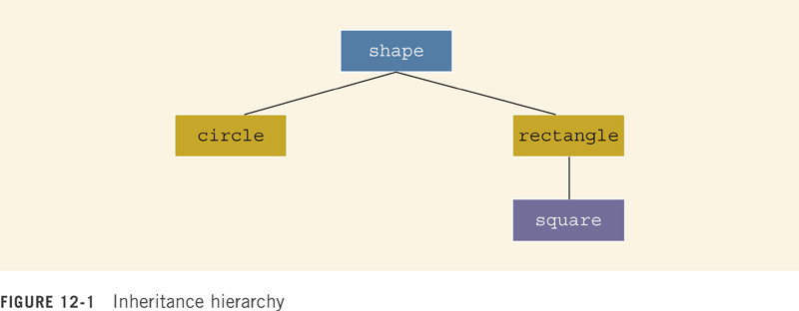
Inheritance can be viewed as a tree-like, or hierarchical, structure wherein a base class is shown with its derived classes.

Slide 8

where memberAccessSpecifier is public, protected, or private. When no memberAccessSpecifier is specified, it is assumed to be a private inheritance.

Slide 9
Inheritance (continued)
1. The private members of a base class are private to the base class; hence, the members of the derived class cannot directly access them. In other words, when you write the definitions of the member functions of the derived class, you cannot directly access the private members of the base class.
2. The public members of a base class can be inherited either as public members or as private members by the derived class. That is, the public members of the base class can become either public or private members of the derived class.
3. The derived class can include additional members--data and/or functions.

Slide 10
Inheritance (continued)
4. The derived class can redefine the public member functions of the base class. That is, in the derived class, you can have a member function with the same name, number, and types of parameters as a function in the base class. However, this redefinition applies only to the objects of the derived class, not to the objects of the base class.
5. All member variables of the base class are also member variables of the derived class. Similarly, the member functions of the base class (unless redefined) are also member functions of the derived class. (Remember Rule 1 when accessing a member of the base class in the derived class.)

Slide 11
Redefining (Overriding) Member Functions of the Base Class
To redefine a public member function of a base class
  Corresponding function in the derived class must have the same name, number, and types of parameters

Slide 12
Redefining (Overriding) Member Functions of the Base Class (continued)
If derived class overrides a public member function of the base class, then to call the base class function, specify:
  Name of the base class
  Scope resolution operator (::)
  Function name with the appropriate parameter list

Slide 13
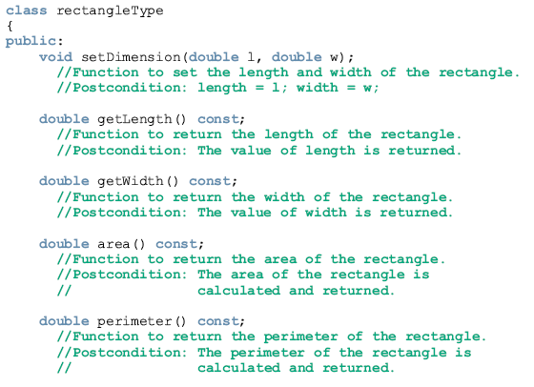

Slide 14
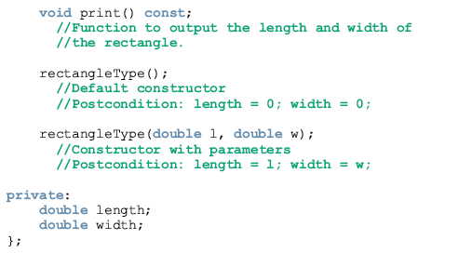

Slide 15
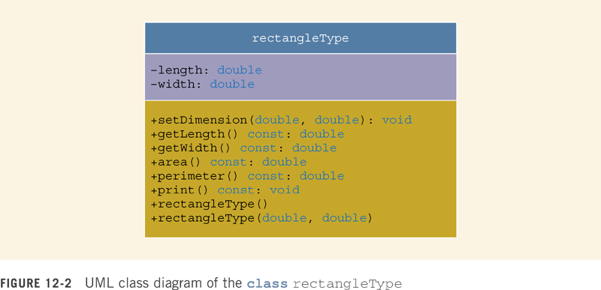

Slide 16
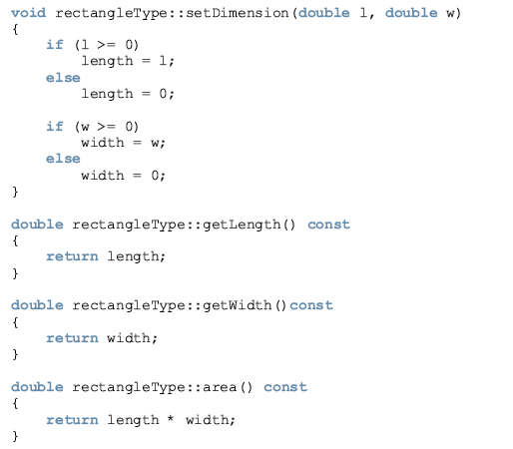

Slide 17
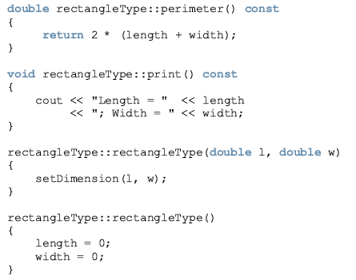

Slide 18
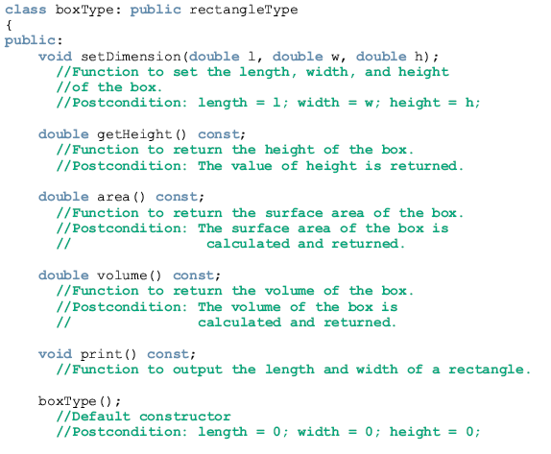

Slide 19
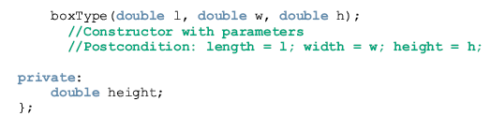
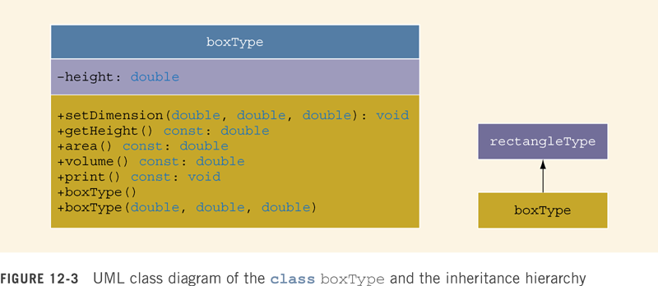

Slide 20
From the definition of the class boxType, it is clear that the class boxType is derived from the class rectangleType, and it is a public inheritance. Therefore, all public members of the class rectangleType are public members of the class boxType. The class boxType also overrides (redefines) the functions print and area.
In general, while writing the definitions of the member functions of a derived class to specify a call to a public member function of the base class, we do the following:
If the derived class overrides a public member function of the base class, then to specify a call to that public member function of the base class you use the name of the base class, followed by the scope resolution operator, ::, followed by the function name with the appropriate parameter list.
If the derived class does not override a public member function of the base class, you may specify a call to that public member function by using the name of the function and the appropriate parameter list.

Slide 21
The class boxType has three member variables: length, width, and height. The member function print of the class boxType prints the values of these member variables. To write the definition of the function print of the class boxType, keep in mind the following:
The member variables length and width are private members of the class rectangleType, and so cannot be directly accessed in the class boxType. Therefore, when writing the definition of the function print of the class boxType, we cannot access length and width directly.
The member variables length and width of the class rectangleType are accessible in the class boxType through the public member functions of the class rectangleType. Therefore, when writing the definition of the member function print of the class boxType, we first call the member function print of the class rectangleType to print the values of length and width. After printing the values of length and width, we output the values of height.

Slide 22
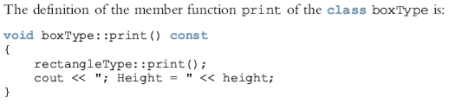
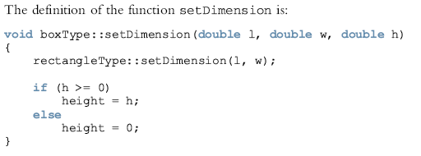

Slide 23

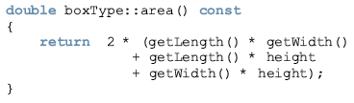


Slide 24
Constructors of Derived and Base Classes
Derived class constructor cannot directly access private members of the base class
Derived class can directly initialize only public member variables of the derived class
When a derived object is declared
  It must execute one of the base class constructors
Call to the base class constructor is specified in the heading of derived class constructor definition

Slide 25

The class rectangleType has two constructors and two member variables. The class boxType has three member variables: length, width, and height. The member variables length and width are inherited from the class rectangleType.
First, let us write the definition of the default constructor of the class boxType. Recall that if a class contains the default constructor and no values are specified when the object is declared, the default constructor executes and initializes the object. Because the class rectangleType contains the default constructor, when writing the definition of the default constructor of the class boxType, we do not specify any constructor of the base class.

Slide 26
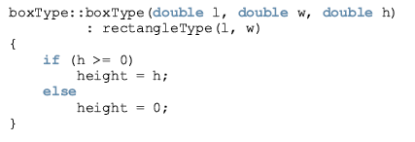
Definitions of constructors with parameters
  To trigger the execution of a constructor (with parameters) of the base class, you specify the name of a constructor of the base class with the parameters in the heading of the definition of the constructor of the derived class.

Slide 27

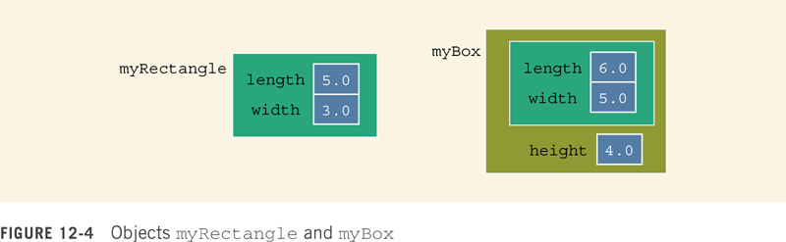

Slide 28

Output:

Slide 29
Suppose that a base class, baseClass, has private member variables and constructors.
Suppose that the class derivedClass is derived from baseClass, and derivedClass has no member variables.
The member variables of derivedClass are the ones inherited from baseClass.
A constructor cannot be called like other functions, and the member variables of baseClass cannot be directly accessed by the member functions of derivedClass.
To guarantee the initialization of the inherited member variables of an object of the type derivedClass, even though derivedClass has no member variables, it must have the appropriate constructors.

Slide 30
A constructor (with parameters) of derivedClass merely issues a call to a constructor (with parameters) of baseClass.
Therefore, when you write the definition of the constructor (with parameters) of derivedClass, the heading of the definition of the constructor contains a call to an appropriate constructor (with parameters) of baseClass, and the body of the constructor is empty.

Slide 31
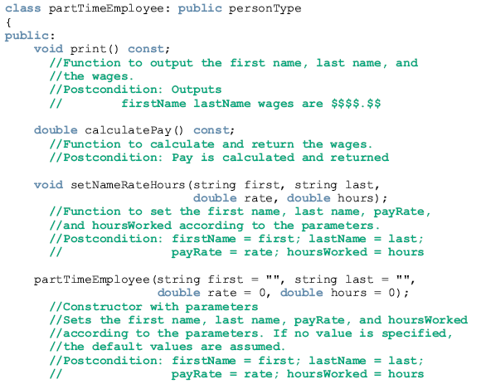
Example 12-3

Slide 32

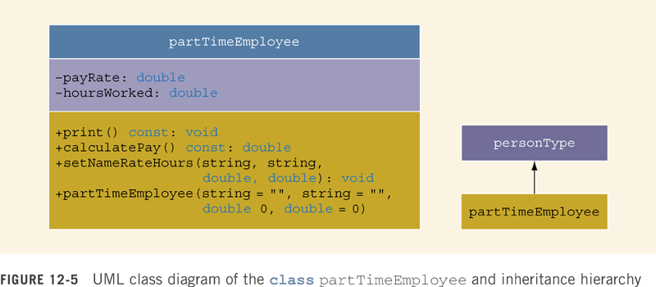

Slide 33
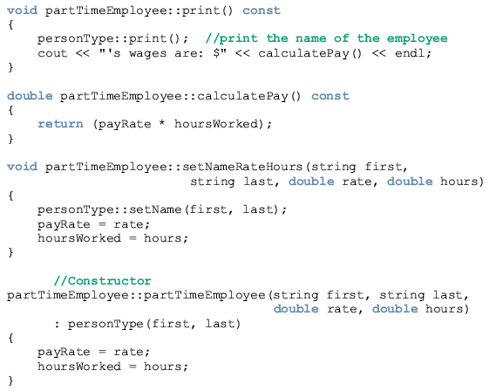

Slide 34
Header File of a Derived Class
To define new classes
  Create new header files
To create new classes based on previously defined classes
  Header files of the new classes contain commands that specify where to look for the definitions of the base classes
The definitions of the member functions can be placed in a separate file

Slide 35
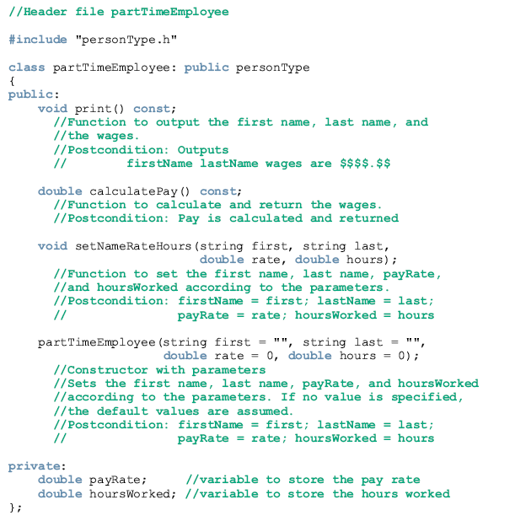

Slide 36
Multiple Inclusions
Use the preprocessor command (#include) to include a header file in a program
The preprocessor processes the program before it is compiled
To avoid multiple inclusion of a file in a program
  Use certain preprocessor commands in the header file (“file guard”)

Slide 37

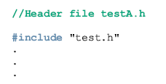
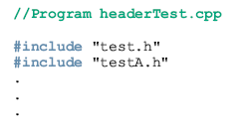

Slide 38
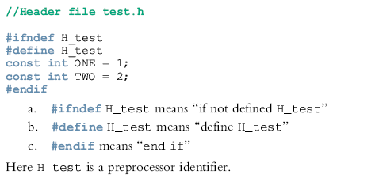

Slide 39
C++ Stream Classes
ios is the base class for all stream classes
istream and ostream are derived from ios
ifstream is derived from istream
ofstream is derived from the ostream
ios contains formatting flags and member functions to access/modify the flag settings

Slide 40
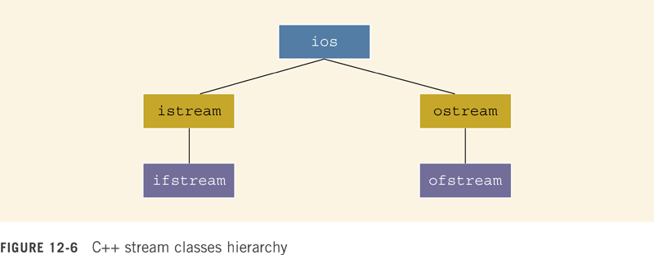

Slide 41
C++ Stream Classes (continued)
istream and ostream provide operations for data transfer between memory and devices
istream defines the extraction operator (>>) and functions such as get and ignore
ostream defines the insertion operator (<<), which is used by cout

Slide 42
C++ Stream Classes (continued)
ifstream is derived from istream for file input
ofstream is derived from ostream for file output
Objects of type ifstream are for file input
Objects of type ofstream are for file output
Header file fstream contains the definitions of ifstream and ofstream

Slide 43
Protected Members of a Class
Private members of a class cannot be directly accessed outside the class
For a base class to give derived class access to a private member
  Declare that member as protected
The accessibility of a protected member of a class is in between public and private
A derived class can directly access the protected member of the base class

Slide 44
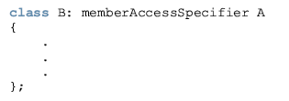
Protected Members of a Class (continued)

Slide 45
Public Inheritance
If memberAccessSpecifier is public, then
public members of A (base) are public members of B (derived) and can be directly accessed in class B
protected members of A are protected members of B and can be directly accessed by the member functions (and friend functions) of B
private members of A are hidden in B and can be accessed by member functions (and friend functions) of B through public or protected members of A

Slide 46
Protected Inheritance
If memberAccessSpecifier is protected, then
public members of A are protected members of B and can be accessed by the member functions (and friend functions) of B
protected members of A are protected members of B and can be accessed by the member functions (and friend functions) of B
private members of A are hidden in B and can be accessed by member functions (and friend functions) of B through public or protected members of A

Slide 47
Private Inheritance
If memberAccessSpecifier is private, then
public members of A are private members of B and can be accessed by member functions (and friend functions) of B
protected members of A are private members of B and can be accessed by member functions (and friend functions) of B
private members of A are hidden in B and can be accessed by member functions (and friend functions) of B through the public or protected members of A

Slide 48
Composition
In composition, one or more member(s) of a class are objects of another class type
Composition is a “has-a” relation
Arguments to the constructor of a member-object are specified in the heading part of the definition of the constructor

Slide 49
Example 11-9, in Chapter 11, defined the class personType. The class personType stores a person’s first name and last name.
Suppose we want to keep track of additional information for a person, such as a personal ID (e.g., a Social Security number) and a date of birth.
Because every person has a personal ID and a date of birth, we can define a new class, called personalInfo, in which one of the members is an object of the type personType.
We can declare additional members to store the personal ID and date of birth for the class personalInfo.
First we define another class, dateType, to store only a person’s date of birth.
Then we construct the class personalInfo from the classes personType and dateType.

Slide 50
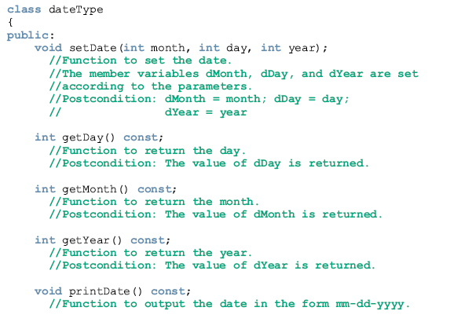

Slide 51
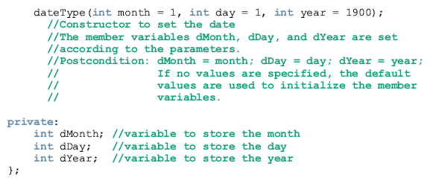

Slide 52
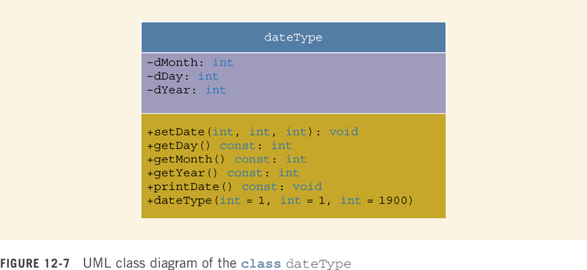

Slide 53
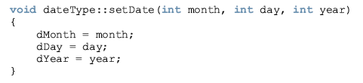
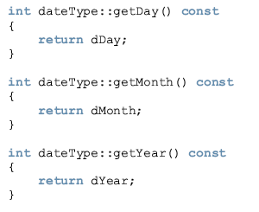

Slide 54
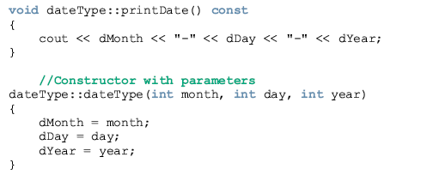

Slide 55
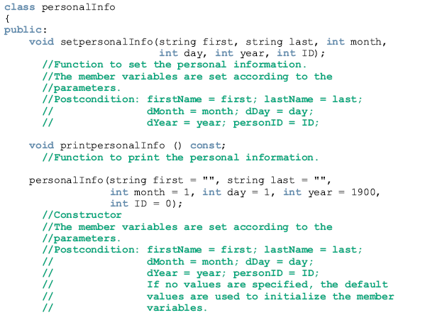

Slide 56

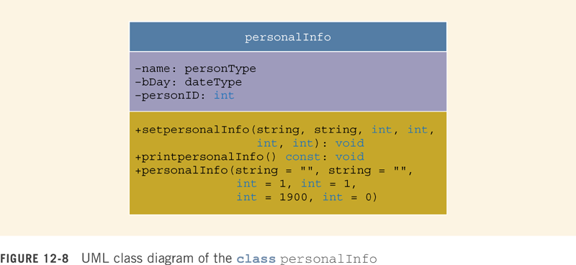

Slide 57
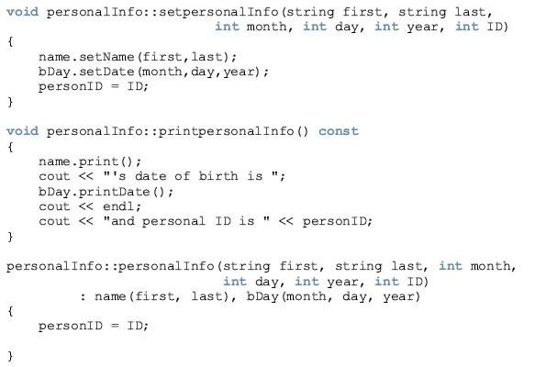

Slide 58
Composition (continued)
Member-objects of a class are constructed
  In the order they are declared
    Not in the order they are listed in the constructor’s member initialization list
  Before the enclosing class objects are constructed

Slide 59
OOD and OOP
The fundamental principles of Object-Oriented Design (OOD) are:
  Encapsulation: combine data and operations on data in a single unit
  Inheritance: create new objects from existing objects
  Polymorphism: the ability to use the same expression to denote different operations

Slide 60
OOD and OOP (continued)
OOD
  Object is a fundamental entity
  Debug objects
  Program is a collection of interacting objects
  Programmer is object-oriented
  OOD encourages code reuse

Slide 61
OOD and OOP (continued)
Structured programming
  Function is a fundamental entity
  Debug functions
  Program is a collection of interacting functions
  Programmer is action-oriented

Slide 62
OOD and OOP (continued)
Object-oriented programming (OOP) implements OOD
C++ supports OOP through the use of classes
Polymorphic function or operator has many forms
Function name and operators can be overloaded

Slide 63
OOD and OOP (continued)
Templates provide parametric polymorphism
C++ provides virtual functions as a means to implement polymorphism in an inheritance hierarchy
Objects are created when class variables are declared
Objects interact via function calls

Slide 64
OOD and OOP (continued)
Every object has an internal state and external state
Private members form the internal state
Public members form the external state
Only the object can manipulate its internal state

Slide 65
Classes, Objects, & Operations
Finding classes: begin with a problem description and identify all nouns and verbs
From the list of nouns choose the classes
From the list of verbs choose the operations
Suppose we want to write a program that calculates and prints the volume and surface area of a cylinder

Slide 66
Classes, Objects, & Operations (continued)
We can state this problem as follows:
  Write a program to input the dimensions of a cylinder and calculate and print the surface area and volume
  The nouns are bold and the verbs are italic
  From the list of nouns we visualize a cylinder as a class (cylinderType) from which we can create many cylinder objects of various dimensions

Slide 67
Classes, Objects, & Operations (continued)
The nouns (dimensions, surface area, and volume) are characteristics of a cylinder
After identifying a class, determine three pieces of information about its objects:
  Operations that an object can perform
  Operations that can be performed on an object
  Information that an object must maintain

Slide 68
Classes, Objects, & Operations (continued)
From the verbs, choose a list of possible operations that an object of that class can perform, or have performed, on itself
For the cylinderType class the possible operations are
  Input, calculate, and print
  Dimensions represent the data

Slide 69
Classes, Objects, & Operations (continued)
The center of the base, radius of the base, and height of the cylinder are the characteristics of the dimensions
Calculate: determine the volume and the surface area
You can deduce the operations: cylinderVolume and cylinderSurfaceArea
Print: display the volume and the surface area on an output device

Slide 70
Classes, Objects, & Operations (continued)
Identifying classes via the nouns and verbs from the descriptions to the problem is not the only technique possible
There are several other OOD techniques in the literature

Slide 71
Programming Example
This programming example illustrates the concepts of inheritance and composition
Problem: The mid-semester point at your local university is approaching
  The registrar’s office wants to prepare the grade reports as soon as the students’ grades are recorded

Slide 72
Programming Example (continued)
Some of the students enrolled have not yet paid their tuition
  If a student has paid the tuition, the grades are shown on the grade report together with the grade-point average (GPA)
  If a student has not paid the tuition, the grades are not printed
    Grade report indicates that grades have been held for nonpayment of the tuition
    Grade report also shows the billing amount

Slide 73
The Data File
Data are stored in a file in the following form:
15000 345
studentName studentID isTuitionPaid numberOfCourses
courseName courseNumber creditHours grade
courseName courseNumber creditHours grade
.
studentName studentID isTuitionPaid numberOfCourses
courseName courseNumber creditHours grade
courseName courseNumber creditHours grade
.

Slide 74
The Data File (continued)
The first line indicates number of students enrolled and tuition rate per credit hour
Students’ data is given thereafter
A sample-input file is:
3 345
Lisa Miller 890238 Y 4
Mathematics MTH345 4 A
Physics PHY357 3 B
ComputerSci CSC478 3 B
History HIS356 3 A
.

Slide 75
Output
Sample output for each student:
Student Name: Lisa Miller
Student ID: 890238
Number of courses enrolled: 4
Course No Course Name Credits Grade
CSC478 ComputerSci 3 B
HIS356 History 3 A
MTH345 Mathematics 4 A
PHY357 Physics 3 B
Total number of credits: 13
Mid-Semester GPA: 3.54

Slide 76
Input and Output
Input: file containing data in the form given above
Assume that the name of the input file is "stData.txt"
Output: a file containing output of the form given above

Slide 77
Problem Analysis
Two main components are:
Course
  Main characteristics of a course are: course name, course number, and number of credit hours
Student
  Main characteristics of a student are: student name, student ID, number of courses enrolled, name courses, and grade for each course

Slide 78
Problem Analysis (continued)
  Operations on an object of the course type are:
    Set the course information
    Print the course information
    Show the credit hours
    Show the course number

Slide 79
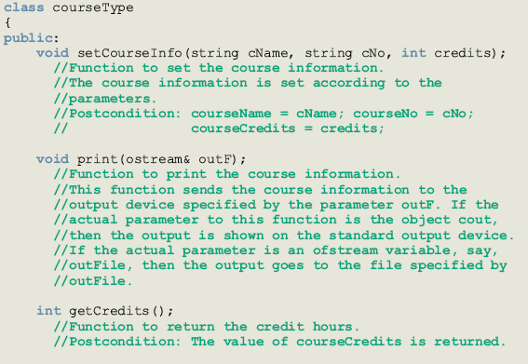

Slide 80
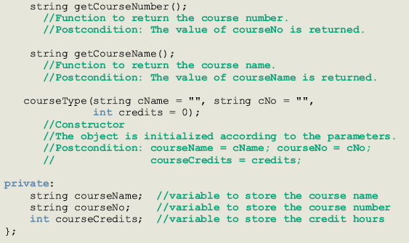

Slide 81
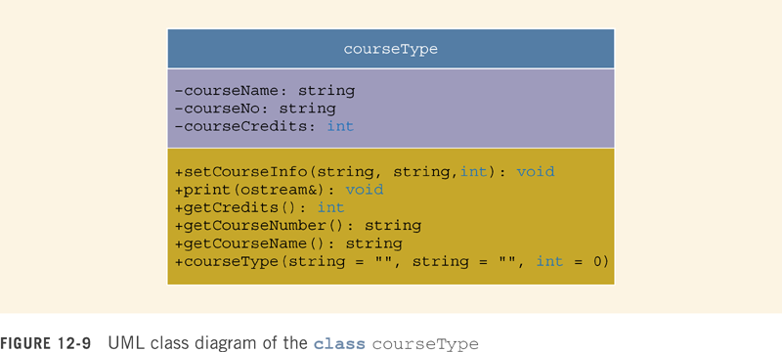

Slide 82
The basic operations to be performed on an object of the type studentType are as follows:
Set the student information.
Print the student information.
Calculate the number of credit hours taken.
Calculate the GPA.
Calculate the billing amount.
Because the grade report will print the courses in ascending order, sort the courses according to the course number.

Slide 83
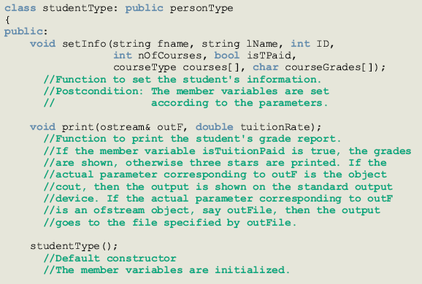

Slide 84
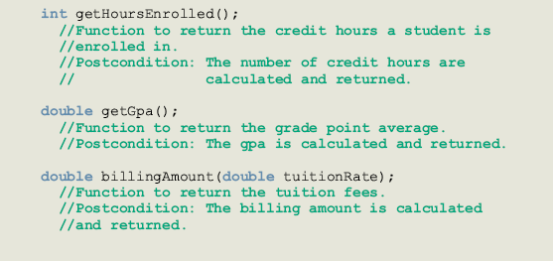

Slide 85
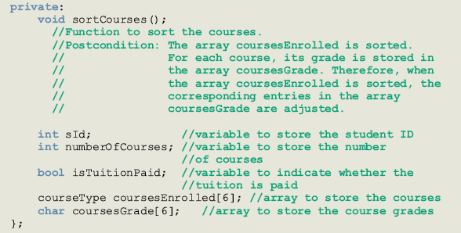

Slide 86
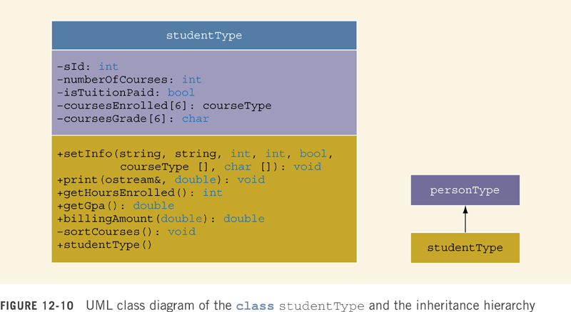

Slide 87
Main Program
Declare variables
Open input file
If input file does not exist, exit program
Open output file
Get number of students registered and tuition rate
Load students’ data
Print grade reports

Slide 88
Summary
Inheritance and composition are meaningful ways to relate two or more classes
Inheritance is an “is-a” relation
Composition is a “has-a” relation
Single inheritance: a derived class is derived from one class, called the base class
Multiple inheritance: a derived class is derived from more than one base class

Slide 89
Summary (continued)
Private members of a base class are private to the base class
Public members of a base class can be inherited either as public or private
Derived class can redefine function members of a base class
  Redefinition applies only to objects of derived class

Slide 90
Summary (continued)
A call to a base class constructor (with parameters) is specified in the heading of the definition of the derived class constructor
When initializing object of a derived class, the base class constructor is executed first
In composition
  Class member is an object of another class
  Call to constructor of member objects is specified in heading of the definition of class’s constructor

Slide 91
Summary (continued)
Three basic principles of OOD are
  Encapsulation
  Inheritance
  Polymorphism
Finding classes: describe the problem and choose classes from the list of nouns and operations from the list of verbs

