Slide 1
If and switch
CONTROL STRUCTURES I
(Selection)

Slide 2
Control Structures
A computer can proceed:
  in sequence
  selectively (branch) - making a choice
  repetitively (iteratively) - performing a statement over and over, also called a loop
Some statements are executed only if certain conditions are met
A condition is represented by a logical (Boolean) expression that has a value of either true or false
A condition is met if it evaluates to true

Slide 3
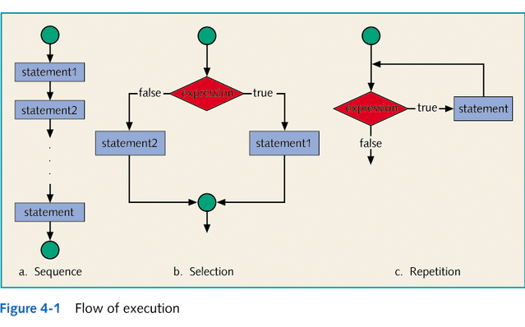

Slide 4
Relational Operators
A relational operator allows you to make comparisons in a program
Equality of real numbers is usually machine dependent so it is possible that on a particular machine 6.8 + 3.1 == 2.7 + 7.2 might evaluate to false
Comparing values of different data types may produce unpredictable results
For example, 8 < '5' should not be done
C++ returns an integer value of 1 if the logical expression evaluates to true and the value of 0 otherwise
In C++, any nonzero value is treated as true

Slide 5
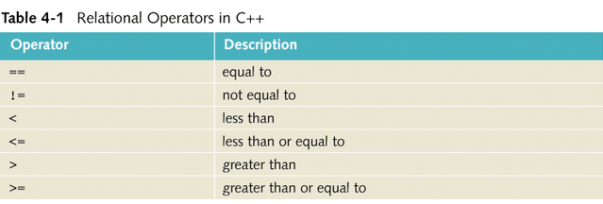
Relational Operators in C++

Slide 6
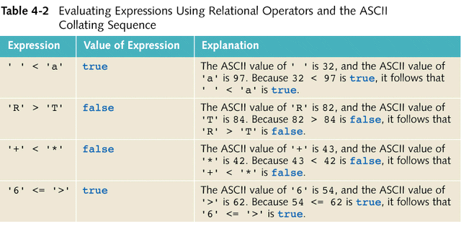

Slide 7
Comparing string Types
Relational operators can be applied to string variables
They are compared character by character, starting with the first character, using the collating sequence
This comparison continues until either a mismatch is found or the last characters have been compared and are equal
If two strings of different lengths are compared and the comparison is equal to the last character of the shorter string, the shorter string is less than the larger string

Slide 8
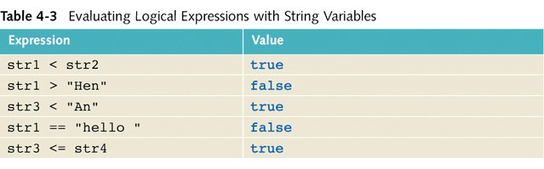
string Comparison Example
Suppose we have the following declarations:
  string str1 = "Hello";
  string str2 = "Hi";
  string str3 = "Air";
  string str4 = "Bill";

Slide 9
Logical (Boolean) Operators
Logical (Boolean) operators enable you to combine logical expressions
There are three logical (Boolean) operators:
  ! - not
  && – and
  || - or
Logical operators take logical values as operands and yield logical values as results
! is unary, so it has only one operand, while && and || are binary operators
Putting ! in front of a logical expression reverses the value of that logical expression

Slide 10
Precedence of Operators
Relational and logical operators are evaluated from left to right so the associativity is said to be from left to right
Parentheses can be used to indicate an order of operation that is different than the order indicated by order of precedence
Short-circuit evaluation (of a logical expression) - a process in which the computer evaluates a logical expression from left to right and stops as soon as the value of the expression is known

Slide 11
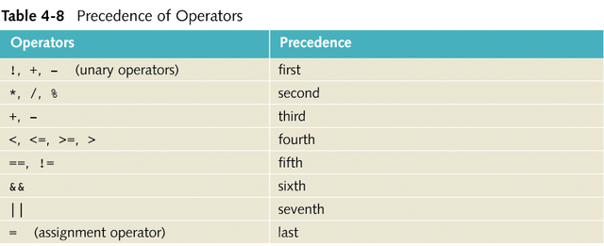

Slide 12
Logical (Boolean) Assignments
The int Data Type and Logical (Boolean) Expressions
  earlier versions of C++ had no built in data type that had logical (or Boolean) values, true and false
  since logical expressions are evaluated to either 1 or 0, the value of a logical expression is stored in a variable of the type int
  logical (Boolean) expressions were manipulated with the help of the int data type
  any nonzero value is treated as true

Slide 13
Logical (Boolean) Assignments
The bool Data Type and Logical (Boolean) Expressions
  recent versions of C++ contain a built in data type called bool
  the data type bool has logical (Boolean) values true and false
  in C++, bool, true, and false are reserved words
  the identifier true has the value 1
  the identifier false has the value 0

Slide 14
Logical (Boolean) Assignments
Logical expressions do not always behave as expected
The following expression appears to represent a comparison of 0, num, and 10:
0 <= num <= 10
It will always evaluate to true because 0 <= num evaluates to either 0 or 1, and 0 <= 10 is true and 1 <= 10 is true
The correct way to write this expression is:
0 <= num && num <= 10

Slide 15
One-Way (if) Selection
The syntax of one-way selection is:
if(expression)
statement
If the value of the expression is true the statement is executed
If the value is false the statement is not executed and the computer goes on to the next statement in the program
The expression is usually a logical expression
statement is any C++ statement
if is a reserved word

Slide 16
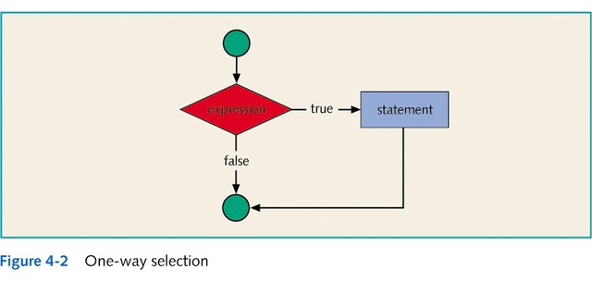
One-Way Selection

Slide 17
Two-Way (if…else) Selection
Two-way selection takes the form:
if(expression)
statement1
else
statement2
If the value of the expression is true, statement1 is executed otherwise statement2 is executed
statement1 and statement2 are any C++ statements
else is a reserved word

Slide 18
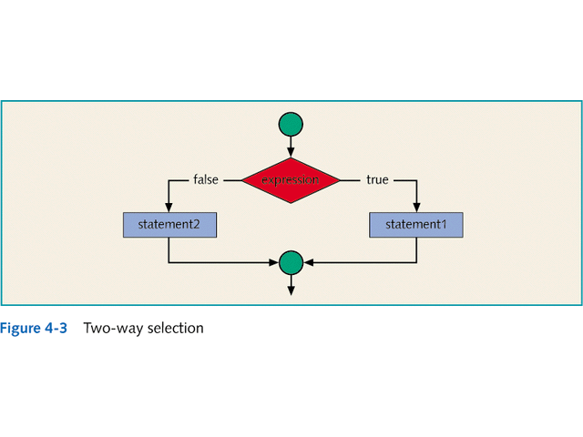
Two-Way Selection

Slide 19
Compound Statement
A compound statement (also called a block of statements) takes the form
{
statement1;
statement2;
.
.
.
statementn;
}
A compound statement is considered a single statement

Slide 20
Compound Statement Example
if(age > 18)
{
cout<<" Eligible to vote."<<endl;
cout<<" No longer a minor."<<endl;
}
else
{
cout<<"Not eligible to vote."<<endl;
cout<<"Still a minor."<<endl;
}

Slide 21
Nested if
When one control statement is within another, it is said to be nested
An else is associated with the most recent if that has not been paired with an else
For example:
if(score >= 90)
cout<<"The grade is A"<<endl;
else if(score >= 80)
cout<<"The grade is B"<<endl;
else
cout<<"The grade is F"<<endl;

Slide 22
switch Structures
In a switch structure, the expression is evaluated first
Next, the value of the expression is used to perform the corresponding action
The expression is usually an identifier
It is sometimes called the selector
The expression value can be only integral
Its value determines which statement is selected for execution
A particular case value should appear only once

Slide 23
switch Structures
One or more statements may follow a case label
Braces are not needed to turn multiple statements into a single compound statement
The break statement may or may not appear after each statement
The break statement has a special meaning and may or may not appear after each statement
switch, case, break, and default are reserved words

Slide 24
switch Statement Rules
When the value of the expression is matched against a case value, the statements execute until a break statement is found or the end of the switch structure is reached
If the value of the expression does not match any of the case values, the statements following the default label execute. If there is no default label, and if the value of the expression does not match any of the case values, the entire switch statement is skipped
A break statement causes an immediate exit from the switch structure

