Slide 1
Varieties, Quasivarieties and Prevarieties: Completing the Picture
Wataru Hino & Ichiro Hasuo
The University of Tokyo

Slide 2
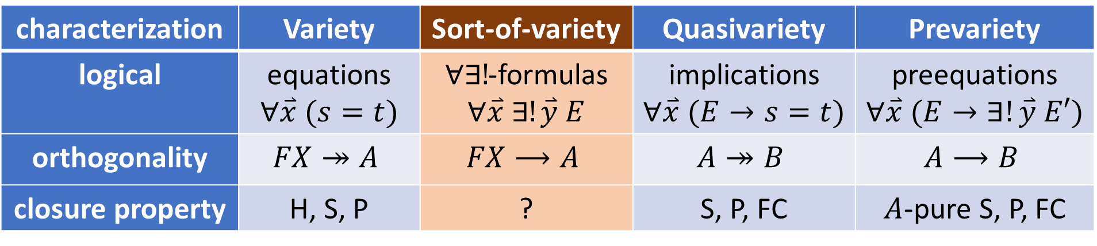
Outline
Review 1: variety and quasivariety
Review 2: orthogonality and prevariety
New notion: sort-of-variety
New
characterization | Variety | Sort-of-variety | Quasivariety | Prevariety
logical | equations $$∀\overset{⃑}{x} (s=t)$$ | $∀∃!$-formulas $$∀\overset{⃑}{x} ∃!\overset{⃑}{y} E$$ | implications $$∀\overset{⃑}{x} (E→s=t)$$ | preequations $$∀\overset{⃑}{x} (E→∃!\overset{⃑}{y} E′)$$
orthogonality | $$FX↠A$$ | $$FX⟶A$$ | $$A↠B$$ | $$A⟶B$$
closure property | H, S, P | ? | S, P, FC | $A$-pure S, P, FC

Slide 3
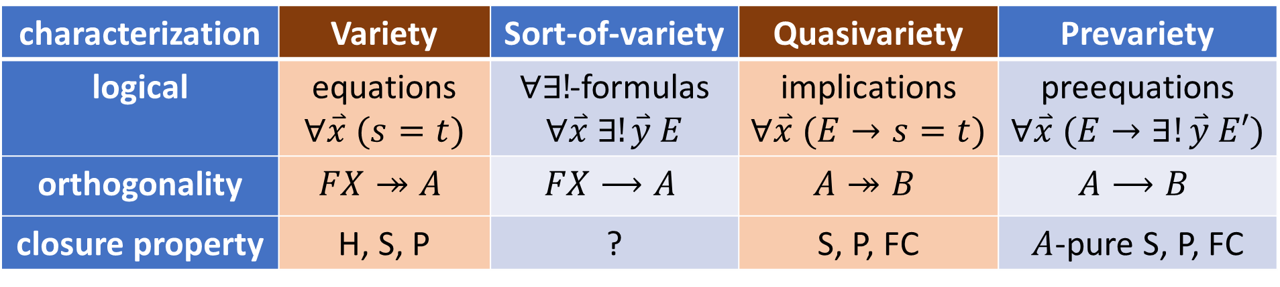
Review: variety and quasivariety
characterization | Variety | Sort-of-variety | Quasivariety | Prevariety
logical | equations $$∀\overset{⃑}{x} (s=t)$$ | $∀∃!$-formulas $$∀\overset{⃑}{x} ∃!\overset{⃑}{y} E$$ | implications $$∀\overset{⃑}{x} (E→s=t)$$ | preequations $$∀\overset{⃑}{x} (E→∃!\overset{⃑}{y} E′)$$
orthogonality | $$FX↠A$$ | $$FX⟶A$$ | $$A↠B$$ | $$A⟶B$$
closure property | H, S, P | ? | S, P, FC | $A$-pure S, P, FC

Slide 4
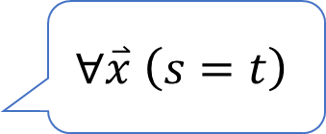
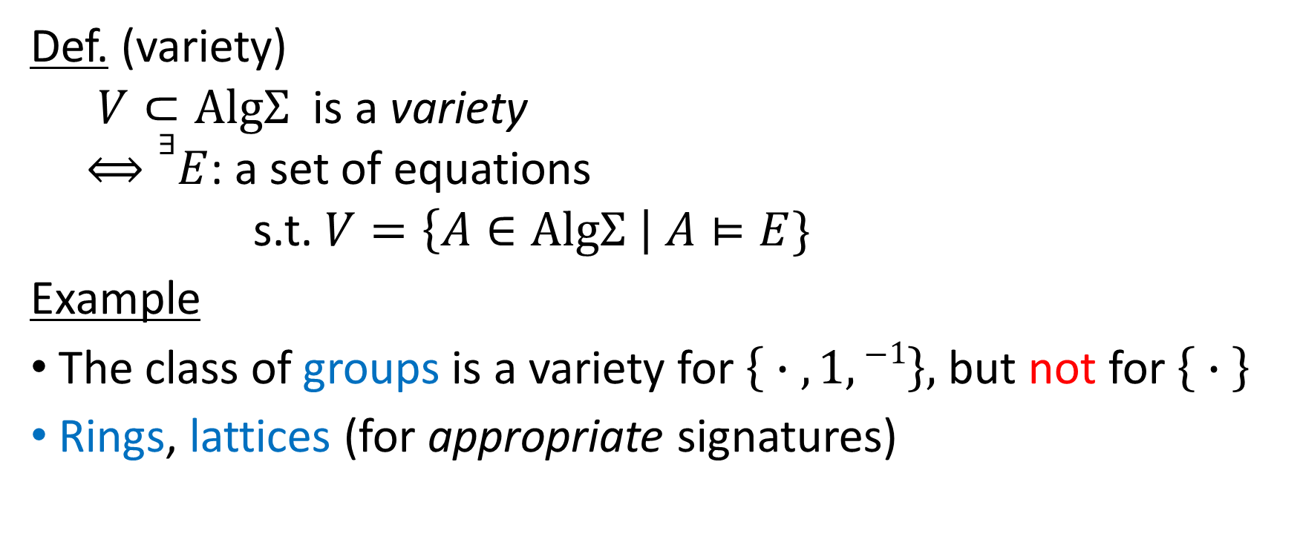
Variety: definition
Def. (variety)
$V⊂\text{Alg}Σ$ is a variety
$⟺∃E$: a set of equations
s.t. $V=\left\{A∈\text{Alg}Σ \right| A⊨E\}$
Example
The class of groups is a variety for $\left\{ ∙ , 1,−1\right\},$but not for $\left\{ ∙ \right\}$
Rings, lattices (for appropriate signatures)
$$∀\overset{⃑}{x} \left(s=t\right)$$
signature-relevant definition

Slide 5
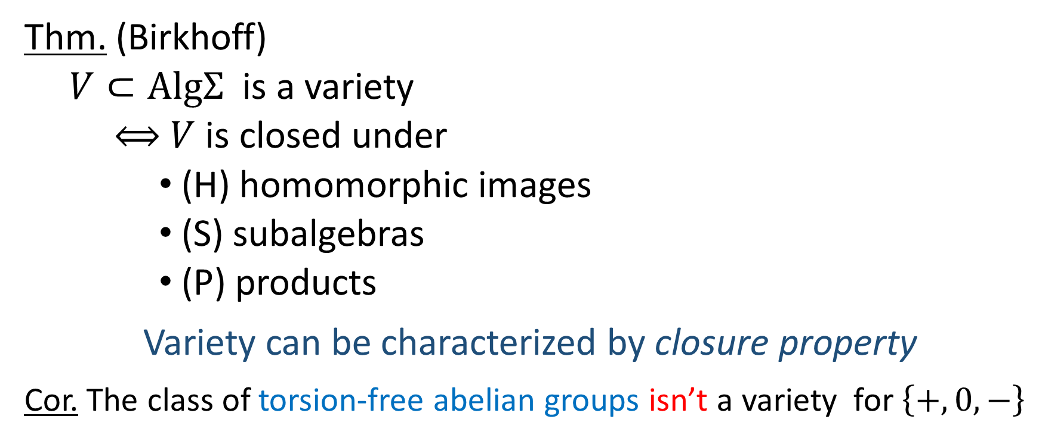
Variety: HSP theorem
Thm. (Birkhoff)
$V⊂\text{Alg}Σ$ is a variety
$⟺$ $V$ is closed under
(H) homomorphic images
(S) subalgebras
(P) products
Variety can be characterized by closure property
Cor. The class of torsion-free abelian groups isn’t a variety for $\left\{+, 0,−\right\}$

Slide 6

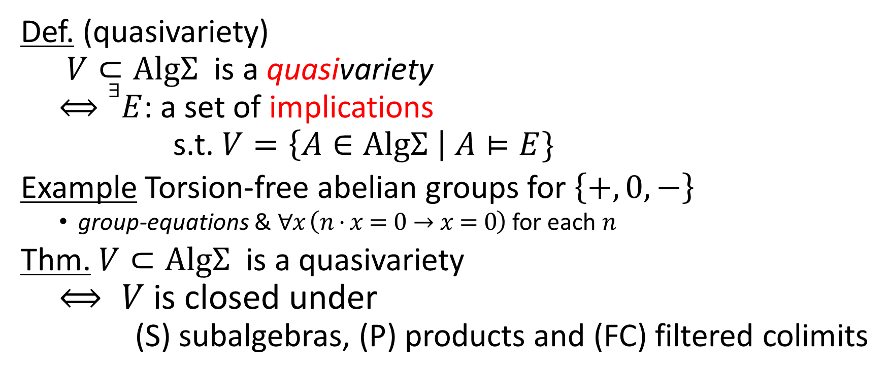
Quasivariety
Def. (quasivariety)
$V⊂\text{Alg}Σ$ is a quasivariety
$⟺∃E$: a set of implications
s.t. $V=\left\{A∈\text{Alg}Σ \right| A⊨E\}$
Example Torsion-free abelian groups for $\left\{+, 0,−\right\}$
group-equations & $∀x \left(n⋅x=0→x=0\right)$ for each $n$
Thm. $V⊂\text{Alg}Σ$ is a quasivariety
$$⟺ V \text{is} \text{closed} \text{under}$$
$$\text{(}\text{S}\text{) }\text{subalgebras}\text{, }\text{(}\text{P}\text{) }\text{products} \text{and}\text{ (}\text{FC}\text{) }\text{filtered} \text{colimits}$$
$$∀\overset{⃑}{x} \left(∧s_{i}=t_{i}→s=t\right)$$

Slide 7
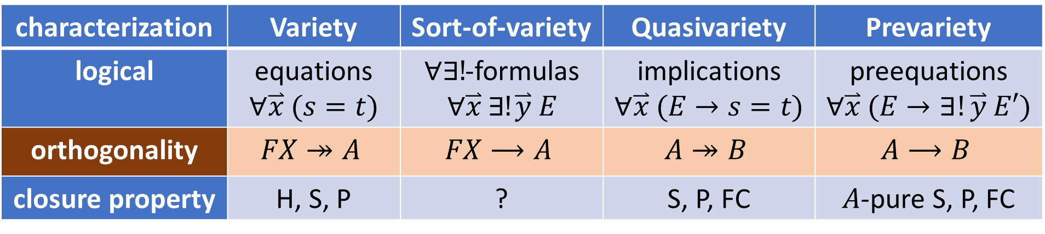
Review: orthogonality
characterization | Variety | Sort-of-variety | Quasivariety | Prevariety
logical | equations $$∀\overset{⃑}{x} (s=t)$$ | $∀∃!$-formulas $$∀\overset{⃑}{x} ∃!\overset{⃑}{y} E$$ | implications $$∀\overset{⃑}{x} (E→s=t)$$ | preequations $$∀\overset{⃑}{x} (E→∃!\overset{⃑}{y} E′)$$
orthogonality | $$FX↠A$$ | $$FX⟶A$$ | $$A↠B$$ | $$A⟶B$$
closure property | H, S, P | ? | S, P, FC | $A$-pure S, P, FC

Slide 8



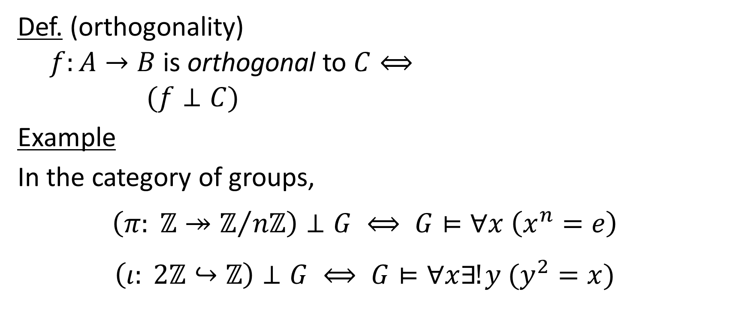



Orthogonality [Freyd, Kelly 1972]
$$∃!\overline{g}$$
$$B$$
$$C$$
Def. (orthogonality)
$f:A→B$ is orthogonal to $C⟺$
$(f⊥C)$
Example
In the category of groups,
$$\left(π: ℤ↠ℤ/{nℤ}\right)⊥G ⟺ G⊨∀x \left(x^{n}=e\right)$$
$$\left(ι: 2ℤ↪ℤ\right)⊥G ⟺ G⊨∀x∃!y (y^{2}=x)$$
$$f$$
$$∀g$$
$$A$$

Slide 9
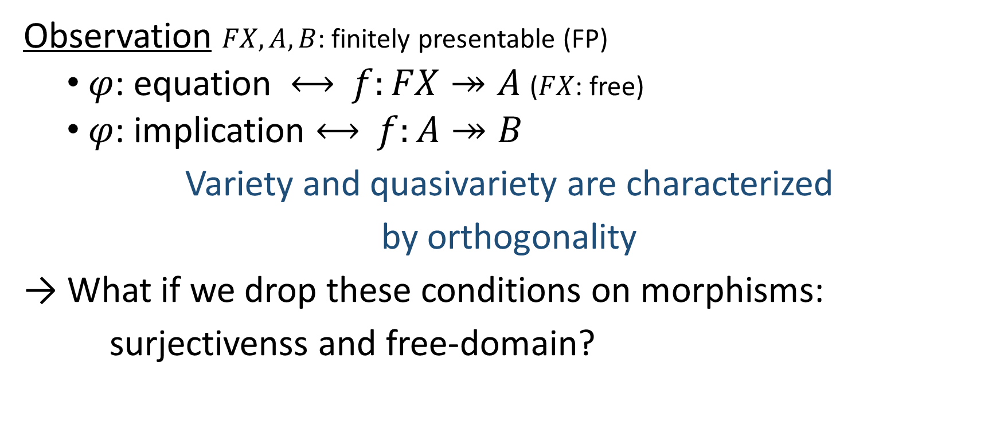
Orthogonality
Observation $FX, A, B$: finitely presentable (FP)
$φ$: equation $⟷$ $f:FX↠A$ ($FX$: free)
$φ$: implication $⟷$ $f:A↠B$
Variety and quasivariety are characterized
by orthogonality
→ What if we drop these conditions on morphisms:
surjectivenss and free-domain?

Slide 10
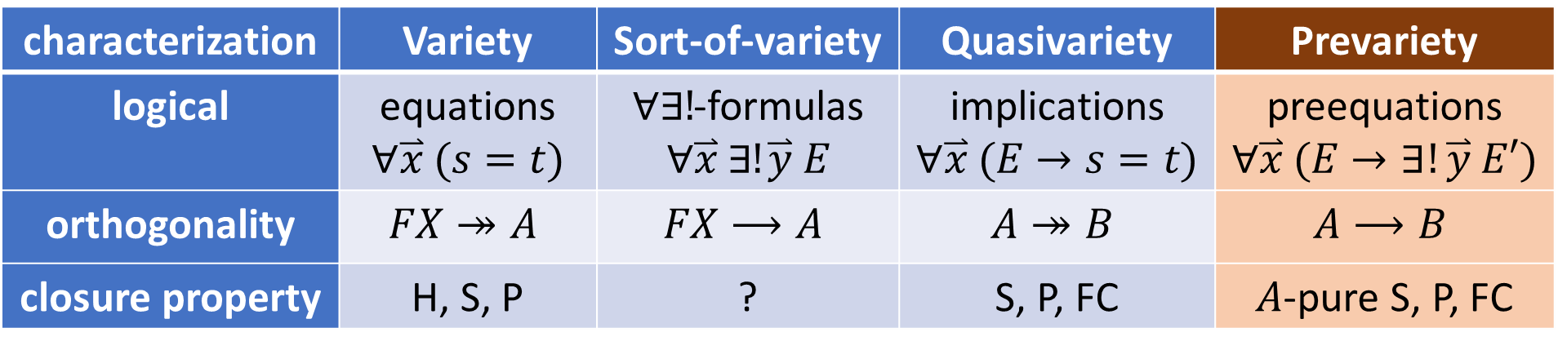
Review: prevariety
characterization | Variety | Sort-of-variety | Quasivariety | Prevariety
logical | equations $$∀\overset{⃑}{x} (s=t)$$ | $∀∃!$-formulas $$∀\overset{⃑}{x} ∃!\overset{⃑}{y} E$$ | implications $$∀\overset{⃑}{x} (E→s=t)$$ | preequations $$∀\overset{⃑}{x} (E→∃!\overset{⃑}{y} E′)$$
orthogonality | $$FX↠A$$ | $$FX⟶A$$ | $$A↠B$$ | $$A⟶B$$
closure property | H, S, P | ? | S, P, FC | $A$-pure S, P, FC

Slide 11

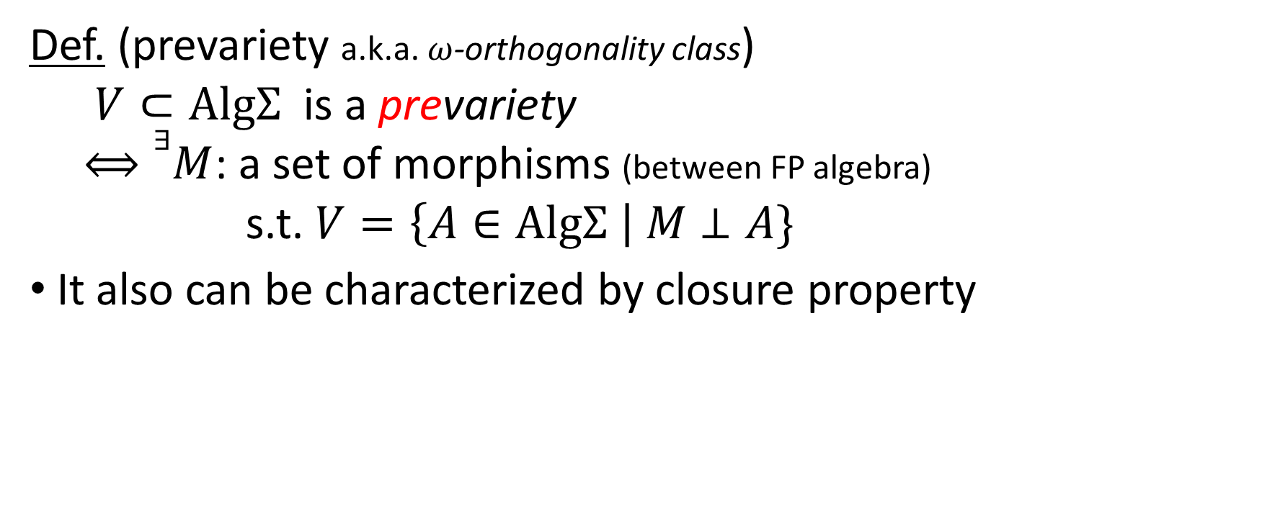
Prevariety [Adámek, Sousa 2004]
Def. (prevariety a.k.a. $ω$-orthogonality class)
$V⊂\text{Alg}Σ$ is a prevariety
$⟺∃M$: a set of morphisms (between FP algebra)
s.t. $V=\left\{A∈\text{Alg}Σ \right| M⊥A\}$
It also can be characterized by closure property
correspond to pre-equation
$$∀\overset{⃑}{x} (E→∃!\overset{⃑}{y} E′)$$

Slide 12
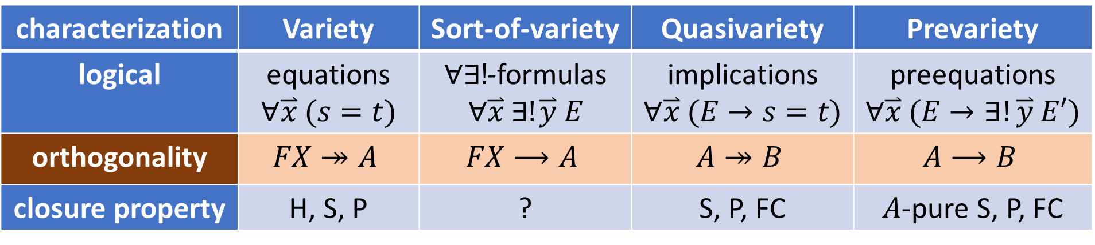
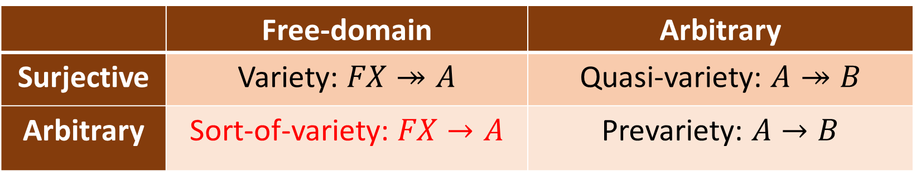
2 axes for variety-like notions
 | Free-domain | Arbitrary
Surjective | Variety: $FX↠A$ | Quasi-variety: $A↠B$
Arbitrary | Sort-of-variety: $FX→A$ | Prevariety: $A→B$
characterization | Variety | Sort-of-variety | Quasivariety | Prevariety
logical | equations $$∀\overset{⃑}{x} (s=t)$$ | $∀∃!$-formulas $$∀\overset{⃑}{x} ∃!\overset{⃑}{y} E$$ | implications $$∀\overset{⃑}{x} (E→s=t)$$ | preequations $$∀\overset{⃑}{x} (E→∃!\overset{⃑}{y} E′)$$
orthogonality | $$FX↠A$$ | $$FX⟶A$$ | $$A↠B$$ | $$A⟶B$$
closure property | H, S, P | ? | S, P, FC | $A$-pure S, P, FC

Slide 13

New notion: sort-of-variety
characterization | Variety | Sort-of-variety | Quasivariety | Prevariety
logical | equations $$∀\overset{⃑}{x} (s=t)$$ | $∀∃!$-formulas $$∀\overset{⃑}{x} ∃!\overset{⃑}{y} E$$ | implications $$∀\overset{⃑}{x} (E→s=t)$$ | preequations $$∀\overset{⃑}{x} (E→∃!\overset{⃑}{y} E′)$$
orthogonality | $$FX↠A$$ | $$FX⟶A$$ | $$A↠B$$ | $$A⟶B$$
closure property | H, S, P | ? | S, P, FC | $A$-pure S, P, FC

Slide 14

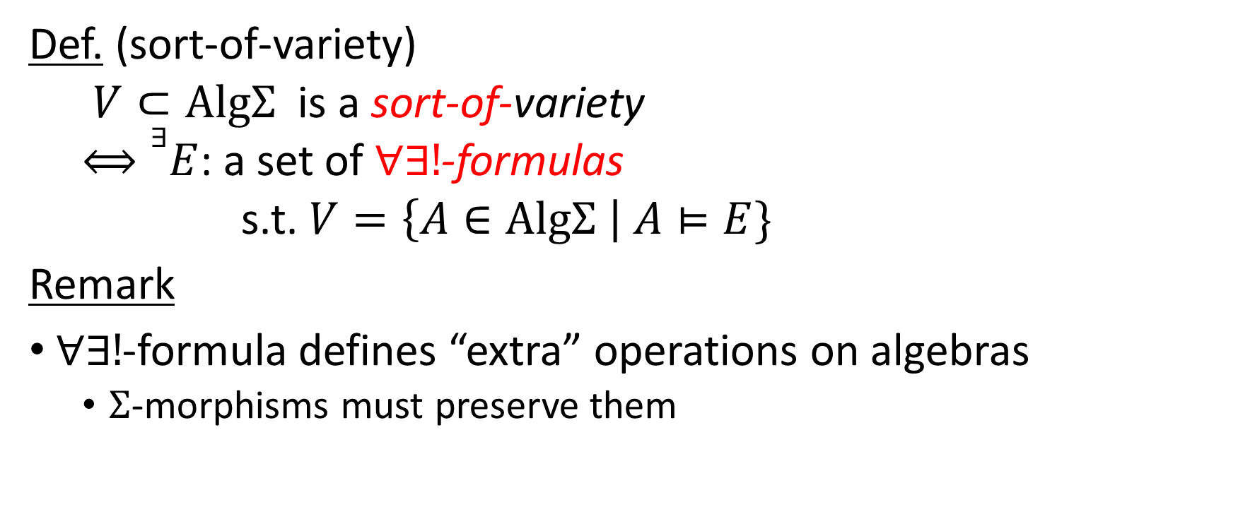

Sort-of-variety: definition
orthogonality to
$$f:FX→A$$
Def. (sort-of-variety)
$V⊂\text{Alg}Σ$ is a sort-of-variety
$⟺∃E$: a set of $∀∃!$-formulas
s.t. $V=\left\{A∈\text{Alg}Σ \right| A⊨E\}$
Remark
$∀∃!$-formula defines “extra” operations on algebras
$Σ$-morphisms must preserve them
$$∀\overset{⃑}{x} ∃!\overset{⃑}{y} E$$

Slide 15
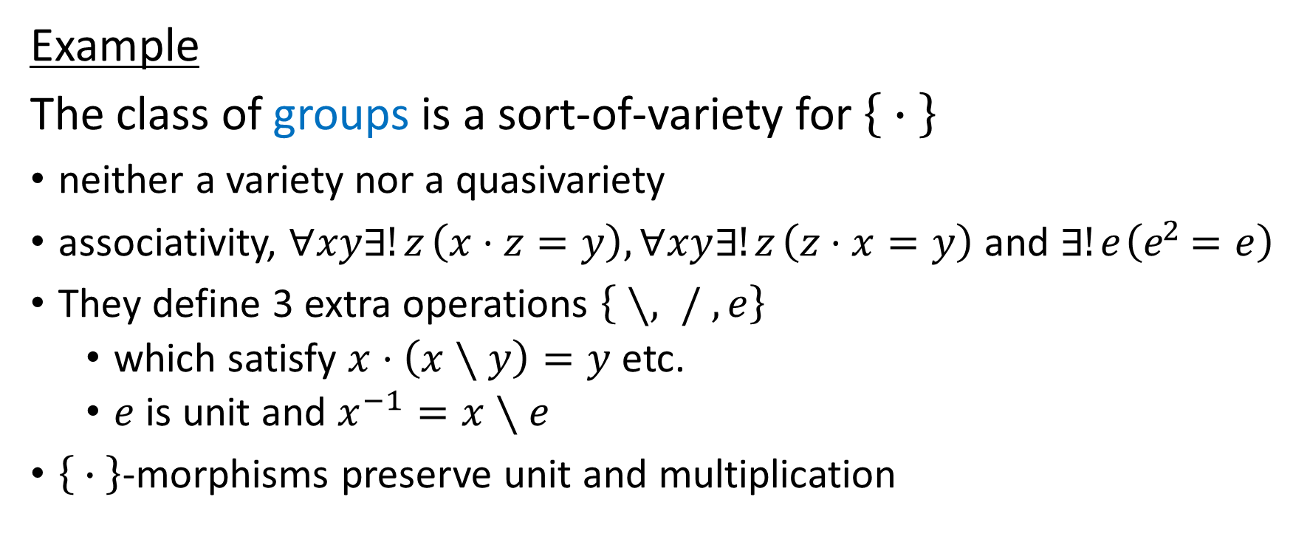
Sort-of-variety: example
Example
The class of groups is a sort-of-variety for $\left\{ ∙ \right\}$
neither a variety nor a quasivariety
associativity, $∀xy∃!z \left(x⋅z=y\right), ∀xy∃!z \left(z⋅x=y\right)$ and $∃!e \left(e^{2}=e\right)$
They define 3 extra operations $\left\{ ∖, / , e\right\}$
which satisfy $x⋅\left(x∖y\right)=y$ etc.
$e$ is unit and $x^{−1}=x∖e$
$\left\{ ∙ \right\}$-morphisms preserve unit and multiplication

Slide 16
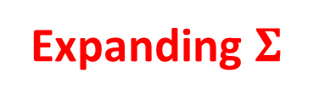

Relation between other variety-like notions
Thm.
A sort-of-variety for $Σ$ is isomorphic to a quasivariety for an extended signature $Σ$’ (by the forgetful functor).
 | Free-domain | Arbitrary
Surjective | Variety | Quasi-variety
Arbitrary | Sort-of-variety | Prevariety
Expanding $Σ$

Slide 17
Converse?
Observation
The quasivariety of torsion-free abelian groups and that of positive monoids are a sort-of-variety.
The class of left-cancellative monoids is quasivariety, but doesn’t seem to be a sort-of-variety.
 | Free-domain | Arbitrary
Surjective | Variety | Quasi-variety
Arbitrary | Sort-of-variety | Prevariety
??

Slide 18
Summary
Reviewed variety, quasivariety and prevariety
Introduced a new variety-like notion: sort-of-variety
Future work
Find the closure property for sort-of-variety
Exploit its relation between other variety-like notions

