Slide 1



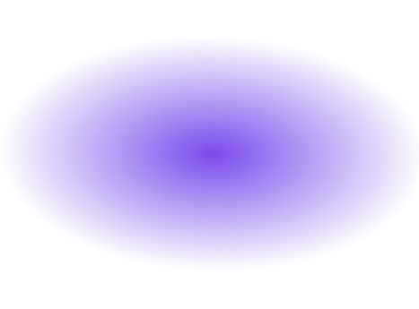
DA Project 2
Fernando Oliveira
Ilaha Rahman
Mariana Conde

Slide 2
Classes
ToyGraph
FileHandler
Interface
Functions that have the data type of the csv data files, i.e., the origin node, the destination node, and the distance
Collection of Functions that allows us to read the csv files and store the data properly in our system
Main Class of the Program since its what the user sees when they run it, allowing for the user to interact with it
Node
Edge
Graph
Utils
Stores the important data relate to a Node, like its Id and possible outgoing edges
Stores the Edges found in the files, i.e., the connection between the nodes.
A class that puts togethter class Node and class Edge, and forms a graph, along with some functions for proper searching
Class that contains all the functions that needed to be used outside the ones from the other classes

Slide 3
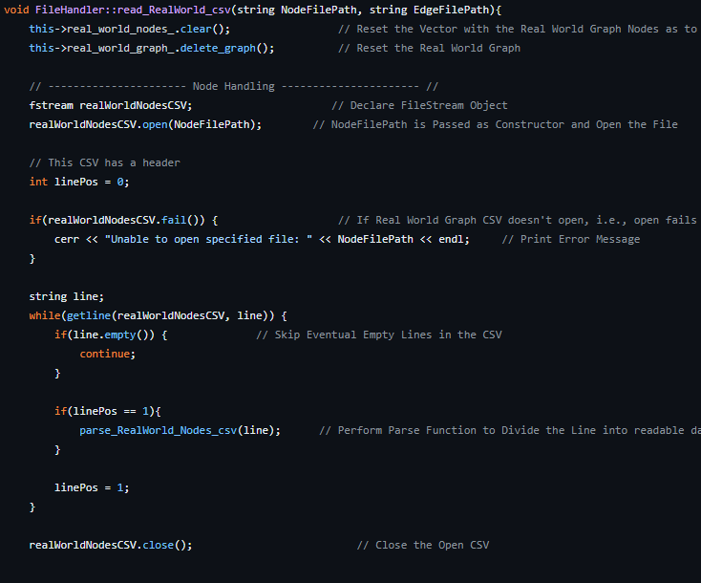
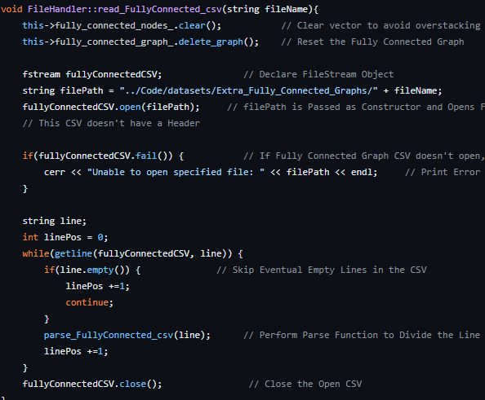
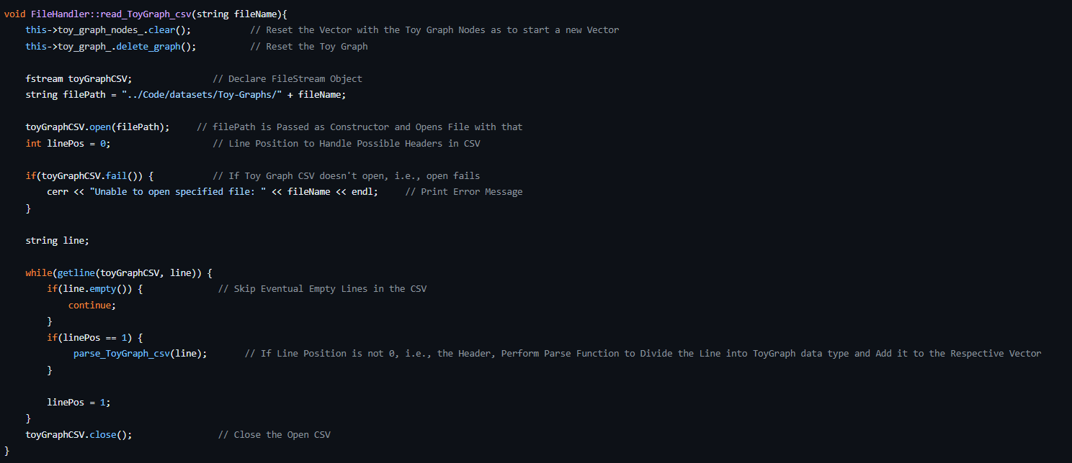
Reading and Importing Datasets
readToyGraph
readRealWorldGraph
readFullyConnectGraph
Obtains the data from each of the datasets in ToyGraphs directory like:
Origin
Distance
Obtains the data from each of the datasets in Real World Graphs directory like:
Nodes
And joins them to make a Graph
Obtains the data from each of the datasets in Extra Connected directory like:
Edge Origin
Edge Distance
Destination
Possible Node Names
Edges
Edge Destination
Using the format of the files of the dataset (csv) for our benefit, since they are "comma-separated values", i.e., looking into each line of said file gives us info about another object in file, this is further explored using the parse functions that show up in the functions above

Slide 4
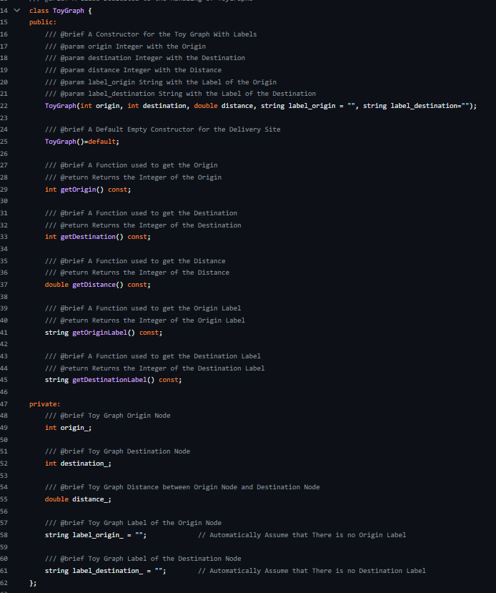
Toy Graph
Structures
Source and Destination
Distance
Has the information of the graphs edges, admitting that each one has an origin node and a destination node
Has the Information related to the distance in between these two nodes
These Structures aid us in dealing with the data type of our datasets, and further getting more information about said data as to make our search of these objects easier. Another argument in the construction are the labels that in some graphs are present and other are not. By giving it a default value, means that this data does not always need to be inputted

Slide 5
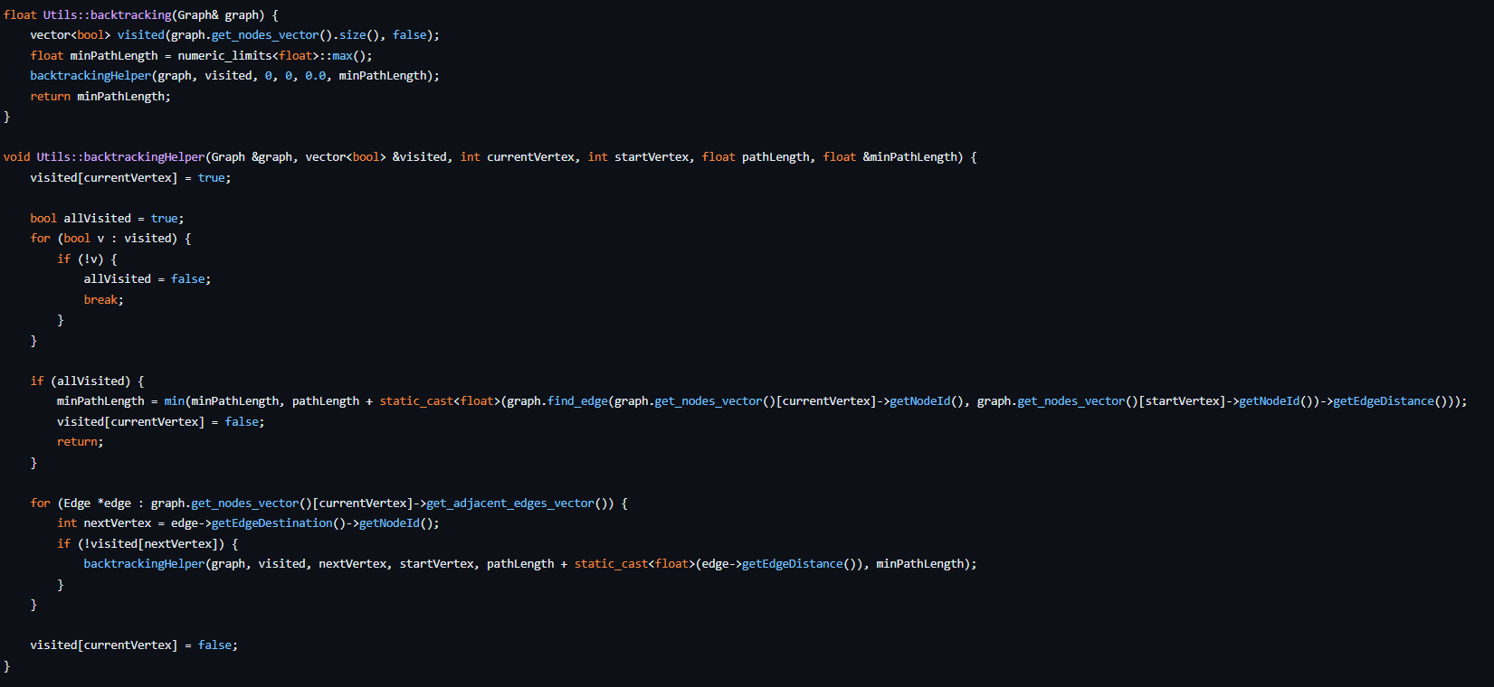
Implemented Functions
Backtracking algorithm
This is one of the asked functions, that performs a
Backtracking algorithm in our Graphs. Along with
A function used as auxiliary to the main one

Slide 6
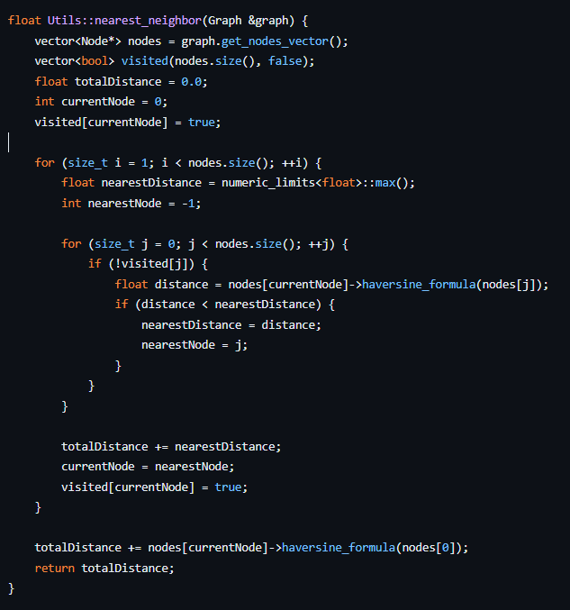
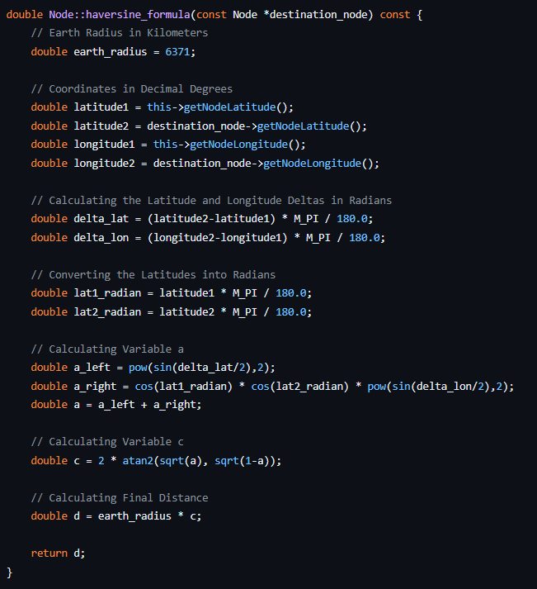
Implemented Functions
Nearest Neighbour
A function used to find the nearest neighbour
In a graph , and returns the distance between them
Haversine Formula
A function used to calculate the distance between points, using their latitude and longitude

Slide 7
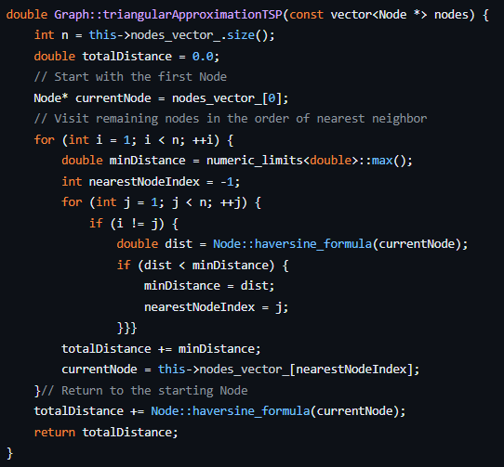
Implemented Functions
Triangular Approximation
This is one of the asked functions, that performs a
Triangle Aproximation in our Graphs.

Slide 8
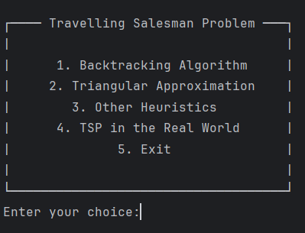
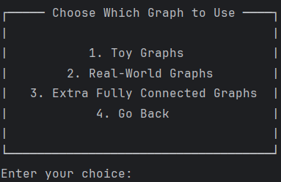
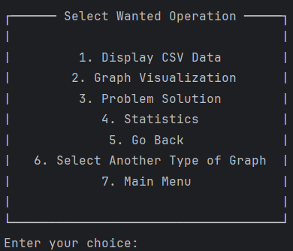
User Interface
Main Menu
Graph Menu
Allow the user to choose between which algorithm he wants to go through
Allow the user to choose which type of graphs he would prefer to work with based on our datasets
In Depth Graph Menu
Operation Menu
Allow the user to choose what to do with the data, that being:
Display The CSV
Show the Graph Created
Solve the Algorithm Previously Chosen
Obtain Statistics of the Algoritmh
Allow the user to choose which graphs he would prefer to work with based on their choice of graph type, i.e, allowing the user to choose the csv

Slide 9
Biggest Difficulties
The Part of Working with the DataSets was probably the simplest part, along with the creation of the menu.
The Implementation of the Graph caused some issues initially but were quickly fixed and started working as intended
The Functions Implementations was a bit harder, as to trying to use our data and perform the algorithms asked of us
The Statistics Part we did not manage to do.
The Hardest was probably implementing our algorithmic functions in with our interface, stuff that we couldn’t manage to finish and make it work.

