Slide 1
Lecture 8. Public Key
Symmetric key vs ASymmetric key (Public key)
RSA
Digital Signature
Public Key Certificate (X.509)
Notes:
Ddf

Slide 2
Symmetric key vs Asymmetric key(public key)
Symmetric key system: e==d or you can compute one from the other
Asymmetric key system: e != d and you can't compte one from the other
In asymmetric key system, e is called public key and d is called private key
Symmetric key algorithms: DES, 3DES, AES, RC4, IDEA, ........
Public key algorithms : RSA, Elliptic-curve, ElGamal, .......
Symmetric key is faster, secure, and easy to use
But symmetric key has "key distribution problem"
Asymmetric key has no "key distribution problem" and secure
But aymmetric key is slower and harder to generate
Notes:
Ddf

Slide 3
key distribution problem
Symmetric key is faster, secure, and easy to use
But symmetric key has "key distribution problem"
client
(chrome browser)
SYN
Amazon
SYN/ACK
ACK
order a book
credit card number?
enc(credit card number, e)
How can you exchange "e" with Amazon before this transaction?
=> you have to send "e" securely to Amazon => need another "Key"
=> and that "Key" needs another "Key" for secure transmission, etc.
Notes:
Ddf

Slide 4
public key solves "key distribution problem"
Symmetric key system: e==d or you can compute one from the other
Asymmetric key system: e != d and you can't compte one from the other
In asymmetric key system, e is called public key and d is called private key
Asymmetric key has no "key distribution problem"
client
(chrome browser)
SYN, SYN/ACK, ACK
Amazon
order a book
credit card number?
amzon's public key?
amazon-e
enc(credit card number, amazon-e)
- this message is secure because you can decrypt it only with Amazon's
private key (amazon-d) which only Amazon knows
- amazon-e is sent in plain text, but you can't compute amazon-d from it
Notes:
Ddf

Slide 5
Symmetric key vs Asymmetric key
Symmetric key system: you can select a key "e" randomly
DES: you can select a random 64 bit number
d == e
Assymtric key system: you need (e, d) pair such that
1) e != d (you can't compute one from the other)
2) you encrypt with one of them and decrypt with the other
C = enc(M, e)
M = dec(C, d)
Notes:
Ddf

Slide 6
RSA (Rivest, Shamir, and Adelman): math background
Relative prime: x, y are relative prime to each other if GCD(x, y)=1
ex) 21, 10 are relative prime: GCD(21, 10) = 1
phi function: phi(N) is the number of relative prime numbers to N in [1..N-1]
ex) phi(8) = 4: {1, 3, 5, 7} are relative prime to 8.
phi(7) = 6: {1, 2, 3, 4, 5, 6} are relative prime to 7
phi(N)=N-1 if N is a prime number
phi(P*Q)=(P-1)*(Q-1) if P and Q are both prime numbers.
ex) phi(15) = phi(3*5)=2*4=8 because 3 and 5 are both prime numbers.
{1, 2, 4, 7, 8, 11, 13, 14} are relative prime to 15 whose size is 8
so phi(15) = 8.
Notes:
Ddf

Slide 7
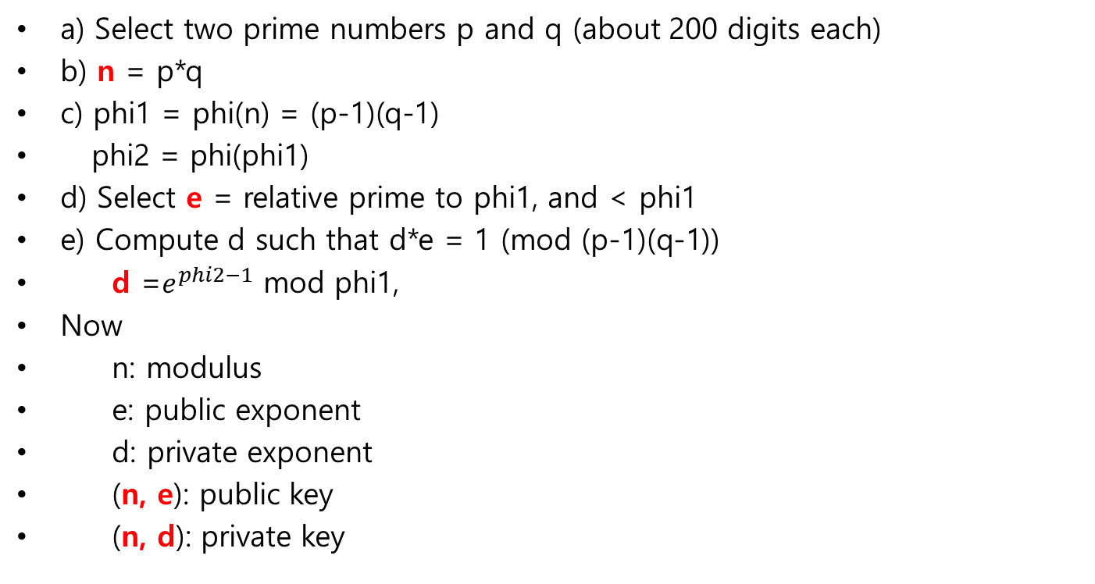
RSA algorithm: generating public key and private key pair
a) Select two prime numbers p and q (about 200 digits each)
b) n = p*q
c) phi1 = phi(n) = (p-1)(q-1)
phi2 = phi(phi1)
d) Select e = relative prime to phi1, and < phi1
e) Compute d such that d*e = 1 (mod (p-1)(q-1))
d =$e^{phi2−1}$ mod phi1,
Now
n: modulus
e: public exponent
d: private exponent
(n, e): public key
(n, d): private key
Notes:
Ddf

Slide 8

RSA algorithm: encryption, decryption
1. Divide plain text into a sequence of blocks
2. Convert each block (M) into a number < n
3. Encrypt: C = $M^{e} mod n$
4. Decrypt: M = $C^{d} mod n$
Notes:
Ddf

Slide 9
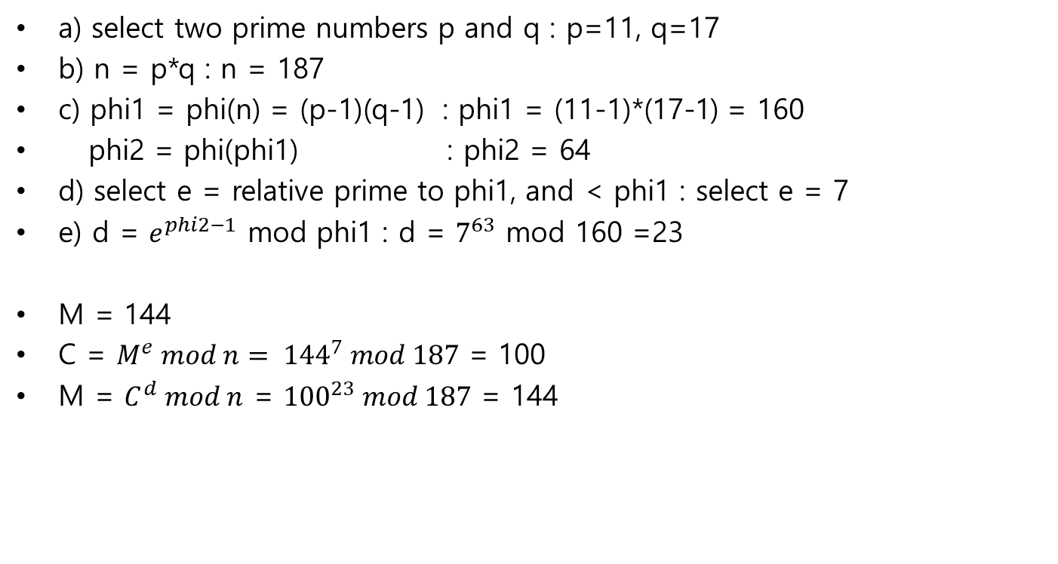
RSA algorithm: example
a) select two prime numbers p and q : p=11, q=17
b) n = p*q : n = 187
c) phi1 = phi(n) = (p-1)(q-1) : phi1 = (11-1)*(17-1) = 160
phi2 = phi(phi1) : phi2 = 64
d) select e = relative prime to phi1, and < phi1 : select e = 7
e) d = $e^{phi2−1}$ mod phi1 : d = $7^{63}$ mod 160 =23
M = 144
C = $M^{e} mod n= {144}^{7} mod 187$ = 100
M = $C^{d} mod n$ = ${100}^{23} mod 187$ = 144
Notes:
Ddf

Slide 10
Security of RSA
public key: (n, e)
private key: (n, d)
(n, e) is known to every body
Computing (n, d) from (n, e) is virtually impossible
Number of bits in n : key length of this RSA
key length: 1024(weak), 2048(strong), 4096(very strong)
Notes:
Ddf

Slide 11
Usage of public key system
Encryption
Digital signature
Notes:
Ddf

Slide 12
Digital Signature by A
- A's public key: e_A
- A's pivate key: d_A
- Digital signature by A for document M : signatureByA= enc(M, d_A)
==> encrypt M with A's private key.
- A sends (M, signatureByA): M is digitally signed by A
- It is a signature by A because
1) It can be decrypted with e_A wich means it was encrypted with d_A
and A is the only person who knows d_A
2) No one can modify M because the modified one will not match
signatureByA
- For faster checking, digital signature uses H(M) instead of M
H(M): hash of M
signatureByA = enc(H(M), d_A)
Notes:
Ddf

Slide 13
X.509: public certificate
client
(chrome browser)
SYN, SYN/ACK, ACK
Amazon
order a book
credit card number?
amzon's public key?
amazon-e
enc(credit card number, amazon-e)
- How we can be sure amazon-e is really Amazon's public key?
- Amazon sends (amazon-e, signatureByCA)
- amazon-e is signed by CA(Certificate Authority)
- signatureByCA is enc(H(amazon-e), d_CA)
- X.509 is the format for (amazon-e, signatureByCA)
- Certificate Authority
Thawte, globaltrust, ......., signkorea, yessign, ...
Notes:
Ddf

Slide 14
X.509: public certificate
X.509 field:
Version number
Serial number
Signature Algorithm ID
Issuer Name
Validity period
Not Before
Not After
Subject name
Subject Public Key Info
Public Key Algorithm
Subject Public Key
Certificate Signature Algorithm
Certificate Signature
Notes:
Ddf

Slide 15
X.509: example
Certificate:
Data:
Version: 1 (0x0)
Serial Number: 7829
Signature Algorithm: md5WithRSAEncryption
Issuer: ..............., O=Thawte Consulting cc, ......
Validity
............
Subject: ..........., O=Brent Baccala, ............
Subject Publick Key Info:
Public Key Algorithm: rsaEncryption
RSA Public Key: (1024 bit)
Modulus (1024 bit):
00:b4:31:98:......................
..........................
e8:35:1c:9e:27:52:7e:41:8f
Exponent: 65537
Signature Algorithm: md5WithRSAEncryption
93:5f:8f:.............................
...............................
68:9f
CA
(who signed this cert)
client
(owner of this cert)
client's public key
signature by CA
Notes:
Ddf

