Slide 1
Information Security
No text book. Lecture notes will be provided via iclass.
Homework everyweek.
You can find homework at the end of the lecture note
Zoom id: 638 677 0929 (passwd: 7451)

Slide 2
Using Lab Server
class 1 students:
use 165.246.38.151 machine if your id <= 12163659
use 165.246.38.157 machine if your id > 12163659
class 2 students:
use 165.246.38.151 machine if your id <= 12161720
use 165.246.38.157 machine if your id > 12161720
class 3 students:
use 165.246.38.151 machine
Use putty.exe (download from iclass) to access the server.
login ID is your student ID: for example, 12161728
passwd is p+your student ID: for example, p12161728
(When you type password, it won't show in the screen. So
please type carefully.)

Slide 3
Information Security Overview: attack side
Information collecting
sniffing: collect info on packet data
scanning: collect info on live ports
Breaking into the target system
brute-force: password guessing
unexpected input:
buffer overflow, SQL injection, Cross-Site Scripting,
format string, integer overflow, …
unexpected behavior/protocol:
MIM, application vulnerabilities, java vulnerabilities
social engineering
Control the target system
malware, ransomware, spyware : install attacker’s program
kernel hacking : modify the kernel (LKM)
Block/Destroy target system
DoS, DDos
Notes:
Ddf

Slide 4
Information Security Overview: defense side
Detect/block the attack
detect scanning
detect attack packet: IDS(Intrusion Detection System)
block port: firewall
Make system/protocol/application secure
encryption, secure os, SSL(secure socket layer), secure programming
Trace the attacker
logging, ip trace, computer forensics
Notes:
Ddf

Slide 5
Background for Buffer Overflow Attack
Understand CALL, RET instruction
x86 instruction set
Debugging a program at instruction level
Drawing a memory map
Using gdb to debug a program
Notes:
Ddf

Slide 6
compiler converts C code to machine instructions
ex1.c:
#include <stdio.h>
void main(){
int x;
x=30;
printf("x is %d\n", x);
}
gcc -m32 -o ex1 ex1.c ==> will produce "ex1" executable file
ex1:
55 89 e5 83 e4 f0 83 ec 20 .......... ==> machine instructions for ex1.c
080483c4 <main>:
80483c4: 55 push ebp
80483c5: 89 e5 mov ebp, esp
80483c7: 83 e4 f0 and esp, 0xfffffff0
80483ca: 83 ec 20 sub esp, 0x20
80483cd: c7 44 24 1c 1e 00 00 00 mov DWORD PTR [esp+0x1c], 0x1e
...............................
Notes:
Ddf

Slide 7
cpu will execute each instruction one by one
cpu execution cycle
fetch next instruction (pointed by eip)
update eip
execute fetched instruction

Slide 8
x86 cpu (before running the main code at 0x80483c4)
registers
........
eax
........
ebx
1e
ecx
1c
........
edx
24
80483cb
ebp
00000000
mar
44
esp
ffffd5ec
80483ca
80483c4
mbr
c7
80483c9
eip
........
ec
80483c8
83
80483c7
e5
80483c6
89
80483c5
cntrl unit
55
80483c4
........
........
ALU
mem
instruction
register

Slide 9
x86 cpu (after one cpu clock tick:fetch instruction)
registers
........
eax
........
ebx
1e
ecx
1c
........
edx
24
80483cb
ebp
00000000
mar
44
esp
ffffd5ec
80483ca
80483c4
mbr
c7
80483c9
eip
........
ec
80483c8
83
80483c7
e5
80483c6
89
80483c5
cntrl unit
55
80483c4
........
........
ALU
55
mem
instruction
register

Slide 10
x86 cpu (after another cpu clock tick:update eip)
registers
........
eax
........
ebx
1e
ecx
1c
........
edx
24
80483cb
ebp
00000000
mar
44
esp
ffffd5ec
80483ca
80483c5
mbr
c7
80483c9
eip
........
ec
80483c8
83
80483c7
e5
80483c6
89
80483c5
cntrl unit
55
80483c4
........
........
ALU
55
mem
instruction
register

Slide 11
x86 cpu (after another cpu clock tick:execute "push ebp")
registers
eax
ffffd5ec
ebx
00
ffffd5eb
00
ffffd5ea
ecx
00
ffffd5e9
edx
00
ffffd5e8
ebp
00000000
........
mar
esp
ffffd5e8
mbr
eip
80483c5
1e
........
1c
........
24
80483cb
44
80483ca
c7
80483c9
cntrl unit
ec
80483c8
83
80483c7
ALU
e5
80483c6
55
89
80483c5
instruction
register
55
80483c4
........
........
mem
........

Slide 12
x86 cpu (after another cpu clock tick:fetch next instruction)
registers
eax
ffffd5ec
ebx
00
ffffd5eb
00
ffffd5ea
ecx
00
ffffd5e9
edx
00
ffffd5e8
ebp
00000000
........
mar
esp
ffffd5e8
mbr
eip
80483c5
1e
........
1c
........
24
80483cb
44
80483ca
c7
80483c9
cntrl unit
ec
80483c8
83
80483c7
ALU
e5
80483c6
89 e5
89
80483c5
instruction
register
55
80483c4
........
........
mem
........

Slide 13
instruction: push, pop
push x
esp = esp – 4
mem[esp] ß x
pop y
y ß mem[esp]
esp = esp + 4
esp
1004
1004
esp
1004
1003
push x
00
1003
pop y
00
1003
1002
00
1002
00
1002
1001
00
1001
00
1001
1000
esp
30
1000
30
1000
0fff
0fff
0fff
0ffe
0ffe
0ffe
x=30
y=30
Notes:
Ddf

Slide 14
instruction: mov, sub
mov eax, 0x31 # eax <-- 0x00000031
sub eax, 0x10 # eax <-- eax - 0x10 == 0x21
mov DWORD PTR [1000], 0x21 # mem[1000] <-- 0x00000021
(* DWORD PTR means DoubleWord Pointer. Double word means 4 byte.
this instruction will store 0x21 in the 4 byte at memory address 1000.)
1004
00
1003
mov DWORD PTR [1000], 0x21
1004
00
1002
00
1003
00
1001
00
1002
30
1000
00
1001
0fff
21
1000
0ffe
0fff
0ffe
Notes:
Ddf

Slide 15
instruction: and
mov eax, 0x31 # eax <-- 0x00000031
and eax, 0xfffffff0 # eax <-- eax AND 0xfffffff0 == 0x00000030
0 0 0 0 0 0 0 0 3 1
f f f f f f f f f 0
AND
0 0 0 0 0 0 0 0 3 0
0
0000
AND
1111
f
AND
0000
(hexadecimal)
(binary)
Notes:
Ddf

Slide 16
instruction: call
call x
1) push return-addr (the address of the instruction after “call x”)
2) jump to x
esp
ffffd5c0
ffffd5c0
ffffd5bf
08
ffffd5bf
ffffd5be
04
ffffd5be
ffffd5bd
1)
esp
83
ffffd5bd
ffffd5bc
call 80482f4
ea
ffffd5bc
........
........
........
........
......
80483ec
......
80483ec
c3
80483eb
c3
80483eb
c9
80483ea
return address
c9
80483ea
ff
80483e9
ff
80483e9
ff
80483e8
ff
80483e8
ff
80483e7
call 80482f4
ff
80483e7
0a
80483e6
0a
80483e6
eip
e8
80483e5
e8
80483e5
........
........
........
........
2)
eip
80482f4
........
mem
Notes:
Ddf

Slide 17
instruction: ret
esp
ret
1) eip <-- mem[esp]
2) esp = esp + 4
ffffd5c0
2)
esp
ffffd5c0
08
ffffd5bf
08
ffffd5bf
04
ffffd5be
04
ffffd5be
esp
83
ffffd5bd
ret
83
ffffd5bd
ea
ffffd5bc
ea
ffffd5bc
........
........
........
........
......
80483ec
......
80483ec
c3
80483eb
c3
80483eb
c9
80483ea
1)
eip
c9
80483ea
ff
80483e9
ff
80483e9
ff
80483e8
ff
80483e8
ff
80483e7
ff
80483e7
0a
80483e6
0a
80483e6
e8
80483e5
e8
80483e5
........
........
........
........
eip
80482f4
........
mem
Notes:
Ddf

Slide 18
Examining changes in register and memory with gdb
ex1.c:
#include <stdio.h>
void main(){
int x;
x=30;
printf("x is %d\n", x);
}
gcc -m32 -g -o ex1 ex1.c ==> to use gdb add "-g" option
gdb ex1 ==> run gdb
Notes:
Ddf

Slide 19
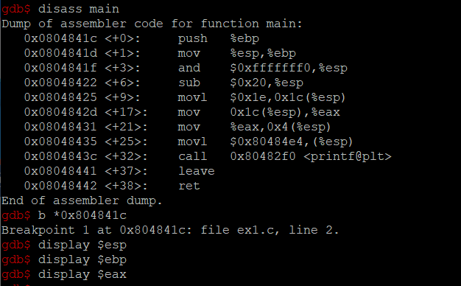
using gdb
disass main: show instructions in function main
b *0x804841c : set a break point at 0x804841c
display register: show the value of register after each instr

Slide 20
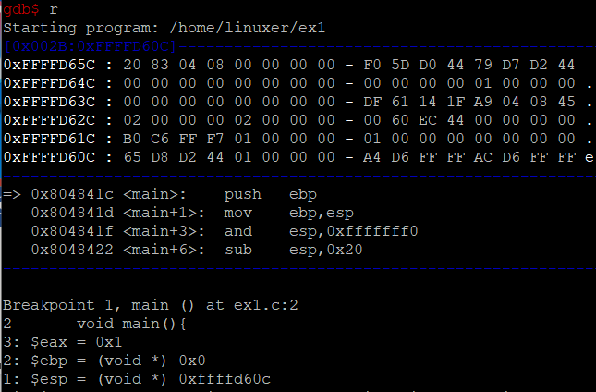
using gdb
start running unstil first break point
memory content for stack area
next instruction to execute
current value of
eax, ebp, esp

Slide 21
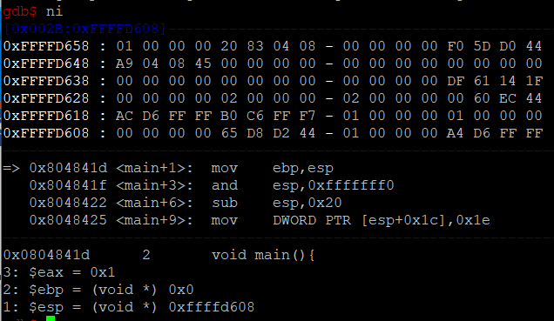
using gdb
execute next instruction:
"push ebp"
push ebp:
1) esp <-- esp-4
2) mem[esp] <-- ebp
2) we store ebp(=0) at mem[0xffffd608]
1) esp was 0xffffd60c
now it is 0xffffd608

Slide 22
hw4
x=30;
mov DWORD PTR [esp+0x1c], 0x1e
30
x
0x1c
esp

Slide 23
hw4: function call
push z
push y
push x
call foo
foo(x, y, z);
store parameters in stack
call foo
1) push x
2) push "x is %d\n"
3) call printf
printf("x is %d\n", x);
store parameters in stack
call printf

Slide 24
hw4
address of "x is %d\n"
mov eax, 0x80484b4
mov edx, DWORD PTR [esp+0x1c]
mov DWORD PTR [esp+0x4], edx
mov DWORD PTR [esp], eax
call 80482f4
printf("x is %d\n", x);
1) store x in stack
2) store address
of string
"x is %d\n" in
stack
0x80484b4
3) and call printf
1)
x
esp+0x4
3) call 80482f4
2)
0x80484b4
esp
push two argumenents
in the stack

