Slide 1
Lecture 4, 5: sniffing
Review on socket
Information collecting via sniffing
Notes:
Ddf

Slide 2
Information Security Overview: attack side
Information collecting
sniffing: collect info on packet data
scanning: collect info on live ports
Breaking into the target system
brute-force: password guessing
unexpected input:
buffer overflow, SQL injection, Cross-Site Scripting,
format string, integer overflow, …
unexpected behavior/protocol:
MIM, application vulnerabilities, java vulnerabilities
social engineering
Control the target system
malware, ransomware, spyware : install attacker’s program
kernel hacking : modify the kernel (LKM)
Block/Destroy target system
DoS, DDos
Notes:
Ddf

Slide 3
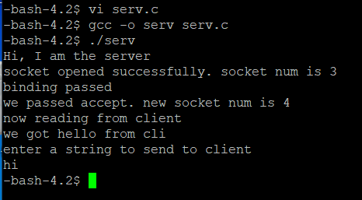
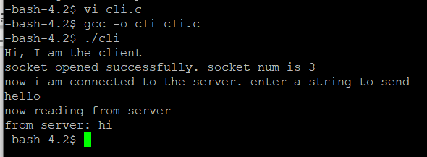
Lecture 4: Review on socket
Make client and server program
Run the server first and then the client
Client should talk first
Notes:
Ddf

Slide 4
Lecture 5: sniffing
Sniff packets between the server and the client
Analyze the packet
client
server
SYN
SYN/ACK
system packet for connection establishment
final ACK
hi
user
data packet
hello
Notes:
Ddf

Slide 5
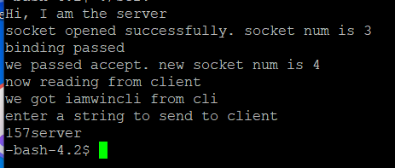

client in PC
Make client in PC
Run the server first and then the client
Client should talk first
Notes:
Ddf

Slide 6
server, client, windump
server(151 or 157)
client (PC)
windump
Notes:
Ddf

Slide 7
sniffing packets between the server and PC client
- download win10pcap from iclass and install
- download windump.exe from iclass
- open CMD window as admin
- go to the directory where you have windump
- "windump -D" will show all network interfaces
- windump -eSXX -i 2 -s 80 port 9924
- run server
- run client
windump -eSXX -i 2 -s 80 port 9924
printing format
capture all packets
whose dest/src port number is 9924
dump packet from
network interface 2
show upto 80 bytes
Notes:
Ddf

Slide 8
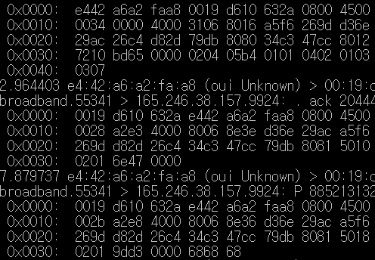
sniffing packets between the server and PC client
Notes:
Ddf

Slide 9
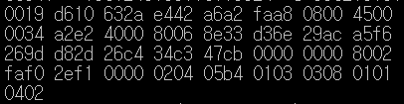
Analyzing packet(SYN packet)
ethernet header(14 bytes)
IP header (20 bytes)
TCP header(20+x bytes)
Notes:
Ddf

Slide 10
packet structure: ethernet header (14 bytes)
0019 d610 632a e442 a6a2 faa8 0800
dest MAC addr
src MAC addr
type: IP packdt
Notes:
Ddf

Slide 11
packet structure: ip header (20 bytes)
type of service
4 5 00 0034 a2e2 4000 80 06 8e33 d36e 29ac a5f6 269d
ip version
ip header
checksum
src ip
dest ip
paket
length
header length=5*4=20
Notes:
Ddf

Slide 12
packet structure: tcp header (20 bytes+α)
ip version
seq number
tcp header
checksum
d82d 26c4 34c3 47cb 0000 0000 8 002 faf0 2ef1 0000
src port
dst port
tcpheader length=8*4=32
0000 00 00 0010
reserved
URG ACK PSH RST SYN FIN
0204 05b4 0103 0308 0101 0402
Notes:
Ddf

