Slide 1
Lecture 7: Sending SYN packet with winpcap
Use pcap_sendpacket(fp, packet, ....) to send a packet
You need to compute ip and tcp checksum correctly
Use in_checksum() to compute checksum
Notes:
Ddf

Slide 2
in_checksum
unsigned short in_checksum(unsigned short *ptr,int nbytes) {
register long sum;
unsigned short oddbyte;
register short answer;
sum=0;
while(nbytes>1) {
sum+=*ptr++;
nbytes-=2;
}
if(nbytes==1) {
oddbyte=0;
*((u_char*)&oddbyte)=*(u_char*)ptr;
sum+=oddbyte;
}
sum = (sum>>16)+(sum & 0xffff);
sum = sum + (sum>>16);
answer=(SHORT)~sum; // use “short” in MacOS
return(answer);
}
Notes:
Ddf

Slide 3
IP and TCP checksum
ether hdr
IP hdr
TCP dhr
Data
ip chksum
tcp chksum
Notes:
Ddf

Slide 4
computing IP checksum
struct ip_hdr *myih;
myih = (struct ip_hdr *)(pkt_data + 14);
// reset ip checksum to 0 and recompute
1) myih->ip_checksum = 0;
2) myih->ip_checksum = in_checksum((unsigned short *)myih, 20);
ether hdr
IP hdr(20)
TCP dhr
Data
0
ip chksum
tcp chksum
myih
Notes:
Ddf

Slide 5
computing TCP checksum
struct tcp_hdr *myth;
myth = (struct tcp_hdr *)(pkt_data + 14 + 20);
// reset ip checksum to 0 and recompute
1) myih->tcp_checksum = 0;
2) myih->tcp_checksum =
in_checksum((unsigned short *)sudo, length-of-sudo);
Notes:
Ddf

Slide 6
computing sudo
seudo
src IP
dst IP
0
6
tcp len
pseudo_header
ether hdr
IP hdr
TCP dhr
Data
0
ip chksum
tcp chksum
Notes:
Ddf

Slide 7
computing TCP checksum
1) myih->tcp_checksum = 0;
2) myih->tcp_checksum =
in_checksum((unsigned short *)sudo, length-of-sudo);
seudo
src IP
dst IP
0
6
tcp len
pseudo_header
ether hdr
IP hdr
TCP dhr
Data
0
ip chksum
tcp chksum
Notes:
Ddf

Slide 8
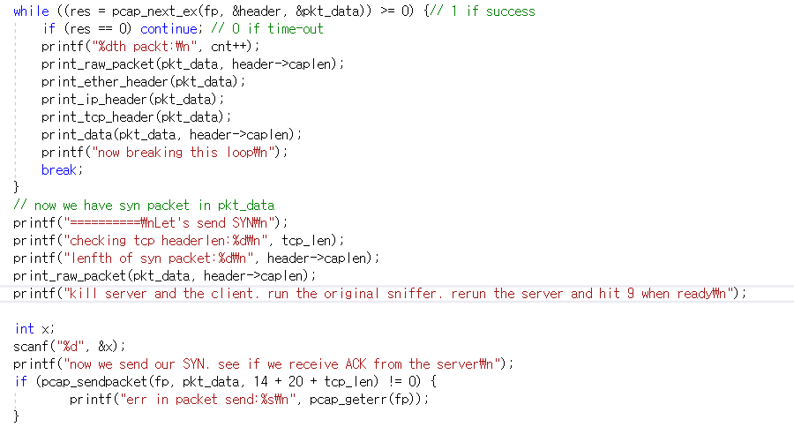
hw 1-1
Capture SYN
Kill the server and the client
Run the original sniffer. Rerun the server
Send the captured SYN
The server should respond with SYN/ACK
capture SYN and break out
check if we have the same SYN
wait until ready
send SYN
Notes:
Ddf

Slide 9
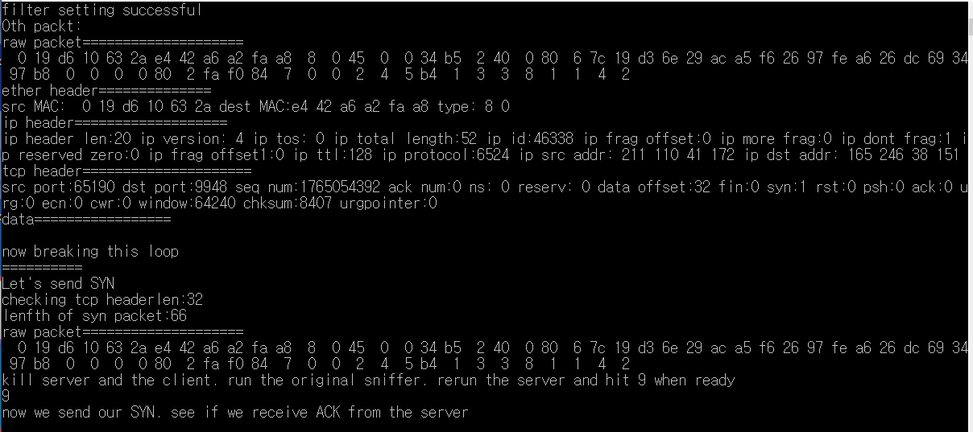
hw 1-1
our syn-sender sends SYN
Notes:
Ddf

Slide 10
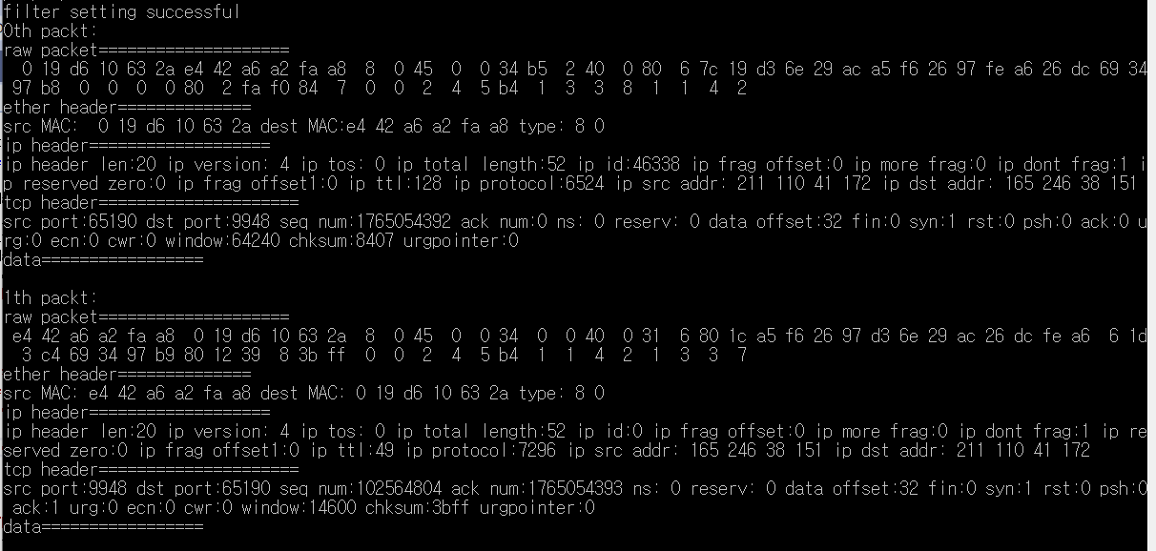
hw 1-1
In the original sniffer, we observe SYN (sent by syn-sender) and SYN/ACK
fromt the server
Notes:
Ddf

Slide 11
hw 1-2
Capture SYN
Copy pkt_data[] to packet[]
Set ip and tcp checksum to 0 in packet[]
Recompute ip and tcp checksum in packet[]
Check if packet[] is same as pkt_data[]
Kill the server and the client
Run the original sniffer. Rerun the server
Send packet[]
The server should respond with SYN/ACK
Notes:
Ddf

Slide 12
hw 2
Stealth scanner: harder to detect
Send SYN to all possible port numbers (1 to 65535) in the server
Only live port will respond with SYN/ACK
Can detect which ports are alive in the server, which tells what programs are currently running in the server.
Notes:
Ddf

