Slide 1
Create eCert Download platform

Slide 2
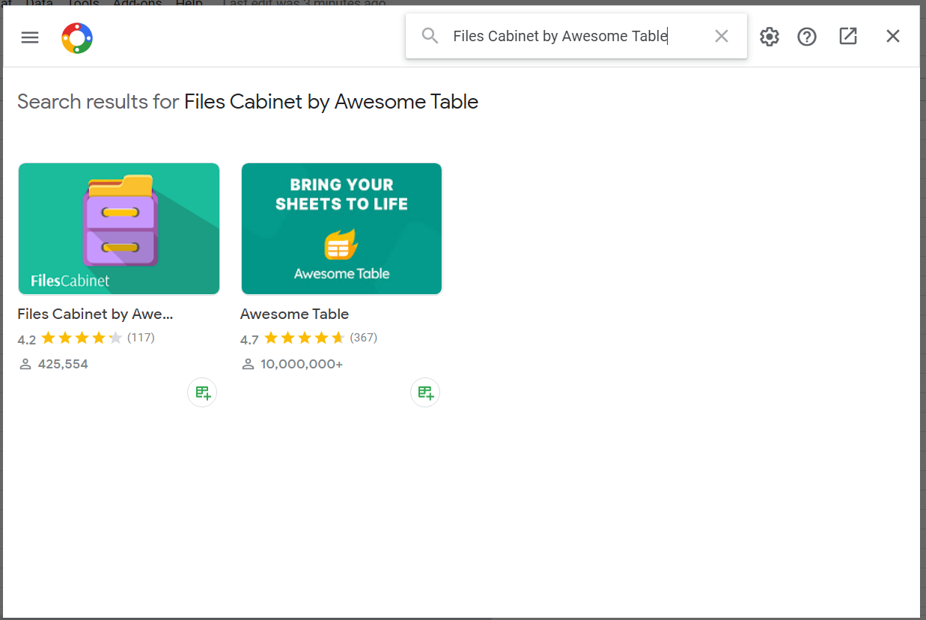
Requirement
List of participants (name)
Any possible details require for user search later
Pdf file for each participant (rename by participant)
Install add-on (Files Cabinet by Awesome Table) at Google Sheet
Using chrome incognito recommended

Slide 3
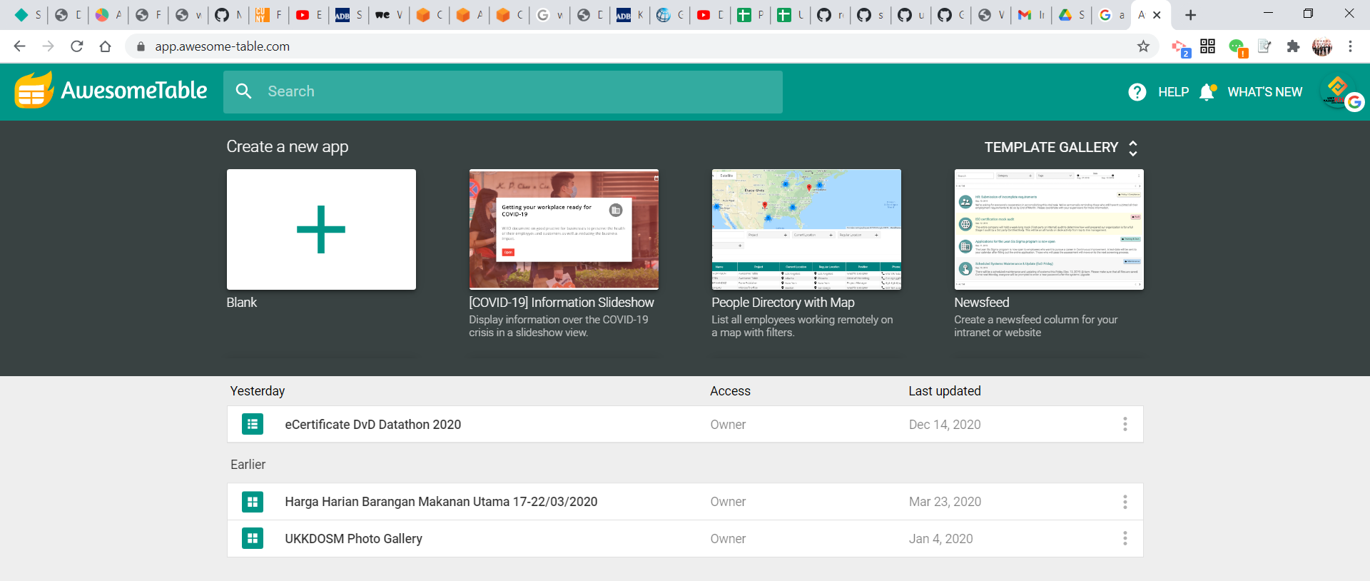
Create Awesome Table Platform
Sign up with google account
Select Template
E.g Awesome Table with Google Forms
Link to Google Sheet

Slide 4
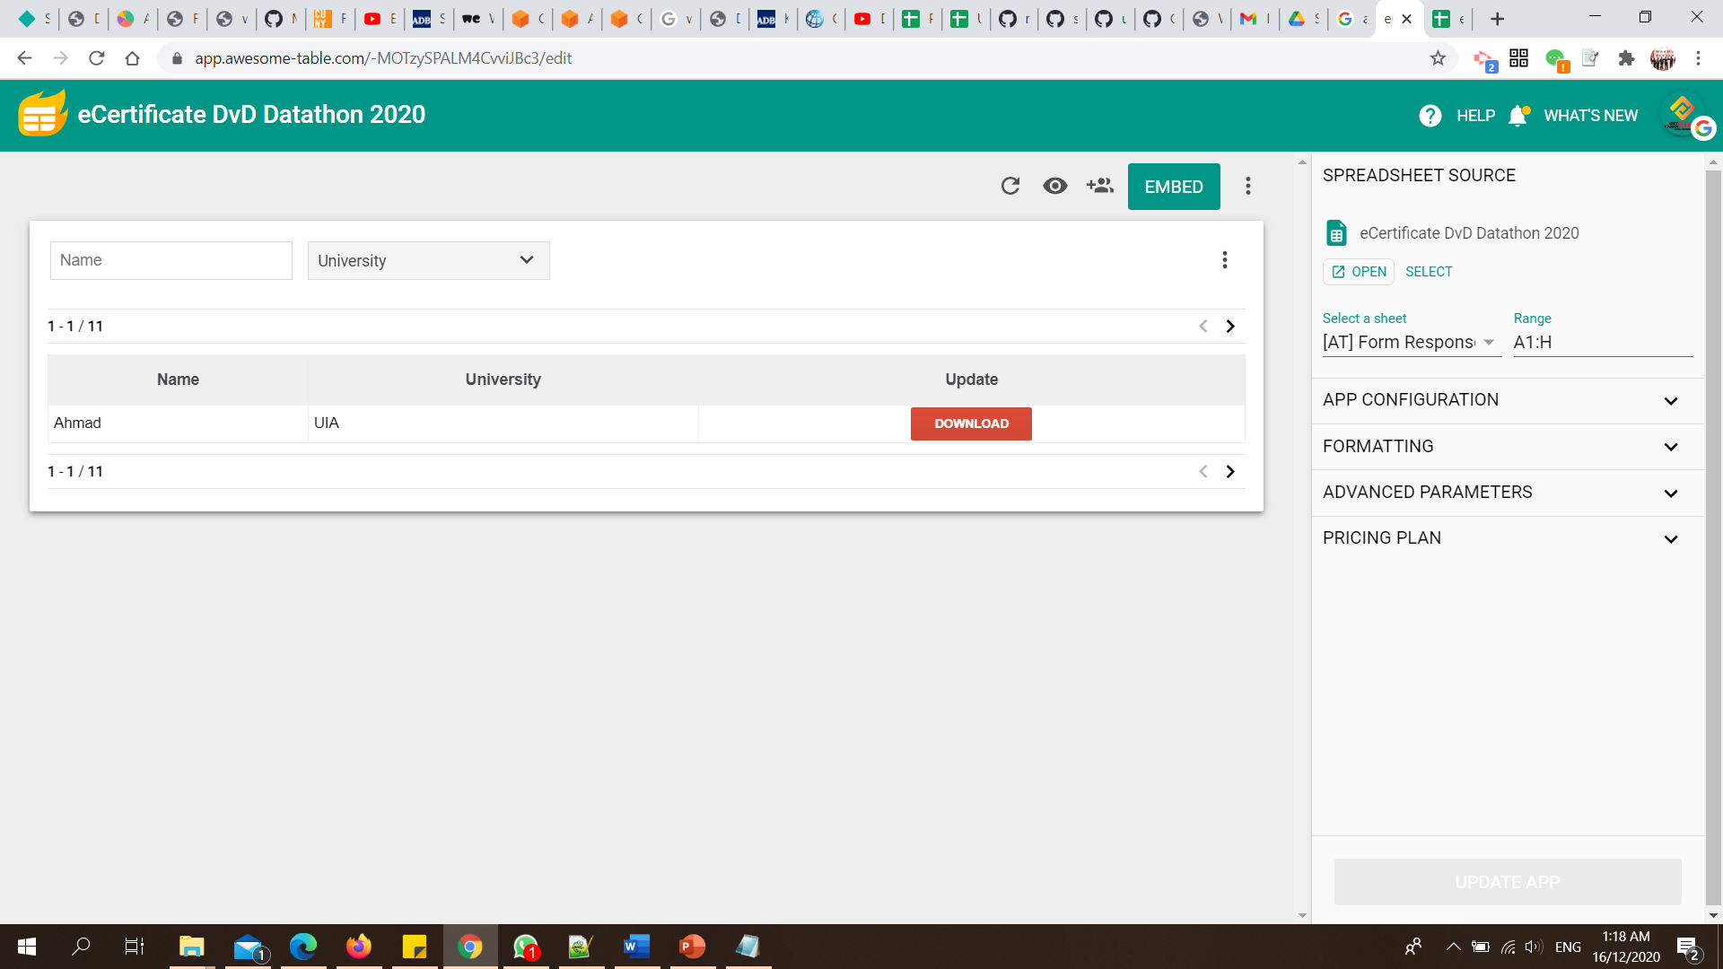

Slide 5
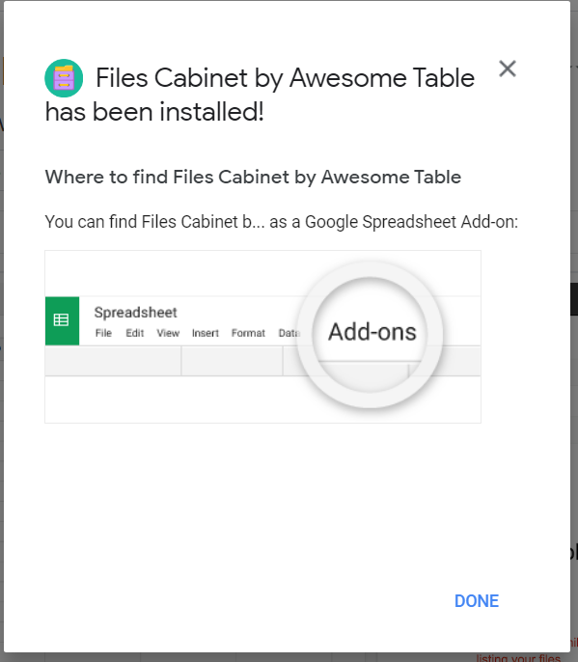
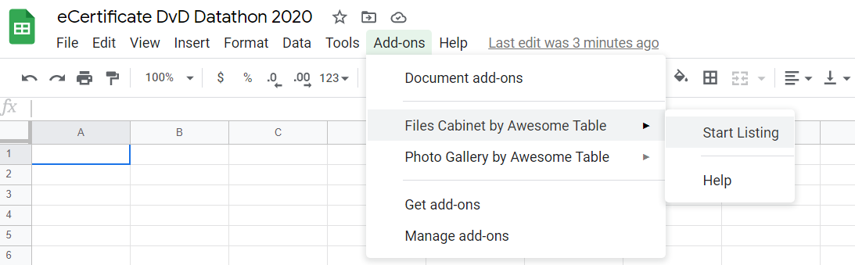
Upload File to Google Drive
Upload Folder with PDF files, set Folder as “share for view”
Create new tab
Run Add-on: Files Cabinet by Awesome Table to sort the filename

Slide 6
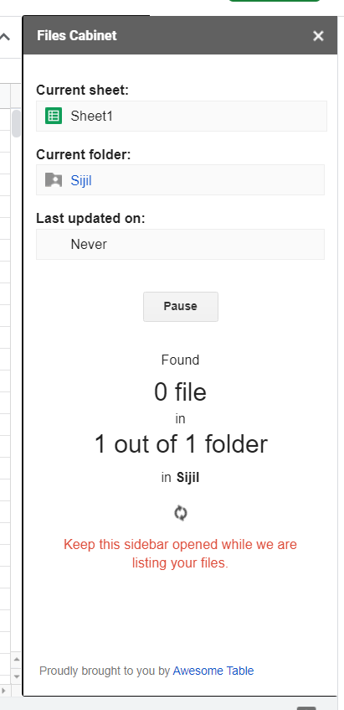
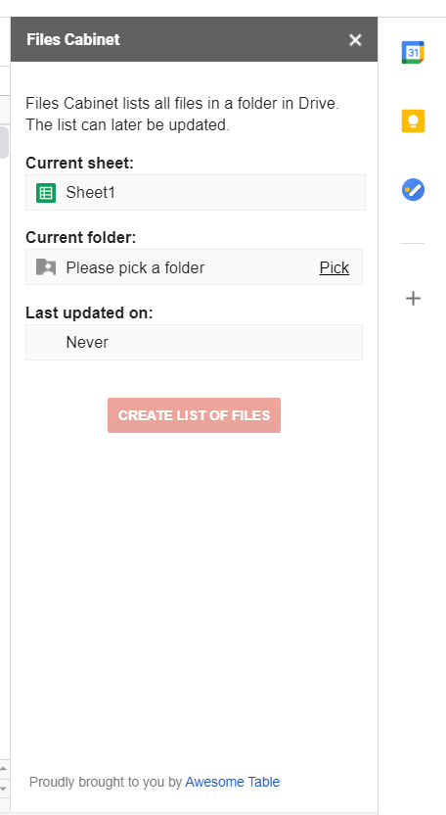
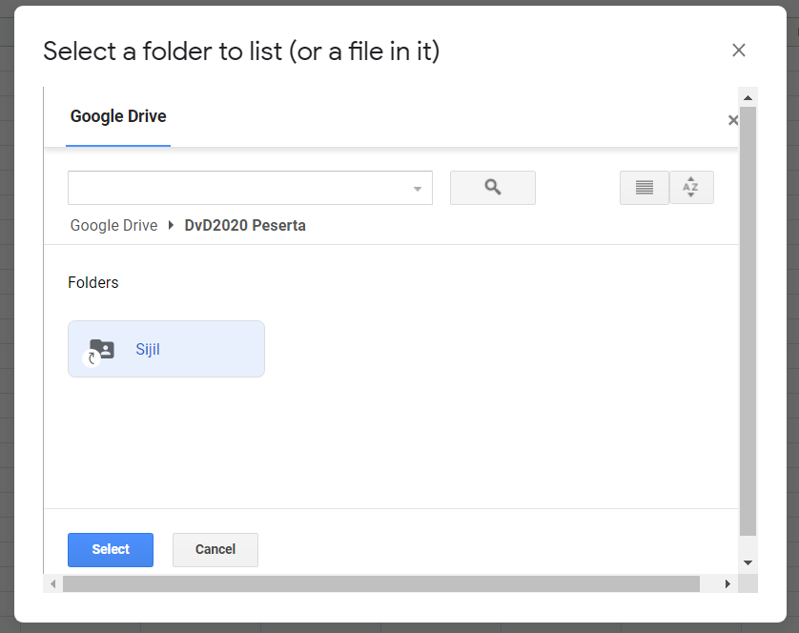
Pick Folder
Pick and Run

Slide 7
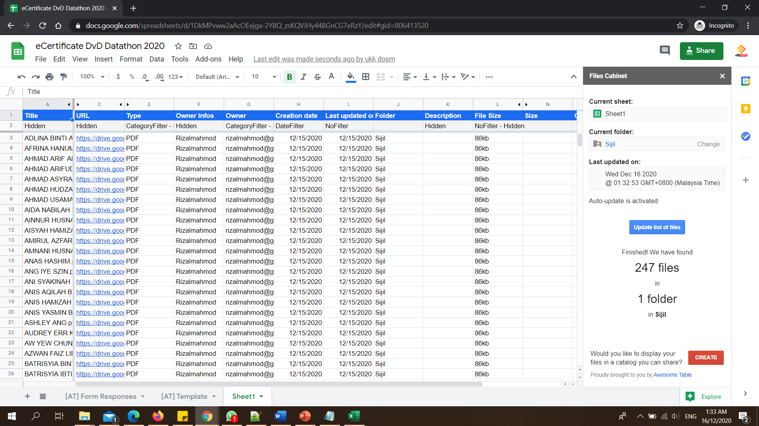

Slide 8
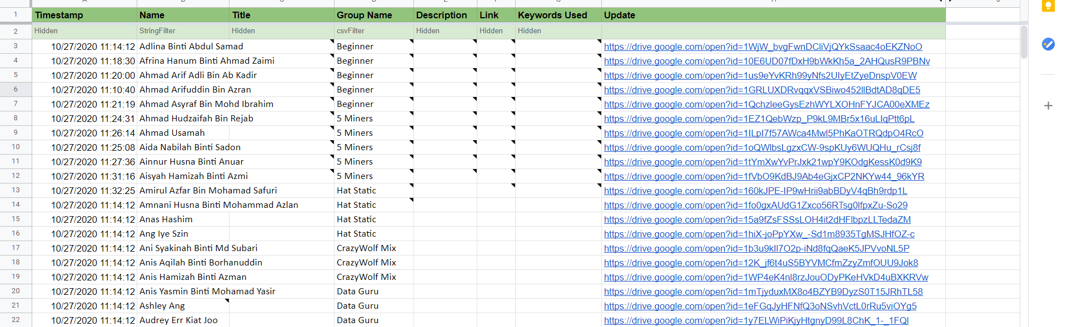
Sorting
Sort filename by A-Z (easier to match the files)
Copy Filename [Title] and URL >> Main List [e.g Form Responses]

Slide 9
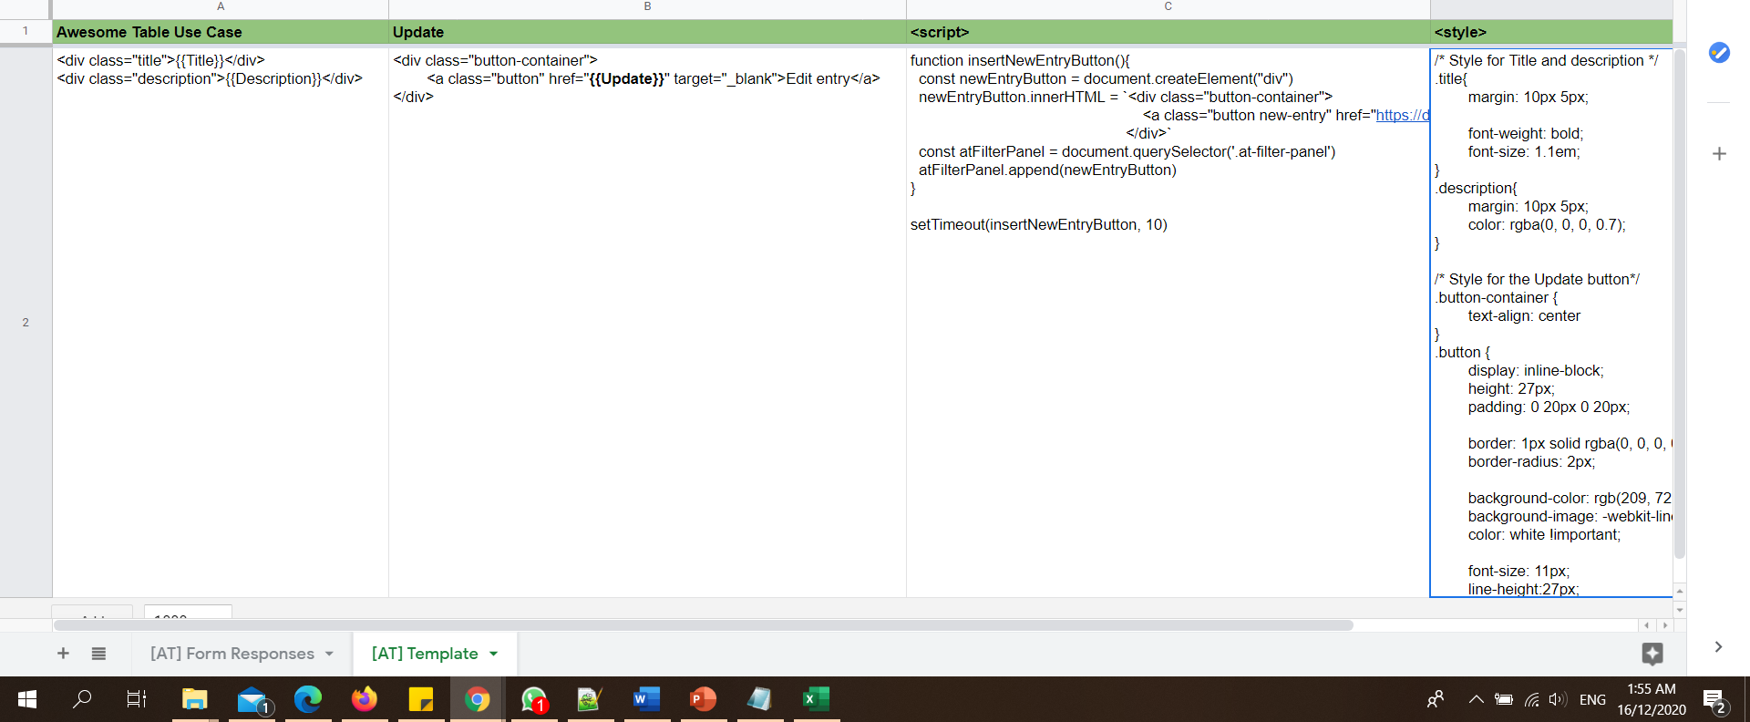
Backend Template

Slide 10
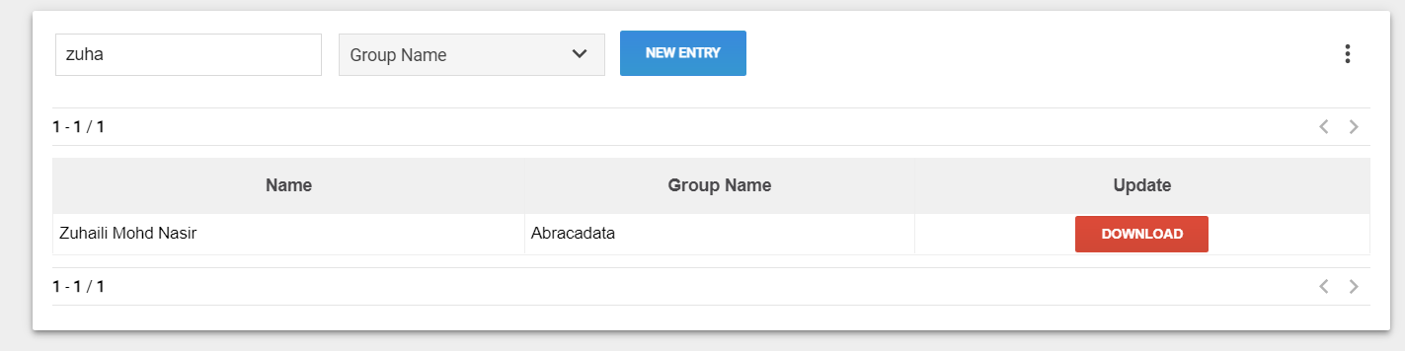
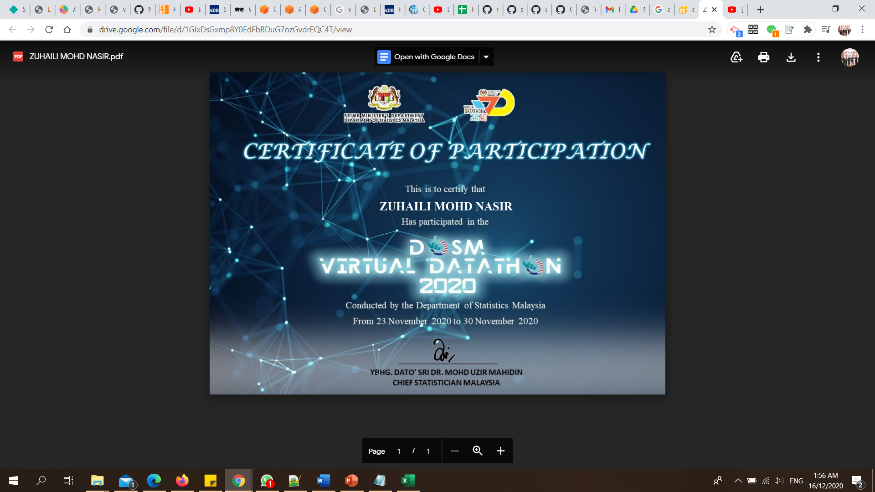
DONE
Blank the first row
All set

