Slide 1
DEVOPS 2021S4
Project by Lysyi Viktor “Project_name”

Slide 2
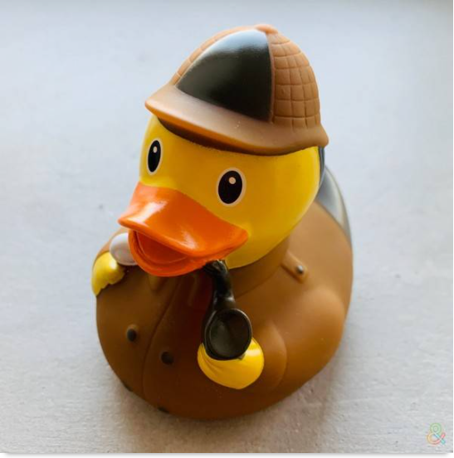
Goal and motivation
As final project I decide to create CI\CD for internet-shop. Using main devops instruments.1 pipeline for 1st creating.And another for CI.
My motivation was to understand how to use devops instruments
And my goals was :
Maximal automation

Slide 3
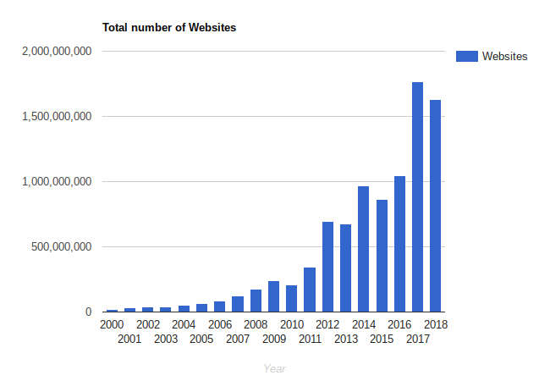
Relevance, everyone need website and with every year more and more websites creates .

Slide 4
Technology stack
- Git
- Jenkins
- Terraform
-Github
-Php
-Docker
-Some AWS technologies ( RDS Mysql,Elastic Ip, EC2 etc)
Microsoft Powerpoint

Slide 5







Scheme of the project realisation

Slide 6

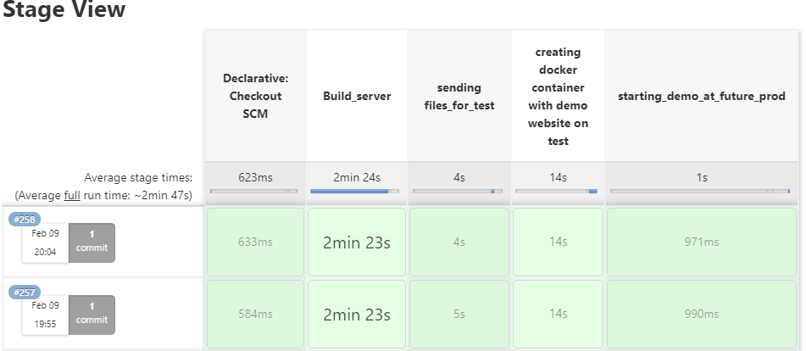

Stage view of project.Time and Stages

Slide 7
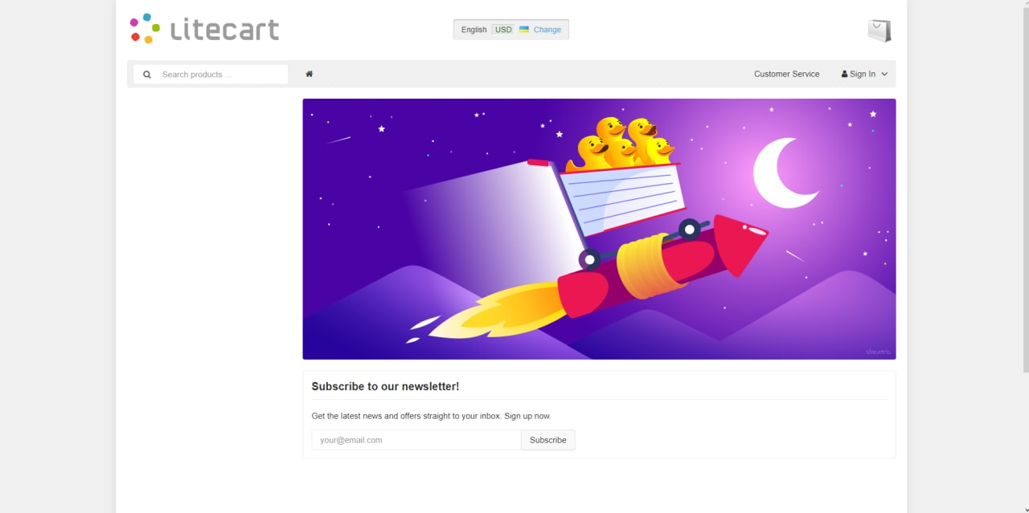
Example of website

Slide 8

Project done
tasks completed. fully automate web-shop,CI\CD.
achieved experience of creating pipelines
used relevant technological and software solutions

