Slide 1
Reddit classifier: NLP and ML models
Udayshankar Menon

Slide 2
Objective
Compare different classification models to classify tea and coffee subreddit posts (169172, 285090)
EDA: To gain some perspective on the information at hand
Fit and score various models
Can we predict the number of upvotes based on the information at hand?
Can we define a basis vector for each subreddit?

Slide 3
Methodology
Train and test split the combined data set with id for each home subreddit
Fit various classifiers and text vectorizer models
Features considered in this study:
Post titles
Month of posting
Time of posting
Upvotes on title

Slide 4
Expectations
Correlation of post timing, subreddit, and score?
Correlation of title length and upvotes?
Predicting upvotes based on length of posts and other features?

Slide 5
No significant or observable correlation of post timing, subreddit, and score
EDA

Slide 6
“Maybe” some correlation of score and title length
EDA

Slide 7
Score distribution has some pattern to it
EDA

Slide 8
Baseline accuracy
Baseline accuracy: 50.40 %
“If the posts were randomly assumed to be from subreddit tea, there is a 50% possibility of it being a correct assumption.”
Our classes seem very well balanced.
You don’t need a $100, 000 data scientist, a dollar and ignorance is enough!

Slide 9
Classification models
Id | Model | Vectorizer
1 | Logistic Regression | Tfidf Vectorizer
2 | Bernoulli Naïve Bayes | Count Vectorizer
3 | Logistic Regression | Count Vectorizer
4 | K-Nearest Neighbors | Tfidf Vectorizer
5 | Decision Tree Classifier | Tfidf Vectorizer
6 | Extra Tree Classifier | Tfidf Vectorizer
7 | Bagged Decision Tree | Tfidf Vectorizer
8 | Random Forest | Tfidf Vectorizer

Slide 10
Best parameters across models
Vectorizers:
Maximum features: 75
N word grams : (1,1)
Stop words : English
K-Nearest neighbors: 5
Tree classifiers:
Max depth, min leaves, min split

Slide 11
Classification models
Model | Training score | Testing score
Logistic Regression | 87.64 | 84.88
Bernoulli Naïve Bayes | 86.59 | 85.04
Logistic Regression | 87.87 | 85.19
K-Nearest Neighbors | 85.15 | 79.39
Decision Tree Classifier | 84.10 | 85.34
Extra Tree Classifier | 82.14 | 82.75
Bagged Decision Tree | 85.00 | 84.88
Random Forest | 87.42 | 83.97

Slide 12
Classification models
Model | Training score | Testing score
Logistic Regression | 87.64 | 84.88
Bernoulli Naïve Bayes | 86.59 | 85.04
Logistic Regression | 87.87 | 85.19
K-Nearest Neighbors | 85.15 | 79.39
Decision Tree Classifier | 84.10 | 85.34
Extra Tree Classifier | 82.14 | 82.75
Bagged Decision Tree | 85.00 | 84.88
Random Forest | 87.42 | 83.97

Slide 13
Conclusions and Recommendations
There is no significant correlation of scores and timing of post.
Tea subreddit has consistent higher scores

Slide 14
Conclusions and Recommendations
There is no significant correlation of scores and timing of post.
Tea subreddit has consistent higher scores
Developed models that fit title text to subreddit class
Developed and compared various classification models
Improved prediction accuracy to 85% from a baseline accuracy of 50%
Attempted at developing a Poisson regression model to predict the scores, though it provided poor results

Slide 15
Alignment of vectors
Each subreddit must have a unit vector
Posts from that subreddit must be closely aligned to this unit vector
How separated are the two subreddit post unit vectors?
Fit a vectorizer on one kind of subreddit
Transform other subreddit based on previous vectorizer

Slide 16
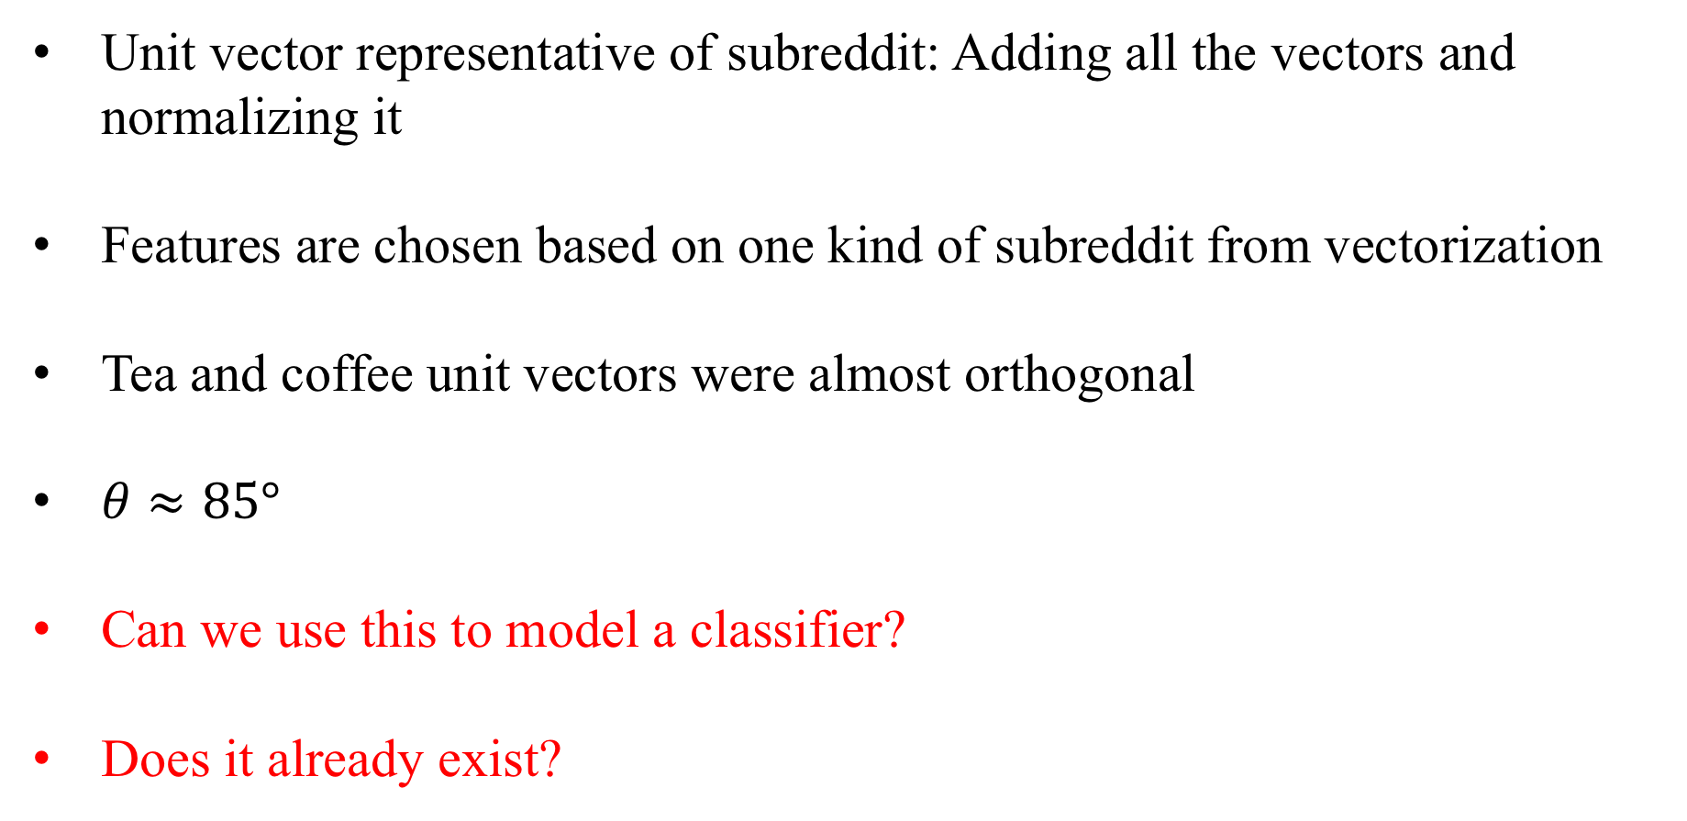
Alignment of vectors
Unit vector representative of subreddit: Adding all the vectors and normalizing it
Features are chosen based on one kind of subreddit from vectorization
Tea and coffee unit vectors were almost orthogonal
$θ≈85°$
Can we use this to model a classifier?
Does it already exist?

Slide 17
Thank you

