Slide 1
Optimization of Genetic Algorithm Computations through CUDA Parallel Processing
Aleksieienko Anastasiia
Supervisor: Senior Lecturer Sergii Medvid
NaUKMA, Department of Computer Science, 2026
Notes:
Dear committee members and attendees, I present to you a course paper on the topic: Optimization of Genetic Algorithm Computations through CUDA Parallel Processing.

Slide 2
Research Goal
Goal:
Investigate whether CUDA-based GPU parallelization can significantly accelerate
genetic algorithm operations compared to sequential CPU execution
Determine conditions under which acceleration becomes effective
Hypothesis:
Speedup scales with population size and fitness function complexity,
subject to Amdahl's Law and data transfer overhead
Notes:
The goal of this research is to investigate whether CUDA-based GPU parallelization can significantly accelerate genetic algorithm operations compared to sequential CPU execution, and to determine the conditions under which this acceleration becomes effective. The hypothesis states that speedup will scale with population size and fitness function complexity, subject to Amdahl's Law and data transfer overhead.

Slide 3
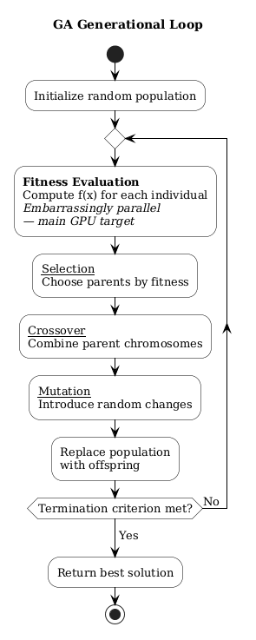
Overview of Known Approaches
Three categories of GPU-accelerated GA:
1. Native CUDA C/C++ kernels
2. High-level frameworks (EvoJAX, EvoTorch, EvoX)
3. Python-native CUDA via Numba (rarely studied)
Research gap (Semantic Scholar):
GPU-accelerated GAs: 28-39x less studied
than established optimization domains
Python-native kernel dev is particularly rare
Notes:
A review of existing approaches shows three categories of GPU-accelerated GA implementations: native CUDA C/C++ kernels, high-level framework abstractions like EvoJAX and EvoTorch, and Python-native CUDA development via Numba. Publication analysis on Semantic Scholar confirms that GPU-accelerated GAs are 28-39x less studied than established optimization domains, and Python-native kernel development is particularly rare. This gap motivates the investigation.

Slide 4
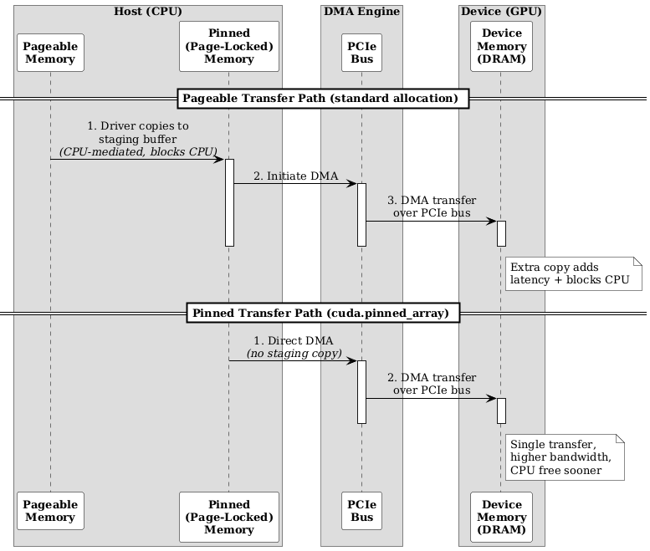
Proposed Method - CUDA Kernel Design
Thread mapping:
One thread = one individual
Per-generation complexity: O(n) -> O(1)
Four optimizations:
1. Shared Memory - cache read-only data (20x faster)
2. Persistent Device Buffers - population stays on GPU
3. Pinned Host Memory - direct DMA transfer
4. GPU-side RNG (Xoroshiro128p) - no CPU sync
Notes:
The proposed method develops custom CUDA kernels for all four GA operators using Python Numba JIT compilation. Each individual maps to one GPU thread, reducing per-generation fitness evaluation from O(n) to O(1). Four optimizations are applied: shared memory caches read-only data at 20x lower latency; persistent device buffers keep the population GPU-resident across generations, eliminating per-generation population transfers; pinned host memory enables direct DMA; and GPU-side RNG via Xoroshiro128p eliminates CPU-GPU synchronization for mutation.

Slide 5
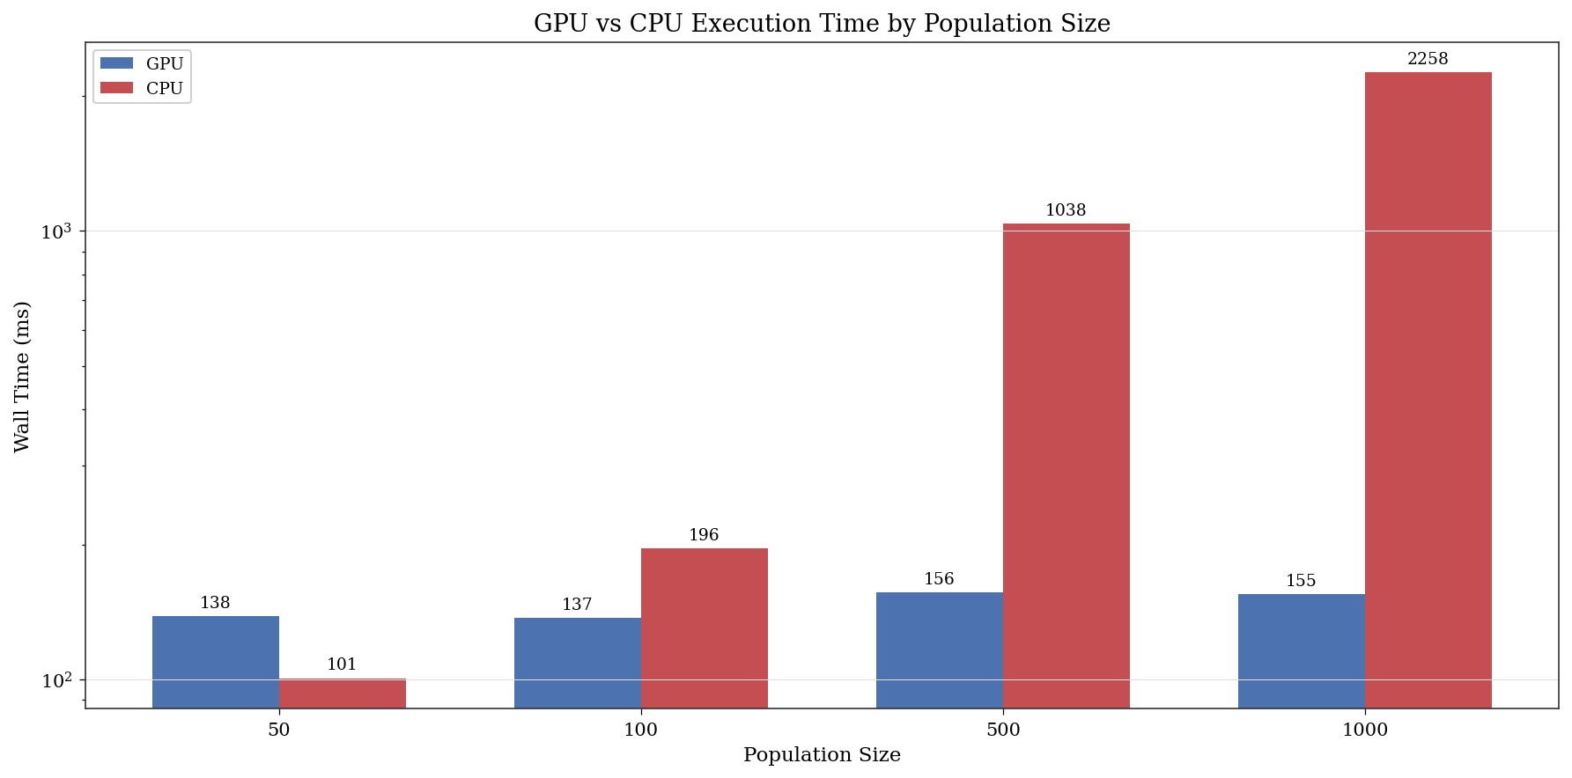
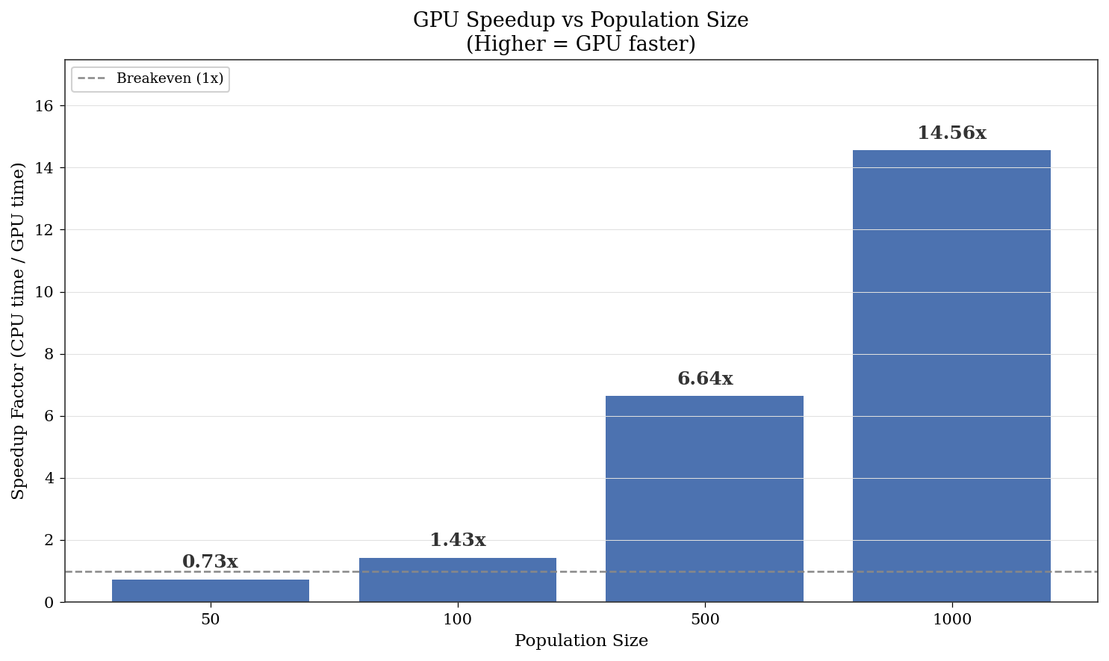
Application - XOR Perceptron Benchmark
Lightweight fitness function:
Breakeven at population ~100
14.56x speedup at population 1000
GPU scaling:
GPU time nearly constant (138-155 ms)
CPU time scales linearly (100-2,250 ms)
Notes:
The first benchmark is XOR perceptron training - a lightweight fitness function that isolates transfer and launch overhead. The GPU breaks even at population 100. At population 1000, speedup reaches 14.56x. GPU compute time stays nearly constant at 138-155 ms across a 20x population increase, while CPU time scales linearly from 100 to 2,250 ms. All differences are statistically significant.

Slide 6
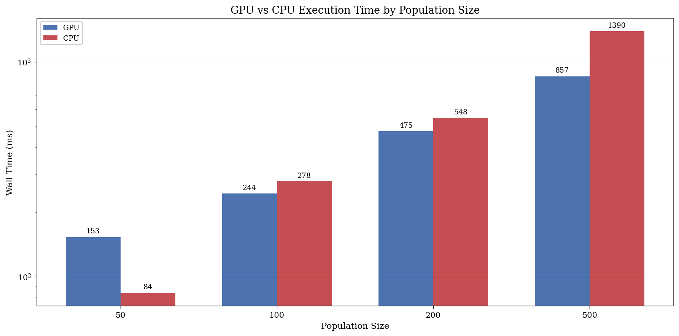
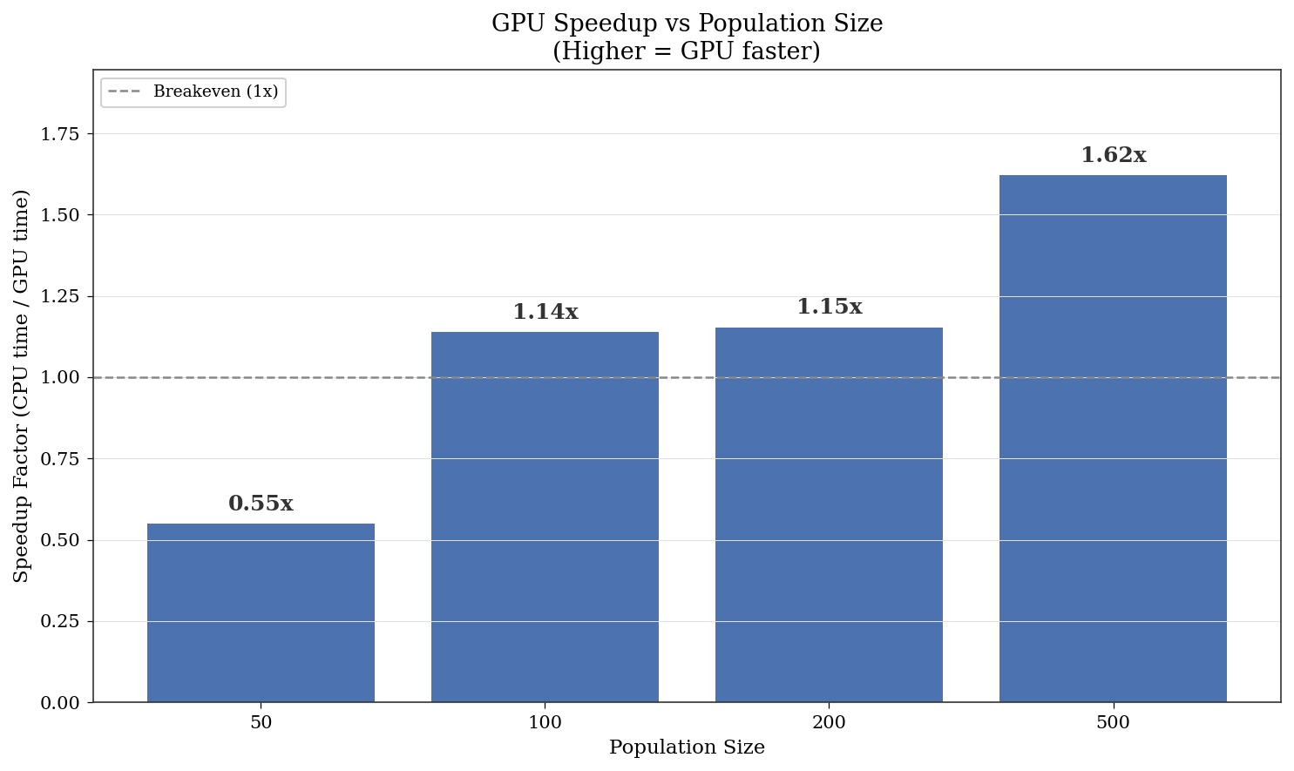
Application - Traveling Salesman Problem
Heavy fitness: O(n) per individual:
Up to 1.61x speedup at 200 cities
Better solution quality (p < 0.001)
Scaling pattern:
Larger city count widens GPU advantage
Confirms complexity-dependent speedup
Notes:
The second benchmark is the Traveling Salesman Problem with heavier O(n) fitness computation. Speedups reach 1.61x at 200 cities. The GPU also finds statistically better solutions. Increasing city count widens the GPU advantage even at fixed population sizes, confirming that speedup scales with fitness function complexity as hypothesized.

Slide 7
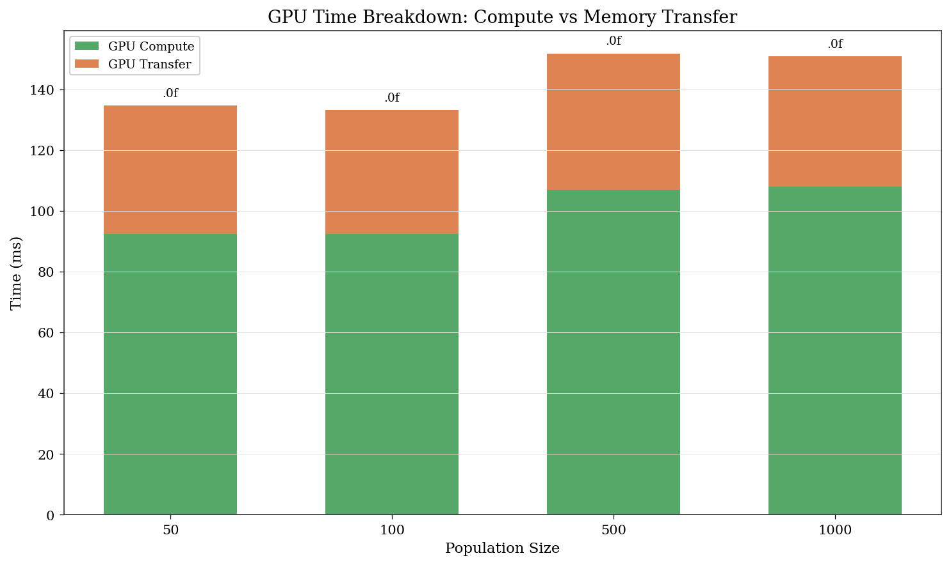
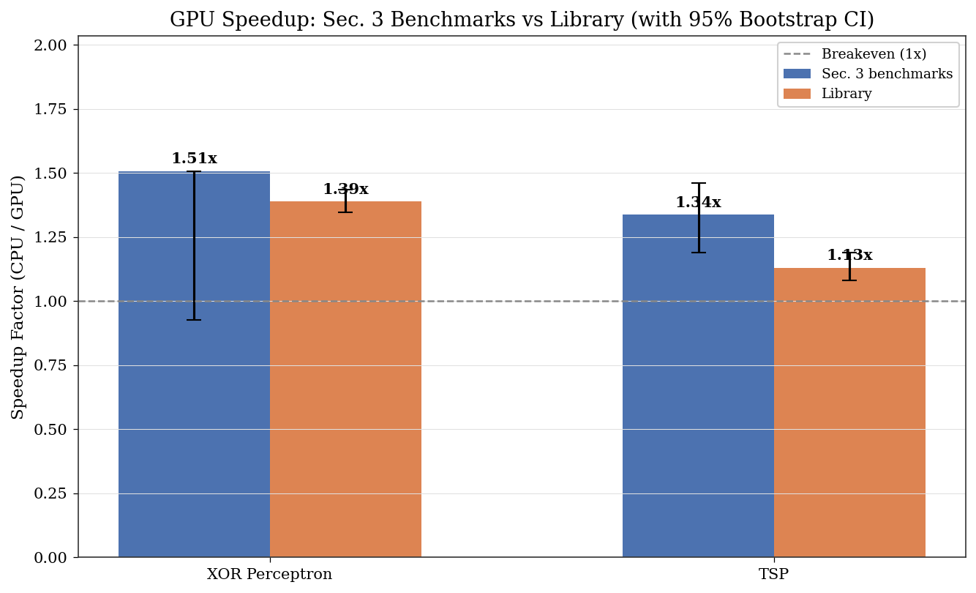
Comparison with Known Results
Key patterns:
Transfer overhead: 17-39% of GPU wall time (dominant bottleneck, not kernel computation)
Results align with Amdahl's Law: Speedup = 1 / ((1-P) + P/N)
Library validation confirms reproducibility with original benchmarks
Notes:
Comparison with literature confirms consistent patterns: the dominant bottleneck is host-device data transfer at 17-39% of GPU time, not kernel computation. Results align with Amdahl's Law predictions. The experimental code was refactored into a reusable library, and validation experiments confirmed statistical consistency with original benchmarks, confirming reproducibility.

Slide 8
Practical Significance
Open-source library: py-cuda-ga
Plug in your fitness function, get GPU acceleration
No need to write CUDA code
Example applications:
Delivery route optimization (TSP variant) -
thousands of routes evaluated in parallel
Neural architecture search -
each candidate network scored independently
Practical guidelines:
Use populations above 100 for GPU benefit
Keep data GPU-resident across generations
Cache read-only data in shared memory
Notes:
The practical output is an open-source Python library where you plug in your fitness function and get GPU acceleration without writing CUDA. For example: optimizing delivery routes for a fleet of vehicles - a TSP variant where evaluating thousands of candidate routes in parallel cuts optimization time from minutes to seconds. Or training a neural network's architecture through evolution, where each candidate network needs a full forward pass to score - exactly the kind of independent, repeated computation GPUs excel at. The library handles memory management, kernel launch, and RNG. Practical guidelines from this work: use populations above 100 for GPU benefit, keep data GPU-resident, cache read-only data in shared memory.

Slide 9
What This Work Adds
1. Empirical data on GPU vs CPU scaling with population size
O(1) vs O(n) pattern confirmed with statistical tests
2. Practical breakeven threshold identified for entry-level mobile GPU
3. A data point for an underexplored area:
Python-native Numba kernels for genetic algorithms
Hypothesis: Confirmed
Speedups: 1.15x to 14.56x | All results significant (p < 0.05, d > 0.8)
Notes:
In terms of what this work contributes: first, the experiments provide empirical data on how GPU and CPU execution times scale differently with population size, confirming the O(1) vs O(n) pattern with statistical tests. Second, the results help identify a practical breakeven threshold for entry-level mobile GPU hardware. Third, since Python-native Numba kernels for genetic algorithms are rarely benchmarked in the literature, this work adds a data point to that gap.

Slide 10
Future Research
Directions:
Fully GPU-resident evolutionary loop (eliminate per-generation transfers)
Multi-objective optimization kernels
Higher-end hardware (lower breakeven threshold)
Adaptive operator selection on GPU
Thank you for your attention!
Notes:
Future research directions include fully GPU-resident evolutionary loops to eliminate per-generation transfers, multi-objective optimization kernels, testing on higher-end hardware where the breakeven threshold should shift lower, and adaptive operator selection on GPU. The presentation is complete. Thank you for your attention!

