Slide 1


Implementation and Defense Against
Adversarial Attacks in Image Classification
Model
Presented by
Umesh Kumar
23MT0430
Under Supervision
Of
Prof. Rajendra Pamula

Slide 2
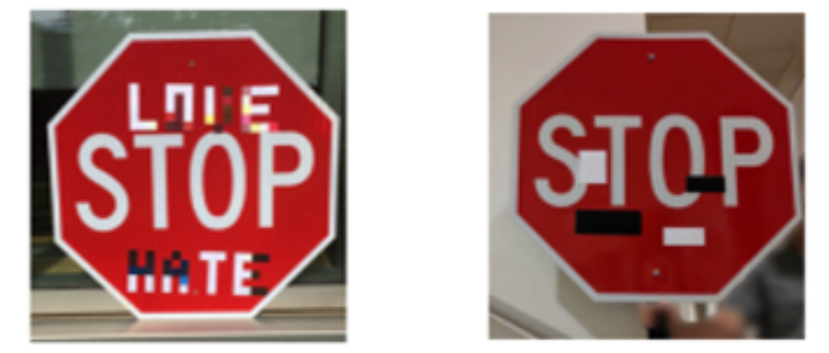
ADVERSARIAL ATTACKS
Small, intentional perturbations to input images designed
to mislead machine learning models.
These perturbations are often imperceptible to the
human eye but can significantly impact model predictions.

Slide 3
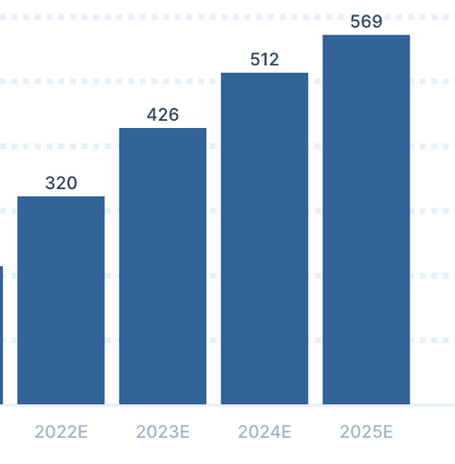
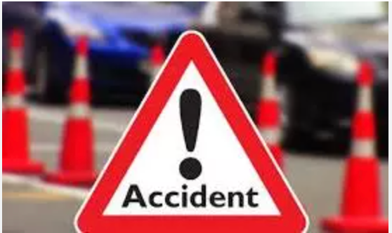
Impact On Real Life
Autonomous vehicle operation an incorrect identification of
traffic signs can produce severe accidents.
Incorrect image classifications within medical scenarios could
cause the misdiagnosis along with improper treatment methods.
US 2022 - 25

Slide 4
PROBLEM STATEMENT
This project aims to explore the effectiveness of adversarial attacks, specifically the Fast Gradient Sign Method (FGSM), on a deep learning based image classification model
Implimenting and Testing Defense mechanisms to enhance model robustnes
The problem addressed is two fold:
1) Evaluating Vulnerability
2) Implimenting and Testing Defenses

Slide 5
Proposed Work
Evaluating Vulnerability :
FGSM Attack
Implimenting and Testing Defenses :
Adversarial Training
Defense Layer (DefendedModel)
Noise Injection Techniques
Multiple Epsilons Training

Slide 6
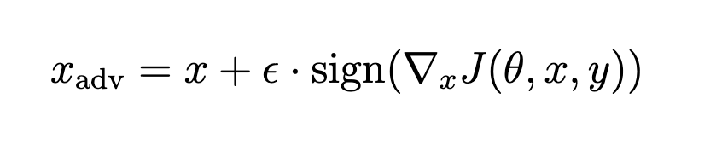
Adversarial Attack -
FGSM
Generates adversarial examples by adding noise in the direction of the gradient.
Formula: perturbed_image = original_image + epsilon *sign(data_grad)
Epsilon controls the attack strength (i.e., perturbation level).

Slide 7
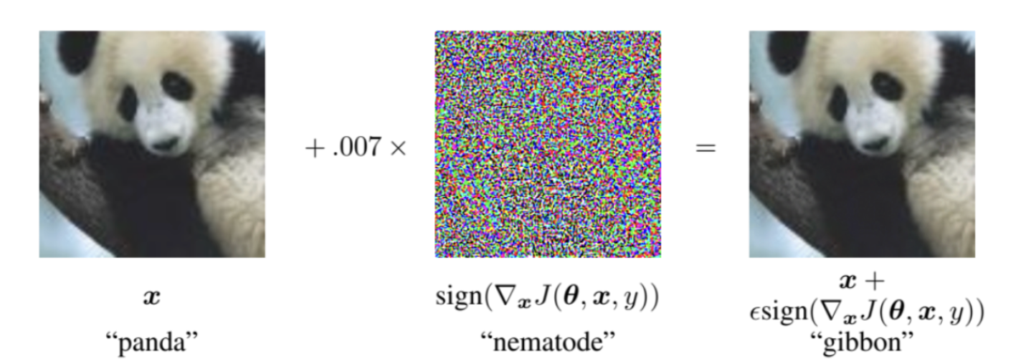
Example of FGSM attack.
Adding a small perturbation with ϵ = 0.007 in panda image encoding successfully causes misclassification, while remaining imperceptible to the human eye.

Slide 8
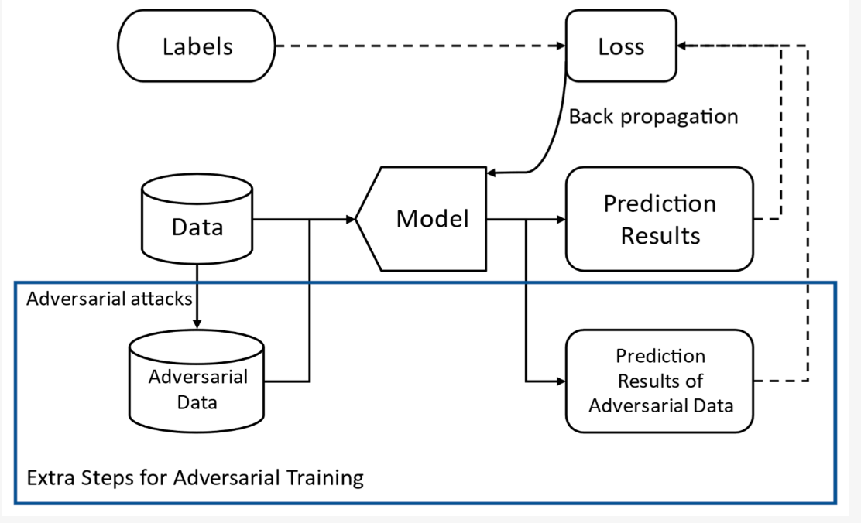
Adversarial Defense Using Adversarial Train-
ing

Slide 9
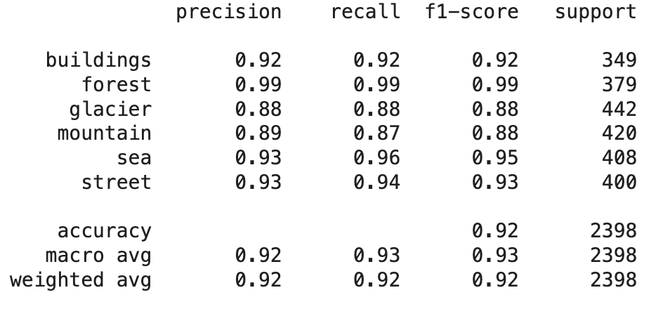
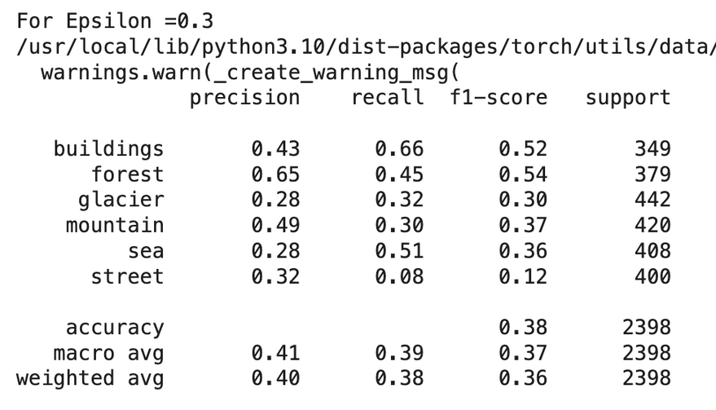
Results After Adversarial Training
Accuraccy of ResNet-34 before Attack
Accuraccy of ResNet-34 After Attack

Slide 10
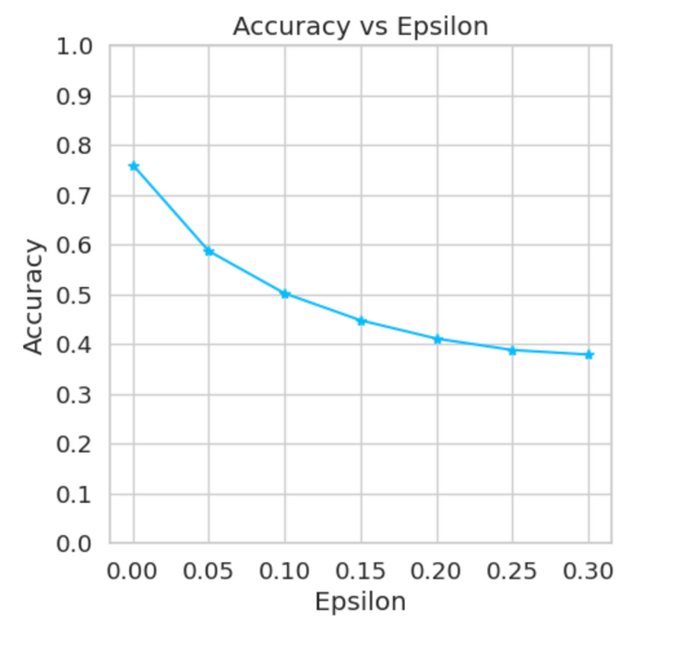
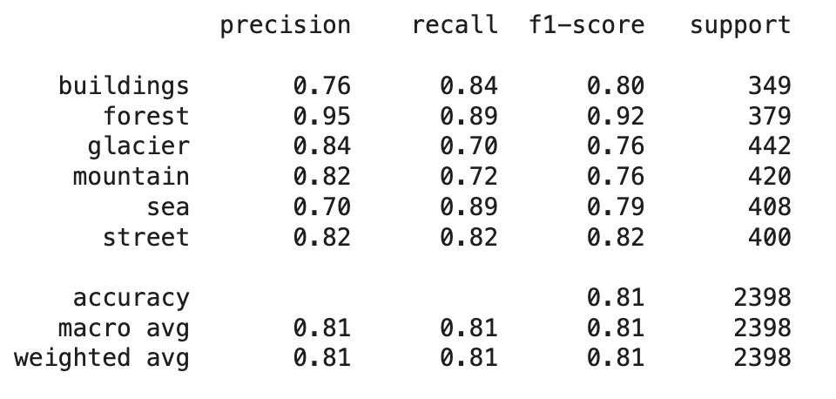
Accuracy vs Epsilon
Accuracy After Adversarial Training

Slide 11
Problem With Adversarial Training
More than one training.
Wastage of resources(GPUs).
Time taking
Hard to tune(epsilon value).

Slide 12
Adversarial Defense Using Noise Injection
It aim to harden the model during training
One time training
Noise Injection Techniques
Random Gaussian Noise (RGN): helps models to generalize better even under minor distortions
Stochastic Motion Blur (SMB): make models less sensitive to sharp changes or small perturbations.
Stochastic Glass Blur (SGB): remove adversarial patterns that depend on fine pixel arrangements.

Slide 13
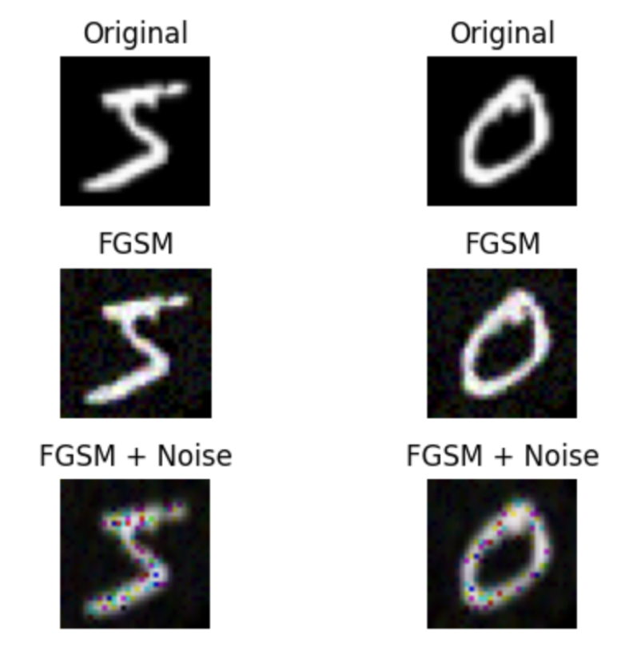
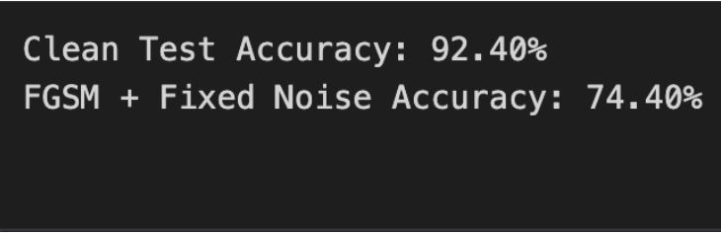
Images After FGSM And Noise Injection.
Accuracy After Noise Injection.

Slide 14
Defense Layers
Clean the inputs before feeding to the CNN model
One time training
Various techniques are :
Using Gaussian Blur: Smooths the image by averaging pixels with their neighbors using a Gaussian kernel.
Using JPEG Compression: Compresses the image using JPEG format and then decompresses it back.
Using Median Filtering (Input Denoising): Each pixel is replaced by the median of its neighboring pixels.

Slide 15
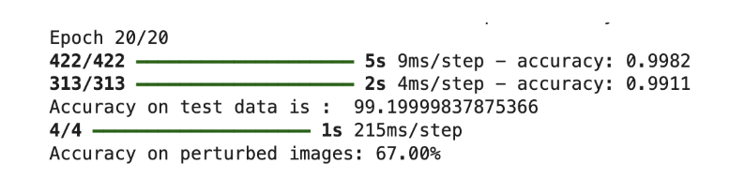
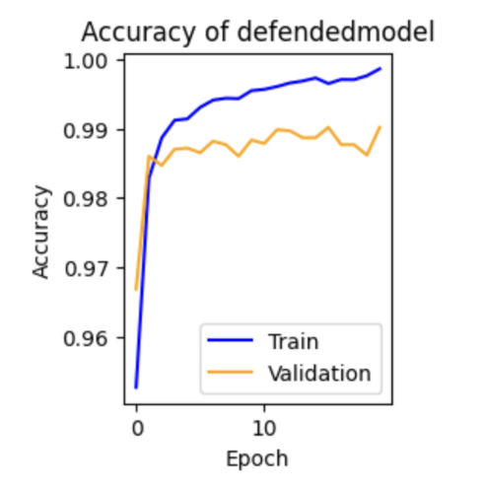
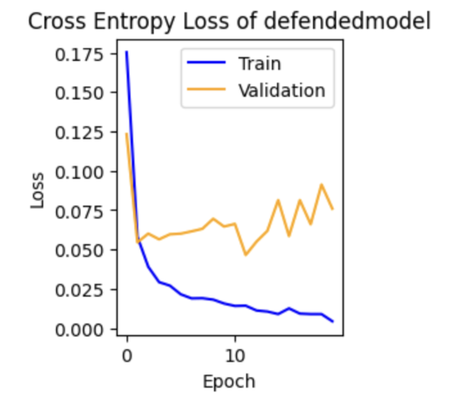
DefendedModel Accuracy
Accuracy vs Epoch
Loss vs Epoch

Slide 16
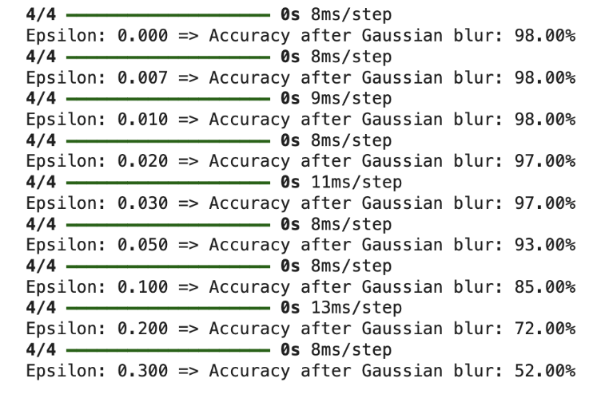
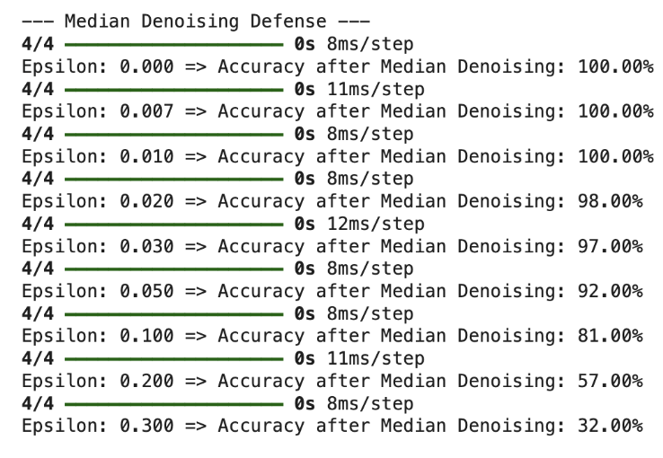
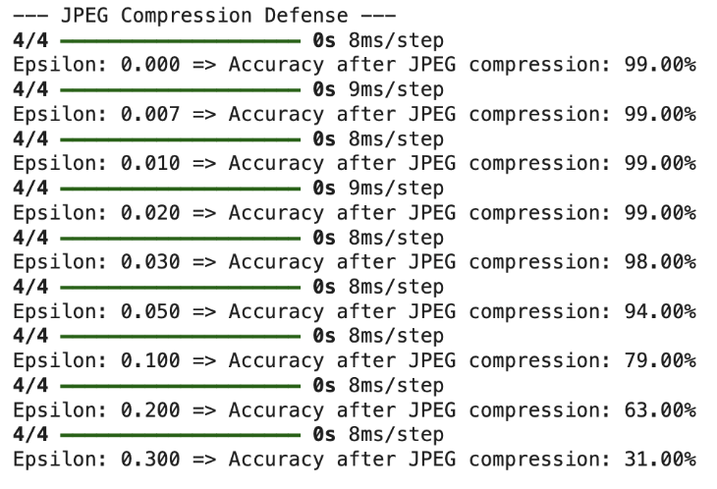
Using GaussianBlur
Defense Layer
Using Median Denoising Defense Layer
Using JPEGCompression Defense Layer

Slide 17
Training with Multiple Epsilons
Rather than using a single, fixed perturbation strength ϵ, adversarial samples were generated using multiple epsilon values
Values used are ϵ ∈ {0.01, 0.05, 0.1, 0.2, 0.3}.
This approach led to a substantial improvement in the model’s robustness to adversarial attacks, particularly in the lower to mid-range epsilon values (e.g., 0.01–0.1).
Compared to the baseline model, the accuracy showed less significant degradation for higher epsilon values

Slide 18
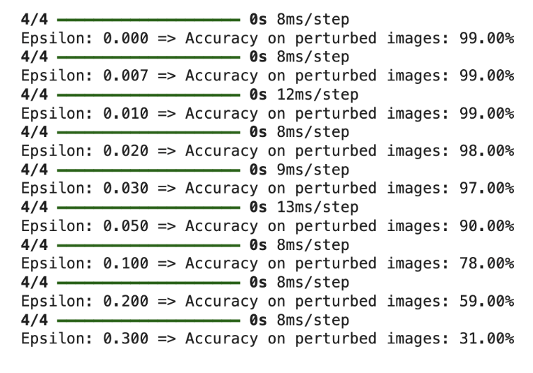
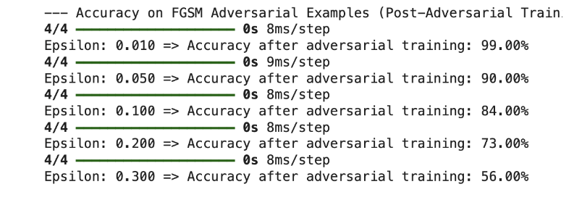
Accuracy After Epsilon Training
Accuracy On Various Epsilon

Slide 19
Comparisions Among Defences
Technique | Accuracy
WITHOUT ATTACK | 92%
FGSM ATTACK | 38%
ADVERSEARIAL TRAINING | 81%
USING GAUSSIAN BLUR (eps = 0.1) | 85%
USING JPEG COMPRESSION (eps = 0.1) | 81%
USING MEDIAN FILTERING (Input Denoising) (eps = 0.1) | 79%
NOISE INJECTION | 74%
EPSILON TRAINING | 84%

Slide 20
Future Scope
More advanced and stronger attacks, including PGD, DeepFool
Design of adaptive or learnable defensive schemes that have the capabilityof responding to varied perturbations dynamically
Experimenting on these defense strategies with larger and more diverse sets, e.g., CIFAR-10, CIFAR-100, or domain-specific datasets
Deploying these methods in federated learning settings may provide solutions to practical security issues

Slide 21
Thank you

