Slide 1
Spring Framework

Slide 2
Introduction to Spring Framework
The Spring Framework is an open source application development framework
Spring Provides comprehensive infrastructural support for developing enterprise Java applications very easily
Spring is a lightweight framework. It can be thought of as a framework of frameworks because it provides support to various frameworks such as Struts, Hibernate, EJB, JSF etc.
The spring framework was designed by Rod Johnson.

Slide 3
Benefits of Using Spring Framework
Develop enterprise-class applications using POJOs
Spring makes use of some of the existing technologies like ORM frameworks, Logging frameworks, JEE, JDK Timers etc..
Good web MVC framework
Nice technical api exception handling
Best Transaction Management
Light weight comparing EJBs
Provides good Testing support
Good security and logging service etc

Slide 4
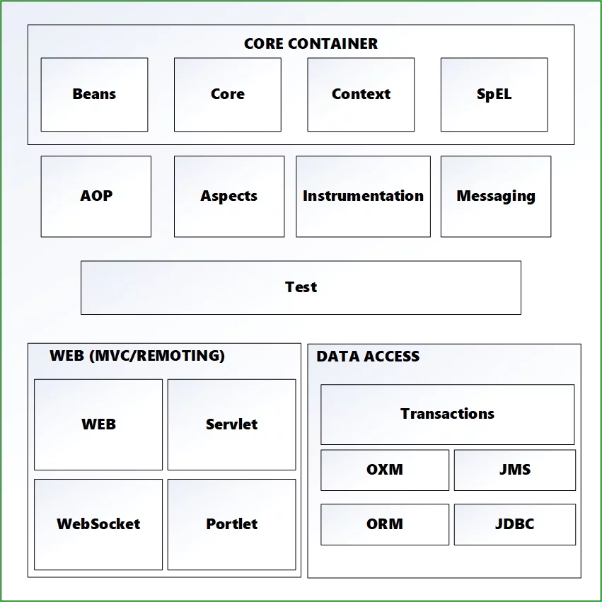
Spring Framework Architecture

Slide 5
Core Components
The SpEL module provides a powerful expression language for manipulating objects during execution.
Context is built on the basis of Beans and Core and allows you to access any object that is defined in the settings. The key element of the Context module is the ApplicationContext interface.
The Core module provides key parts of the framework including IoC and DI properties.
The Bean module is responsible for creating and managing Spring Beans – is application context structure unit.

Slide 6
Web Components
The Web module provides functions such as as multipart file-upload functionality, downloading files, creating web application, rest web service etc.
Web-MVC contains a Spring MVC implementation for web applications.
Web-Socket provides support for communication between the client and the server, using Web-Sockets in web applications.
Web-Portlet provides MVC implementation with portlet environment

Slide 7
Data Access
JDBC provides an abstract layer of JDBC and eliminates the need for the developer to manually register the monotonous code associated with connecting to the database.
Spring ORM provides integration with popular ORMs such as Hibernate, JDO, which are implementations of JPA.
The OXM module is responsible for linking the Object / XML – XMLBeans, JAXB, etc.
The JMS (Java Messaging Service) module is responsible for creating, sending and receiving messages.
Transactions supports transaction management for classes that implement certain methods and POJOs.

Slide 8
AOP, Aspects and Instrumentation
These modules support aspect oriented programming implementation where you can use Advices, Pointcuts etc. to decouple the code.
The aspects module provides support to integration with AspectJ.
Test
This layer provides support of testing with JUnit and TestNG.

Slide 9
Spring Core Concepts
Inversion of Control – this is the principle of object-oriented programming, in which objects of the program do not depend on concrete implementations of other objects, but may have knowledge about their abstractions (interfaces) for later interaction.
Dependency Injection – The technology that Spring is most identified with is the Dependency Injection (DI) flavor of Inversion of Control. The Inversion of Control (IoC) is a general concept, and it can be expressed in many different ways. Dependency Injection is merely one concrete example of Inversion of Control.
Aspect oriented programming – a programming paradigm that allows you to distinguish cross-through (functional) functionality in application. These functions, which span multiple application nodes, are called cross-cutting concerns and these cross-cutting notes are separated from the immediate business logic of the application. In OOP, the key unit is the class, while in AOP, the key element is the aspect. DI helps to separate application classes into separate modules, and AOP helps to separate cross-cutting concerns from the objects they affect

Slide 10
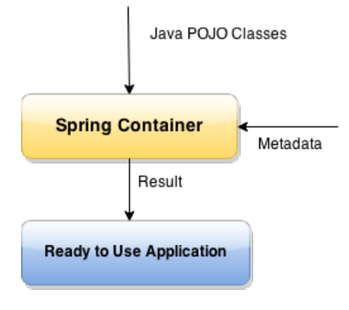
IoC Container
The core of the Spring Framework is its Inversion of Control (Ioc) container.
The container will create the objects, wire them together, configure them, and manage their complete lifecycle from creation till destruction
It is responsible
to instantiate the application class
to configure the object
to assemble the dependencies between the objects
Types of IoC containers are:
BeanFactory
ApplicationContext

Slide 11
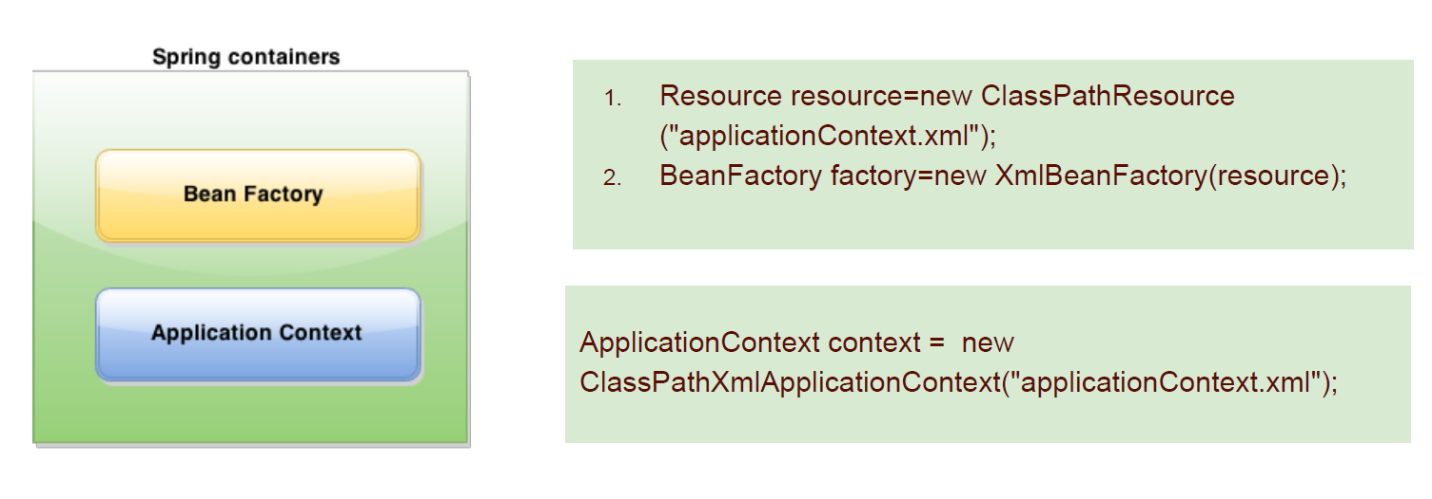
Contd..

Slide 12
Dependency Injection
It is a design pattern that removes the dependency from the programming code so that it can be easy to manage and test the application.
Dependency Injection makes our programming code loosely coupled.
The basic concept of the dependency injection (also known as Inversion of Control pattern) is that you do not create your objects but describe how they should be created.

Slide 13
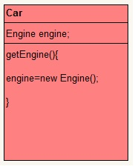
Normal Way:
There are many ways to instantiate a object.
So here Car class contain object of Engine and we have it instantiated using new operator.
Without DI

Slide 14
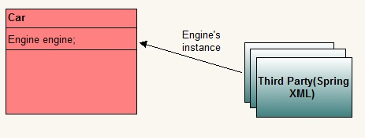
With help of Dependency Injection:
Car needs object of Engine to operate but it outsources that job to some third party.
The designated third party, decides the moment of instantiation and the type to use to create the instance.
The dependency between class Car and class Engine is injected by a third party.
Whole of this agreement involves some configuration information too. This whole process is called dependency injection.
With DI

Slide 15
Dependency Injection
Spring framework provides two ways to inject dependency
By Constructor: Constructor-based DI is realized by invoking a constructor with a number of arguments, each representing a collaborator.
By Setter method: Setter-based DI is realized by calling setter methods on your beans after invoking a no-argument constructor or no-argument static factory method to instantiate your bean.

Slide 16
Constructor vs Setter injection
Partial dependency: can be injected using setter injection. Suppose there are 3 properties in a class, having 3 arg constructor and setters methods. In such case, if you want to pass information for only one property, it is possible by setter method only.
Overriding: Setter injection overrides the constructor injection. If we use both constructor and setter injection, IOC container will use the setter injection.
Changes: We can easily change the value by setter injection. It doesn't create a new bean instance always like constructor. So setter injection is flexible than constructor injection.

Slide 17
Spring Bean scopes
A bean is an object that is instantiated, assembled, and otherwise managed by a Spring IoC container.
In Spring, bean scope is used to decide which type of bean instance should be return from Spring container back to the caller.
singleton – Scopes a single bean definition to a single object instance per Spring IoC container.
prototype – Return a new bean instance each time when requested
request – Return a single bean instance per HTTP request.
session – Return a single bean instance per HTTP session.
globalSession – Return a single bean instance per global HTTP session.
In many cases, spring’s core scopes i.e. singleton and prototype are used. By default scope of beans is singleton.

Slide 18
Spring Configuration
There are two ways via which you can inject dependency in spring
By configuring XML.
By using annotation.
If you have done both i.e. used annotations and XML both. In that case, XML configuration will override annotations because XML configuration will be injected after annotations.
Annotations based configuration is turned off by default so you have to turn it on by entering into spring XML file.
<context:annotation-config/>
<!-- beans declaration goes here -->
</beans>

Slide 19
Annotation based Configuration
@Required:
The @Required annotation applies to bean property setter methods.
@Autowired:
The @Autowired annotation can apply to bean property setter methods, non-setter methods, constructor and properties.
@Qualifier:
The @Qualifier annotation along with @Autowired can be used to remove the confusion by specifiying which exact bean will be wired.

Slide 20
Autowiring
Autowiring feature of spring framework enables you to inject the object dependency implicitly.
To enable it, just define the “autowire” attribute in.
The Spring container can autowire relationships between collaborating beans without using and elements which helps cut down on the amount of XML configuration
It internally uses setter or constructor injection.
Autowiring can't be used to inject primitive and string values. It works with reference only.

Slide 21
Autowiring modes
no: Default, no auto wiring, set it manually via “ref” attribute as we have done in dependency injection via settor method post.
byName: Autowiring by property name. Spring container looks at the properties of the beans on which autowire attribute is set to byName in the XML configuration file and it tries to match it with name of bean in xml configuration file.
byType: Autowiring by property datatype. Spring container looks at the properties of the beans on which autowire attribute is set to byType in the XML configuration file. It then tries to match and wire a property if its type matches with exactly one of the beans name in configuration file. If more than one such beans exists, a fatal exception is thrown.
contructor: byType mode in constructor argument.
autodetect: Spring first tries to wire using autowire by constructor, if it does not work, Spring tries to autowire by byType.

Slide 22
Spring JDBC Template
It is a mechanism to connect to the database and execute SQL queries
JDBC Template class:
It is the central framework class that manages all the database communication and exception handling.
It takes care of creation and release of resources such as creating and closing of connection object etc.
So it will not lead to any problem if you forget to close the connection.

Slide 23
Spring MVC
Spring MVC framework is a robust Model view controller framework which helps us to develop a loosely coupled web application. It separates different aspects of web applications with the help of MVC architecture.
Model: Model carries application data. It generally includes POJO in the form of business objects
View: View is used to render User interface (UI). It will render application data on UI. For example JSP
Controller: Controller takes care of processing user request and calling back end services.

Slide 24
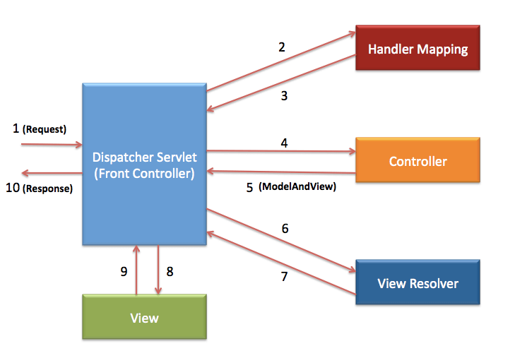
Spring MVC workflow

Slide 25
Spring MVC workflow
The request will be received by Front Controller i.e. DispatcherServlet.
DispatcherServlet will pass this request to HandlerMapping. HandlerMapping will find suitable Controller for the request
HandlerMapping will send the details of the controller to DispatcherServlet.
DispatcherServlet will call the Controller identified by HandlerMapping. The Controller will process the request by calling appropriate method and prepare the data. It may call some business logic or directly retrieve data from the database.
The Controller will send ModelAndView(Model data and view name) to DispatcherServlet.
Once DispatcherServlet receives ModelAndView object, it will pass it to ViewResolver to find appropriate View.
ViewResolver will identify the view and send it back to DispatcherServlet.
DispatcherServlet will call appropriate View identified by ViewResolver.
The View will create Response in form of HTML and send it to DispatcherServlet.
DispatcherServlet will send the response to the browser. The browser will render the html code and display it to end user.

