Slide 1
INTRODUCTION
INTRODUCTION
Git is a distributed version control system that tracks changes in any set of computer files used for coordinating work among programmers developing source code during software development.
Its goals include speed, data integrity, and support for distributed, non-linear workflows (thousands of parallel branches running on different computers).
Git was originally authored by Linus Torvalds in 2005 for development of the Linux kernel .Since 2005, Junio Hamano has been the core maintainer.

Slide 2
As with most other distributed version control systems, and unlike most client–server systems.
All Git directory on every computer is a full-fledged repository with complete history and full version-tracking abilities, independent of network access or a central server.
Git is free and open-source software shared under the GPL-2.0-only license.
it has become the most popular distributed version control system, with nearly 95% of developers reporting it as their primary version control system as of 2022.
There are many popular offerings of Git repository services, including GitHub, SourceForge, Bitbucket and GitLab.

Slide 3
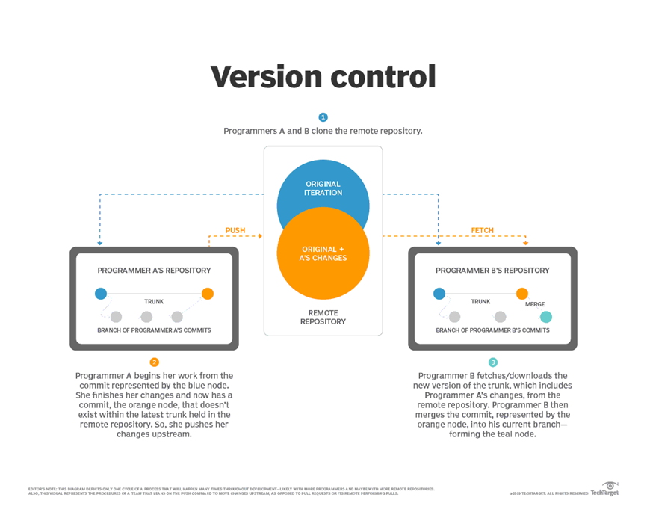

Slide 4
Git Providers
These are the following Git providers for storing your repository code:
Bitbucket Cloud
Bitbucket Server
GitHub
GitLab

Slide 5
Bitbucket Cloud
Bitbucket Cloud (previously known as Bitbucket) is written in Python using the Django web framework.
Bitbucket is mostly used for code and code review. Bitbucket supports the following features:
Pull requests with code review and comments.
Bitbucket Pipelines, a continuous delivery service.
Two-step verification and required two-step verification.
IP whitelisting.

Slide 6
Merge Checks.
Code search (Alpha).
Git Large File Storage (LFS).
Documentation, including automatically rendered README files in a variety of Markdown-like file formats
Issue Tracking.
Static sites hosted on Bitbucket Cloud: Static websites have the bitbucket.io domain in their URL.
Add-ons and integrations.
REST APIs to build third-party applications which can use any development language.
Snippets that allow developers to share code segments or files.
Smart Mirroring.

Slide 7
Bitbucket Server
Bitbucket Server (formerly known as Stash) is a combination Git server and web interface product written in Java and built with Apache Maven.
It allows users to do basic Git operations (such as reviewing or merging code, similar to GitHub) while controlling read and write access to the code and provides integration with other Atlassian tools.
It is a commercial software product that can be licensed for running on-premises.
Atlassian provides Bitbucket Server for free to open source projects meeting certain criteria, and to organizations that are non-profit, non-government, non-academic, non-commercial, non-political, and secular.

Slide 8
GitHub
GitHub is a subsidiary of Microsoft, is a for-profit company that offers a cloud-based Git repository hosting service.
It houses over 100 million repositories, making it the largest host of source code globally.
GitHub offers a plethora of features that facilitate collaborative coding and project management with an interface user-friendly enough that it can compete in the GitHub vs GitLab duel.

Slide 9
GitLab
GitLab is an open source Git repository management and collaboration tool created in 2011.
The GitLab project was started by Ukrainian developers, Dmytro Zaporozhets and Valeriy Sizov, and today is one of the world’s largest all-remote companies.
It is known for its comprehensive DevSecOps platform with built-in version control, issue tracking, and CI/CD pipelines, covering the entire software development lifecycle.

