Slide 1


Some Models of Tool Path Optimization Problem for Sheet Metal Cutting Machines
Alexander Petunin, Eugeny Ivanko, Efim Polishuk, Pavel Chentsov, Stanislav Ukolov
IX International Conference
“Optimization and Applications”
OPTIMA 2018
Petrovac, Montenegro
October, 1st-5th
Notes:
1

Slide 2
Abstract
1. Statement of the problem of cutter head path optimization for the computer numerical control (CNC) sheet metal cutting equipment. Objective function (time of cutting and cost of cutting).
2. Classification of tool path optimization problems (CCP, ECP, ICP, GTSP). Classification of cutting techniques.
3. Mathematical formalization for tool path problem based on the concept of cutting segment. Extending of the tool path problem classification (SCCP).
4. Generalized SCCP.
5. Development of new algorithms:
5.1. Exact algorithm for GTSP case using special scheme of dynamic programming. Heuristic algorithm for GTSP case with additional constraints.
5.2. Approximate algorithm for SCCP case.
5.3. Approximate algorithm for ECP case (method allowing to reduce the tool path problems that do not include embedded contours and allow partial cutting to the TSP with a special distance matrix).

Slide 3
NC program development
Development of NC programs for CNC sheet cutting machine includes two optimization problems:
Nesting: placement of parts onto plate
2)Tool path problem: tool path routing and choosing tool path according to some optimization criteria

Slide 4
Tool path components
Lead-out
1
3
Lead-in
2
Initial point
Pierce point
Contour entry point
Tool switching off point
Airtime motion
Cutting segments

Slide 5
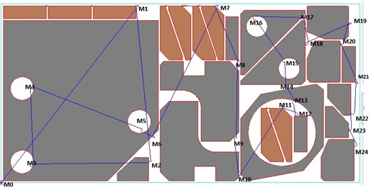


Definition of tool path (route)
Parts:
$A_{1},A_{2},$ … $A_{n}⊂ℝ^{2};i=\overline{1, n}$
Closed contours:
$C_{1},C_{2},$ … $C_{N}⊂ℝ^{2};j=\overline{1, N};N≥n$
Tool path components:
$M_{k}$ - pierce points, $k=\overline{1, K}$
${M^{0}}_{k}^{}$ - segment entry points
$M^{∗}$ - tool off points
Definition 1: Cutting segment $S_{k}$ is trajectory between pierce point $M_{k}$ and tool off point ${M^{∗}}_{k}^{}.$ $S_{k}⊂ℝ^{2};k=\overline{1, K}$
Note: Segment $S_{k}$ has a direction at every point.
Definition 2: $Route= \left\langle M_{1}S_{1}M_{1}^{∗},M_{2}S_{2}M_{2}^{∗}, …M_{K}S_{K}M_{K}^{∗},i_{1},i_{2}, …i_{K}\right\rangle$,
where $i_{1},i_{2}, …i_{K}$ - sequence of segments cutting.
Petunin, Aleksandr A. (2015). Modeling of tool path for the CNC sheet cutting machines// AIP conference proceedings. 41st International Conference on Applications of Mathematics in Engineering and Economics (AMEE), Sozopol, BULGARIA, JUN 08-13, 2015, 1690., pp.060002-1 – 060002-7.
Example of route containing 24 cutting segments
n = 24, N = 30, K = 24
Brown parts are cut by one segment

Slide 6
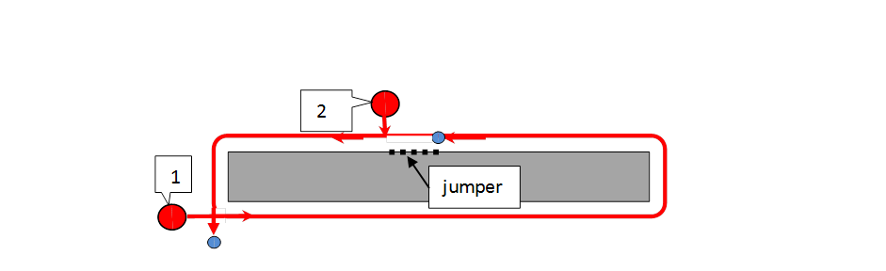
Cutting techniques
2
Standard cutting (every closed contour is in its own cutting segment)
Multi-contour cutting (some segments contain several contours)
Multi-segment cutting (one contour is cut by several cutting segments)
1
Chain cutting
1
2
Snake cutting
6
5
Jumper cutting
3
7
8
4
1
Bridge cutting
9
Common edge cutting

Slide 7

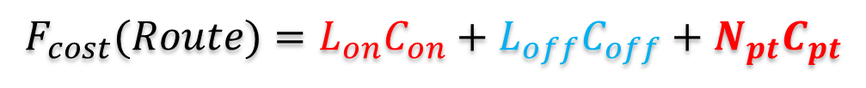
Objective functions
Cutting cost
$$F_{cost}(Route)=L_{on}C_{on}+L_{off}C_{off}+N_{pt}C_{pt}$$
Cutting time
$$t_{cut}(Route)=\frac{L_{off}}{V_{off}}\text{+} \frac{L_{on}}{V_{on}}+N_{pt}t_{pt}$$
Where:
L_{off} – Length of airtime motion
L_{on} – Length of cutting segments
C_{on} – Cost of airtime motion unit
C_{off} – Cost of cutting unit
C_{pt} – Piercing cost
V_{off} – Speed of airtime motion
V_{on} – Speed of cutting
N_{pt} – Number of piercing points
t_{pt} – Time of piercing
1
3
2
Initial point

Slide 8
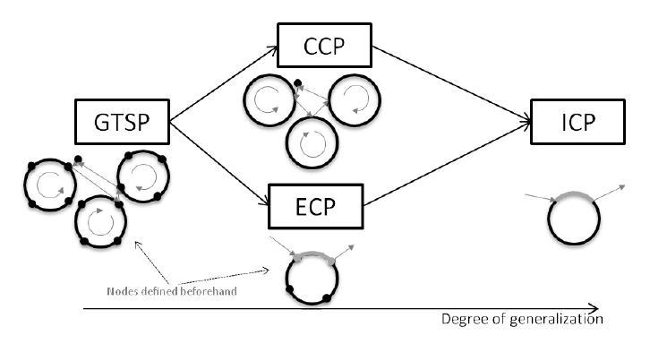
Problem classification
CCP: Continuous Cutting Problem
ECP: Endpoint Cutting Problem
ICP: Intermittent Cutting Problem
GTSP: Generalized Traveling Salesman Problem
Dewil, R., Vansteenwegen, P., Cattrysse, D. (2014) Construction heuristics for generating tool paths for laser cutters. International Journal of Production Research, Mar. 2014, 1-20.

Slide 9
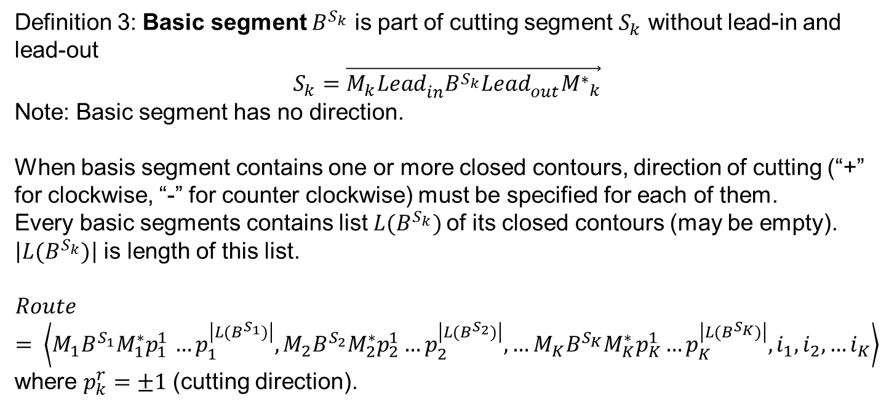
Mathematical formalization
Definition 3: Basic segment $B^{S_{k}}$ is part of cutting segment $S_{k}$ without lead-in and lead-out
$$S_{k}=\vec{M_{k}{{Lead}_{in}^{}B}^{S_{k}}{Lead}_{out}^{}{M^{∗}}_{k}^{}}$$
Note: Basic segment has no direction.
When basis segment contains one or more closed contours, direction of cutting (“+” for clockwise, “-” for counter clockwise) must be specified for each of them.
Every basic segments contains list ${L(B}^{S_{k}})$of its closed contours (may be empty). $\left|{L(B}^{S_{k}})\right|$ is length of this list.
$$Route= \left\langle M_{1}B^{S_{1}}M_{1}^{∗}p_{1 }^{1}…p_{1}^{\left|{L(B}^{S_{1}})\right|},M_{2}B^{S_{2}}M_{2}^{∗}p_{2}^{1}…p_{2}^{\left|{L(B}^{S_{2}})\right|}, …M_{K}B^{S_{K}}M_{K}^{∗}p_{K}^{1}…p_{K}^{\left|{L(B}^{S_{K}})\right|},i_{1},i_{2}, …i_{K}\right\rangle$$
where $p_{k}^{r}=±1$(cutting direction).

Slide 10
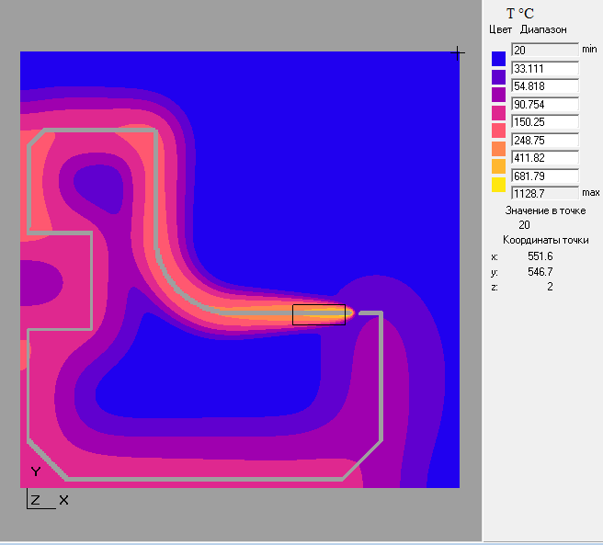
Technological constraints
$$Route=$$
$$\left\langle M_{1}B^{S_{1}}M_{1}^{∗}p_{1 }^{1}…p_{1}^{\left|{L(B}^{S_{1}})\right|},M_{2}B^{S_{2}}M_{2}^{∗}p_{2}^{1}…p_{2}^{\left|{L(B}^{S_{2}})\right|}, …M_{K}B^{S_{K}}M_{K}^{∗}p_{K}^{1}…p_{K}^{\left|{L(B}^{S_{K}})\right|},i_{1},i_{2}, …i_{K}\right\rangle$$
Static ones:
Precedence constraint
Piercing points coordinates
…
Dynamic ones:
Part Hardness Rule
Sheet Hardness Rules
…
Thermal deformations

Slide 11

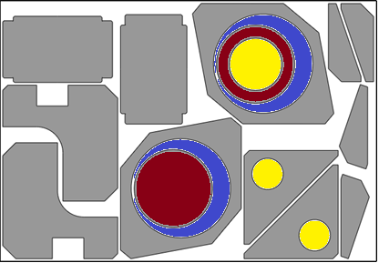

Precedence constraint
When the external contour contains one or more internal contour(s), that external contour must be cut after the cutting of all internal contours
If the internal contour of part contains the external contour(s) of another part(s), then the latter parts should be cut first
Permutation:
$$I=\left\{i_{1}, i_{2}, … i_{K}\right\}$$
Yellow
Red
Blue
Gray

Slide 12
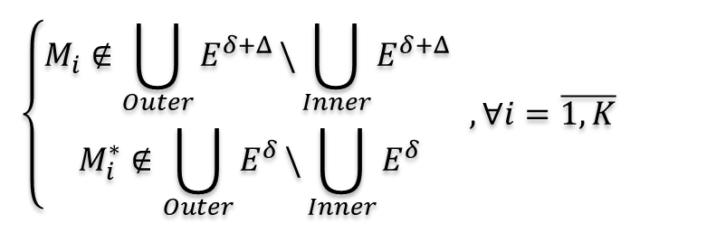
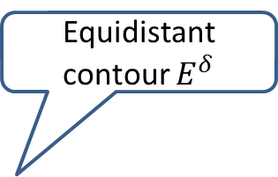
Piercing constraint
Equidistant contour $E^{δ}$
$$\left\{\begin{aligned}M_{i}∉\bigcup_{Outer}{E^{δ+Δ}}\backslash \bigcup_{Inner}{E^{δ+Δ}} \\ M_{i}^{∗}∉\bigcup_{Outer}{E^{δ}}\backslash \bigcup_{Inner}{E^{δ}} \end{aligned}\right.,∀i=\overline{1, K}$$
Lead-in
M_{i}: Piercing point
Feasible area
Part_{i}
δ
Lead-out
Δ
M*_{i}: Tool off point
Part_{j}

Slide 13
Part Hardness Rule
Cutting path should start next to sheet border or previous cuts
End of cutting should happen near “hard” (not cut yet) sheet zone
Detail | Piercing point | CW | CCW
I | 1 | + | ×
 | 2 | × | ×
 | 3 | × | +
 | 4 | + | +
II | 4 | + | ×
 | 5 | × | ×
 | 6 | × | +
 | 7 | + | +
III | 6 | × | ×
 | 7 | + | ×
 | 8 | × | +
 | 9 | × | ×
9
8
6
7
5
4
3
2
1

Slide 14
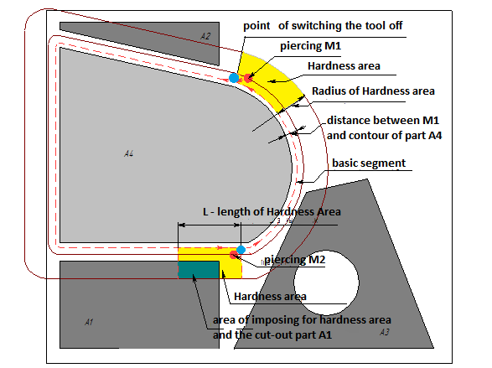
Formalization
The “Hardness” area (the end of detail cutting path) should lay in not cut yet sheet zone.
OK
BAD

Slide 15
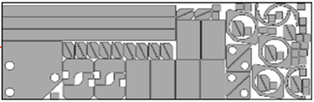
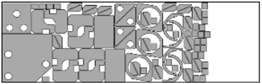
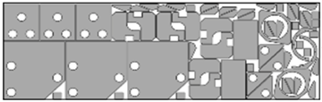
Sheet Hardness Rules
Start from:
Long narrow parts
Nested zone
Small parts
Avoid:
Uncut ‘islands’
Narrow uncut zones

Slide 16
SCCP

Slide 17
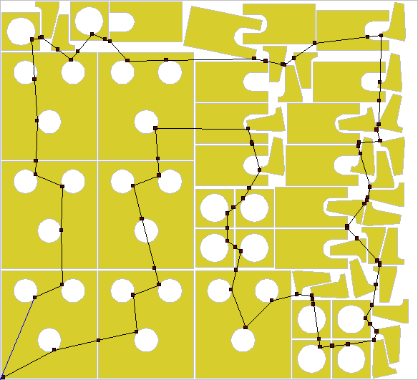
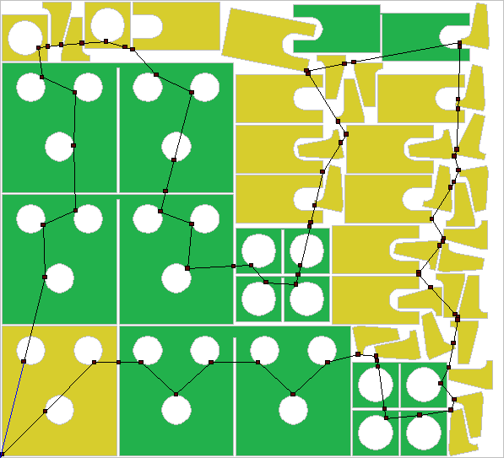
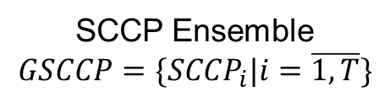
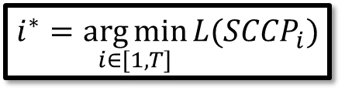
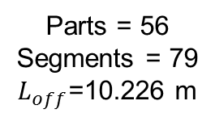
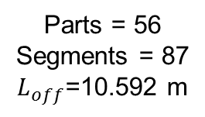
Generalized SCCP
Nesting
…
SCCP₁
SCCP₂
SCCP₃
SCCP₄
…
SCCP_{T}
SCCP Ensemble
$$GSCCP=\{{SCCP}_{i}|i=\overline{1, T}\}$$
Parts = 56
Segments = 87
$L_{off}$=10.592 m
Parts = 56
Segments = 79
$L_{off}$=10.226 m
$$i^{∗}=\underset{i∈[1, T]}{\arg{min}}{L({SCCP}_{i})}$$
Solution of generalized SCCP

Slide 18
Algorithms
GTSP
Exact algorithm based on a dynamic programming (up to 30 segments / “megalopolises”)
Genetic algorithm
Iterative greedy algorithm (with Part Hardness Rule)
Iterative greedy algorithm with tool path modification using Bellman’s scheme
Special option of iterative greedy algorithm for the accounting of a Sheet Hardness Rules
ECP
Reduction to TSP
CCP
Dual relaxation
SCCP
Reduction to GTSP
Reduction to CCP

Slide 19
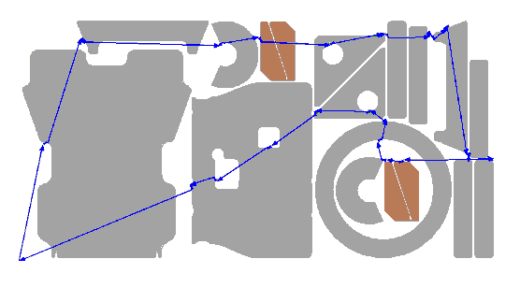
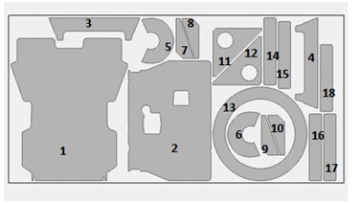
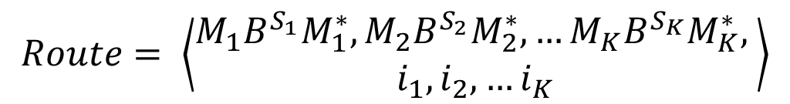

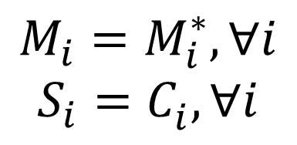
CCP Heuristic
$$M_{i}=M_{i}^{∗}, ∀i$$
$$S_{i}=C_{i}^{}, ∀i$$
Continuous optimization
$$Route= \left\langle \begin{aligned}M_{1}B^{S_{1}}M_{1}^{∗},M_{2}B^{S_{2}}M_{2}^{∗}, …M_{K}B^{S_{K}}M_{K}^{∗}, \\ i_{1},i_{2}, …i_{K}\end{aligned}\right\rangle$$
$$L_{off}→\min_{Route∈G}{}$$
Discrete optimization
Precedence constraint
Inner contours (holes) before outers (e.g. 11, 12 & 13)
Inner parts (inside holes) before containers (e.g. 6, 9, 10 before 13)

Slide 20



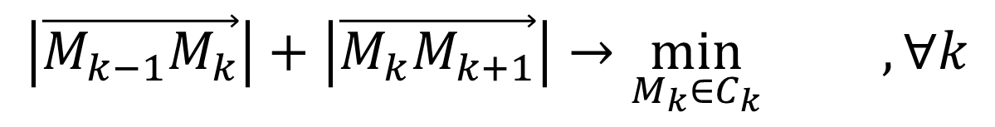




Continuous relaxation
$${\left|\vec{M_{k−1}M_{k}}\right|+\left|\vec{M_{k}M_{k+1}}\right|→\min_{M_{k}∈C_{k}}{}}_{} ,∀k$$
Relaxation
Permutation $I= i_{1},i_{2}, …i_{K}$ - fixed
For $∀k=1, 2, …K$
Fixed${\{M}_{1},M_{2}, …M_{K}\}\backslash \{M_{k}\}$
Processing:
Sequential
Random
Parallel
$$C_{k−1}$$
$$C_{k}$$
$$M_{k−1}$$
$$C_{k+1}$$
$$M_{k+1}$$
$$M_{k}$$
Fermat principle

Slide 21
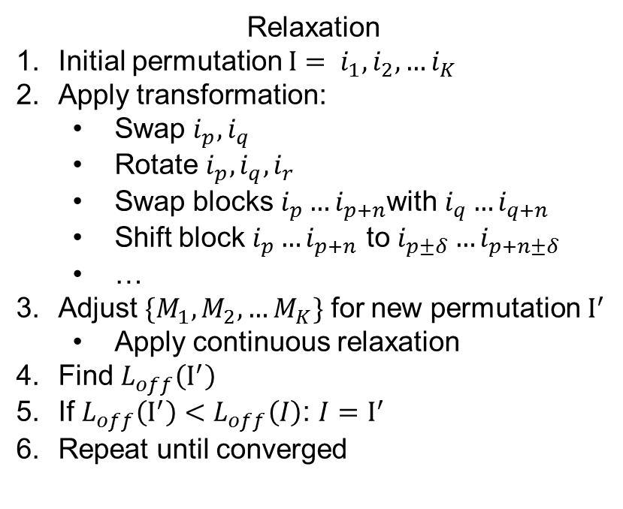
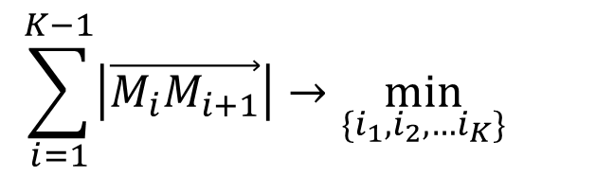
Discrete relaxation
$$\sum_{i=1}^{K−1}{\left|\vec{M_{i}M_{i+1}}\right|}{→\min_{\{i_{1},i_{2}, …i_{K}\}}{}}_{}$$
Relaxation
Initial permutation $I= i_{1},i_{2}, …i_{K}$
Apply transformation:
Swap $i_{p},i_{q}$
Rotate $i_{p},i_{q},i_{r}$
Swap blocks $i_{p}…i_{p+n}$with $i_{q}…i_{q+n}$
Shift block $i_{p}…i_{p+n}$ to $i_{p±δ}…i_{p+n±δ}$
…
Adjust ${\{M}_{1},M_{2}, …M_{K}\}$ for new permutation $I^{′}$
Apply continuous relaxation
Find $L_{off}\left(I^{′}\right)$
If $L_{off}\left(I^{′}\right)<L_{off}\left(I\right)$: $I{=I}^{′}$
Repeat until converged

Slide 22
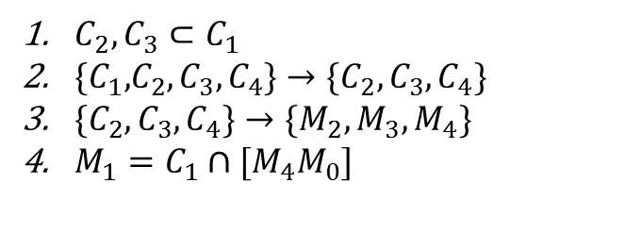
Precedence constraint
C₁
C₄
C₁
C₄
C₂
C₃
C₂
C₃
$C_{2},C_{3}⊂C_{1}$
${\{C_{1}\text{,}C}_{2},C_{3},C_{4}\}→{\{C}_{2},C_{3},C_{4}\}$
${\{C}_{2},C_{3},C_{4}\}→{\{M}_{2},M_{3},M_{4}\}$
$M_{1}=C_{1}∩[M_{4}M_{0}]$
C₁
M₃
C₄
M₃
C₄
M₂
M₂
C₂
C₃
C₂
C₃
M₄
M₄
M₁
M₀
M₀

Slide 23
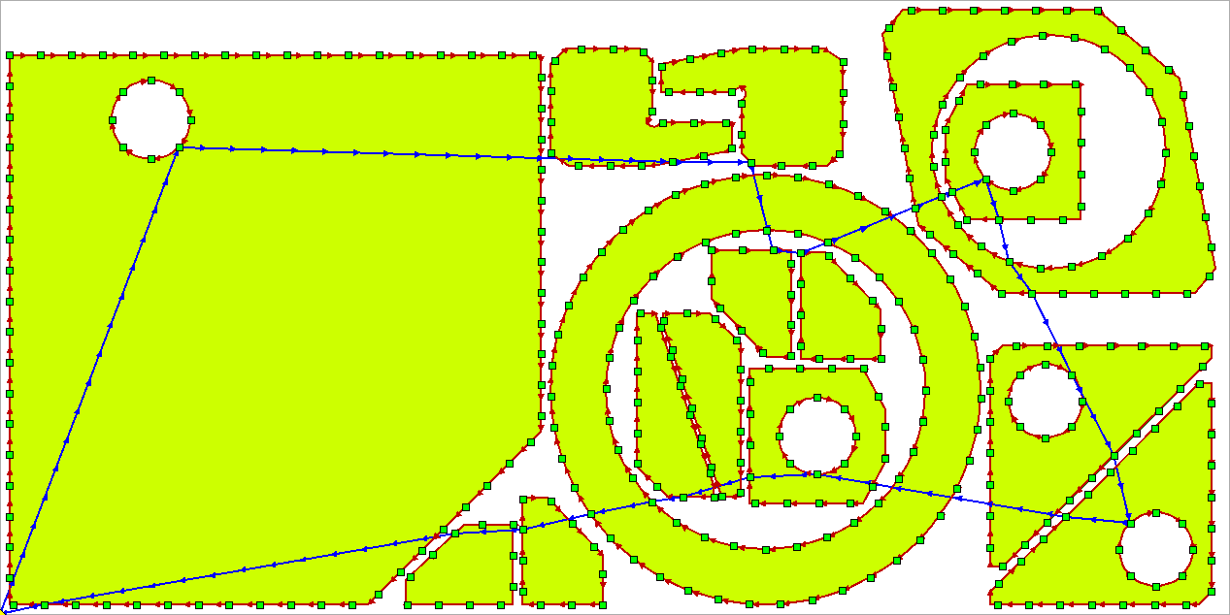
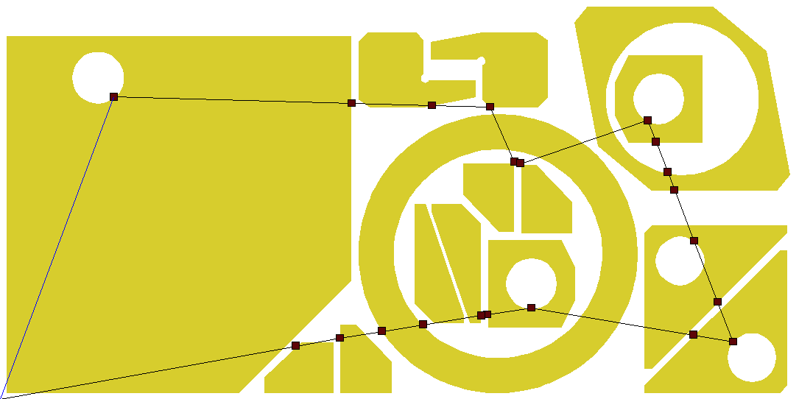
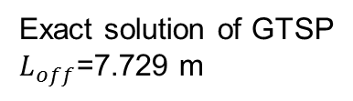
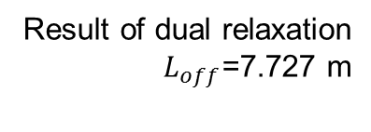
Numerical experiments
Exact solution of GTSP
$L_{off}$=7.729 m
Broken line
Result of dual relaxation
$L_{off}$=7.727 m
Straight line

Slide 24



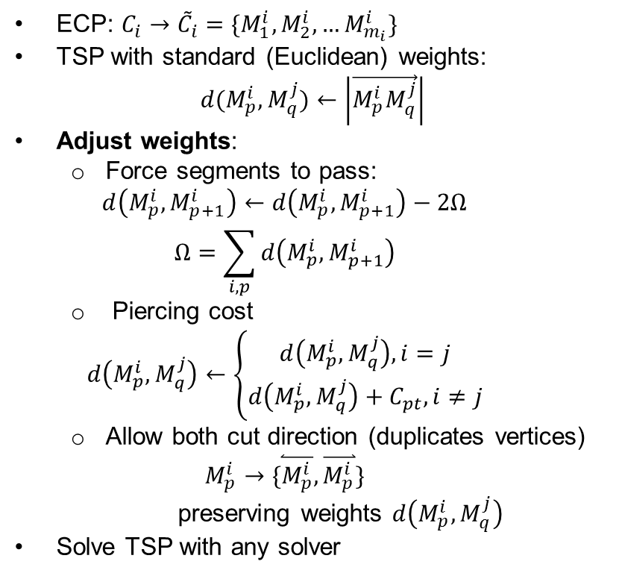
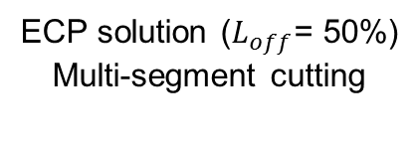



ECP reduction to TSP
$$M_{2}^{i}$$
$$M_{1}^{i}≡M_{5}^{i}$$
C_{i}
$$M_{3}^{i}$$
$$M_{4}^{i}$$
ECP: $C_{i}→{\tilde{C}}_{i}=\{M_{1}^{i},M_{2}^{i},…M_{m_{i}}^{i}\}$
TSP with standard (Euclidean) weights:
$$d(M_{p}^{i},M_{q}^{j})←\left|\vec{M_{p}^{i}M_{q}^{j}}\right|$$
Adjust weights:
Force segments to pass:
$$d\left(M_{p}^{i},M_{p+1}^{i}\right)←d\left(M_{p}^{i},M_{p+1}^{i}\right)−2Ω$$
$$Ω=\sum_{i,p}{d\left(M_{p}^{i},M_{p+1}^{i}\right)}$$
Piercing cost
$$d\left(M_{p}^{i},M_{q}^{j}\right)←\left\{\begin{matrix}d\left(M_{p}^{i},M_{q}^{j}\right), i=j \\ d\left(M_{p}^{i},M_{q}^{j}\right)+C_{pt}, i≠j\end{matrix}\right.$$
Allow both cut direction (duplicates vertices)
$$M_{p}^{i}→\{\overset{⃐}{M_{p}^{i}},\overset{⃑}{M_{p}^{i}}\}$$
preserving weights $d\left(M_{p}^{i},M_{q}^{j}\right)$
Solve TSP with any solver
Greedy algorithm ($L_{off}$= 100%)
CCP solution ($L_{off}$= 78%)
ECP solution ($L_{off}$= 50%)
Multi-segment cutting

Slide 25
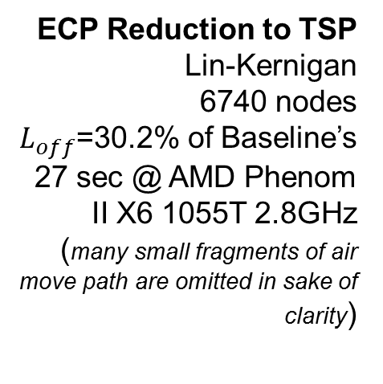
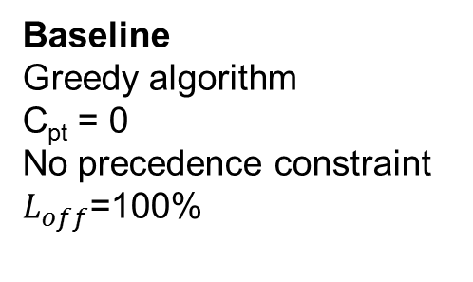
Numerical experiments
Baseline
Greedy algorithm
C_{pt} = 0
No precedence constraint
$L_{off}$=100%
ECP Reduction to TSP
Lin-Kernigan
6740 nodes
$L_{off}$=30.2% of Baseline’s
27 sec @ AMD Phenom II X6 1055T 2.8GHz
(many small fragments of air move path are omitted in sake of clarity)

Slide 26
Thank you for your attention!
Alexander A. Petunin
a.a.petunin@urfu.ru
620002, Mira street, 19
Ural Federal University
Yekaterinburg, Russia

