Slide 1
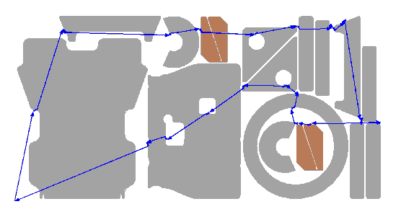
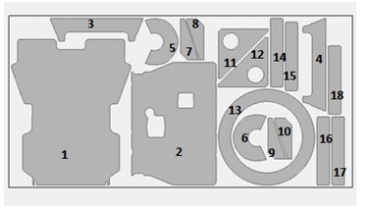
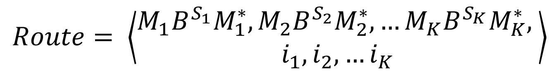
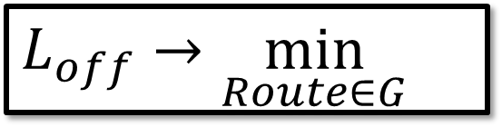
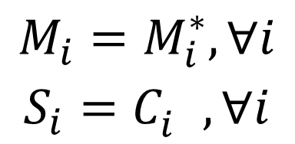
CCP Heuristic
$$M_{i}=M_{i}^{∗}, ∀i$$
$$S_{i}=C_{i}^{}, ∀i$$
Continuous optimization
$$Route= \left\langle \begin{aligned}M_{1}B^{S_{1}}M_{1}^{∗},M_{2}B^{S_{2}}M_{2}^{∗}, …M_{K}B^{S_{K}}M_{K}^{∗}, \\ i_{1},i_{2}, …i_{K}\end{aligned}\right\rangle$$
$$L_{off}→\min_{Route∈G}{}$$
Discrete optimization
Precedence constraint
Inner contours (holes) before outers (e.g. 11, 12 & 13)
Inner parts (inside holes) before containers (e.g. 6, 9, 10 before 13)

Slide 2
Continuous optimization

Slide 3
Discrete optimization

Slide 4
Precedence constraint handling

Slide 5
Numerical experiments

