Slide 1

One way to find the shortest polyline with vertices on contours in the plane
Alexander Petunin, Efim Polishchuk, Stanislav Ukolov
MOTOR 2019
Mathematical Optimization Theory and Operations Research
July 8 – 12, 2019
Ekaterinburg

Slide 2
Outline
Toolpath routing problems and classification
Continuous cutting problem
Algorithm for CCP solution
Continuous optimization
Discrete optimization
Precedence constraint
Sufficient condition for minimum
Local minimum
Global minimum
Conclusion

Slide 3
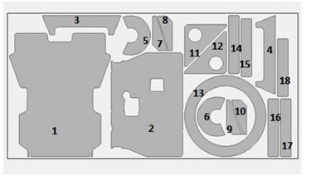
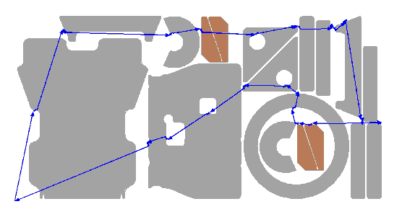
Control program development
for sheet cutting machines
Nesting
Tool path routing
NC Program generation
Maximal material utilization
Minimal path cost in terms of money and resources, including cutting time

Slide 4
Classification of
tool path routing problems
Continuous set of piercing points
CCP
SCCP
GSCCP
ICP
GSCCP
GSCCP
Finite set of piercing points
GTSP
ECP
Fixed piercing points
TSP

Slide 5
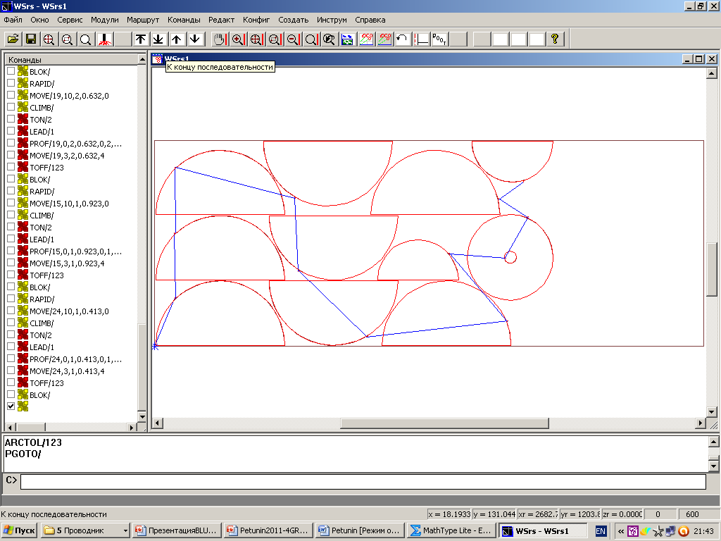
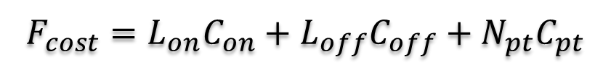
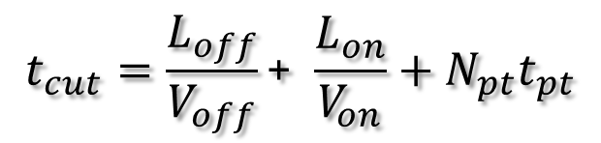
Objective functions
Cutting cost
Cutting time
$$F_{cost}=L_{on}C_{on}+L_{off}C_{off}+N_{pt}C_{pt}$$
$$t_{cut}=\frac{L_{off}}{V_{off}}\text{+} \frac{L_{on}}{V_{on}}+N_{pt}t_{pt}$$
Where:
L_{off} – Length of airtime motion
L_{on} – Length of cutting segments
C_{on} – Cost of airtime motion unit
C_{off} – Cost of cutting unit
C_{pt} – Piercing cost
V_{off} – Speed of airtime motion
V_{on} – Speed of cutting
N_{pt} – Number of piercing points
t_{pt} – Time of piercing

Slide 6
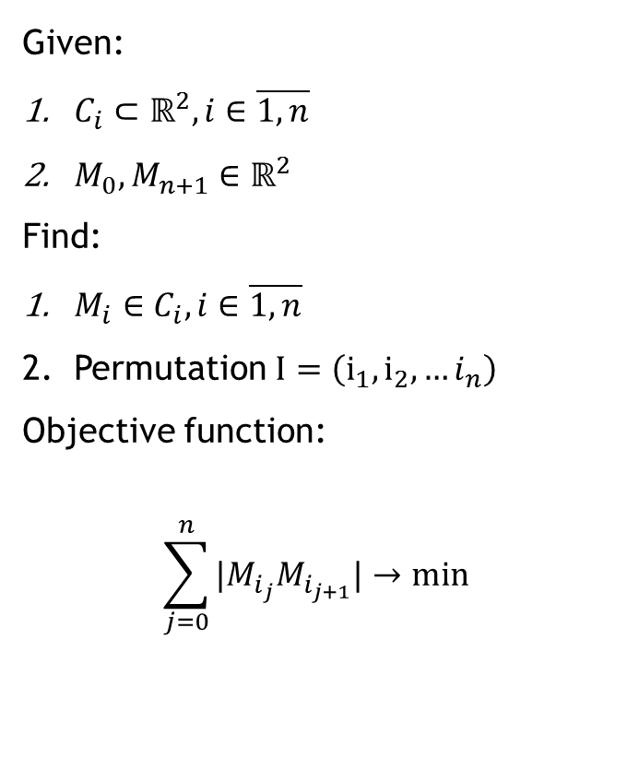
Continuous Cutting Problem
M_{n+1}
C₁
Given:
$M_{0},M_{n+1}∈ℝ^{2}$
Find:
$M_{i}∈C_{i},i∈\overline{1,n}$
Permutation $I=\left(i_{1}, i_{2},…i_{n}\right)$
Objective function:
$$\sum_{j=0}^{n}{|M_{i_{j}}M_{i_{j+1}}|}→min$$
C₂
M₁
C₄
C₅
C₃
M₀
M₃

Slide 7

Precedence Constraint
Other technological constraints exist

Slide 8
CCP Algorithm

Slide 9
Title

Slide 10

Contacts
Thank you for your attention!
Stanislav Ukolov
Institute of New Materials and Technologies, Ural Federal University, Yekaterinburg, Russia
s.s.ukolov@urfu.ru
MOTOR 2019
Mathematical Optimization Theory and Operations Research
July 8 – 12, 2019
Ekaterinburg

