Slide 1

Iterative algorithm for the generalized segmental continuous cutting problem with optimization time constraint
Alexander Petunin, Stanislav Ukolov
Intelligent and Fuzzy Systems (INFUS 2024)
July 16 – 18, 2024
Istanbul , Turkey

Slide 2
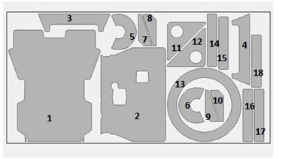
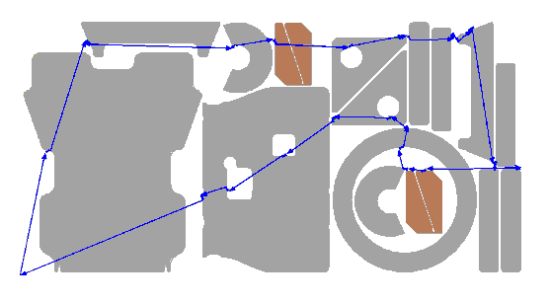
Control program development
for sheet cutting machines
Nesting
Tool path routing
NC Program generation
Maximal material utilization
Minimal path cost in terms of money and resources, including cutting time

Slide 3
Classification of
tool path routing problems
Continuum of piercing points
CCP
SCCP
GSCCP
ICP
GSCCP
GSCCP
Finite set of piercing points
GTSP
ECP
Fixed piercing points
TSP

Slide 4
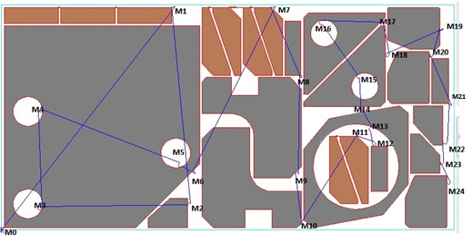


Definition of tool path (route) by cutting segments
Parts:
$A_{1},A_{2},$ …$A_{n}⊂ℝ^{2};i=\overline{1, n}$
Closed contours:
$C_{1},C_{2},$ …$C_{N}⊂ℝ^{2};j=\overline{1, N};N≥n$
Tool path components:
$M_{k}$ - pierce points, $k=\overline{1, K}$
${M^{0}}_{k}^{}$ - segment entry points
$M^{∗}$ - tool off points
Definition 1: Cutting segment${ S}_{k}$ is trajectory between pierce point $M_{k}$ and tool off point ${M^{∗}}_{k}^{}.S_{k}⊂ℝ^{2};k=\overline{1, K}$
Note: Segment $S_{k}$ has a direction at every point.
Definition 2: $Route= \left\langle M_{1}S_{1}M_{1}^{∗},M_{2}S_{2}M_{2}^{∗}, …M_{K}S_{K}M_{K}^{∗},i_{1},i_{2}, …i_{K}\right\rangle$,
where $i_{1},i_{2}, …i_{K}$ - sequence of segments cutting.
Example of route containing 24 cutting segments
n = 24, N = 30, K = 24
Brown parts are cut by one cutting segment

Slide 5
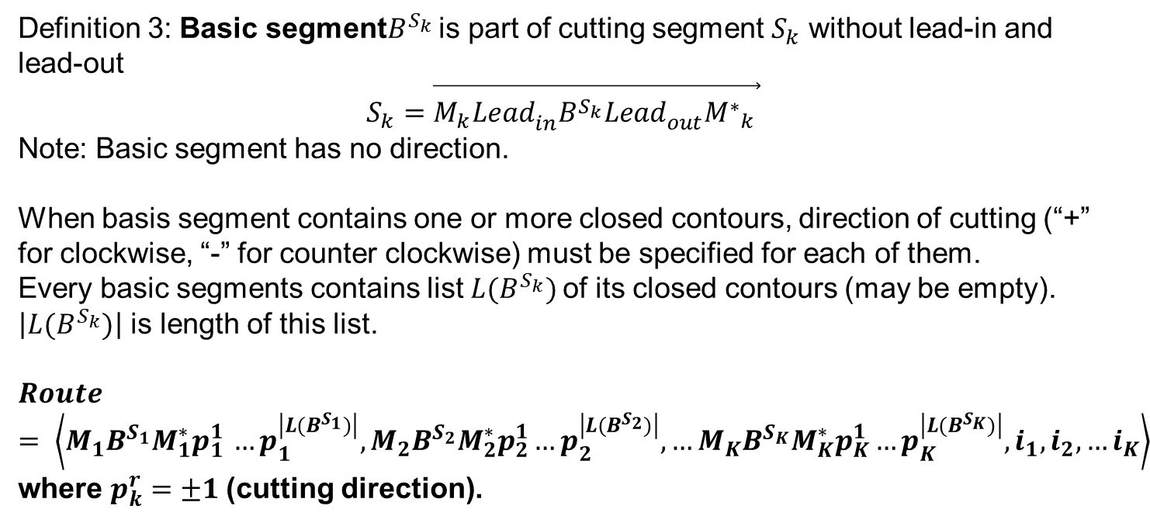
Definition the Cutting path (Route) by using concept the basic cutting segment
Definition 3: Basic segment$B^{S_{k}}$ is part of cutting segment $S_{k}$ without lead-in and lead-out
$$S_{k}=\vec{M_{k}{{Lead}_{in}^{}B}^{S_{k}}{Lead}_{out}^{}{M^{∗}}_{k}^{}}$$
Note: Basic segment has no direction.
When basis segment contains one or more closed contours, direction of cutting (“+” for clockwise, “-” for counter clockwise) must be specified for each of them.
Every basic segments contains list ${L(B}^{S_{k}})$of its closed contours (may be empty). $\left|{L(B}^{S_{k}})\right|$ is length of this list.
$$Route= \left\langle M_{1}B^{S_{1}}M_{1}^{∗}p_{1 }^{1}…p_{1}^{\left|{L(B}^{S_{1}})\right|},M_{2}B^{S_{2}}M_{2}^{∗}p_{2}^{1}…p_{2}^{\left|{L(B}^{S_{2}})\right|}, …M_{K}B^{S_{K}}M_{K}^{∗}p_{K}^{1}…p_{K}^{\left|{L(B}^{S_{K}})\right|},i_{1},i_{2}, …i_{K}\right\rangle$$
where $p_{k}^{r}=±1$(cutting direction).

Slide 6
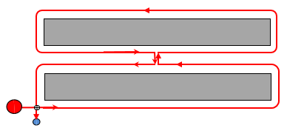
Non-standard cutting techniques
Multi-contour cutting - several contours are combined into one
Multi-segment cutting - one of the contours is divided into several parts
Multi-contour cutting of two parts using a “bridge”
In this study, bridges of zero width were used, so when adding one “bridge” to the nesting layout
The number of circuits is reduced by 1
The number of insertion points N_{pt} is reduced by 1 either
The tool stroke length L_{on} is increased by double bridge length (which is usually chosen as the minimum)
In the practical use of bridges, the stroke length L_{on} may even decrease, depending on the geometry of the bridge.

Slide 7
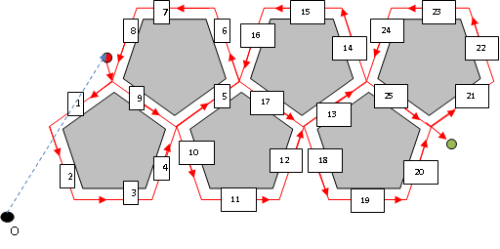
Example of non-trivial cutting segment
Cutting of six pentagons
using single cutting segment
and combined cut technique

Slide 8
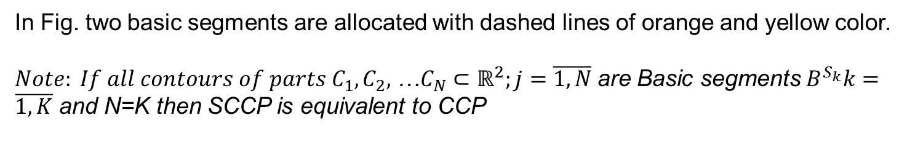

SCCP, GSCCP
Definition 4: SCCP(Segment Continuous Cutting Problem) is a problem with fixed number K and fixed set of Basic segments $B^{S_{k}}k=\overline{1, K}$
Lead-out 2
Lead-in 2
Basic segment 1
Lead-out 1
Basic segment 2
Lead-in 1
In Fig. two basic segments are allocated with dashed lines of orange and yellow color.
${Note: If all contours of parts C}_{1},C_{2},$ …$C_{N}⊂ℝ^{2};j=\overline{1, N}$are Basic segments $B^{S_{k}}k=\overline{1, K}$ and N=K then SCCP is equivalent to CCP
Definition 5: GSCCP (Generalized SCCP) is { SCCP_{i} i=1,2,…,T }
Thus, by introducing the class of GSCCP, we have significantly expanded the existing classification of tool path problem for CNC sheet cutting machines. Actually SCCP and GSCCP are subclasses ICP containing all tasks with finite sets of basic cutting segments, i.e. CCP SCCP GSCCP ICP

Slide 9
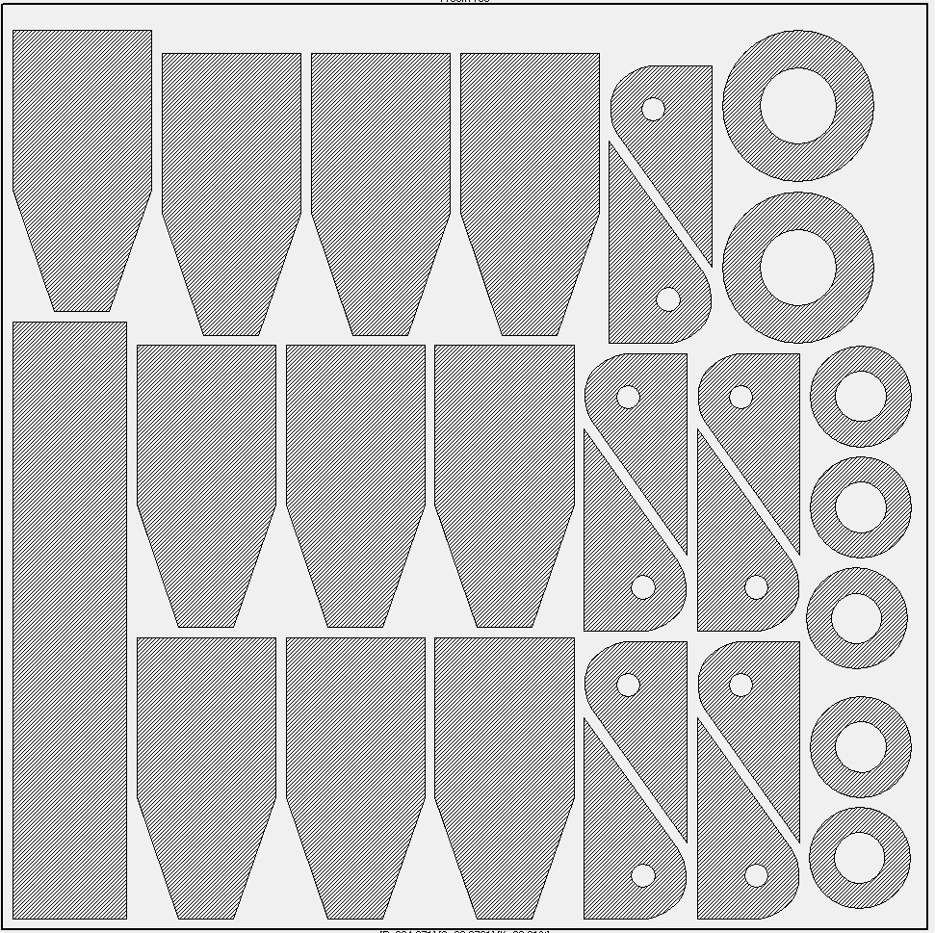
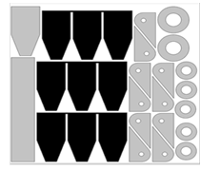
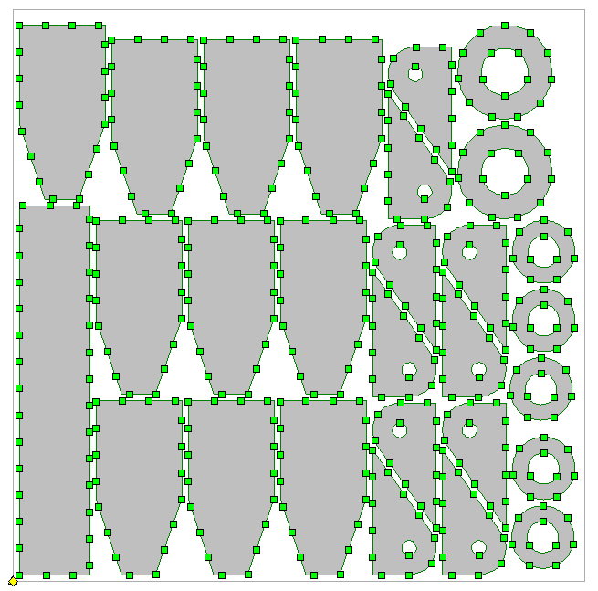
Example of GSCCP task
Standard Cutting Technique:
45 base segments
Introducing Multi-Contour Cutting:
39 base segments
Reduce to GTSP:
425 possible pierce points

Slide 10
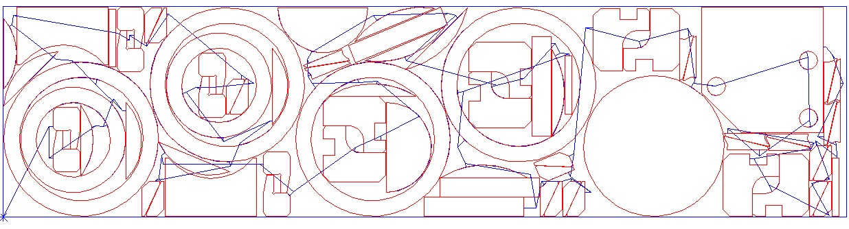
Two optimization criteria
Cost of cutting process F_{cost} = where:
L_{off} — length of tool path with the switched off cutting tool (idle tool path, blue color);
C_{off} — cost of unit length of tool path with the switched off cutting tool;
L_{on} — length of tool path with the switched on cutting tool (including length lead-in and lead-out, red color);
C_{on} — cost of unit of a path with the switched on cutting tool;
N_{pt} — number of pierces;
C_{pt} — cost of one pierce.
Time of cutting process t_{cut}=
where:
V_{on} — speed of cutting process with the switched on cutting tool;
V_{off} — speed of tool’s movement with the switched off cutting tool;
t_{on} — time for one piercing of sheet material.

Slide 11
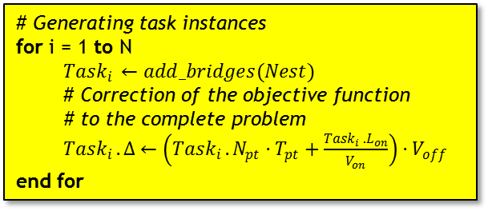

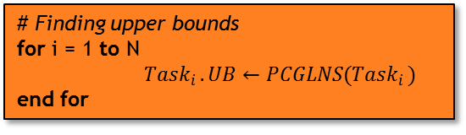
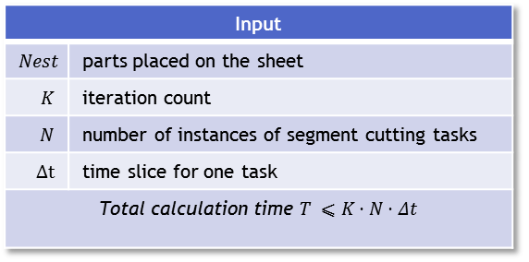
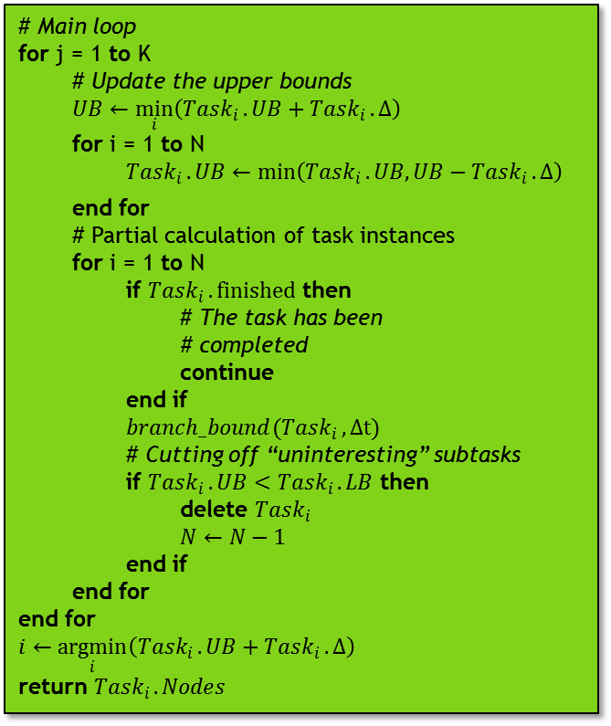
Algorithm pseudocode
Input
$$Nest$$ | parts placed on the sheet
$$K$$ | iteration count
$$N$$ | number of instances of segment cutting tasks
$$Δt$$ | time slice for one task
Total calculation time $T ⩽K⋅N⋅Δt$
# Main loop
for j = 1 to K
# Update the upper bounds
$UB←\min_{i}\left({Task}_{i }.UB+{Task}_{i }.Δ\right)$
for i = 1 to N
${Task}_{i }.UB←\min_{}\left({Task}_{i }.UB,UB−{Task}_{i }.Δ\right)$
end for
# Partial calculation of task instances
for i = 1 to N
if ${Task}_{i }.finished$ then
# The task has been
# completed
continue
end if
${branch_bound(Task}_{i }, Δt)$
# Cutting off “uninteresting” subtasks
if ${Task}_{i }.UB<{Task}_{i }.LB$ then
delete ${Task}_{i }$
$N←N−1$
end if
end for
end for
$$i←\underset{i}{argmin}\left({Task}_{i }.UB+{Task}_{i }.Δ\right)$$
return ${Task}_{i }.Nodes$
# Generating task instances
for i = 1 to N
${Task}_{i }←add_bridges(Nest)$
# Correction of the objective function
# to the complete problem
${Task}_{i }.Δ←\left({Task}_{i }.N_{pt}⋅T_{pt}+\frac{{Task}_{i }.L_{on}}{V_{on}}\right)⋅V_{off}$
end for
# Finding upper bounds
for i = 1 to N
${Task}_{i }.UB←PCGLNS({Task}_{i })$
end for
Output
$$Route$$ | toolpath

Slide 12



Cutoff condition
Correction for every task instance
$$Δ_{i }=\left(N_{pt}⋅T_{pt}+\frac{L_{on}}{V_{on}}\right)⋅V_{off}$$
$${LB}_{i}>{UB}_{i }$$
$${LB}_{i}>\min_{}\left({UB}_{i },UB−Δ_{i }\right)$$

Slide 13
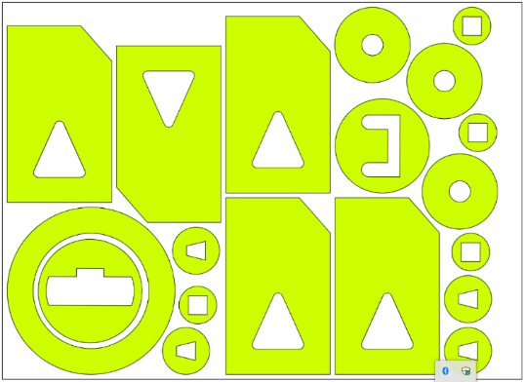
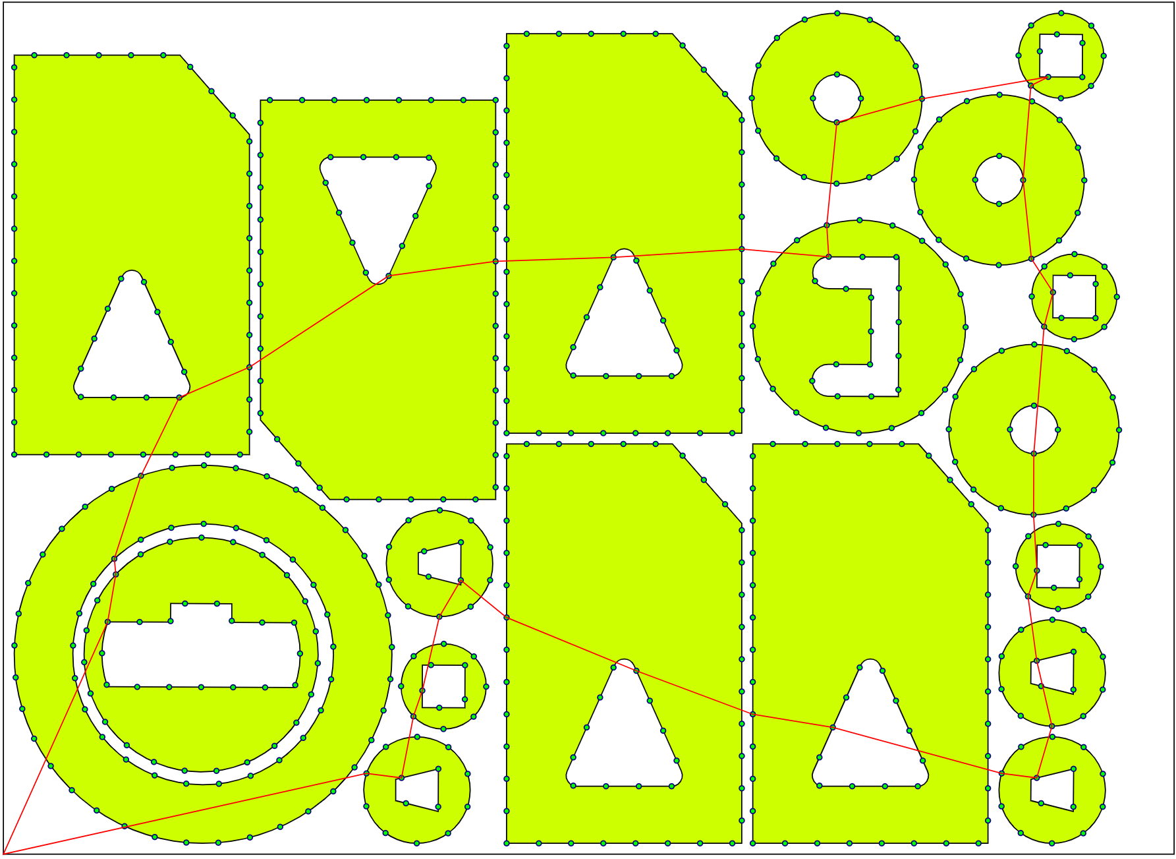
Numerical experiment
Nesting layout | Parts | Contours | L_{on}, mm | Piercing points
p3xl_1 | 16 | 32 | 12040 | 586
p3xl_2 | 17 | 35 | 8783 | 861
p3xl_3 | 16 | 32 | 10698 | 521
p3xl_4 | 18 | 36 | 7193 | 696
p3xl_5 | 19 | 38 | 17233 | 557
p3xl_5
PCGLNS solution

Slide 14
Technological parameters
Material | Thickness, mm | T_{pt}, s | V_{on}, m/s |  | V_{off}, m/s
 |  |  | Good quality | Medium quality
Carbon steel Ст10кп | 1 | 0,8 | 0,112 | 0,158 | 0,85
 | 1,2 | 0,9 | 0,088 | 0,127
 | 1,5 | 1,1 | 0,088 | 0,127
 | 2 | 1,2 | 0,072 | 0,103
 | 2,5 | 1,7 | 0,060 | 0,087
 | 3 | 2,1 | 0,048 | 0,070
 | 3,5 | 2,2 | 0,044 | 0,063
 | 3,9 | 2,2 | 0,044 | 0,063
 | 4 | 2,5 | 0,040 | 0,057
 | 5 | 2,7 | 0,037 | 0,053
 | 8 | 3 | 0,025 | 0,037
 | 10 | 3,2 | 0,022 | 0,030
 | 15 | 4 | 0,013 | 0,018
Aluminium Амг3М | 1 | 1,3 | 0,105 | 0,175
 | 2 | 2 | 0,065 | 0,108
 | 3 | 3 | 0,032 | 0,052
 | 5 | 4 | 0,017 | 0,028
Stainless Steel 12Х18Н10Т | 1 | 1 | 0,105 | 0,175
 | 1,5 | 1,5 | 0,083 | 0,140
 | 2 | 1,8 | 0,062 | 0,103
 | 2,5 | 2,2 | 0,050 | 0,083
 | 3 | 2,8 | 0,042 | 0,068
 | 4 | 3,3 | 0,028 | 0,047
 | 5 | 4 | 0,022 | 0,035
 | 6 | 4,5 | 0,017 | 0,027
 | 8 | 5 | 0,008 | 0,015
 | 10 | 6 | 0,005 | 0,010

Slide 15
Generating subtasks
Name | Bridges | UB, mm | LB₀, mm | N_{pt} | L_{on}, мм
p3xl_1 | 0 | 2289 | 1296 | 32 | 12040
p3xl_1-A | 3 | 2284 | 1314 | 29 | 12104
p3xl_1-B | 4 | 2287 | 1304 | 28 | 12131
p3xl_1-C | 6 | 2283 | 1360 | 26 | 12172
p3xl_2 | 0 | 1629 | 919 | 35 | 8783
p3xl_2-A | 3 | 1629 | 932 | 32 | 8845
p3xl_2-B | 4 | 1627 | 892 | 31 | 8873
p3xl_2-C | 8 | 1628 | 968 | 27 | 8971
p3xl_3 | 0 | 2114 | 1152 | 32 | 10698
p3xl_3-A | 4 | 2014 | 1192 | 28 | 10782
p3xl_3-B | 4 | 2017 | 1156 | 28 | 10799
p3xl_3-C | 6 | 2010 | 1149 | 26 | 10837
p3xl_4 | 0 | 1702 | 937 | 36 | 7193
p3xl_4-A | 3 | 1701 | 938 | 33 | 7263
p3xl_4-B | 5 | 1699 | 972 | 31 | 7297
p3xl_4-C | 8 | 1698 | 989 | 28 | 7405
p3xl_5 | 0 | 3272 | 1908 | 38 | 17233
p3xl_5-A | 3 | 3260 | 1919 | 35 | 17302
p3xl_5-B | 6 | 3261 | 1915 | 32 | 17371
p3xl_5-C | 7 | 3253 | 1935 | 31 | 17439

Slide 16
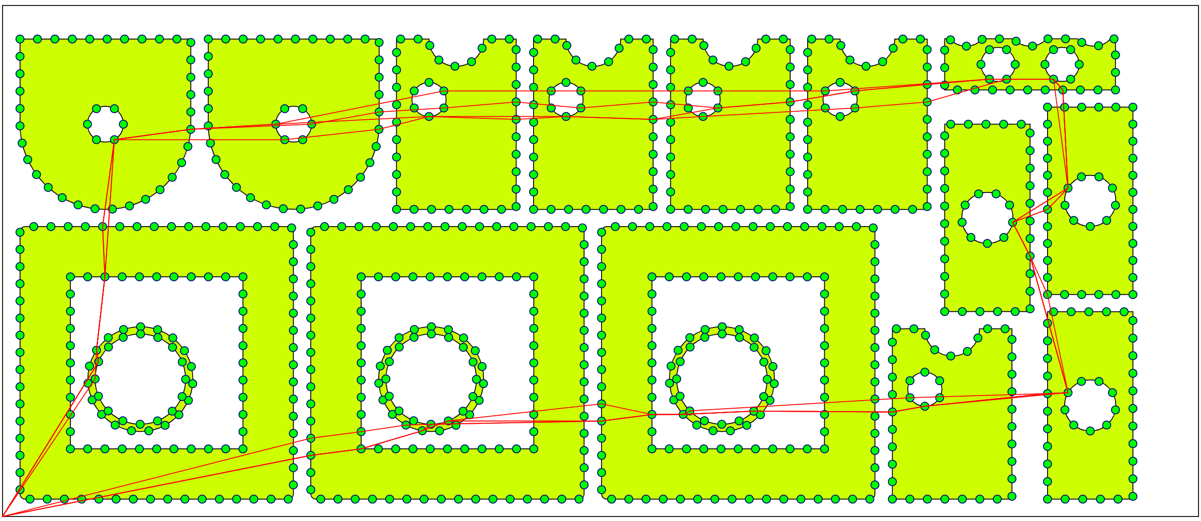
Solutions
Subtasks of p3xl_2

Slide 17
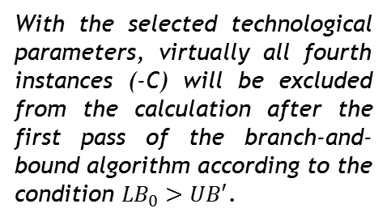
Mutual influence of subtasks
Name | UB | LB₀ | L_{on} | Δ | UB'
p3xl_1 | 2289 | 1296 | 12040 | 97467 | 2289
p3xl_1-A | 2284 | 1314 | 12104 | 97985 | 1771
p3xl_1-B | 2287 | 1304 | 12131 | 98203 | 1552
p3xl_1-C | 2283 | 1360 | 12172 | 98535 | 1220
p3xl_2 | 1629 | 919 | 8783 | 71100 | 1629
p3xl_2-A | 1629 | 932 | 8845 | 71602 | 1127
p3xl_2-B | 1627 | 892 | 8873 | 71829 | 900
p3xl_2-C | 1628 | 968 | 8971 | 72622 | 107
p3xl_3 | 2114 | 1152 | 10698 | 86603 | 2114
p3xl_3-A | 2014 | 1192 | 10782 | 87283 | 1434
p3xl_3-B | 2017 | 1156 | 10799 | 87420 | 1296
p3xl_3-C | 2010 | 1149 | 10837 | 87728 | 989
p3xl_4 | 1702 | 937 | 7193 | 58229 | 1702
p3xl_4-A | 1701 | 938 | 7263 | 58796 | 1135
p3xl_4-B | 1699 | 972 | 7297 | 59071 | 860
p3xl_4-C | 1698 | 989 | 7405 | 59945 | 14
p3xl_5 | 3272 | 1908 | 17233 | 139505 | 3272
p3xl_5-A | 3260 | 1919 | 17302 | 140064 | 2713
p3xl_5-B | 3261 | 1915 | 17371 | 140622 | 2155
p3xl_5-C | 3253 | 1935 | 17439 | 141173 | 1604
With the selected technological parameters, virtually all fourth instances (-C) will be excluded from the calculation after the first pass of the branch-and-bound algorithm according to the condition ${LB}_{0}>UB′$.

Slide 18
Performance
Independent solution of subtasks
Subtask | Time, s | Layers | Prefixes | LB₀ | LB_{max} | Solution
p3xl_1-A | 70072 | 29 | 538704 | 1328 | 2130 | 2283
p3xl_1-B | 271 | 28 | 18363 | 1304 | 2140 | 2302
p3xl_2-A | 30756 | 10 | 261442 | 932 | 1629 | Timeout
p3xl_2-B | 22433 | 14 | 253358 | 892 | 1198 | Timeout
p3xl_3-A | 16 | 2 | 86 | 1192 | 1271 | Timeout
p3xl_3-B | 35175 | 28 | 345857 | 1156 | 1835 | 2012
p3xl_4-A | 12541 | 8 | 185483 | 938 | 1110 | Timeout
p3xl_5-A | 10317 | 7 | 194378 | 1919 | 2129 | Timeout
p3xl_5-B | 42097 | 8 | 327747 | 1915 | 2117 | Timeout
Collaborative solution of subtasks
Subtask | Time, s | Layers | Prefixes | LB₀ | LB_{max} | Solution
p3xl_1-A | 92 | 15 | 652 | 1328 | 1736 | Stop
p3xl_1-B | 75 | 9 | 61 | 1304 | 1473 | Stop
p3xl_2-A | 199 | 11 | 85 | 932 | 1086 | Stop
p3xl_2-B | 84 | 3 | 17 | 892 | 897 | Stop
p3xl_3-A | 61 | 9 | 108 | 1192 | 1306 | Stop
p3xl_3-B | 49 | 8 | 44 | 1156 | 1253 | Stop
p3xl_4-A | 78 | 8 | 106 | 938 | 1110 | Stop
p3xl_5-A | 1779 | 23 | 76269 | 1919 | 2637 | Stop
p3xl_5-B | 73 | 8 | 45 | 1915 | 2117 | Stop

Slide 19
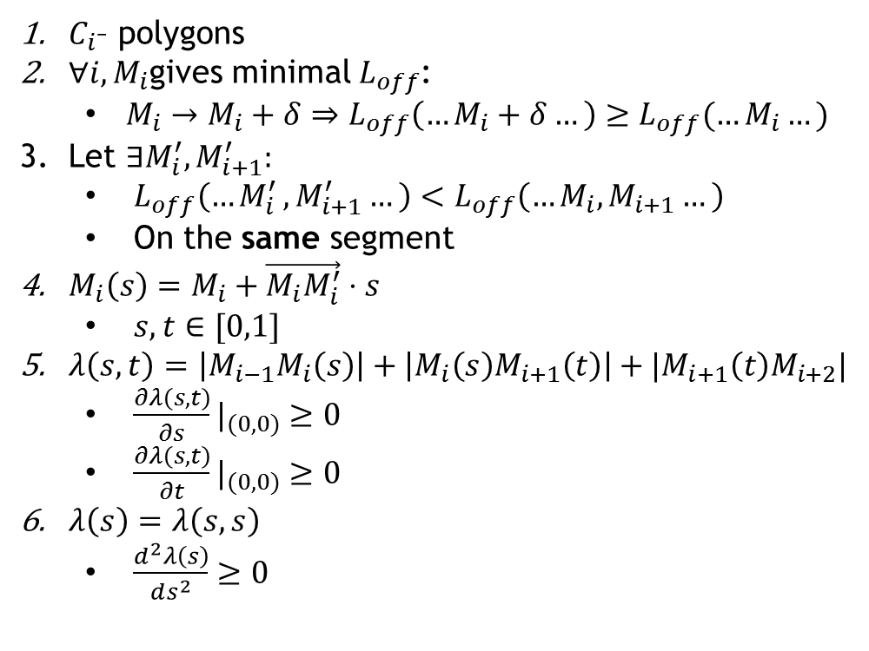
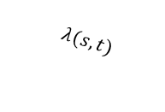
Local minimum
$C_{i}$– polygons
${∀i, M}_{i}$gives minimal $L_{off}$:
$M_{i}→M_{i}+δ⇒L_{off}\left(…M_{i}+δ…\right)≥L_{off}(…M_{i}…)$
Let $∃M_{i}^{′},M_{i+1}^{′}:$
$L_{off}\left({…M}_{i}^{′},M_{i+1}^{′}…\right)<L_{off}\left(…M_{i},M_{i+1}…\right)$
On the same segment
$M_{i}\left(s\right)=M_{i}+\vec{M_{i}M_{i}^{′}}⋅s$
$s,t∈[0,1]$
$λ\left(s,t\right)=\left|M_{i−1}M_{i}\left(s\right)\right|+\left|M_{i}\left(s\right)M_{i+1}\left(t\right)\right|+|M_{i+1}\left(t\right)M_{i+2}|$
${\frac{∂λ\left(s,t\right)}{∂s}|}_{(0,0)}≥0$
${\frac{∂λ\left(s,t\right)}{∂t}|}_{(0,0)}≥0$
$λ\left(s\right)=λ\left(s,s\right)$
$\frac{d^{2}λ\left(s\right)}{ds^{2}}≥0$
C_{i}
C_{i+1}
M_{i}
M_{i+1}
M_{i+2}
M_{i-1}
M_{i}(s)
$$λ(s,t)$$
M_{i+1}(t)
M’_{i}
M’_{i+1}

Slide 20
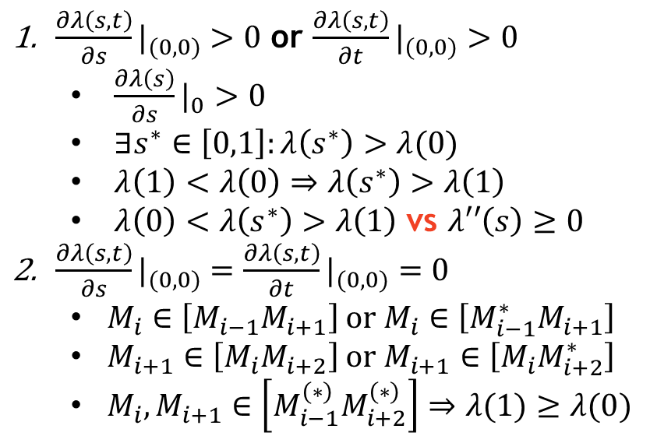
Local minimum cases
${\frac{∂λ\left(s,t\right)}{∂s}|}_{(0,0)}>0$ or ${\frac{∂λ\left(s,t\right)}{∂t}|}_{(0,0)}>0$
${\frac{∂λ\left(s\right)}{∂s}|}_{0}>0$
$∃s^{∗}∈\left[0,1\right]:λ\left(s^{∗}\right)>λ(0)$
$λ\left(1\right)<λ\left(0\right)⇒λ\left(s^{∗}\right)>λ\left(1\right)$
$λ\left(0\right)<λ\left(s^{∗}\right)>λ\left(1\right)$ vs $λ′′\left(s\right)≥0$
${\frac{∂λ\left(s,t\right)}{∂s}|}_{(0,0)}={\frac{∂λ\left(s,t\right)}{∂t}|}_{(0,0)}=0$
$M_{i}∈\left[M_{i−1}M_{i+1}\right]$ or $M_{i}∈\left[M_{i−1}^{∗}M_{i+1}\right]$
$M_{i+1}∈\left[M_{i}M_{i+2}\right]$ or $M_{i+1}∈\left[{M_{i}M}_{i+2}^{∗}\right]$
${M_{i},M}_{i+1}∈\left[M_{i−1}^{\left(∗\right)}M_{i+2}^{\left(∗\right)}\right]⇒λ(1)≥λ(0)$
C_{i}
C_{i}
C_{i}
C_{i+1}
M_{i-1}
M*_{i-1}
M_{i-1}
M_{i}
M_{i}
M_{i}
M_{i+1}
M_{i+1}
M_{i+1}
M_{i+2}
M_{i-1}

Slide 21
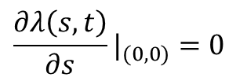

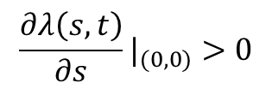
Global minimum
M_{i+1}
M_{i}
M_{i+2}
M_{i-1}
M’_{i}
M’_{i+1}
M_{i}(s)
M_{i+1}(t)
$${\frac{∂λ\left(s,t\right)}{∂s}|}_{(0,0)}=0$$
$${\frac{∂λ\left(s,t\right)}{∂s}|}_{(0,0)}>0$$
M_{i+1}
M_{i+1}
M_{i}
M_{i}
C_{i}
M_{i-1}
M_{i-1}
C_{i}
$$M_{i}∈\left[M_{i−1}M_{i+1}\right]$$

Slide 22
Global minimum cases
Edge case
Corner case
Convex contour
M_{i+1}
C_{i}
C_{i}
C_{i}
M_{i}
M_{i-1}
M_{i}
M_{i-1}
M_{i}
M_{i+1}
M_{i-1}
M_{i+1}

Slide 23
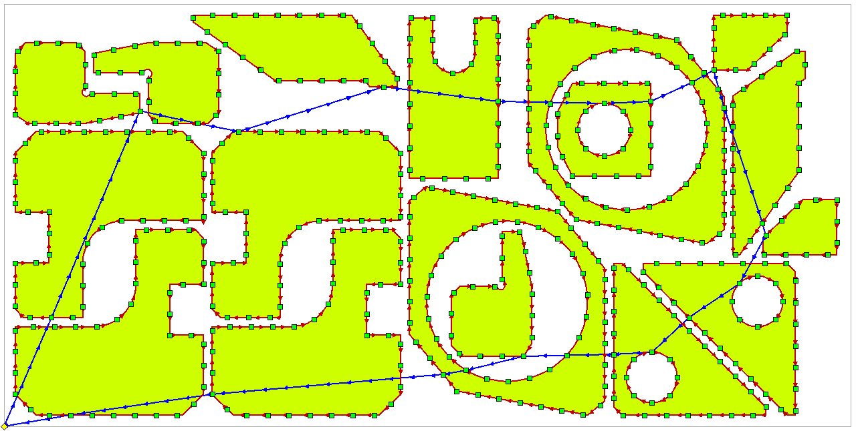
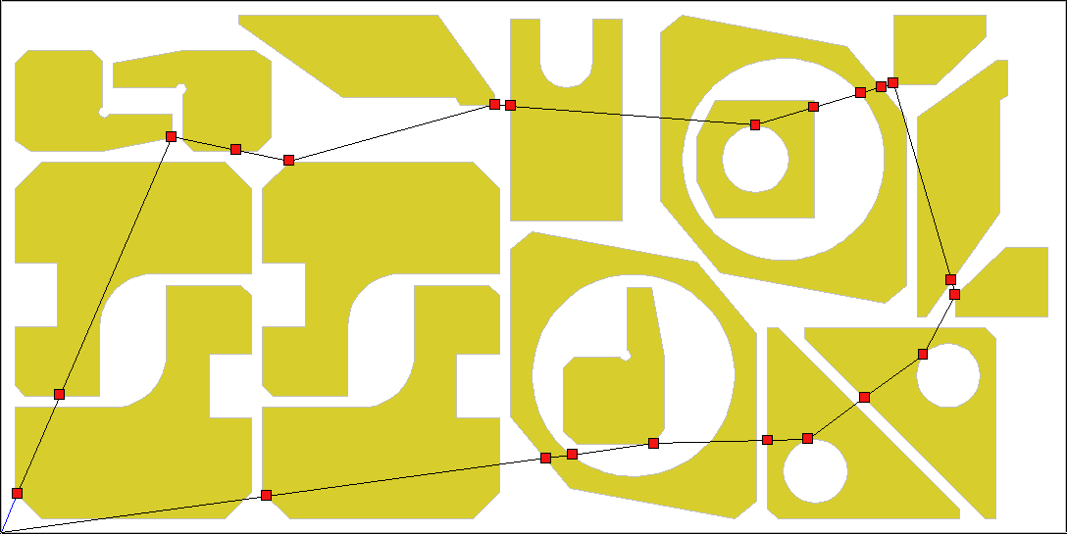
Numerical experiments
GTSP (discrete)
Job | #229 | #464 | #3211
Parts | 11 | 14 | 17
Contours | 12 | 21 | 22
L_{on}, m | 24.609 | 21.717 | 25.051
Pierce points | 491 | 429 | 493
GTSP’s L_{off}, m | 7.729 | 4.743 | 4.557
CCP’s L_{off}, m | 7.727 | 4.706 | 4.536
CCP (continuous + discrete)

Slide 24
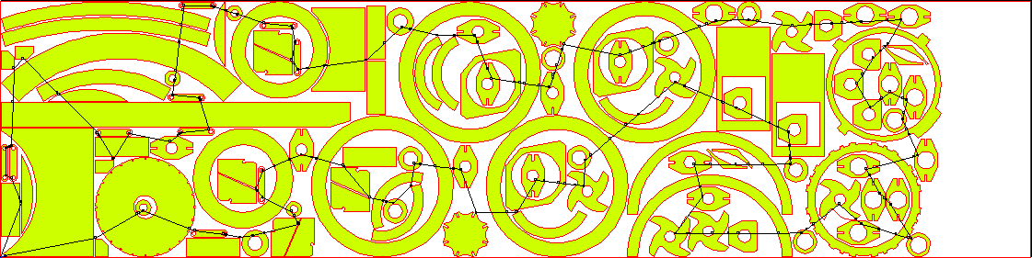
Large scale example
Job | 20205
# Parts | 115
# Contours | 198
# GTSP points | 3917
GTSP toolpath length | 26.098
CCP toolpath length | 25.987

Slide 25
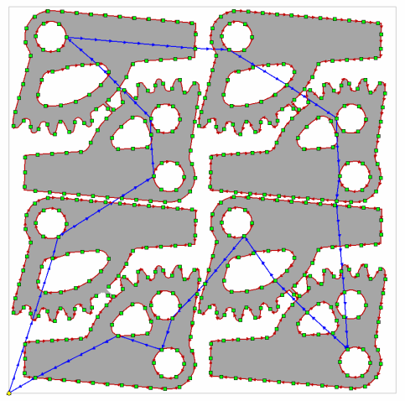
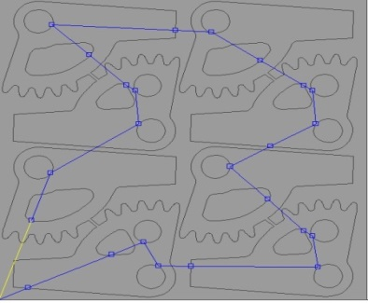
Using Relax_CCP Algorithm for solution of SCCP and GSCCP
(a) DP_GTSP
(b) Relax_CCP
An example of using the DP_GTSP (a) and Relax_CCP (b) algorithms for solution GSCCP

Slide 26
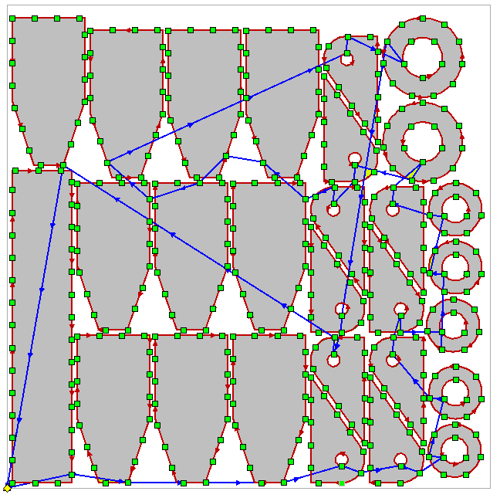
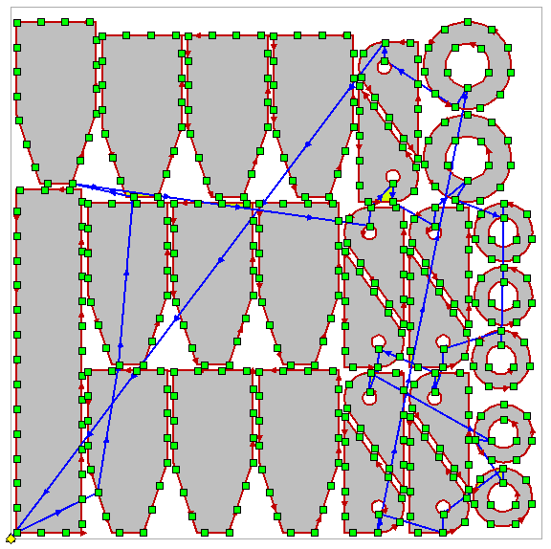
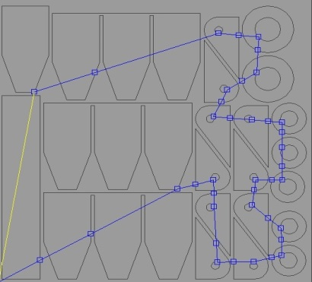
Solving GSCCP:
Greedy vs CCP-Relax
Standard
Cutting Technique:
45 base segments
Multi-Contour Cutting:
39 base segments
Greedy
GTSP Solver
CCP-Relax
Solver

Slide 27
Conclusion
Continuous Cutting Problem is considered
With Precedence Constraint
New heuristic for CCP as well as SCCP, GSCCP is proposed
Both continuous and discrete optimization
Different discrete optimizators allowed
Continuous optimization solution
Local minimum – proved
Global minimum conditions
Verified easily
Further research
Extra constraints on piercing point positions
Using other GTSP solver for discrete part

Slide 28
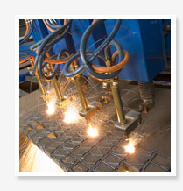
Contacts
Thank you for your attention!
Stanislav Ukolov
Institute of New Materials and Technologies, Ural Federal University, Yekaterinburg, Russia
s.s.ukolov@urfu.ru
Intelligent and Fuzzy Systems (INFUS 2024)
July 16 – 18, 2024
Istanbul , Turkey

