Slide 1

A novel algorithm for construction of the shortest path
between a finite set of nonintersecting contours on the plane
Alexander Petunin, Efim Polishchuk , Stanislav Ukolov
XI International Conference
Optimization and Applications
(OPTIMA 2020)
September 28 – October 2, 2020
Moscow, Russia

Slide 2
Outline
Toolpath routing problems and classification
Continuous cutting problem
Algorithm for CCP solution
Continuous optimization
Discrete optimization
Precedence constraint
Sufficient condition for minimum
Local minimum
Global minimum
Numerical experiments
Conclusion

Slide 3
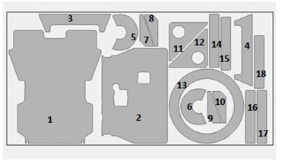
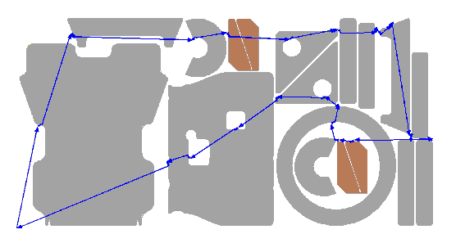
Control program development
for sheet cutting machines
Nesting
Tool path routing
NC Program generation
Maximal material utilization
Minimal path cost in terms of money and resources, including cutting time

Slide 4
Classification of
tool path routing problems
Continuum of piercing points
CCP
SCCP
GSCCP
ICP
GSCCP
GSCCP
Finite set of piercing points
GTSP
ECP
Fixed piercing points
TSP

Slide 5
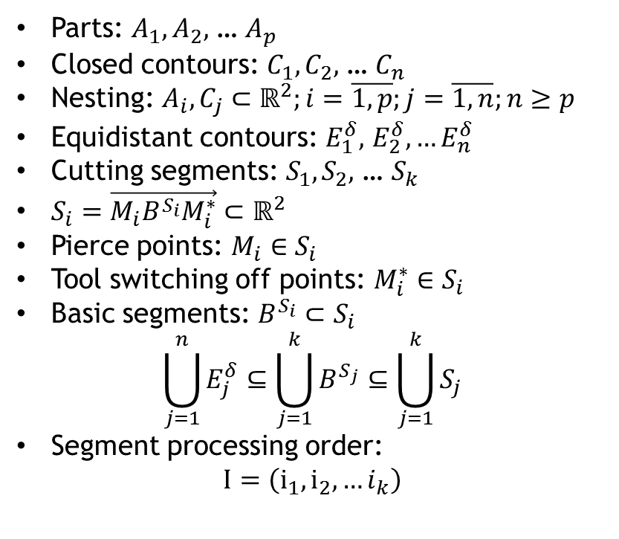

Tool path routing problem
Parts: $A_{1},A_{2},$ … $A_{p}$
Closed contours: $C_{1},C_{2},$ … $C_{n}$
Nesting: $A_{i},C_{j}⊂ℝ^{2};i=\overline{1, p};j=\overline{1, n};n≥p$
Equidistant contours: $E_{1}^{δ},$ $E_{2}^{δ}, …E_{n}^{δ}$
Cutting segments: $S_{1},S_{2},$ … $S_{k}$
$S_{i}=\vec{M_{i}B^{S_{i}}M_{i}^{∗}}⊂ℝ^{2}$
Pierce points: $M_{i}∈S_{i}$
Tool switching off points: $M_{i}^{∗}∈S_{i}$
Basic segments: $B^{S_{i}}⊂S_{i}$
$$\bigcup_{j=1}^{n}{E_{j}^{δ}}⊆\bigcup_{j=1}^{k}{B^{S_{j}}}⊆\bigcup_{j=1}^{k}{S_{j}}$$
Segment processing order:
$$I=\left(i_{1}, i_{2},…i_{k}\right)$$
$$Route= \left\langle \begin{aligned}M_{1}B^{S_{1}}M_{1}^{∗},M_{2}B^{S_{2}}M_{2}^{∗}, …M_{k}B^{S_{k}}M_{k}^{∗}, \\ i_{1},i_{2}, …i_{k}\end{aligned}\right\rangle$$
1
3
2
Initial point
Pierce points
Tool switching off points
Airtime motion
Cutting segments

Slide 6
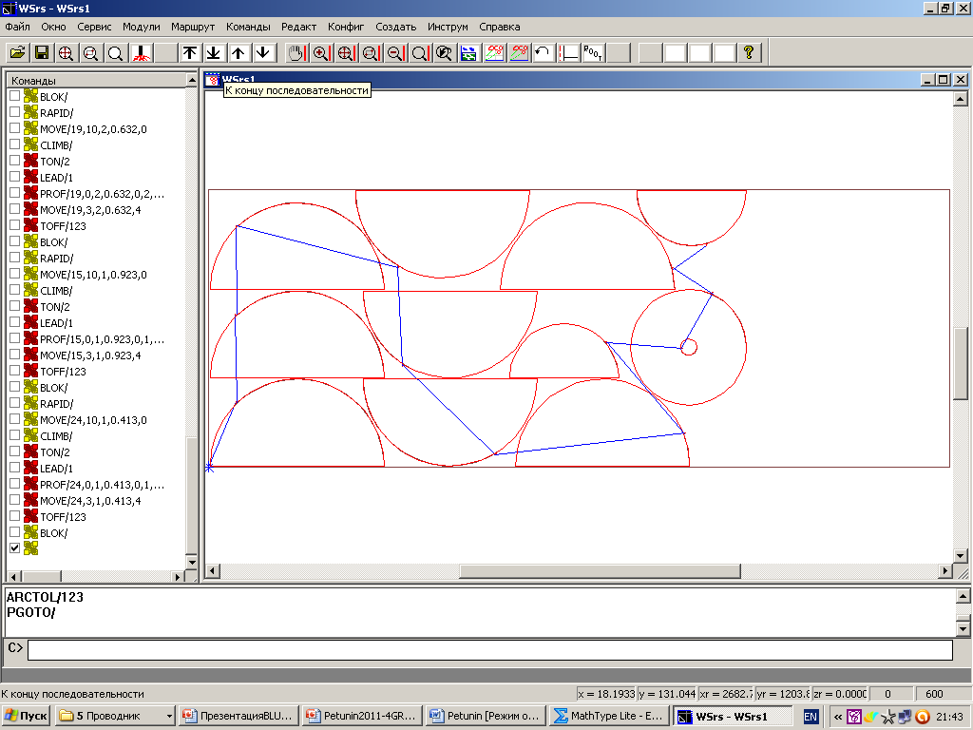
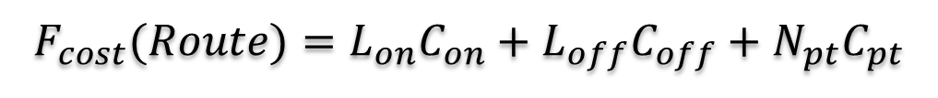
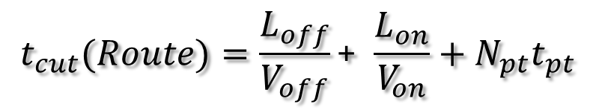
Objective functions
Cutting cost
$$F_{cost}(Route)=L_{on}C_{on}+L_{off}C_{off}+N_{pt}C_{pt}$$
Cutting time
$$t_{cut}(Route)=\frac{L_{off}}{V_{off}}\text{+} \frac{L_{on}}{V_{on}}+N_{pt}t_{pt}$$
Where:
L_{off} – Length of airtime motion
L_{on} – Length of cutting segments
C_{on} – Cost of airtime motion unit
C_{off} – Cost of cutting unit
C_{pt} – Piercing cost
V_{off} – Speed of airtime motion
V_{on} – Speed of cutting
N_{pt} – Number of piercing points
t_{pt} – Time of piercing

Slide 7
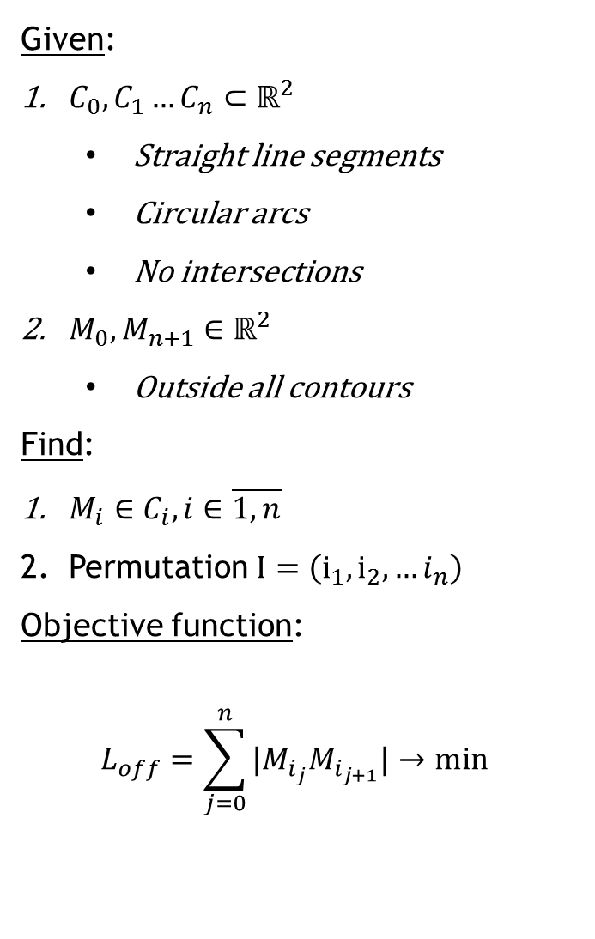
Continuous Cutting Problem
Given:
$C_{0},C_{1}…C_{n}⊂ℝ^{2}$
Straight line segments
Circular arcs
No intersections
$M_{0},M_{n+1}∈ℝ^{2}$
Outside all contours
Find:
$M_{i}∈C_{i},i∈\overline{1,n}$
Permutation $I=\left(i_{1}, i_{2},…i_{n}\right)$
Objective function:
$$L_{off}=\sum_{j=0}^{n}{|M_{i_{j}}M_{i_{j+1}}|}→min$$
M_{n+1}
C₁
C₂
M₁
C₄
C₅
C₃
M₀
M₃
Piercing points
Air move length

Slide 8

Precedence Constraint
C_{a}
C_{a}
C_{b}
C_{b}
i_{a}<i_{b}
i_{a}>i_{b}
Other technological constraints exist

Slide 9
CCP Heuristic
Remove “outer” contours
Continuous optimization
Discrete optimization
Put “outer” contours back

Slide 10
Removing outer contours
Outer contour
Inner
contour

Slide 11
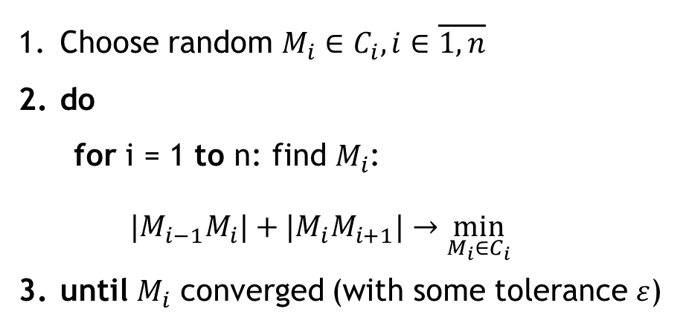
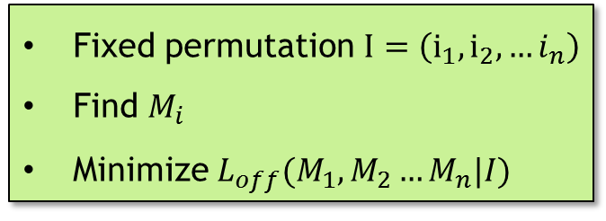
Continuous optimization
Fixed permutation $I=\left(i_{1}, i_{2},…i_{n}\right)$
Find $M_{i}$
Minimize $L_{off}(M_{1},M_{2}…M_{n}|I)$
Choose random $M_{i}∈C_{i},i∈\overline{1,n}$
do
for i = 1 to n: find $M_{i}$:
$$|M_{i−1}M_{i}|+|M_{i}M_{i+1}|→\min_{M_{i}∈C_{i}}{}$$
until $M_{i}$ converged (with some tolerance $ε$)
C_{i-1}
C_{i-1}
C_{i}
M*_{i-1}
M_{i-1}
C_{i+1}
M_{i}
C_{i+1}
M_{i-1}
M’_{i}
M’_{i}
M_{i+1}
C_{i}
M_{i}
M_{i+1}

Slide 12
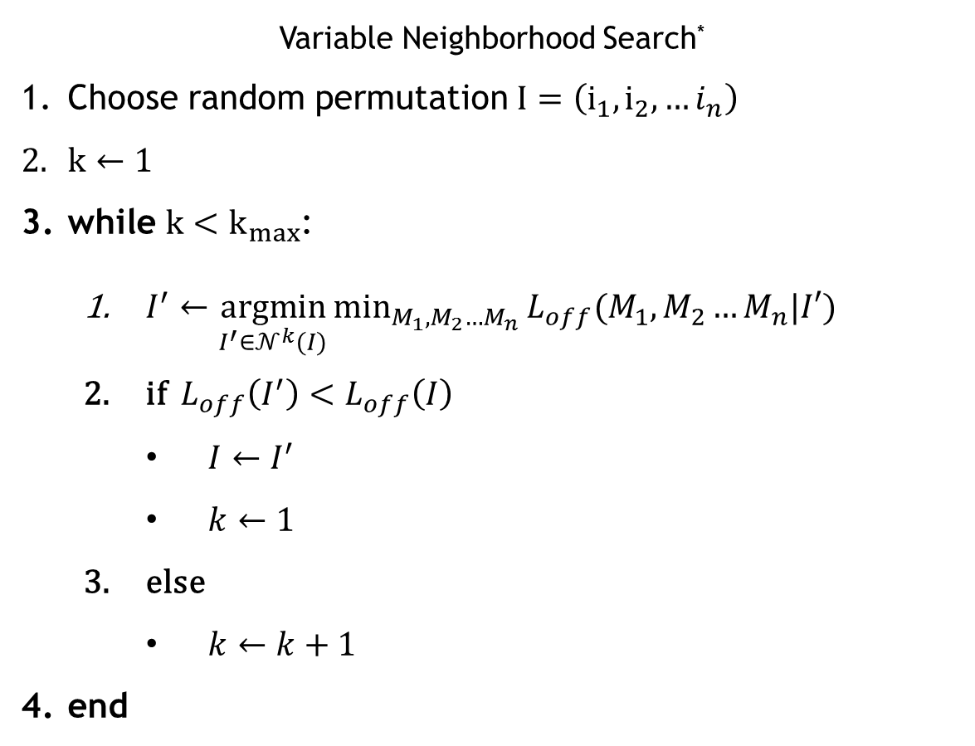
Discrete optimization
Variable Neighborhood Search*
Choose random permutation $I=\left(i_{1}, i_{2},…i_{n}\right)$
$k←1$
while $k<k_{max}$:
$I^{′}←\underset{I^{′}∈𝒩^{k}(I)}{argmin}{\min_{M_{1},M_{2}…M_{n}}{L_{off}(M_{1},M_{2}…M_{n}|I′)}}$
if $L_{off}\left(I^{′}\right)<L_{off}\left(I\right)$
$I←I^{′}$
$k←1$
else
$k←k+1$
end
Continuous optimization
* Hansen, P., Mladenovic, N., and Moreno Perez, J.A. (2010). Variable neighbourhood search: methods and applications. Annals of Operations Research, 175(1), 367 - 407.

Slide 13
Outer contours
Outer contour
M_{i-1}
M_{i+2}
M_{i}
M_{i+1}
Extra piercing point
M_{i-2}
Length is preserved
Remains optimal

Slide 14
Counter example
Local
optimum
1 m
C₁
C₂
1 m
1 m
3 m
0.2 m
1.8 m
M₀
M₃
Global
optimum

Slide 15
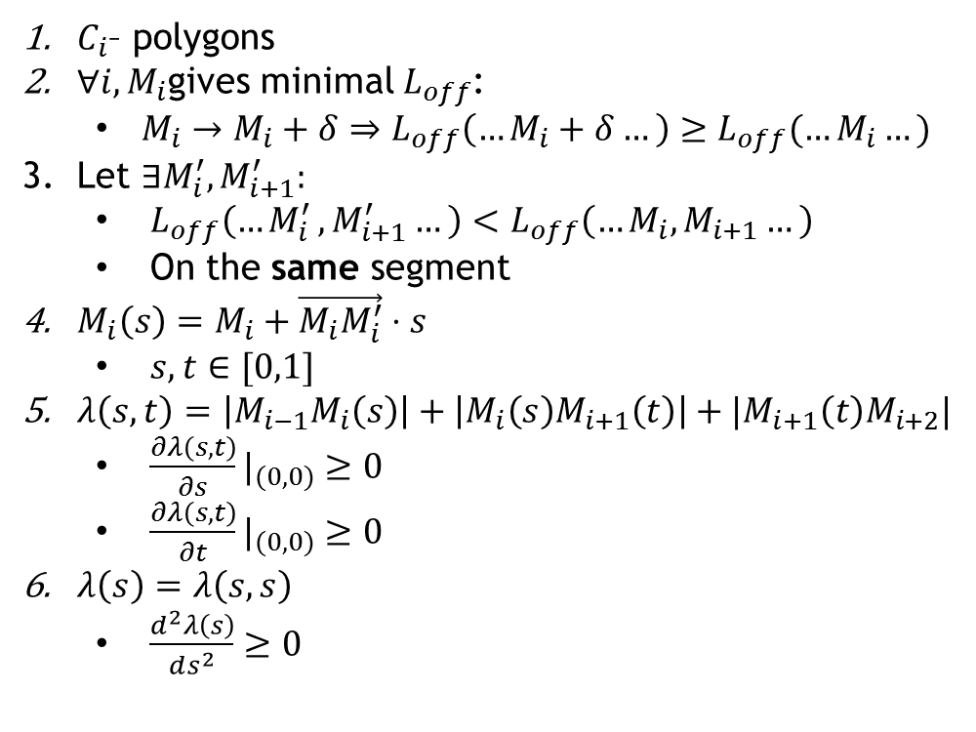
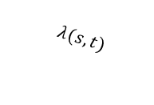
Local minimum
$C_{i}$– polygons
${∀i, M}_{i}$gives minimal $L_{off}$:
$M_{i}→M_{i}+δ⇒L_{off}\left(…M_{i}+δ…\right)≥L_{off}(…M_{i}…)$
Let $∃M_{i}^{′},M_{i+1}^{′}:$
$L_{off}\left({…M}_{i}^{′},M_{i+1}^{′}…\right)<L_{off}\left(…M_{i},M_{i+1}…\right)$
On the same segment
$M_{i}\left(s\right)=M_{i}+\vec{M_{i}M_{i}^{′}}⋅s$
$s,t∈[0,1]$
$λ\left(s,t\right)=\left|M_{i−1}M_{i}\left(s\right)\right|+\left|M_{i}\left(s\right)M_{i+1}\left(t\right)\right|+|M_{i+1}\left(t\right)M_{i+2}|$
${\frac{∂λ\left(s,t\right)}{∂s}|}_{(0,0)}≥0$
${\frac{∂λ\left(s,t\right)}{∂t}|}_{(0,0)}≥0$
$λ\left(s\right)=λ\left(s,s\right)$
$\frac{d^{2}λ\left(s\right)}{ds^{2}}≥0$
C_{i}
C_{i+1}
M_{i}
M_{i+1}
M_{i+2}
M_{i-1}
M_{i}(s)
$$λ(s,t)$$
M_{i+1}(t)
M’_{i}
M’_{i+1}

Slide 16
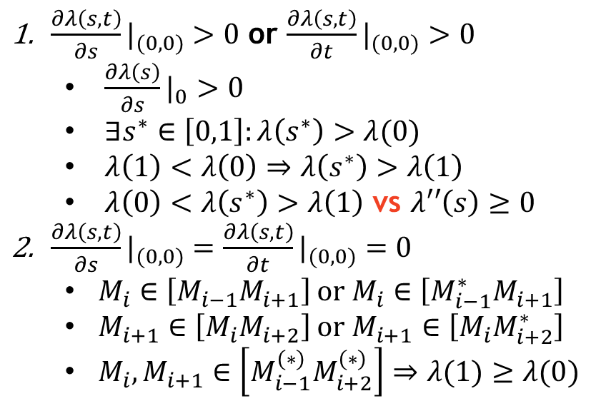
Local minimum cases
${\frac{∂λ\left(s,t\right)}{∂s}|}_{(0,0)}>0$ or ${\frac{∂λ\left(s,t\right)}{∂t}|}_{(0,0)}>0$
${\frac{∂λ\left(s\right)}{∂s}|}_{0}>0$
$∃s^{∗}∈\left[0,1\right]:λ\left(s^{∗}\right)>λ(0)$
$λ\left(1\right)<λ\left(0\right)⇒λ\left(s^{∗}\right)>λ\left(1\right)$
$λ\left(0\right)<λ\left(s^{∗}\right)>λ\left(1\right)$ vs $λ′′\left(s\right)≥0$
${\frac{∂λ\left(s,t\right)}{∂s}|}_{(0,0)}={\frac{∂λ\left(s,t\right)}{∂t}|}_{(0,0)}=0$
$M_{i}∈\left[M_{i−1}M_{i+1}\right]$ or $M_{i}∈\left[M_{i−1}^{∗}M_{i+1}\right]$
$M_{i+1}∈\left[M_{i}M_{i+2}\right]$ or $M_{i+1}∈\left[{M_{i}M}_{i+2}^{∗}\right]$
${M_{i},M}_{i+1}∈\left[M_{i−1}^{\left(∗\right)}M_{i+2}^{\left(∗\right)}\right]⇒λ(1)≥λ(0)$
C_{i}
C_{i}
C_{i}
C_{i+1}
M_{i-1}
M*_{i-1}
M_{i-1}
M_{i}
M_{i}
M_{i}
M_{i+1}
M_{i+1}
M_{i+1}
M_{i+2}
M_{i-1}

Slide 17
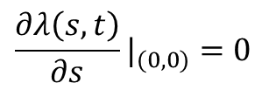

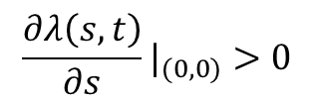
Global minimum
M_{i+1}
M_{i}
M_{i+2}
M_{i-1}
M’_{i}
M’_{i+1}
M_{i}(s)
M_{i+1}(t)
$${\frac{∂λ\left(s,t\right)}{∂s}|}_{(0,0)}=0$$
$${\frac{∂λ\left(s,t\right)}{∂s}|}_{(0,0)}>0$$
M_{i+1}
M_{i+1}
M_{i}
M_{i}
C_{i}
M_{i-1}
M_{i-1}
C_{i}
$$M_{i}∈\left[M_{i−1}M_{i+1}\right]$$

Slide 18
Global minimum cases
Edge case
Corner case
Convex contour
M_{i+1}
C_{i}
C_{i}
C_{i}
M_{i}
M_{i-1}
M_{i}
M_{i-1}
M_{i}
M_{i+1}
M_{i-1}
M_{i+1}

Slide 19
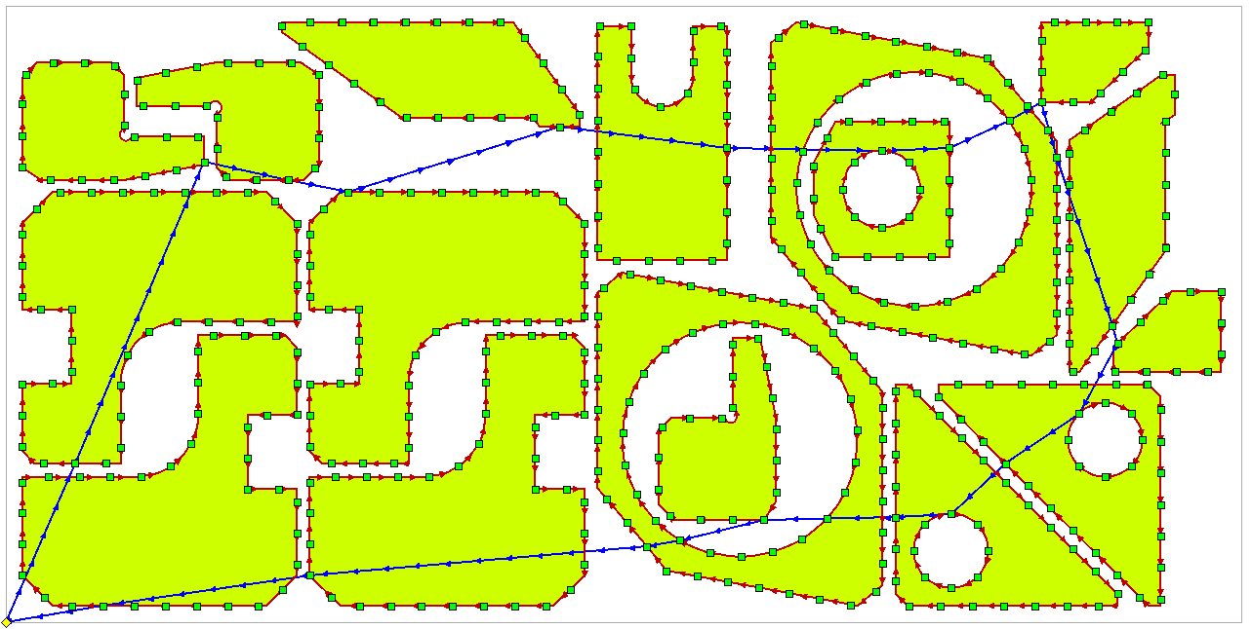
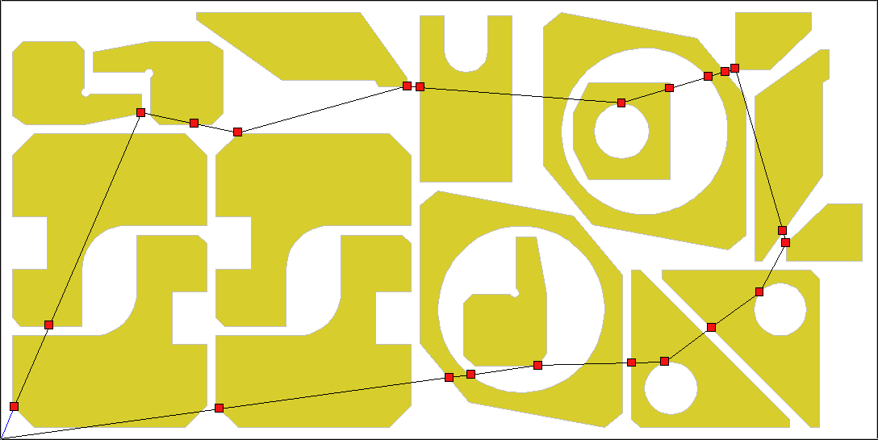
Numerical experiments
GTSP (discrete)
Job | #229 | #464 | #3211
Parts | 11 | 14 | 17
Contours | 12 | 21 | 22
L_{on}, m | 24.609 | 21.717 | 25.051
Pierce points | 491 | 429 | 493
GTSP’s L_{off}, m | 7.729 | 4.743 | 4.557
CCP’s L_{off}, m | 7.727 | 4.706 | 4.536
CCP (continuous + discrete)

Slide 20
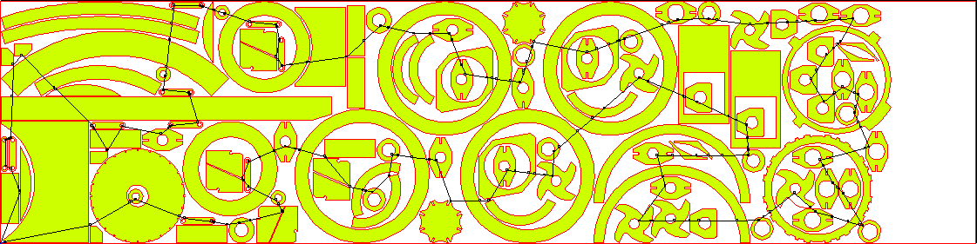
Large scale example
Job | 20205
# Parts | 115
# Contours | 198
# GTSP points | 3917
GTSP toolpath length | 26.098
CCP toolpath length | 25.987

Slide 21
Conclusion
Continuous Cutting Problem is considered
With Precedence Constraint
New heuristic for CCP is proposed
Both continuous and discrete optimization
Continuous optimization solution
Local minimum – proved
Global minimum conditions
Verified easily
Further research
Extra constraints on piercing point positions

Slide 22

Contacts
Thank you for your attention!
Stanislav Ukolov
Institute of New Materials and Technologies, Ural Federal University, Yekaterinburg, Russia
s.s.ukolov@urfu.ru
XI International Conference
Optimization and Applications
(OPTIMA 2020)
September 28 – October 2, 2020
Moscow, Russia

