Slide 1
Population growth and structures
7. 12. 2022
Bety Ukolova – ukolovae@natur.cuni.cz

Slide 2
Outline
Motivation
Measures of population growth
Models of population growth
Typology of population structures
Measures of population structures
Examples, exercises

Slide 3
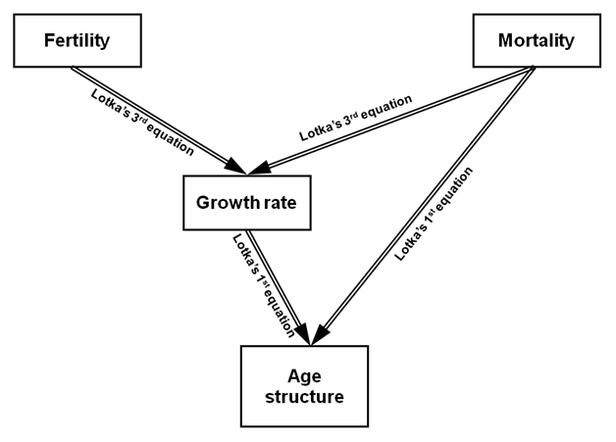
Demographic processes vary with the individual’s age, sex as well as with other attributes (marital status, educational level, social or ethnic group, religion etc.). These attributes describe population structures.
Source: [2]

Slide 4
Population growth: measures
P_{t+1} = P_{t} + B_{t} – D_{t} + I_{t} – E_{t} (balancing equation)
There are two different types of entries and departures to natural populations: birth and immigration and death and emigration. Difference between birth and death is natural increase, difference between immigration and emigration is net migration. In closed populations there is no migration. Closed populations are useful in demographic modeling.
Above mentioned measures of population growth are absolute. Relating them to population size leads to relative measures of population growth (next slide).
Source: [1]

Slide 5
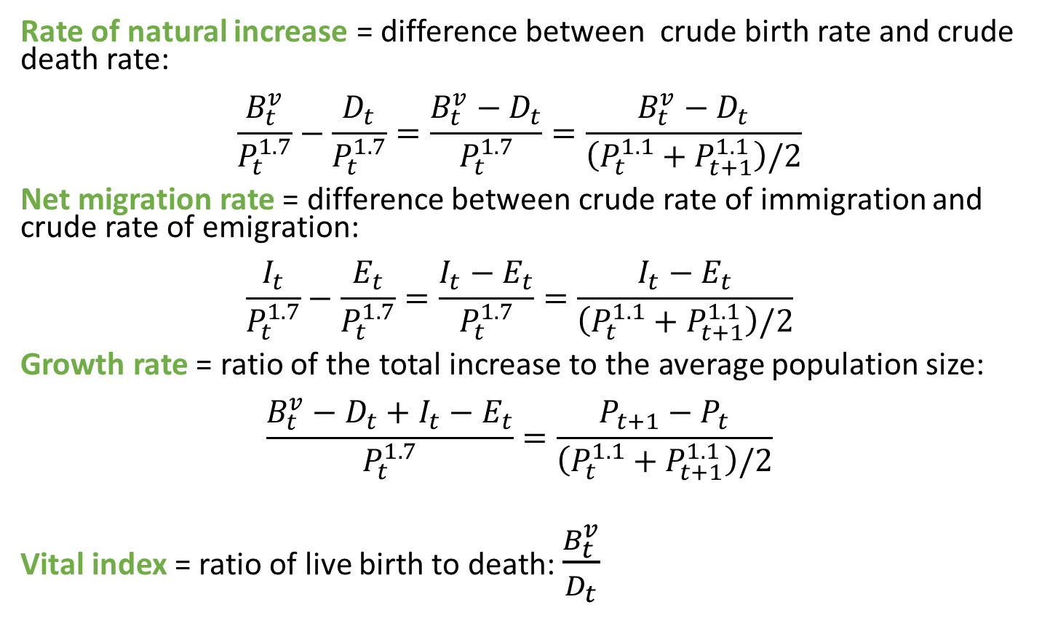
Population growth: measures
Rate of natural increase = difference between crude birth rate and crude death rate:
$$\frac{B_{t}^{v}}{P_{t}^{1.7}}−\frac{D_{t}}{P_{t}^{1.7}}=\frac{B_{t}^{v}−D_{t}}{P_{t}^{1.7}}=\frac{B_{t}^{v}−D_{t}}{\left(P_{t}^{1.1}+P_{t+1}^{1.1}\right)/2}$$
Net migration rate = difference between crude rate of immigration and crude rate of emigration:
$$\frac{I_{t}}{P_{t}^{1.7}}−\frac{E_{t}}{P_{t}^{1.7}}=\frac{I_{t}−E_{t}}{P_{t}^{1.7}}=\frac{I_{t}−E_{t}}{\left(P_{t}^{1.1}+P_{t+1}^{1.1}\right)/2}$$
Growth rate = ratio of the total increase to the average population size:
$$\frac{B_{t}^{v}−D_{t}+I_{t}−E_{t}}{P_{t}^{1.7}}=\frac{P_{t+1}−P_{t}}{\left(P_{t}^{1.1}+P_{t+1}^{1.1}\right)/2}$$
Vital index = ratio of live birth to death: $\frac{B_{t}^{v}}{D_{t}}$
Source: [1]

Slide 6
Population increase/decrease: theory
First attempts of producing population projections were based on distinct models of population growth
By a model of population growth we mean mathematical sequences of numbers, which population size may follow during its development
Basic mathematical sequences are f. e: Fibonacci, arithmetic, geometric, exponential…
From that, we distinguish
Arithmetic population increase/decrease (or linear)
Geometric population increase/decrease
Exponential population increase/decrease
Logistic population increase/decrease
Fibonacci sequence: https://en.wikipedia.org/wiki/Fibonacci_number

Slide 7
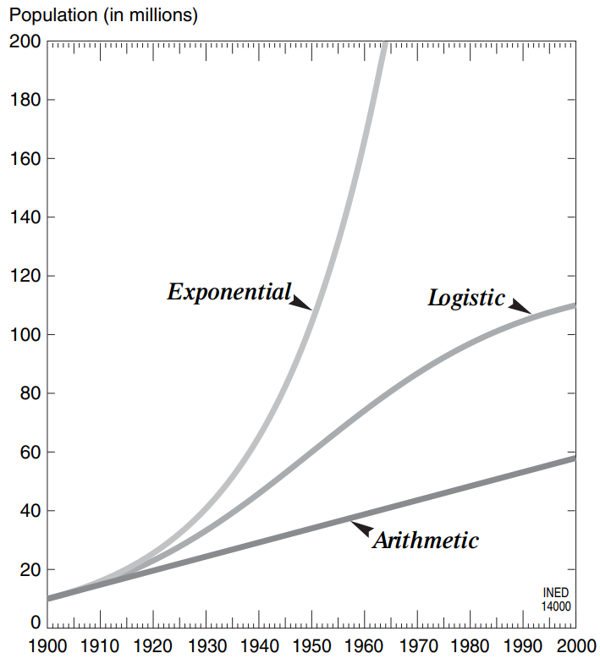
Population increase/decrease: theory
← Evolution over a period of 100 years of a population of 10 million inhabitants with the same initial growth rate of around 5% per annum but following three different models of growth [1].
Source: [1]

Slide 8
Population increase/decrease: theory
Arithmetic growth (or linear) means, that between P_{t} and P_{t+1} there is the over time constant difference. Thus, in n years, the difference will be n-times its basic value.
Geometric population increase/decrease means, that each P_{t+n} is some multiple of previous population (P_{t}). This multiple remains constant over time.
Exponential population increase/decrease the amount of increase from a single generation keeps increasing.
Logistic population increase/decrease is characterized by growth rate, which changes over time. If a population follows logistic model, its size converges to some target size and does not grow unlimitedly.
1
1
1
1
1
1
1
1
1
1
1
1
1
1
1

Slide 9
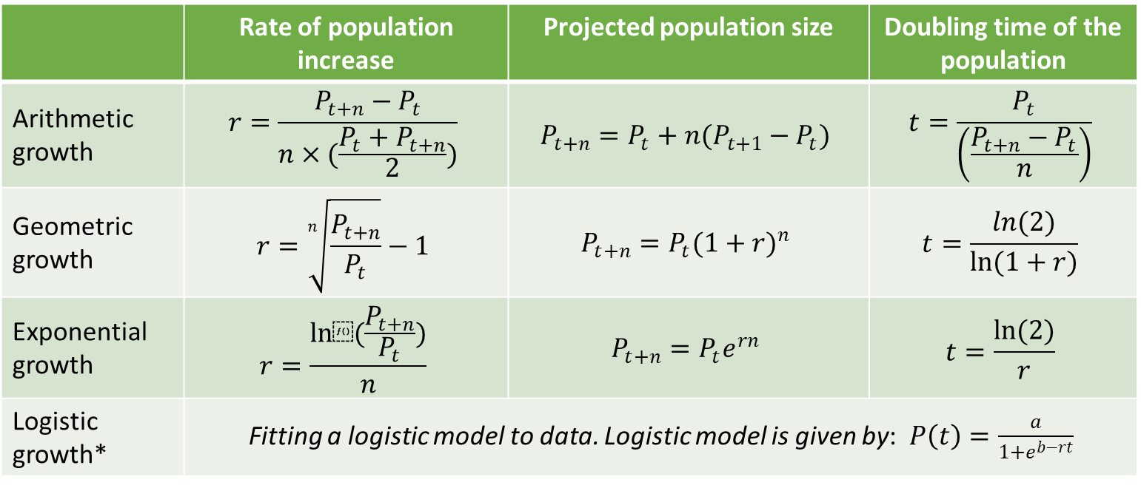
Population increase/decrease: theory
 | Rate of population increase | Projected population size | Doubling time of the population
Arithmetic growth | $$r=\frac{P_{t+n}−P_{t}}{n×(\frac{P_{t}+P_{t+n}}{2})}$$ | $$P_{t+n}=P_{t}+n(P_{t+1}−P_{t})$$ | $$t=\frac{P_{t}}{\left(\frac{P_{t+n}−P_{t}}{n}\right)}$$
Geometric growth | $$r=\sqrt[n]{\frac{P_{t+n}}{P_{t}}}−1$$ | $$P_{t+n}=P_{t}{(1+r)}^{n}$$ | $$t=\frac{ln(2)}{ln(1+r)}$$
Exponential growth | $$r=\frac{ln⁡(\frac{P_{t+n}}{P_{t}})}{n}$$ | $$P_{t+n}=P_{t}e^{rn}$$ | $$t=\frac{ln(2)}{r}$$
Logistic growth* | Fitting a logistic model to data. Logistic model is given by:$P\left(t\right)=\frac{a}{1+e^{b−rt}}$
*Logistic function is described by three parameters: a is a supremum of the values of the function (final population size, carrying capacity), b is location parameter (determines position of the function in respect to x-axis), r is growth rate (determines, how fast the curve converges to its supremum).

Slide 10
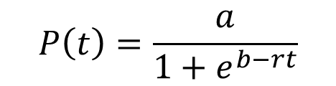
Population increase/decrease: theory
Logistic growth
a = carrying capacity
b = location parameter
r = growth rate
Fit can be done in several steps:
Set a
For t = 0 estimate b with known initial population P(t)
For t>0 estimate r, knowing b
It follows, that r is a function of t. This function reaches its maximum at the same time point, in which inflection point of the logistic curve is located. Since that moment in time, the rate of population growth slows down. The model of logistic growth is implemented in the theory of demographic transition. The model was criticized for its subjectivity, which manifests to f.e setting a priori carrying capacity.
$$P\left(t\right)=\frac{a}{1+e^{b−rt}}$$

Slide 11
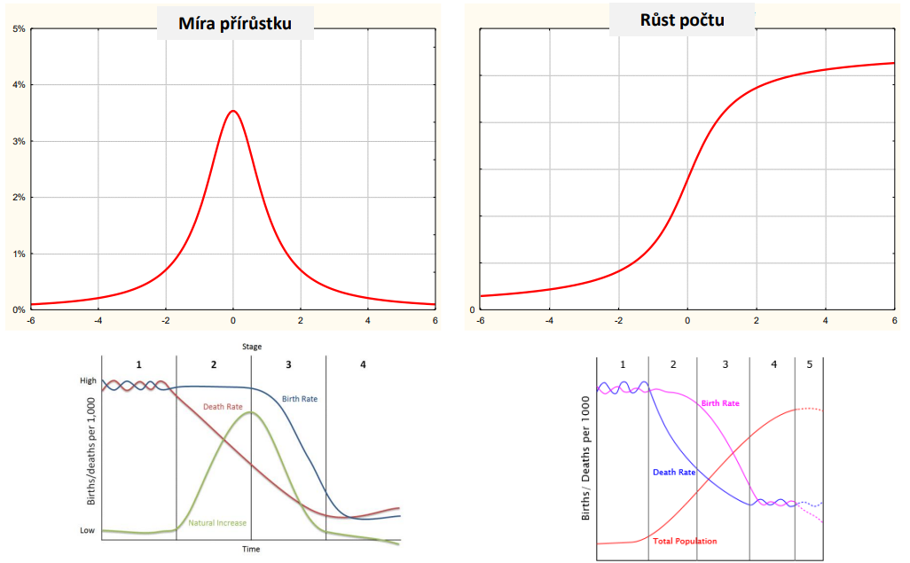
Population increase/decrease: theory
Logistic growth
Growth rate
Population size
r

Slide 12
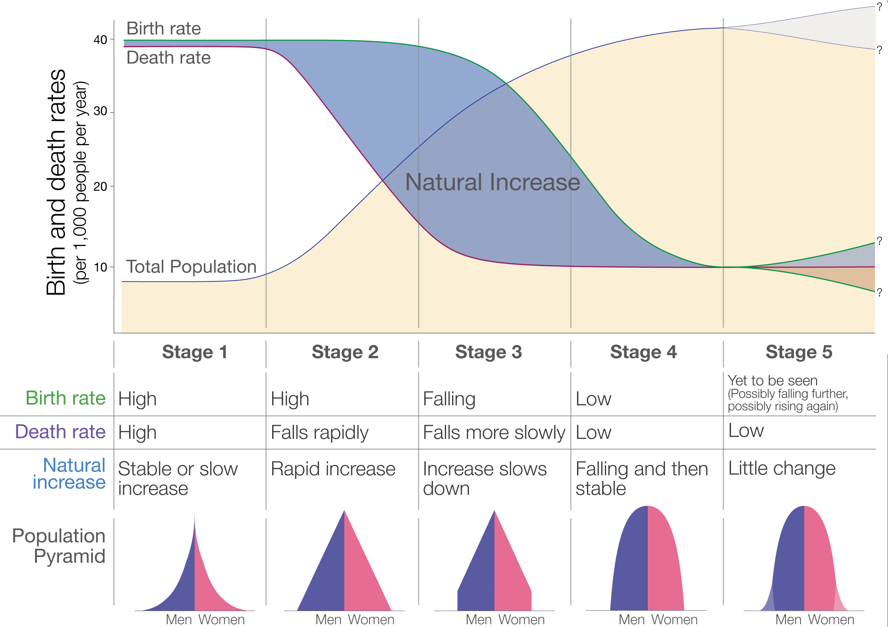
Population structures: typology
Types of the population structure depend on level of mortality and fertility (slide 2).
Source: https://ourworldindata.org/world-population-growth

Slide 13
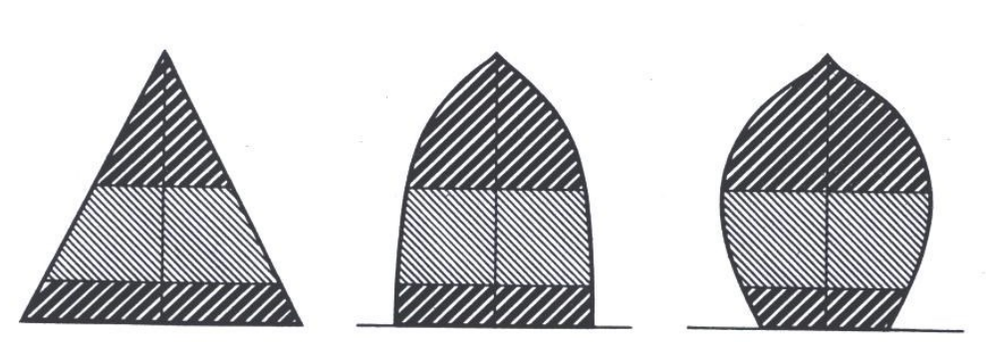
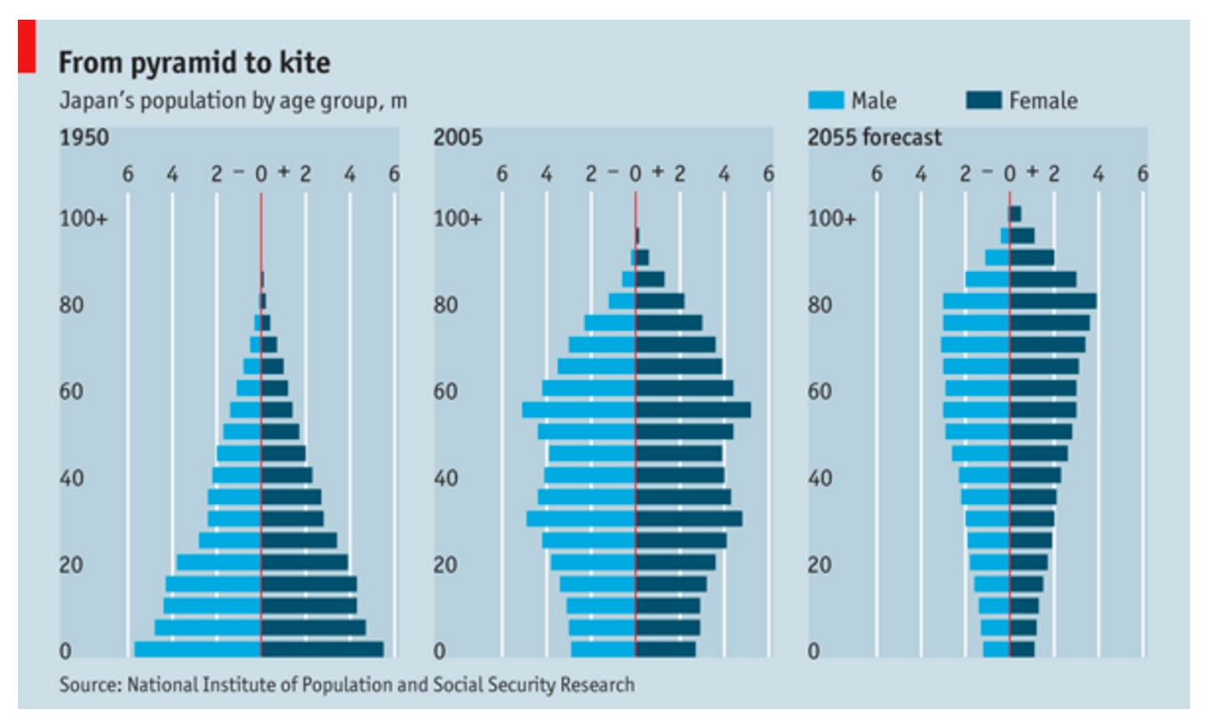
Population structures: typology
Sundbärg (1907) age structure typology
50% of population are in reproductive age and the rest is distributed among youth and old ones. The proportion of distribution of these 50% in non-reproductive ages determines the type of age structure.
Progressive
Stationary
Regressive
Japan’s population by age group
Source: www.geo41.com

Slide 14
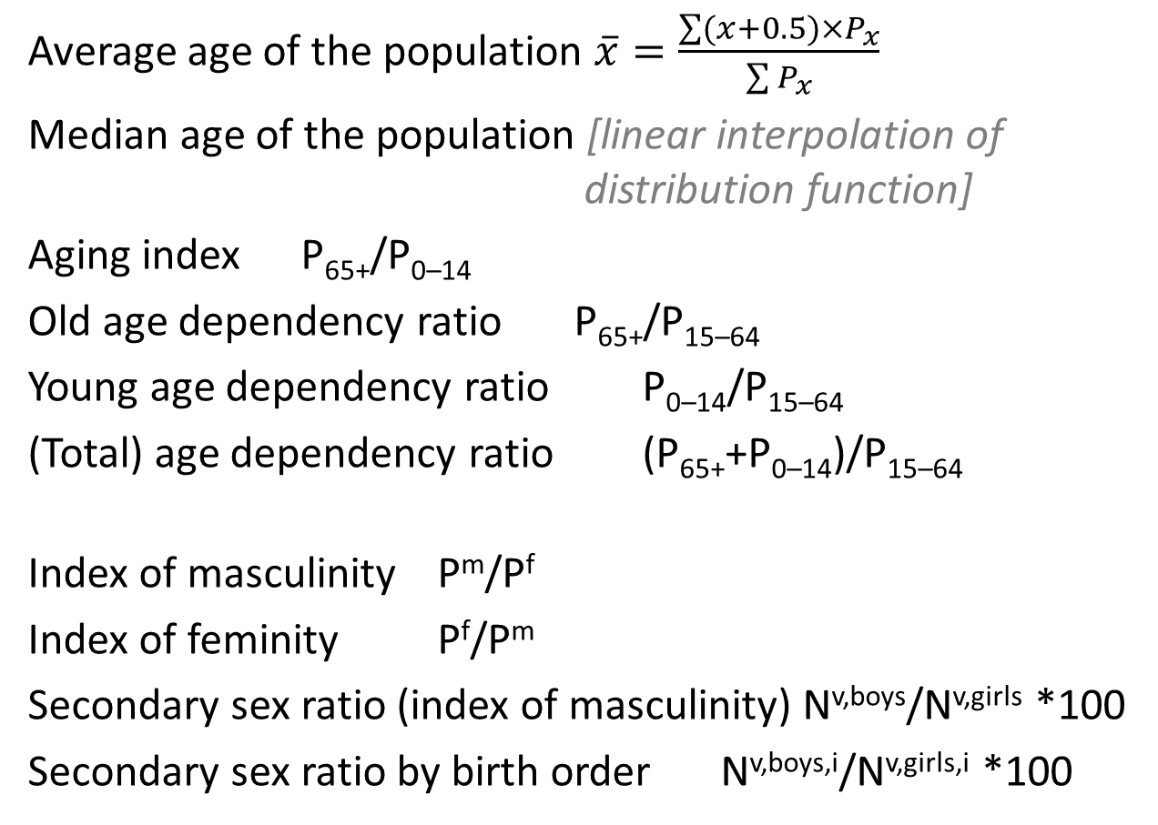
Population structures: measures
Average age of the population $\overline{x}=\frac{\sum{(x+0.5)×P_{x}}}{\sum{P_{x}}}$
Median age of the population [linear interpolation of distribution function]
Aging index P₆₅₊/P_{0–14}
Old age dependency ratio P₆₅₊/P_{15–64}
Young age dependency ratio P_{0–14}/P_{15–64}
(Total) age dependency ratio (P₆₅₊+P_{0–14})/P_{15–64}
Index of masculinity P^{m}/P^{f}
Index of feminity P^{f}/P^{m}
Secondary sex ratio (index of masculinity) N^{v,boys}/N^{v,girls} *100
Secondary sex ratio by birth order N^{v,boys,i}/N^{v,girls,i} *100
Measures of age-structure
Measures of sex-structure

Slide 15
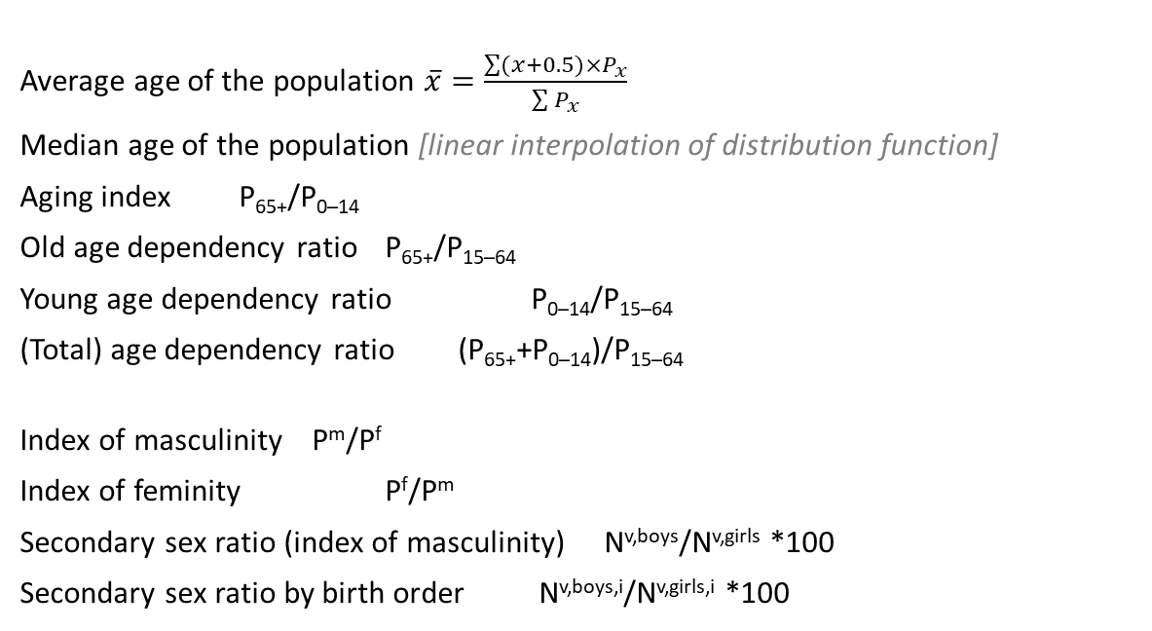
Population structures: measures
Average age of the population $\overline{x}=\frac{\sum{(x+0.5)×P_{x}}}{\sum{P_{x}}}$
Median age of the population [linear interpolation of distribution function]
Aging index P₆₅₊/P_{0–14}
Old age dependency ratio P₆₅₊/P_{15–64}
Young age dependency ratio P_{0–14}/P_{15–64}
(Total) age dependency ratio (P₆₅₊+P_{0–14})/P_{15–64}
Index of masculinity P^{m}/P^{f}
Index of feminity P^{f}/P^{m}
Secondary sex ratio (index of masculinity) N^{v,boys}/N^{v,girls} *100
Secondary sex ratio by birth order N^{v,boys,i}/N^{v,girls,i} *100
Measures of age-structure
Measures of sex-structure
Other sources distinguish between biological and economic generations. Economic generations are defined: 0–19, 20–64, 65+. Biological generations are defined 0–14, 15–49, 50+. It implies, that dependency ratios can be computed in several ways depending on which age categories we use.
Source: [3]

Slide 16
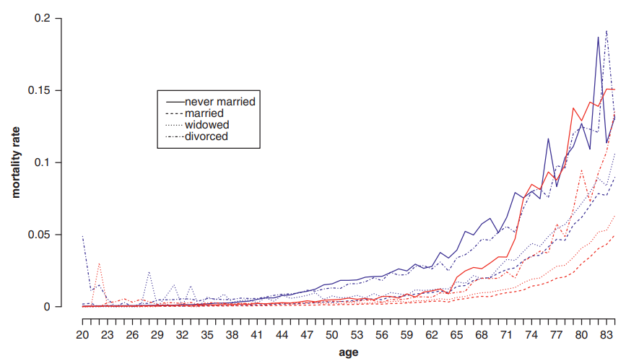
Population structures: measures
Apart from two fundamental structures (by age and sex) it is also marital status that affects demographic behavior.
Marital status (in Czechia): single, married, widowed, divorced
The intensity of mortality depends on marital status.
Empirical mortality rates, South Korea, 2010
Source: [4]

Slide 17
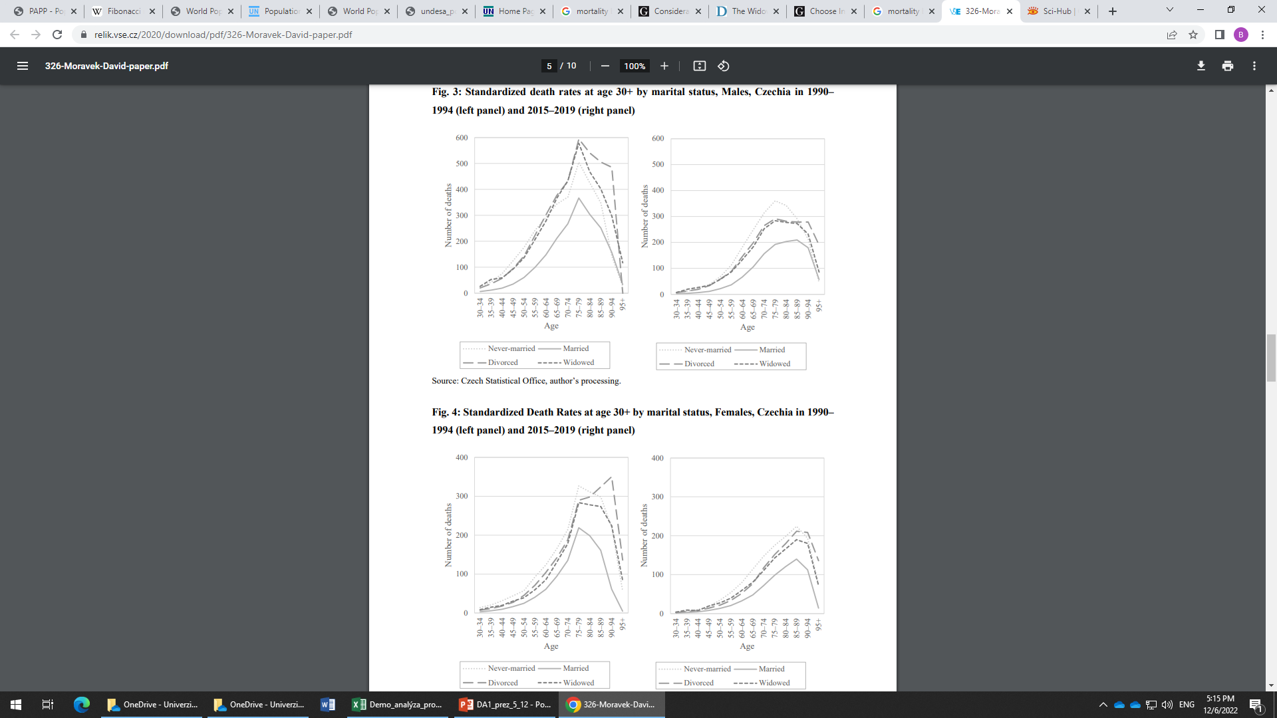
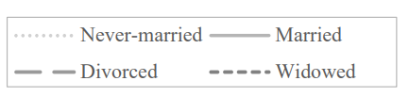
Population structures: measures
Apart from two fundamental structures (by age and sex) it is also marital status that affects demographic behavior.
Marital status (in Czechia): single, married, widowed, divorced
The intensity of mortality depends on marital status.
Standardized death rates by marital status, Czechia
Males, 1990–1994
Males, 2015–2019
Females, 1990–1994
Females, 2015–2019
Source: [5]

Slide 18
Population growth: facts
More info: https://www.un.org/development/desa/pd/sites/www.un.org.development.desa.pd/files/wpp2022_summary_of_results.pdf
+ see reading list

Slide 19
Population structures: examples
More info: https://population.un.org/wpp/Graphs/DemographicProfiles/Pyramid/682
+ see reading list

Slide 20
Population structures: exercise
Assignment from 30. 11. 2022

Slide 21
Population increase/decrease: exercise
Assignment 4
Download from Moodle .xlsx file (or use the one I have sent you before today lecture).
There are world’s population data and you should compute:
Average age of the population
Median age of the population
Population growth rate by linear model, geometric model, exponential model
Projected population for 10-year horizont for all three scenarios
Doubling time for all three scenarios
Deadline: 13. 12. 2022 4:30 am

Slide 22
Sources
[0] slides provided by dr. Burcin
[1] CASELLI, Graziella; VALLIN, Jacques; WUNSCH, Guillaume. Demography: Analysis and Synthesis, Four Volume Set: A Treatise in Population. Elsevier, 2005. Part II, Chapter 8. Pages 79–86.
[2] http://papp.iussp.org/
[3] LANGHAMROVÁ, Jitka a KAČEROVÁ, Eva. Demografie: materiály ke cvičení. 2. přeprac. vyd. Praha: Oeconomica, 2007. 91 s. ISBN 978-80-245-1224-2.
[4] Kwon, Hyuk-Sung. "Consideration of Marital Status in a Mortality Model and its Application for Mortality Risk Management " Asia-Pacific Journal of Risk and Insurance, vol. 10, no. 2, 2016, pp. 193-216. https://doi.org/10.1515/apjri-2015-0018
[5] Langhamrová, David Morávek–Jitka. "MORTALITY DIFFERENTIALS BY MARITAL STATUS IN CZECHIA 1990–2019.“ Available online: https://relik.vse.cz/2020/download/pdf/326-Moravek-David-paper.pdf

